Slide 1
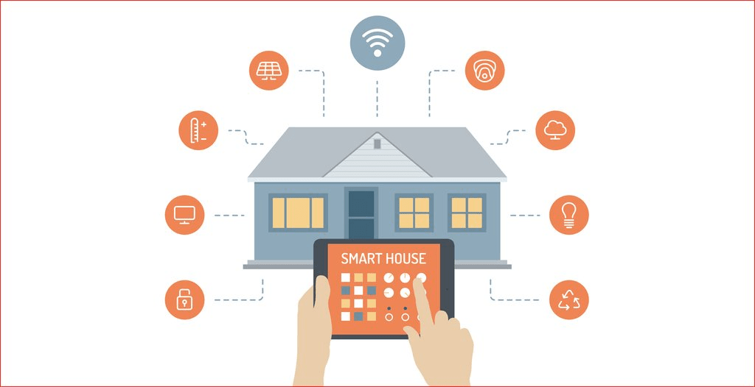
Arduino & Bluetooth Based Home Automation
Mehmet Taha USTA – 21527472
Group Name : Make Wifi Great Again
Group No: 10

Slide 2
Introduction
Using wireless network technology to facilitate daily life. You will see how to automate various gadgets of your home and room. You will be able to control the lights, fan, air conditioning, curtains, locks and TV.
As technology is advancing so houses are also getting smarter. Modern houses are gradually shifting from conventional switches to the centralized control system, involving remote controlled switches. Presently, conventional wall switches located in different parts of the house make it difficult for the user to go near them to operate. It becomes more difficult for the elderly or physically handicapped people to do so. Remote controlled home automation system provides the most modern solution with smartphones.

Slide 3
Components
Hardware
Arduino UNO
Arduino Bluetooth Modül HC05
Arduino 4 Way 5V Relay Module
Breadboard
Connecting Wires
Bluetooth Enabled Smartphone
Software
Arduino 1.8.13 compiler
Android Studio 4.1
Android Application

Slide 4
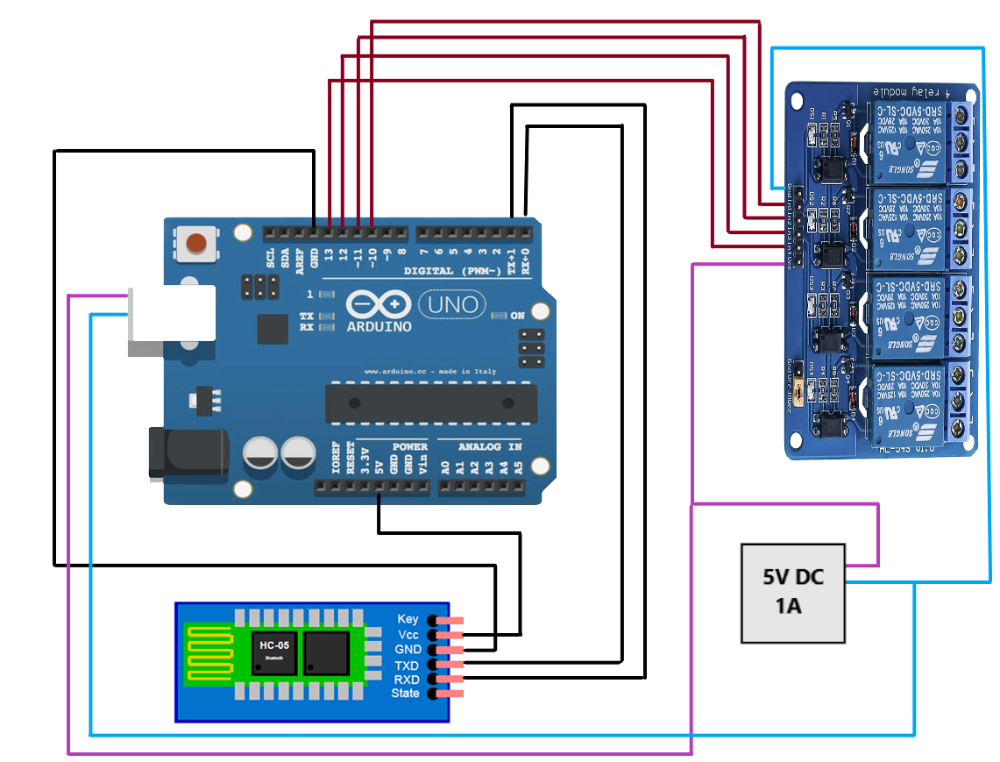

Slide 5
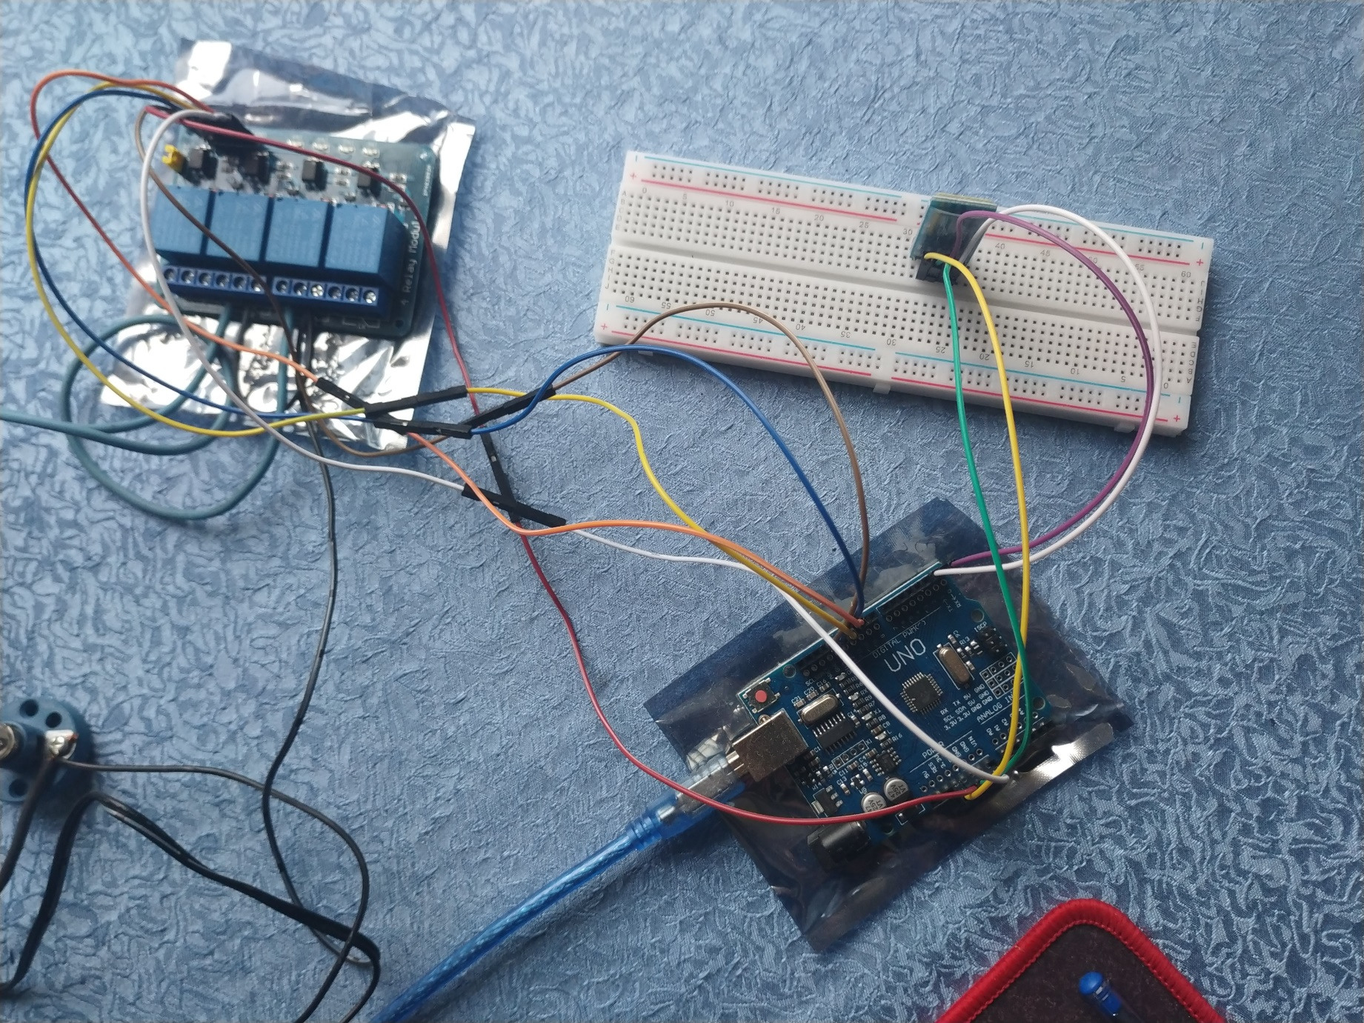

Slide 6
