Slide 1
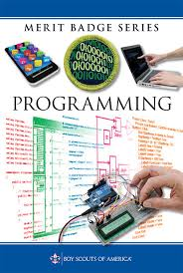
Programming
Chickasaw Council
Michael Waldo

Slide 2
A Little About Me
Recent graduate from Ole Miss (B.S. in Computer Science)
Main focus in Software Development with a variety of side projects.
Projects have included app development, image processing, data engineering, bioinformatics, artificial intelligence.
“Jack of all-trades, master of none. Oftentimes better than a master of one”

Slide 3
What to expect from this merit badge
An overview of the history of programming
An idea of the different kinds of industries that programming is prevalent in
Resources on where to continue your learning.
Brief introduction to the Java, Javascript, and Python programming languages
Tutorials on how to install IDE’s to go into more intensive work
Ability to begin writing your own small programs

Slide 4
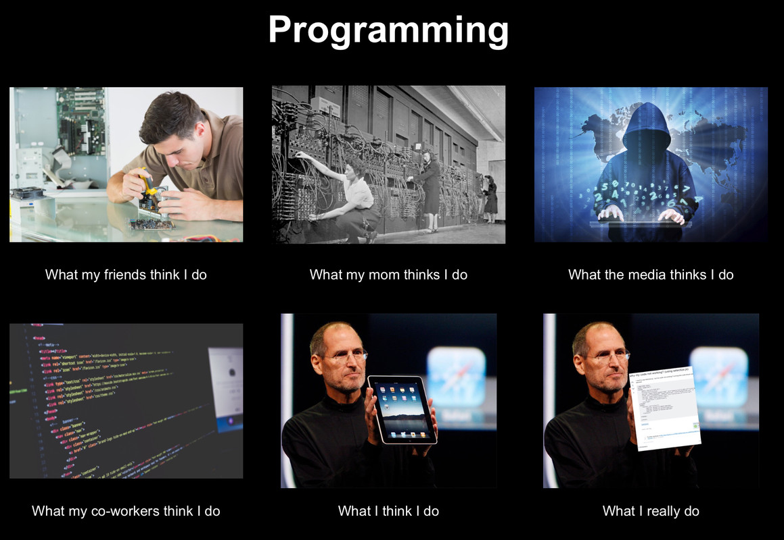
What is programming?
Understanding the purpose of the program and it’s requirements
Designing the instructions and breaking down into steps
Coding the design into your programming language
Testing and Debugging to verify results

Slide 5
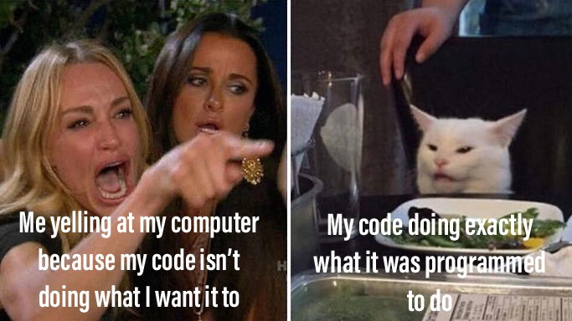
What is a program?
Set of instructions
Tells a processor how to do a particular task
Written by a programmer via a programming language.
Programming languages are the tools that convert the programmer's instructions into a form the processor (the computer’s logic) can easily understand.

Slide 6
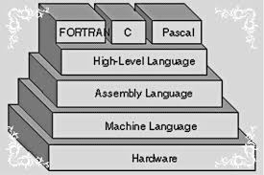
The Set-up

Slide 7
History of Programming

Slide 8
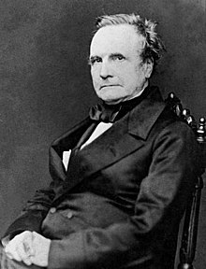
Charles Babbage (1791 – 1871)
Originated the concept of a digital programmable computer
Designer of the Difference Engine’ which was a calculate a series of values automatically
Designer of the Analytical Engine in which its main function was to be programmed using punched cards.

Slide 9
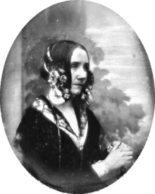
Ada Lovelace (1815 – 1852)
First to recognize the full use and application of Babbage’s proposed machines.
Regarded as the first programmer for creating the first algorithm to be carried out by Babbage’s machines.
Main pioneer in the publicity of the machine and it’s work.

Slide 10
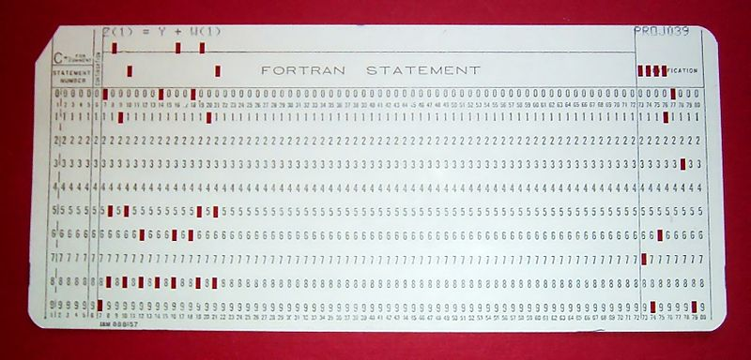
Punch Cards
Used from the invention of programming-languages to mid 1970’s
Programmers created, edited, and stored programs on punch cards
Punched cards are flexible, write-once material that encodes data
Decks are collection of punch cards

Slide 11
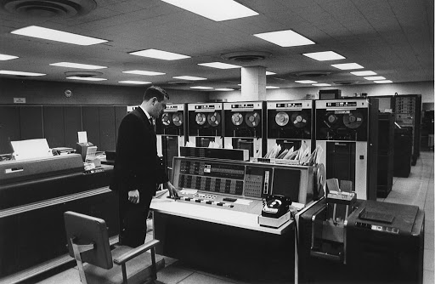
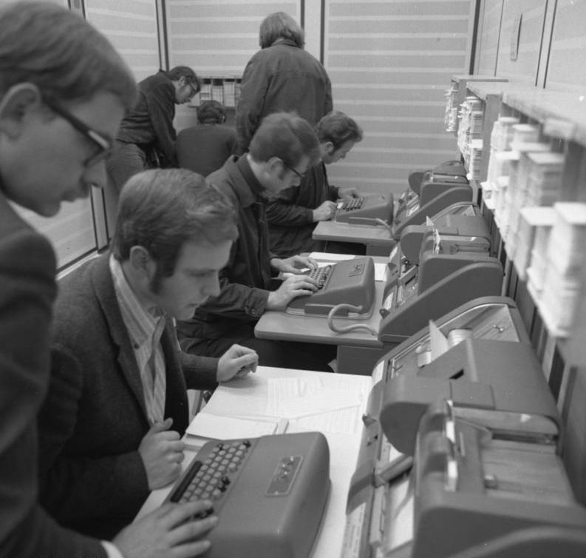

Slide 12
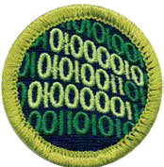
Binary Code
The absolute lowest level of understanding the computer has
The on and off states of the circuits within the computer (1’s are on and 0’s are off)
A group of eight 0’s and 1’s are referred to as a byte.

Slide 13
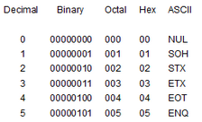
Translating Items from Binary Code
00000000 = NULL
00000001 = Start of Heading
00000010 = Start of Text
00000011 = End of Text
00000100 = End of Transmission
00000101 = Enquiry
**NOTE** : Decimal Value and ASCII Value are DIFFERENT

Slide 14
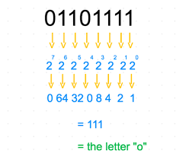
Binary (cont)

Slide 15
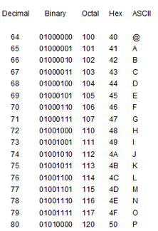
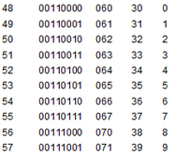
Translating Items from Binary Code - continued

Slide 16
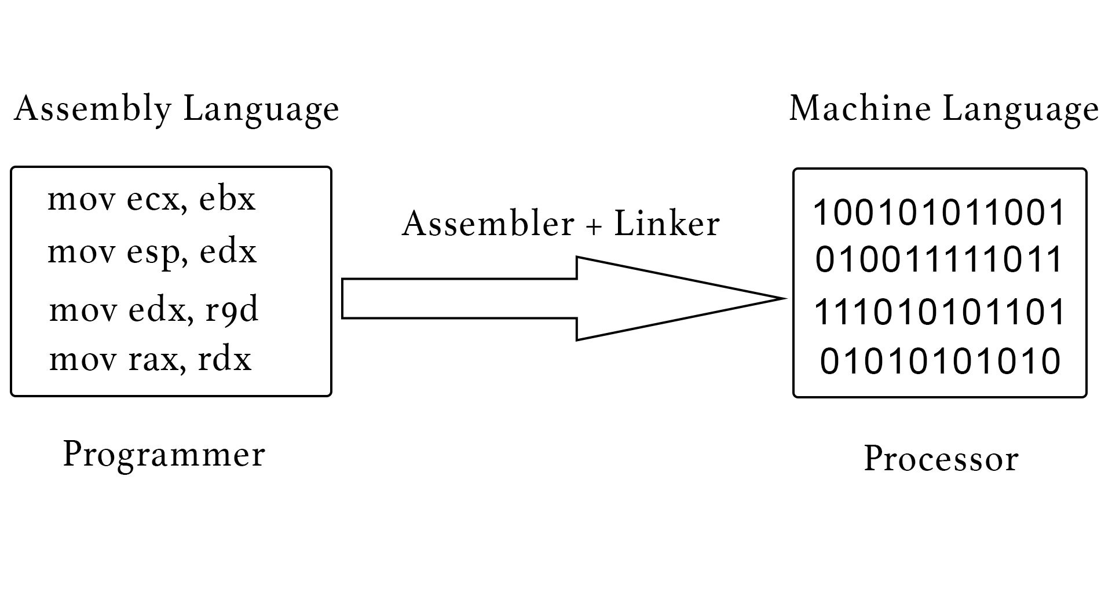
Assembly Language (Low level programming)
The next step in the evolution of modern programming
Allowed programmers to use ‘names’ or characters instead of numbers
Slightly more human-friendly
Lacks portability (different types of processors have different assembly languages)

Slide 17
High-Level Languages
The human-readable code that translate into assembly (which then translate into binary)
Not limited to a machine (Java can work on both Mac and Windows)
Many languages were developed to meet specific needs in science or business
Fortran (1957) –computationally intensive
Lisp (1958) – recursion and list-processing
Cobol (1959) – Business, finance, administration
BASIC (1964) – Great for beginner’s
Pascal (1970) – Data structuring
C (1972) – Widely used, best with integration of Hardware

Slide 18
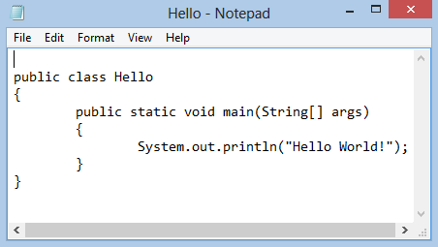
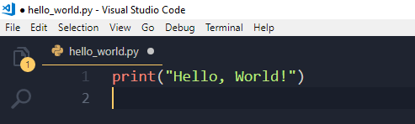

Slide 19
Intellectual Property

Slide 20
Copyrights
Protects a particular expression of an idea
Automatically available once an idea is created and physically stored
Protects against others making copies of images, codes, etc
There does not exist an ‘international copyright’, protection against unauthorized use in a particular country depends on the national laws of that country
However, the United States has copyright relations with most countries throughout the world, and so we honor each other’s citizens’ copyrights.

Slide 21
Patents
Protects useful and innovative:
Processes or methods
Machines
Manufactured items
Not automatic. Must be applied for with the US Patent and Trademark office
Lengthy process; often requires services of a patent attorney or agent

Slide 22
Trade Secrets
Protects commercially valuable information
Owner has taken strong measures to maintain secrecy
Does not protect against the use if developed independently or if information was acquired legitimately

Slide 23
Types of Software
Open Source
Source code is:
Available to the public
Modifiable
May be redistributed
Community of Developers
Free
Support can be community based or paid
Freeware
Free
Developer chooses free distribution
Source code is not available
Distributed from developer site only
Shareware
Free for limited/trial period
Developer owns rights
No collaborative community
Payment often required

Slide 24
Safety

Slide 25
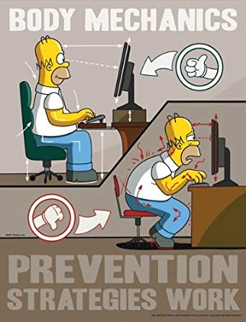
Repetitive Strain Injury
Good posture
Take breaks
Stretch

Slide 26

Eye strain
Use proper lighting
Minimize glare
Adjust display settings
Blink
Take frequent breaks
Invest in blue-light glasses

Slide 27
Where is Programming Used?

Slide 28
Programmed Devices
Mobile Phones
Tablets
DVD/Blu-ray
Game Consoles
Alarm Clocks
TV/DVR
Cars
Watch
Fitness Trackers
GPS
Coffee Pot
Microwave

Slide 29
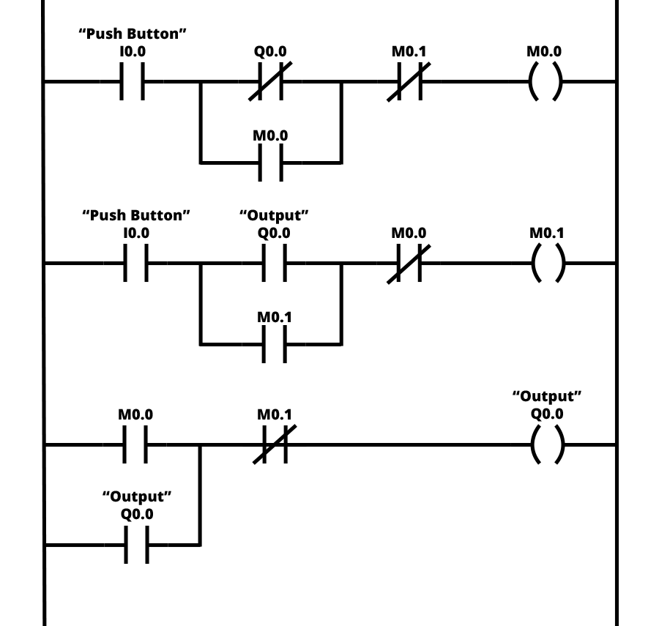
Factory Automation
Programmable Logic Controller
Designed specifically to control machines
Machines themselves are not programmed
Can be programmed to do the same task over and over again
Durable
Work in wide temperature ranges
Work in harsh conditions

Slide 30
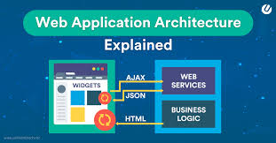
Web Application

Slide 31
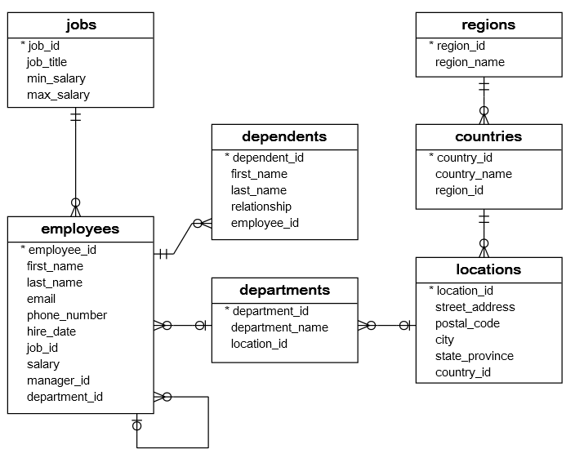
Databases

Slide 32


Version Control

Slide 33
Break

Slide 34

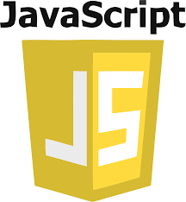

Languages We’re Learning

Slide 35
Java

Slide 36

What is Java
General-purpose programming language
Class-based
Object-oriented
Designed to have few implementation dependencies
‘Write once, run anywhere’

Slide 37
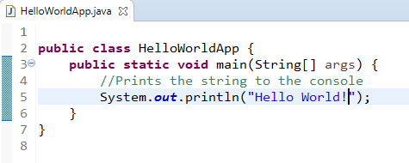
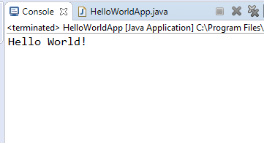
Hello World

Slide 38
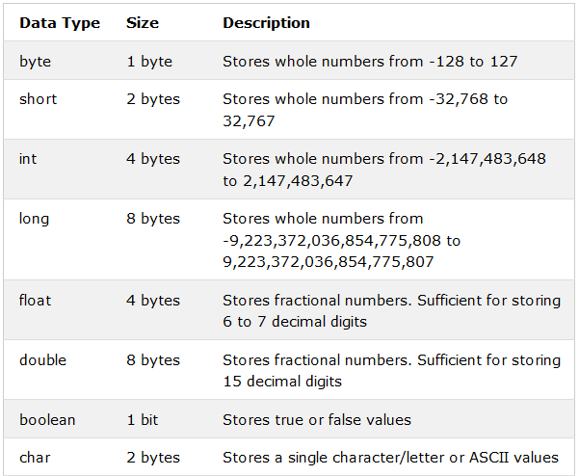
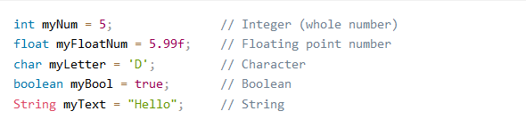
Data Types (Java)

Slide 39
Javascript

Slide 40

What is JavaScript
One of the core technologies of the World Wide Web
Enables interactive web pages and is an essential part of web applications
All major web browsers have a dedicated JavaScript engine to execute it.
Shares similarities with Java (language name, syntax, standard libraries), the two languages are distinct and differ in design.

Slide 41
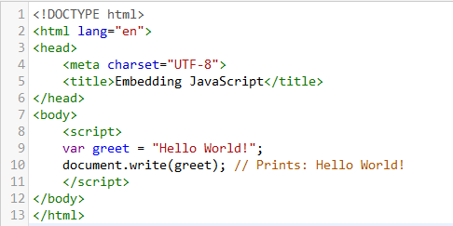
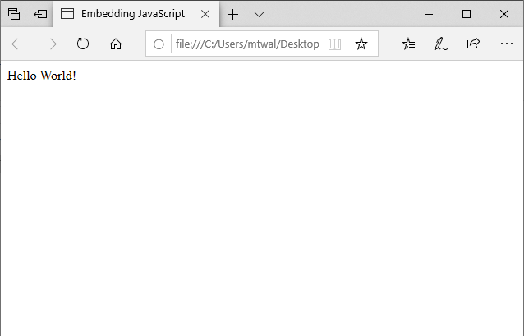
Hello World

Slide 42
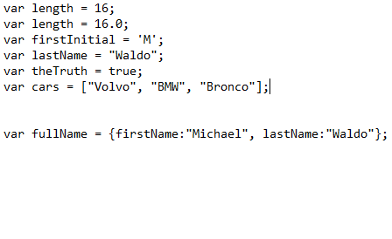
Data Types (JavaScript)

Slide 43
Python

Slide 44

What is Python
Designed to be highly extensible (ability to update existing functionality)
Strives for simpler, less-cluttered syntax and grammar
“There should be one – and preferably only one- obvious way to do it”
Developers strive to keep it fun to use
Highly documented for multi-industry use

Slide 45

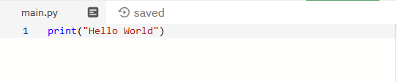
Hello World

Slide 46
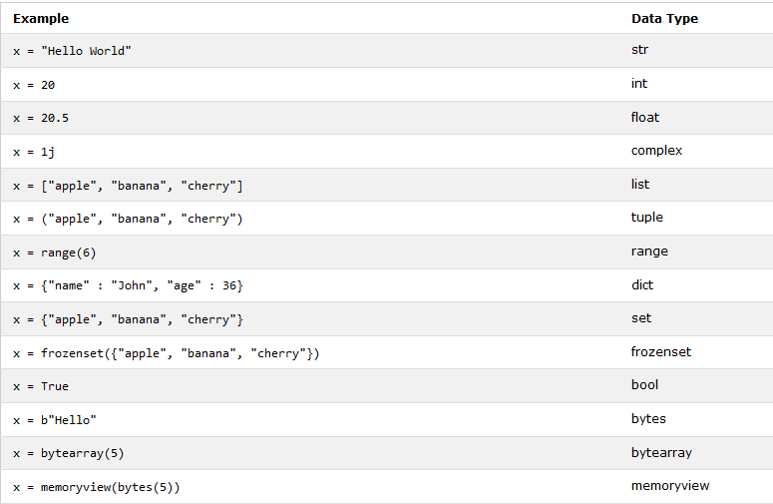
Data Types (Python)

Slide 47
To complete the merit badge
Using the GitHub repository, copy and paste the contents of the Java file and complete the tasks that are commented within
Using the knowledge learned today, recreate the Java Calculator program with both JavaScript and Python
If you do not wish to recreate the provided Java program, and want to create your own, feel free to do so.
Make sure it runs!
Put all code into one folder, zip the folder, and email to chickasawvirtualmb@gmail.com

Slide 48
Resources
https://repl.it/languages/java10 - Online Java IDE
https://playcode.io/ - Online HTML/CSS/JS Editor
https://repl.it/languages/python3 - Online Python IDE
https://github.com/MTWaldo/ProgrammingMB - GitHub Repository for programs used during merit badge
https://www.reddit.com/r/dailyprogrammer/wiki/challenges - Website to find challenges to test your programming logic

Slide 49
Thank you!!!

