Slide 1



Code Club
-St. Thomas’s school-
term3 week one (1.8.16)

Slide 2


Welcome back!
What we’re going to do this term?
Short “wrap up” of last term
An activity of SCRATCH

Slide 3

What we’re gonna do?
SCRATCH(w1-w3)
HTML / CSS(w4,w5)

Slide 4

What we learned
Selecting Sprites, Backdrops
Defining moving(glide, goto…)
Defining looks(costumes, colours..)
Defining sounds
Defining controls
Using variables
Using messages
How to do coding in Scratch

Slide 5

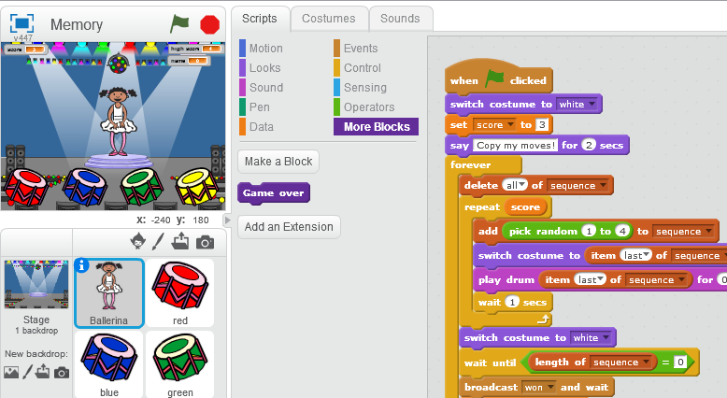
Today…
We are going to code this

Slide 6
Today…
We are going to use “list”
List is a collection of values and we can store multiple things in a list(also called array).
To use a value in a list, we use an “index”.
“Length” of a list = how many things does this list have.

Slide 7
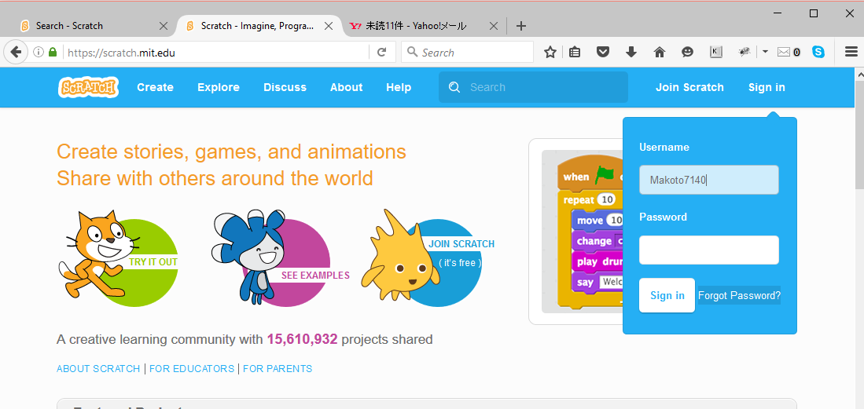
If you forget your password
Use the “Forget Password?” button

Slide 8
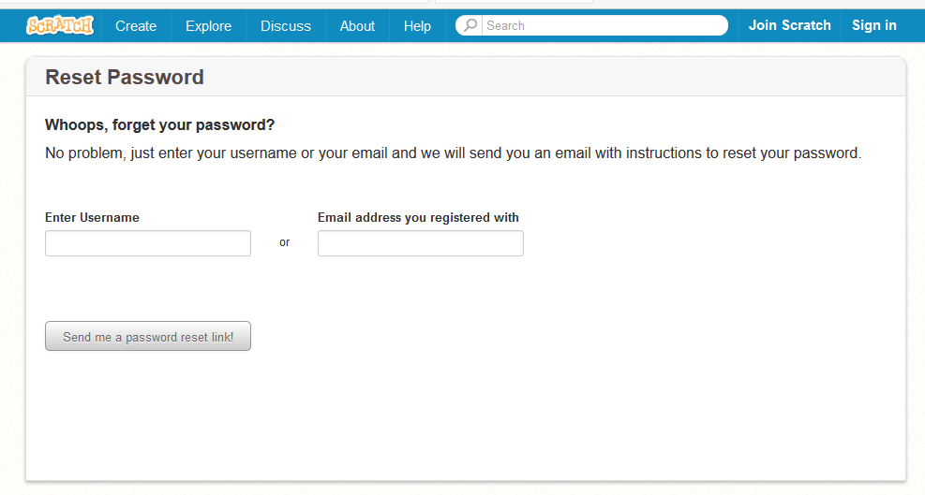
If you forget your password

