Slide 1



Code Club
-St. Thomas’s school-
term3 week four (22.8.16)

Slide 2


Start HTML!
What is HTML?
Making account of “Trinket”
Introductory practice of HTML

Slide 3
What is HTML?
What is HTML?
Hyper
Text
Markup
Language
HTML is a markup language which is used for describing web pages
HTML is essential for constructing of web pages, but…

Slide 4

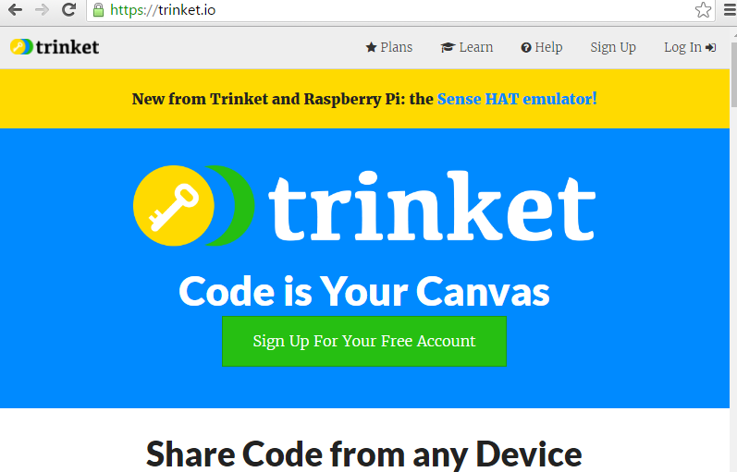
Please go to…
Trinket website
open
https://trinket.io/
and click
“Sign Up”

Slide 5

Basics of HTML(1)
HTML is..
A markup language, which is a set of markup tags
HTML documents are described by HTML tags
Each HTML tag describes different document content

Slide 6
Basics of HTML(1)
TAGs look like these…
Example1
<html>
<body>
<h1>Hello world!!</h1>
</body>
</html>
Start tag
Tag name
End tag
*Opened tags must be closed in correct orders.

Slide 7
Introductory practices
<!DOCTYPE html>
<html>
<head>
<title>Page Title</title>
</head>
<body>
<h1>My First Heading</h1>
<p>My first paragraph.</p>
</body>
</html>
Let’s write
“Example1” on previous page
Another sample on the right

Slide 8
Introductory practices
HTML headings
HTML paragraphs
HTML link
HTML image
<h1>This is heading 1</h1>
<h2>This is heading 2</h2>
<h3>This is heading 3</h3>
<p>This is a paragraph.</p>
<p>This is another paragraph.</p>
<a href="http://www.w3schools.com">St Thomas’s</a>
<img src="rocketship.gif" alt="no image">

Slide 9
Basics of HTML(2)
Tags can be nested
Attributes give the more information
Example1(listed again)
<html>
<body>
<h1>Hello world!!</h1>
</body>
</html>
h1
body
html
<a href="http://www.w3schools.com">St Thomas’s</a>
<img src="rocketship.gif" alt="no image">
Attributes

Slide 10
Basics of HTML(2)
Use lowercase for tag name
Don’t forget end tags!
But there are some “empty” elements…
<html>
<body>
<p>This is a bad example of a paragraph
<p>This is a good example of a paragraph</p>
</body>
</html>
<br>,<hr>,<input>…. : you can close these tags with ending “/” ex) <br />

Slide 11
Introductory practices
Use some attributes
<img src=“rocketship.gif“ alt=“no image” width="150px" height="100px">
<h1 title=“friendly">Hello world!!</h1>
<a title="look!" href="http://www.stthomas.school.nz/">link</a>

Slide 12
Introductory practices
Using of <pre> tag
<p>
My Bonnie lies over the ocean.
My Bonnie lies over the sea.
My Bonnie lies over the ocean.
Oh, bring back my Bonnie to me.
</p>
<pre>
My Bonnie lies over the ocean.
My Bonnie lies over the sea.
My Bonnie lies over the ocean.
Oh, bring back my Bonnie to me.
</pre>

Slide 13
Introductory practices
Table
<table>
<tr>
<th>a</th><th>b</th><th>c</th>
</tr>
<tr>
<td>a11</td><td>b11</td><td>c11</td>
</tr>
<tr>
<td>a12</td><td>b12</td><td>c12</td>
</tr>
<tr>
<td>a13</td><td>b13</td><td>c13</td>
</tr>
</table>

Slide 14
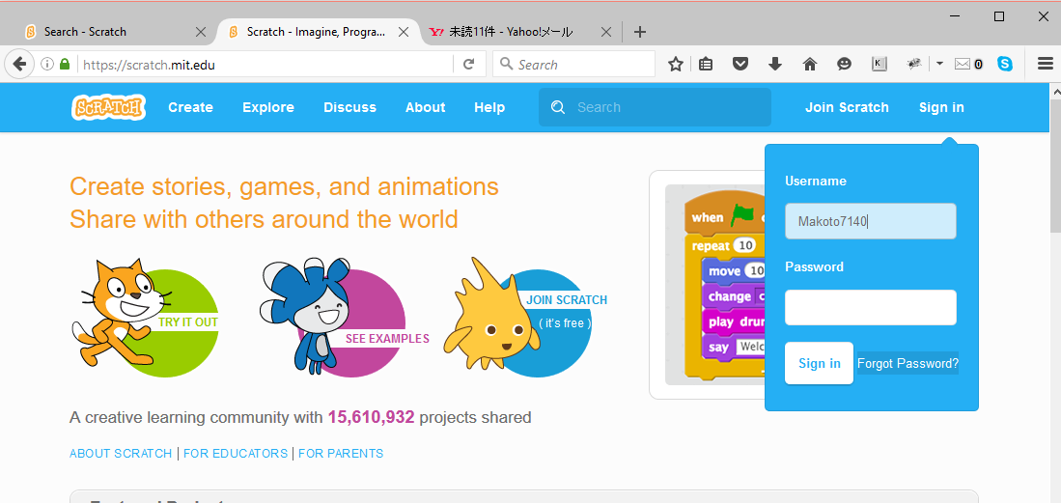
If you forget your password
Use the “Forget Password?” button

Slide 15
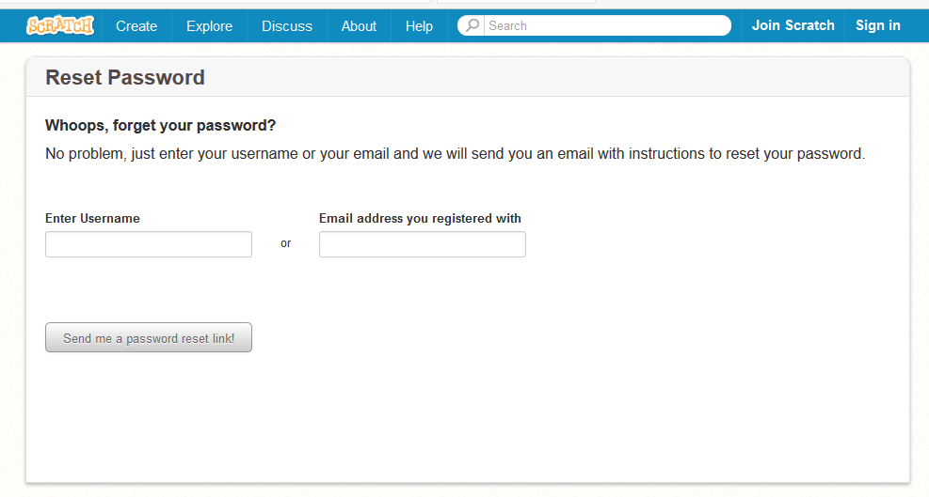
If you forget your password

