Slide 1



Code Club
-St. Thomas’s school-
week one(13.6.16)

Slide 2


Welcome!
Monday 3:15-4:15
No “teacher” in this club

Slide 3
Questions
Do you know computer?
How frequently do you use it?
Do you know coding?

Slide 4

Your imagination matters…
What can you create with coding?

Slide 5

Learning outcome-1
To know/understand coding

Slide 6

Learning outcome-2
Be familiar with Logical Thinking

Slide 7

What we will learn
SCRATCH
HTML / CSS
PYTHON

Slide 8

Small Demonstrations

Slide 9

What we use
School PC
Your own laptop

Slide 10
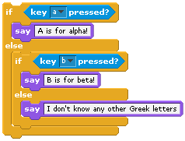
What is SCRATCH
With SCRATCH you can create animations and games.

Slide 11
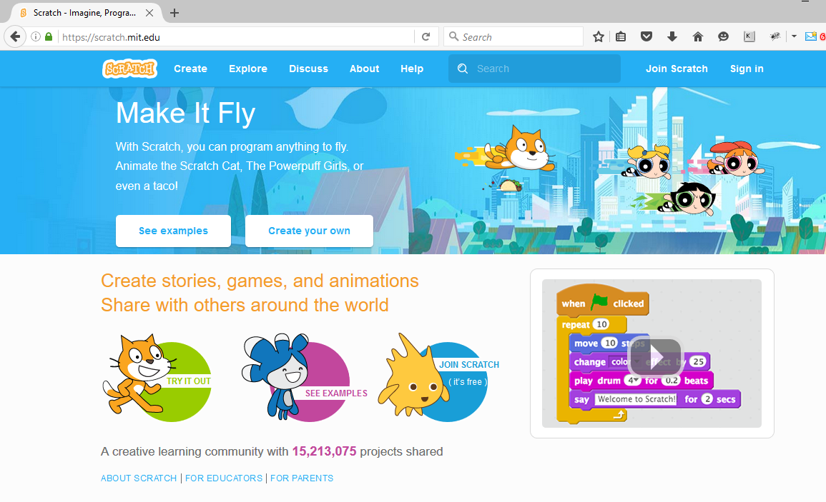
Preparation

Slide 12
Preparation
Go to the site “scratch.mit.edu” => click “Join Scratch” and do your registration.
Your username :
Your password :

Slide 13
Introductory Session

