Slide 1



Code Club
-St. Thomas’s school-
week two (20.6.16)

Slide 2


Welcome back!
Short “wrap up” of last week
Activities of SCRATCH

Slide 3

Learning outcomes
To know/understand coding
Be familiar with Logical Thinking

Slide 4

What we will learn
SCRATCH
HTML / CSS
PYTHON

Slide 5

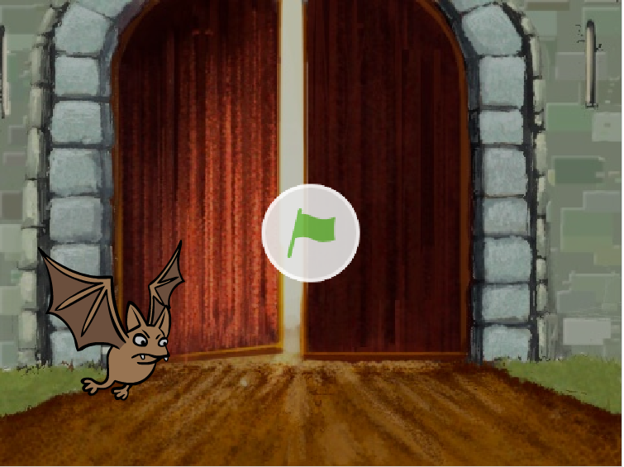

Scratch activity-1
We coded this
What did we used for making bat fly?
What are these?

Slide 6
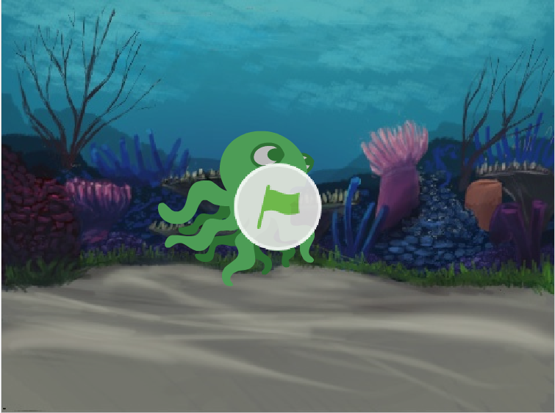

Scratch activity-1
We coded this

Slide 7

What we learned
There are three “sentences” needed for coding
Sequential process
Loop(repetition)
Branch(if… else…)

Slide 8
Let’s create new projects!

