Slide 1



Code Club
-St. Thomas’s school-
week four (4.7.16)

Slide 2


Welcome back!
Short “wrap up” of last week
Activities of SCRATCH

Slide 3
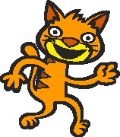
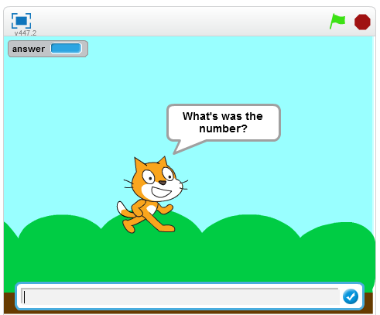

Scratch activity-1
We coded this
We used

Slide 4
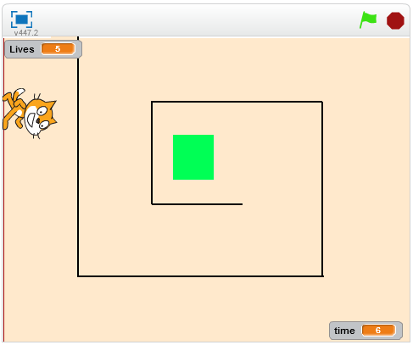
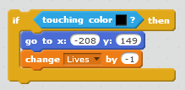
Scratch activity-2
We coded this
We used

Slide 5


There are two type of “if”
One way if
Two way if

Slide 6
This week…
“Complete” maze
With “lives” and “score”….
Using “message”
Make “Cat Flying” game

Slide 7
Scratch activities
Please open your Scratch account now…

Slide 8

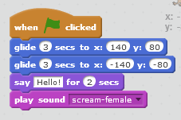
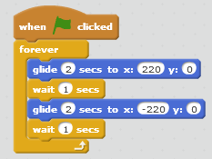
What we learned
There are three “sentences” needed for coding
Sequential process
Loop(repetition)
Branch(if… else…)

Slide 9
What we learned
Selecting Sprites, Backdrops
Defining moving(glide, goto…)
Defining looks(costumes, colours..)
Defining sounds
Defining controls
Using variables
Using messages
How to do coding in Scratch

Slide 10
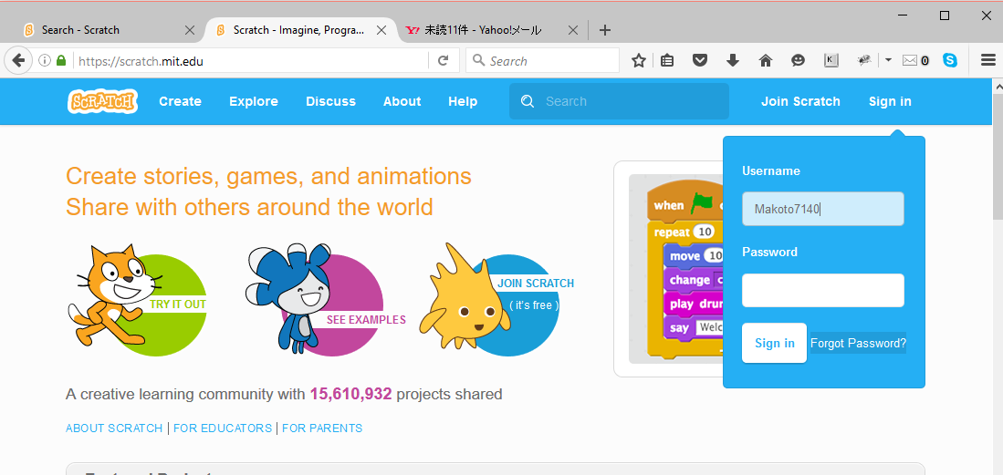
If you forget your password
Use the “Forget Password?” button

Slide 11
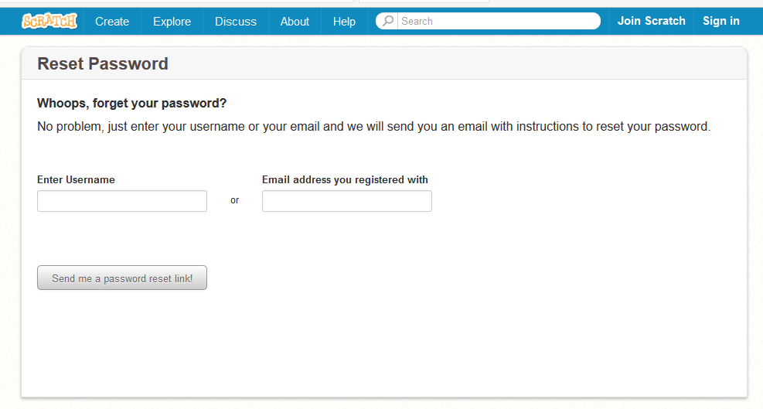
If you forget your password

