Slide 1



Code Club
-St. Thomas’s school-
term3 week two (8.8.16)

Slide 2


Welcome back!
Short “wrap up” of last week
A new activity of SCRATCH

Slide 3
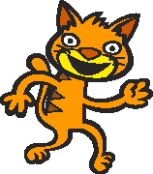
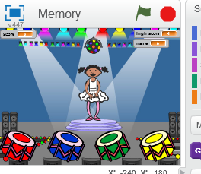

What we did last week
We coded this..
In this one, we used…

Slide 4
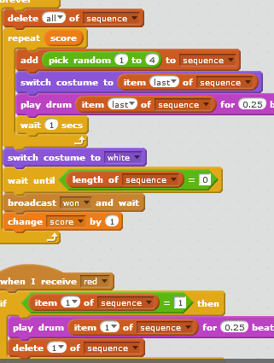
What we did last week
We used “list”
Collection of values.
We use an “index” in order to use a value in a list.
“Length” of a list = how many things does this list have.

Slide 5
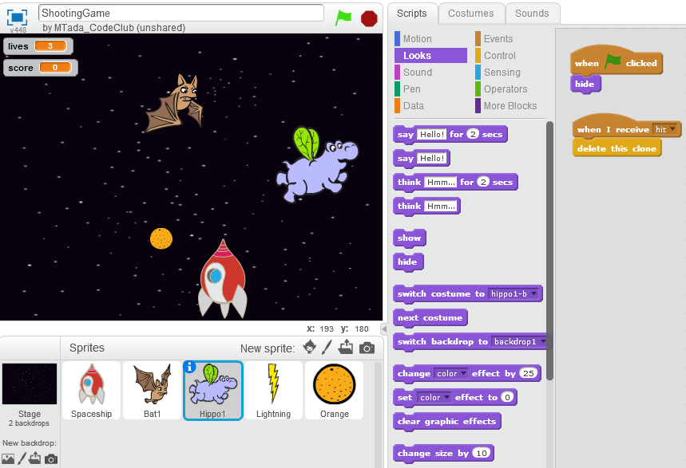
Today…
We are going to code this

Slide 6
Today…
We are going to use “clone”
Clone is a copy of an “object”(in Scratch, it is a Sprite).
In Scratch, you can create as many number of clones of a Sprite as you like.

Slide 7

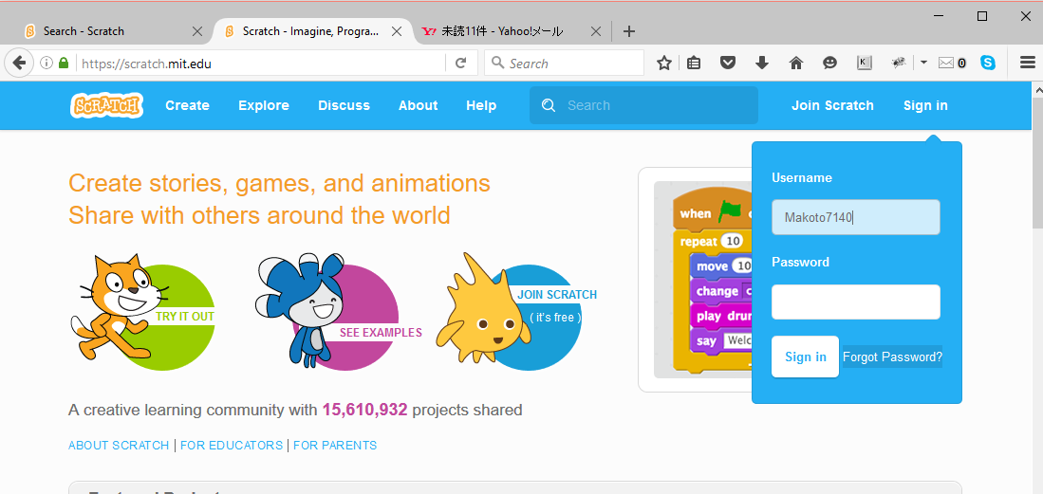
If you forget your password
Use the “Forget Password?” button

Slide 8
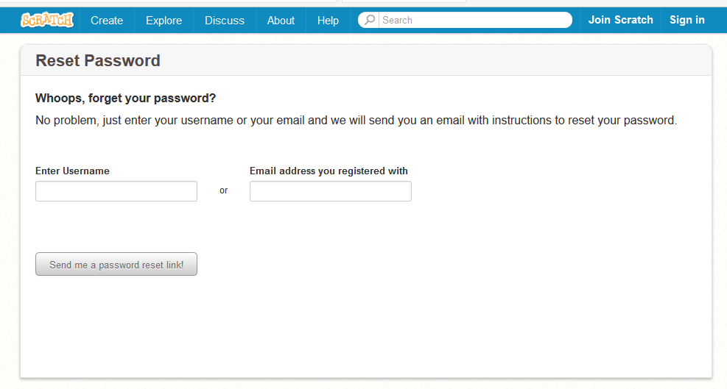
If you forget your password

