Slide 1



Code Club
-St. Thomas’s school-
term3 week five (29.8.16)

Slide 2


Today’s Agenda
Short Wrap-up of last week
What is CSS
Introductory practice of HTML/CSS
Practice Project “Happy Birthday”

Slide 3
What is HTML?
What is HTML?
Hyper
Text
Markup
Language
HTML is a markup language which is used for describing web pages
HTML is essential for constructing of web pages, but…

Slide 4

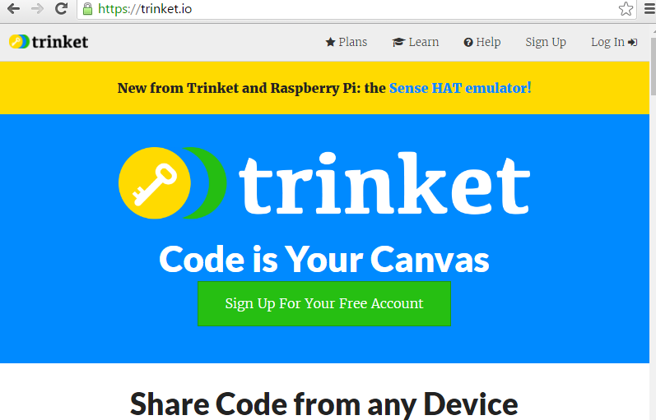
Please go to…
Trinket website
open
https://trinket.io/
and click
“Sign Up”

Slide 5

Basics of HTML(1)
TAGs look like these…
Example1
<html>
<body>
<h1>Hello world!!</h1>
</body>
</html>
Start tag
Tag name
End tag
*Opened tags must be closed in correct orders.

Slide 6
Introductory practices
<!DOCTYPE html>
<html>
<body>
<h1>My First Heading</h1>
<p>My first paragraph.</p>
</body>
</html>
Let’s write
“Example1” on previous page
Another sample on the right

Slide 7
Introductory practices
HTML headings
HTML paragraphs
HTML link
HTML image
<h1>This is heading 1</h1>
<h2>This is heading 2</h2>
<h3>This is heading 3</h3>
<p>This is a paragraph.</p>
<p>This is another paragraph.</p>
<a href="http://www.w3schools.com">St Thomas’s</a>
<img src="rocketship.gif" alt="no image">

Slide 8
What is CSS?
What is CSS?
Cascading
Style
Sheet
CSS defines “visual” effects of web pages.
Including colors, font style, layouts, background, margins, etc…

Slide 9

What is CSS?
How CSS works?
Document Information
HTML
Definitions of visual effects
CSS

Slide 10
Basics of HTML(2)
Tags can be nested
Attributes give the more information
Example1(listed again)
<html>
<body>
<h1>Hello world!!</h1>
</body>
</html>
h1
body
html
<a href="http://http://www.stthomas.school.nz/">St Thomas’s</a>
<img src="rocketship.gif" alt="no image">
Attributes

Slide 11
Basics of HTML(2)
Use lowercase for tag name
Don’t forget end tags!
But there are some “empty” elements…
<html>
<body>
<p>This is a bad example of a paragraph
<p>This is a good example of a paragraph</p>
</body>
</html>
<br>,<hr>,<input>…. : you can close these tags with ending “/” ex) <br />

Slide 12
Introductory practices
Lets add CSS to your HTML
<html>
<head>
<style>
p{ background-color:green;
margin:10px;
padding:20px;
color:blue;
font-size:25px;
}
</style>
</head>

Slide 13
Introductory practices
Using id’s
#pa{ background-color:blue;
margin:10px;
padding:20px;
color:yellow;
font-size:25px;
}
……..
<p id=“pa”>This is paragraph a</p>

Slide 14
Introductory practices
Combine with table tag of HTML
<style>
td{ background-color:blue;
margin:10px;
padding:20px;
color:yellow;
font-size:25px;
}
#col1{background-color:blue;}
#col2{background-color:red;}
#col3{background-color:yellow;}
</style>

Slide 15
Introductory practices
Combine with table tag of HTML
<table>
<tr><td id = 'col1'>A</td>
<td id = 'col2'>B</td>
<td id = 'col3'>C</td></tr>
<tr><td id = 'col1'>D</td>
<td id = 'col2'>E</td>
<td id = 'col3'>F</td></tr>
<tr><td id = 'col1'>G</td>
<td id = 'col2'>H</td>
<td id = 'col3'>I</td></tr>
</table>

Slide 16
Project “Happy Birthday”
Go to following website and download image files
https://github.com/MTada7140/Stthomas2908.git

Slide 17
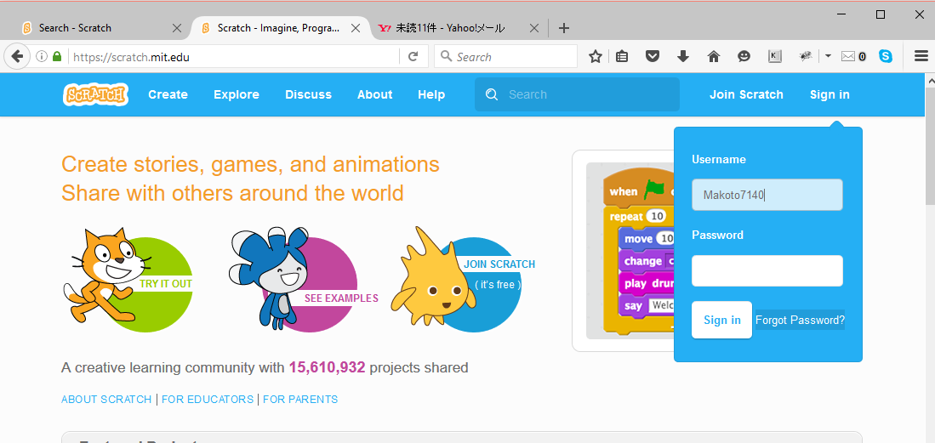
If you forget your password
Use the “Forget Password?” button

Slide 18
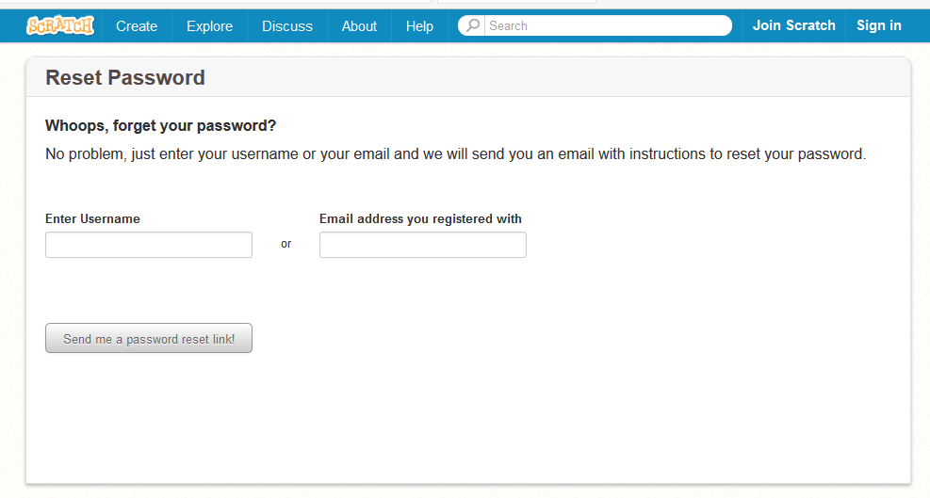
If you forget your password

