Slide 1



Code Club
-St. Thomas’s school-
week three (27.6.16)

Slide 2


Welcome back!
Short “wrap up” of last week
Activities of SCRATCH

Slide 3

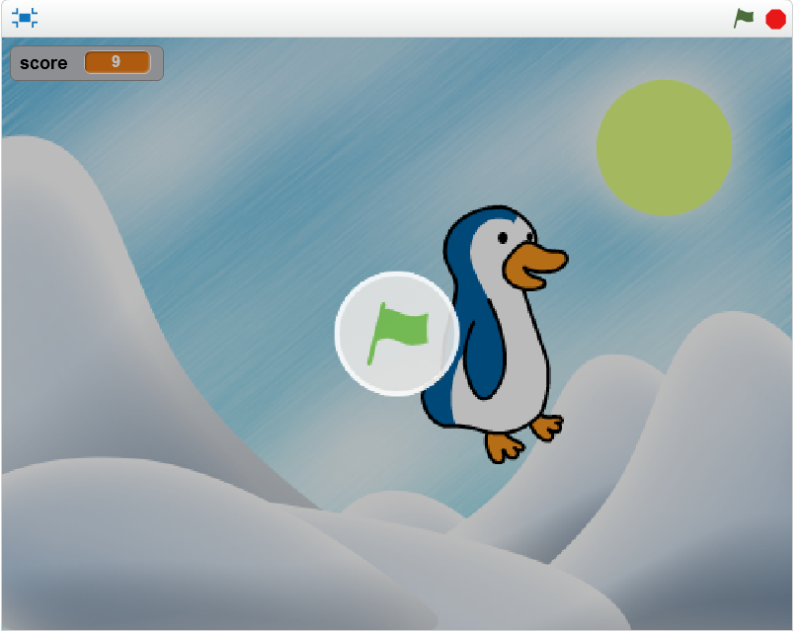

Scratch activity-1
We coded this
…and modify this one to make a small game.
We used

Slide 4
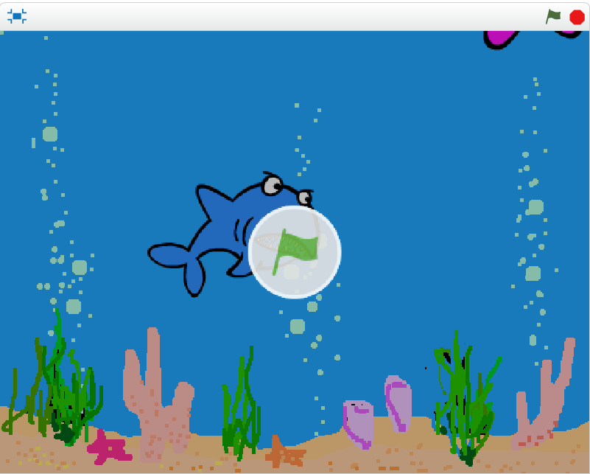
Scratch activity-2
We coded this

Slide 5
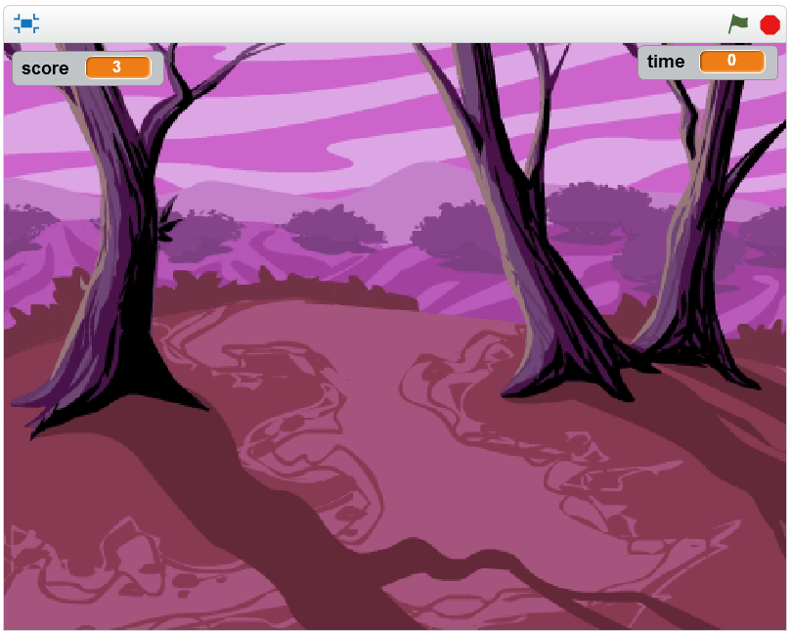
Scratch activity-3
We coded this
We used

Slide 6

What we learned
There are three “sentences” needed for coding
Sequential process
Loop(repetition)
Branch(if… else…)
We already did them
We’re going to do this week

Slide 7


There are two type of “if”

