Slide 1
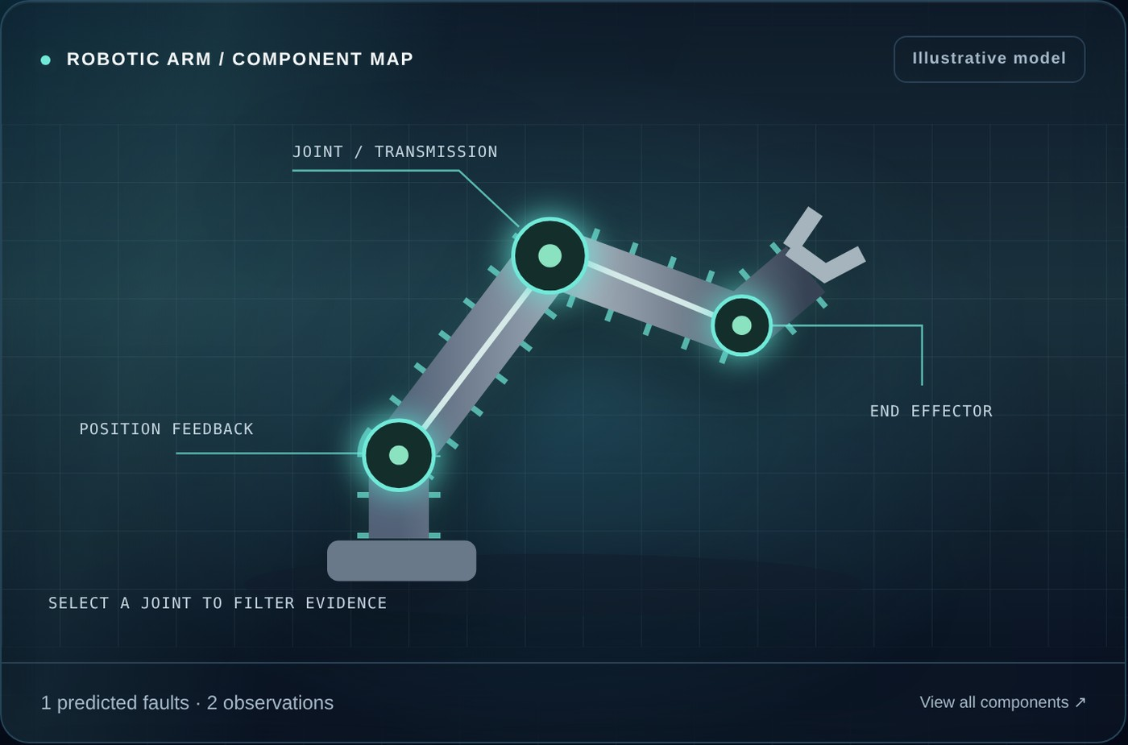
KNOWLEDGE-BASED SYSTEMS · CT-359 · CCP
Robotic Arm
Fault Diagnosis
ARM / INSIGHT
Explainable rule engine · source-aware evidence · maintenance workflow
Saad Ali CT-24221
Muhammad Taha Farrukh CT-24224
Uzair Ahmed CT-24244
UsaidUllah Qureshi CT-24227
NED University of Engineering and Technology, Karachi · Computer Science and Information Technology
Notes:
Introduce the project: ARM / INSIGHT is a rule-based Knowledge-Based System for robotic-arm fault diagnosis and maintenance decision support. Mention the four team members and that the system is demonstrable live. Source: Knowledge Based Systems CT-359 CCP brief, NED University, 2026.

Slide 2



A protective stop can have several plausible causes
An operator needs to see why a hypothesis appeared — and which observation is still missing.
Input
Output
Boundary
Manual observations or source-tagged claims (Yes / No / Unknown / Conflict)
Supported, possible, contradicted or conflicted hypotheses with a reasoning trace
Academic screening on a generic arm — no automated control, no certification
Course learning outcomes addressed
CLO 1
CLO 2
CLO 3
Represent equipment knowledge
Frames + production rules in JSON
Analyse the problem
Stakeholders, constraints, incomplete requirements
Evaluate and justify
Forward chaining vs alternatives, safety first
Notes:
The operator needs to see why a hypothesis appeared and what observation is still missing. The system takes manual observations or source-tagged claims and outputs supported, possible, contradicted or conflicted hypotheses. Boundary: academic screening on a generic arm, no automated control. The three CLOs frame the whole project.

Slide 3





Who needs what — and where requirements collide
Operator
Technician
Conflicts we resolve
Records symptoms and source notes
Sees evidence, cause and a safe next action
Safety vs quick restart
→ Hazards escalate independently
Safety officer
Supervisor
Low cost vs reliability
→ Cost is a secondary sort key
Immediate hazard escalation
Compares cost and downtime
Decision vs missing data
→ Unknown is never counted as No
Knowledge engineer
Examiner
Operator vs sensor
→ Opposing claims become Conflict
Inspects and edits rules
Explainable, demonstrable KBS
Notes:
Six stakeholders pull in different directions. Safety officers need hazard escalation that cannot be skipped; supervisors want lower downtime and cost; technicians need auditable hypotheses. The four conflicts on the right are resolved explicitly in the design.

Slide 4
Frames + production rules, stored as inspectable JSON
Equipment
Robotic arm
Component
Tool configuration
Symptom
protective_stop
Fault
Payload mismatch
Cause
Wrong mass / CoG
Action
Check payload settings
FAULT FRAME (knowledge_base.json)
PRODUCTION RULE
{ "id": "payload",
"component": "Tool configuration",
"conditions": ["protective_stop",
"payload_mismatch"],
"severity": "High",
"cost": "Low", "downtime": "Short",
"cause": "Incorrect tool mass / CoG",
"action": "Compare tool data with
approved payload settings" }
IF protective_stop = Yes
AND payload_mismatch = Yes
THEN support "Payload configuration mismatch"
recommend qualified payload review
Observation states: Yes · No · Unknown · Conflict
Unknown ≠ No — missing evidence never counts as absence.
Notes:
CLO 1: the chain Equipment, Component, Symptom, Fault, Cause, Action is encoded as frames (structure) and production rules (logic). Observations take four states: yes, no, unknown, conflict. The knowledge base stays inspectable and editable for the demonstration. Concepts follow Universal Robots guidance; the exact conjunctions are author-created educational rules.

Slide 5
8 fault frames, 19 symptoms
Fault | Component | Required observations (all = Yes) | Severity | Cost / Down
Payload configuration mismatch | Tool configuration | protective_stop ∧ payload_mismatch | High | Low / Short
Joint mechanical degradation | Joint / transmission | joint_noise ∧ joint_friction ∧ position_drift | High | High / Long
Cooling-related overheating | Motor / controller cooling | overtemperature ∧ cooling_blocked | High | Medium / Medium
Position feedback fault | Encoder / feedback circuit | encoder_alarm ∧ feedback_unstable | High | Medium / Medium
Pneumatic grip fault | End effector | grip_loss ∧ pressure_low | High | Low / Short
Communication connection fault | Communication harness | communication_alarm ∧ connection_damage | Medium | Medium / Medium
Power supply fault | Power system | power_alarm ∧ supply_unstable | High | Medium / Medium
Joint holding / brake fault | Joint brake | brake_alarm ∧ joint_droop | Critical | High / Long
Payload and friction concepts follow Universal Robots guidance; the other conjunctions and all cost / downtime labels are author-created educational rules.
Notes:
Each fault is a frame with component, required conditions, severity, relative cost and downtime. Payload and abnormal-friction concepts follow Universal Robots guidance: https://www.universal-robots.com/articles/ur/robot-care-maintenance/understanding-protective-stops/ . All other conjunctions and all cost / downtime labels are author-created educational attributes.

Slide 6
Forward chaining: facts, rules, explained action
1 Observed facts
2 Rule match
3 Explanation
protective_stop = Yes
Payload condition group is satisfied
Trace lists satisfied facts
payload_mismatch = Yes
Rule derives a fault hypothesis
Qualified payload check suggested
Hypothesis status for every rule
Supported
All conditions Yes
Possible
Some Yes, none No
Conflicted
A condition is Conflict
Contradicted
A condition is No
Unassessed
Nothing Yes yet
Notes:
CLO 3: forward chaining fits the question "given these observations, what fires?". Observations are the initial facts; every satisfied rule adds a conclusion and an action to the trace. Status per rule: Supported when all conditions are Yes; Possible when some are Yes and none is No or Conflict; Conflicted when a condition is Conflict; Contradicted when any condition is No; Unassessed when nothing is Yes. Source: Universal Robots C162 documentation discusses an incorrect payload centre of gravity as a possible cause of a protective stop: https://www.universal-robots.com/manuals/EN/HTML/SW5_19/Content/prod-err-codes/topics/CODE_162.html . This is an illustrative rule, not model-specific validation.

Slide 7
Conflicting observations never get averaged away
OPERATOR OBSERVATION
protective_stop = Yes
CONFLICT
SENSOR / CONTROLLER
protective_stop = No
What the system does
Source claims | Merged state | Payload rule
Operator: Yes | Yes | Counts as evidence
Operator Yes + Sensor No | Conflict | Conflicted
No claims | Unknown | Stays Possible
Sensor: No only | No | Contradicted
Preserves both source records
Marks the affected rule Conflicted — never Supported
Raises the next-best check for a technician
Hazard symptoms still escalate independently
Notes:
When one source says Yes and another says No for the same symptom, the merged state is Conflict. A conflicted symptom cannot support a rule, so the hypothesis becomes Conflicted until a qualified person verifies the source. Both source records are preserved.

Slide 8
Authentic data: UCI Robot Execution Failures
1
2
3
4
5
6
Extract
Parse LP1–LP5 files
Clean incomplete
15-sample windows
Clean outliers
Missing / extreme values
Deduplicate
Sensor fingerprints
Knowledge map
failure_class → symptoms
Load
Clean CSV + cases
463
451
785
5
UCI instances
sensor rows kept
evidence rows mapped
LP prediction cases
Source: UCI Machine Learning Repository · DOI 10.24432/C5M89N · CC BY 4.0 | 4 outliers + 8 duplicates removed
Notes:
ETL is a must-have component. The authentic source is the UCI Robot Execution Failures dataset (DOI 10.24432/C5M89N, CC BY 4.0): force and torque samples after a failure is detected, five learning problems LP1 to LP5, 463 instances. Cleaning removed 4 extreme outliers and 8 duplicates, leaving 451 sensor rows. The knowledge-map step turns failure classes into KB symptom evidence (785 rows) so that rule-based prediction can run on 5 asset cases. Honesty note: UCI does not use our exact symptom strings, so the mapping is explicit and documented.

Slide 9
What the cleaning pipeline did
Noise removed
Drop reason | Count
incomplete_ft_window | 0
missing_class_or_features | 0
extreme_sensor_outlier | 4
duplicate | 8
unmapped_class | 0
Honesty note UCI does not use our symptom strings — an explicit knowledge-map step links failure classes to KB evidence. 13/13 PASS measures software behaviour, not field accuracy.
Notes:
Left: distribution of the 463 UCI instances over the five learning problems. LP5 (failures in motion with part) is the biggest at 164. Right: the noise-removed table — 4 extreme sensor outliers and 8 duplicates; the other drop reasons were zero. Evaluation-lab results measure software behaviour on authored scenarios, not UCI classification accuracy.

Slide 10
System architecture: five layers, one clean contract
Presentation
Diagnostic studio
Case history
Maintenance board
Rule explorer
Dataset & ETL
Evaluation lab
Inference & evidence
engine.mjs — forward chaining
evidence.mjs — conflict merge
state.mjs — validation
Knowledge
knowledge_base.json
sample_cases.json
prediction_cases.json
Data / ETL
dataset/raw — UCI LP1–LP5
etl_cleaning.ipynb
dataset/cleaned
Persistence & deploy
localStorage
Supabase (optional)
Vercel + serve.py
Notes:
The knowledge and inference layers are independent of the user interface and are exercised directly by the Node regression tests. Presentation: six browser screens. Inference and evidence: engine.mjs, evidence.mjs, state.mjs. Knowledge: knowledge_base.json and sample cases. Data/ETL: raw UCI files, pandas notebook, cleaned outputs. Persistence and deployment: localStorage, optional Supabase, Vercel.

Slide 11
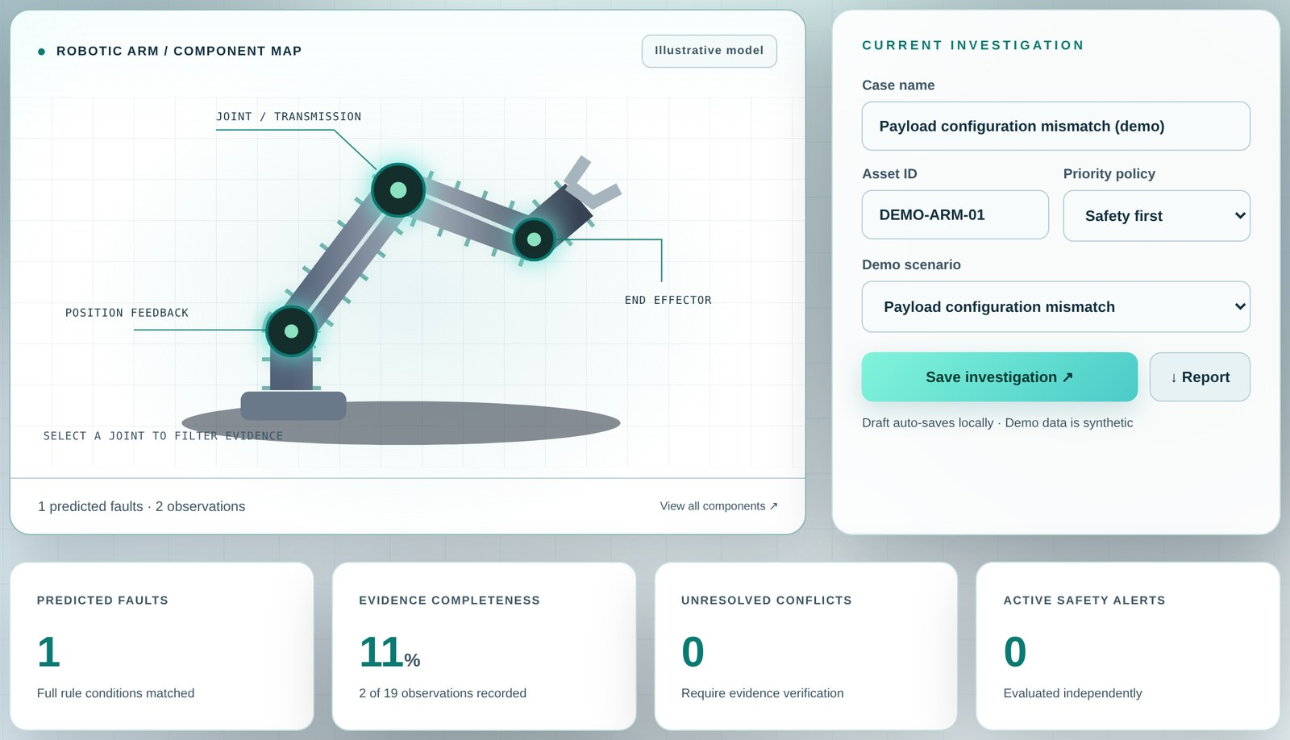


The web app: capture, reason, act
Capture
Symptoms and evidence sources
Review
Hypotheses, missing inputs, rule trace
Act
Save cases, compare, track tasks
Verify
Export report or run evaluation lab
Live: arm-insight-kbs-dist.vercel.app · Local: python serve.py
Notes:
Walk through the four-step workflow. The app runs locally through a small static-file server (serve.py) and is also hosted on Vercel at https://arm-insight-kbs-dist.vercel.app/ . Case data stays in browser storage; Supabase sync is optional.

Slide 12
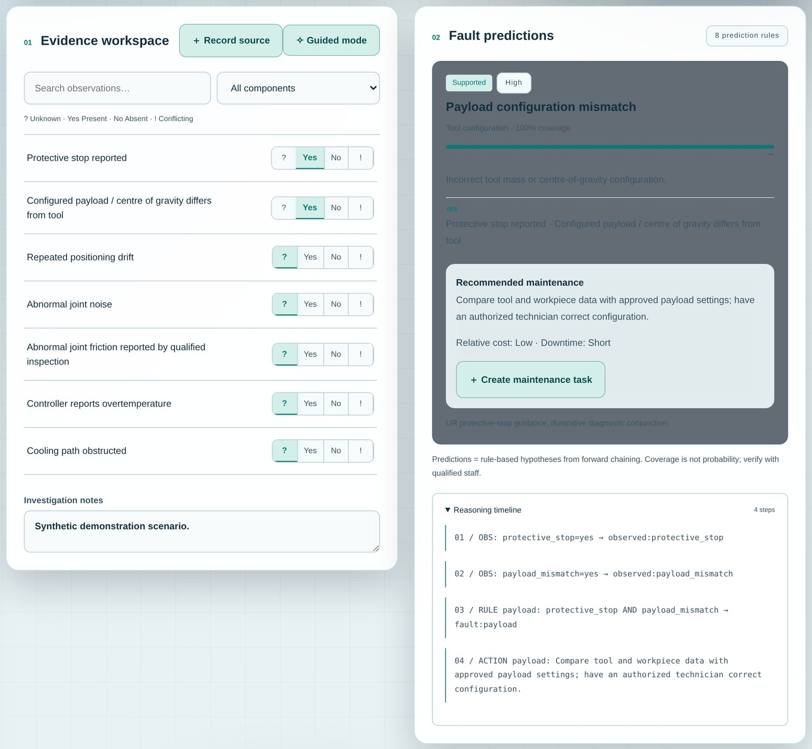
Every prediction explains itself
1
Status + coverage
Supported · 100 % rule coverage. Coverage is not a probability.
2
Cause + qualified action
Recommended maintenance appears only for Supported faults.
3
Reasoning timeline
OBS → RULE → ACTION steps for audit and viva.
Notes:
This is the supported-fault view for the payload scenario: protective_stop = Yes and payload_mismatch = Yes fire the payload rule. The panel shows status and coverage (not a probability), the cause, a qualified maintenance action and a four-step reasoning timeline.

Slide 13
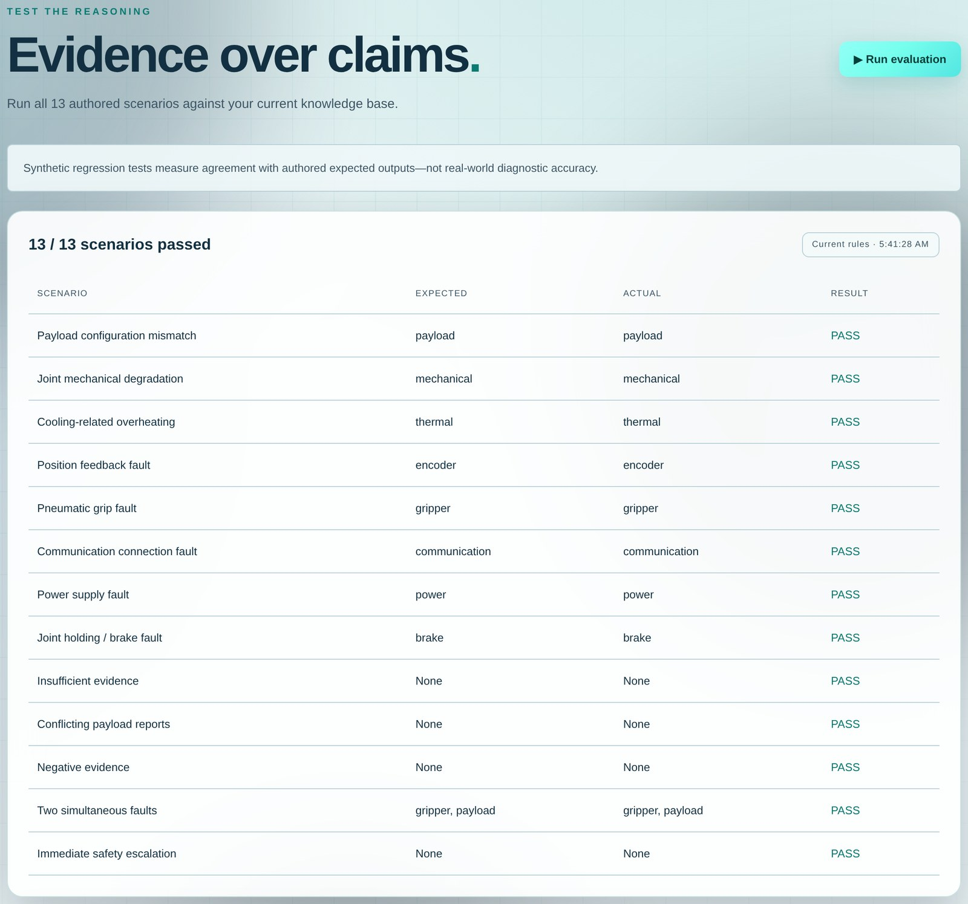
Testing and results
13/13
evaluation scenarios PASS
37
automated checks PASS
Counts are executable regression checks, not an estimate of diagnostic accuracy.
Notes:
All 13 authored evaluation scenarios match the expected supported-fault sets; the three Node suites add 37 checks in total (21 inference/sample checks, 9 workspace/rule validation checks, 7 evidence-source tests). These counts are executable local regression checks, not an estimate of diagnostic accuracy. Test commands and scenarios are included in the source package.

Slide 14
Why forward chaining? Judged on the CLO 3 criteria
Criterion | Rule-based forward chaining (chosen) | Alternative / trade-off
Explainability | Every condition and derived action is inspectable | ML needs labels and post-hoc explanation
Incomplete evidence | Unknown ≠ No; rules stay Possible | Bayesian methods need calibrated probabilities
Safety | Independent hazard alerts, severity-first ranking | Still needs human procedures
Cost / availability | Qualitative secondary ordering | Needs real plant numbers
Maintainability | Editable JSON rules + regression suite | Large ontology scales better across assets
Screening style | “Given these observations, what fires?” | Backward chaining suits one suspected fault
Verdict Maximum explainability and conservative handling of incomplete, conflicting evidence — with no data we do not have.
Notes:
Evaluation against accuracy, explainability, safety, cost and system requirements. Forward chaining over explicit AND rules maximises explainability, handles incomplete and conflicting evidence conservatively and needs no unavailable probabilistic data. The cited UR references support selected protective-stop examples, not the whole generic rule base: https://www.universal-robots.com/manuals/EN/PDF/SW5_24/service-manual_e-series/e-Series_Service_Manual_en.pdf

Slide 15


Limitations and what comes next
Limitations
Future improvements
Generic arm, only eight fault hypotheses
Bind knowledge to one specific robot model and manuals
No live telemetry or model-specific thresholds
Expert-labelled incidents: precision / recall, missed-hazard rate
Source labels do not authenticate claims
Import timestamped alarms; weight source reliability
Cost / downtime are qualitative teaching labels
Authentication and audit logging on the shared store
Demo Supabase policies are open — not production security
Optional ontology / graph view for cross-equipment reuse
A qualified engineer must approve any real maintenance action.
Notes:
Be upfront in the viva: this proves software and KBS behaviour, not validated plant accuracy. A qualified engineer must approve any real maintenance action. Future work: bind to a specific robot model, collect expert-labelled incidents, import alarms, add authentication and audit logs, optionally add an ontology view.

Slide 16
Five-minute viva demonstration
1
2
3
4
5
Dataset & ETL
Cite UCI, show cleaning, batch predict
Payload scenario
Load it, open the rule trace
Conflict
Add opposing source claims
Evaluation lab
Run 13 / 13 scenarios
Close
Real data + explainable rules; tests are regression, not plant accuracy
Notes:
Suggested order: 1) Dataset and ETL page — cite UCI, show cleaning, batch predict. 2) Load the payload scenario and open the reasoning timeline. 3) Add opposing source claims to show Conflict. 4) Run the evaluation lab, 13/13. Optionally show Supabase sync. Close with the honesty statement.

Slide 17
Conclusion
Transparent diagnosis beats a black box
Questions?
CLO 1
Frames + rules represent equipment knowledge
github.com/MTahaFarrukh/arm-insight-kbs
CLO 2
Incomplete, conflicting needs analysed and resolved
CLO 3
Forward chaining justified on explainability and safety
Real deployment needs model-specific knowledge acquisition and independent validation.
Notes:
Wrap up: ARM / INSIGHT demonstrates a transparent KBS for robotic-arm fault diagnosis. CLO 1 knowledge representation, CLO 2 analysis of incomplete stakeholder requirements, CLO 3 justified forward-chaining inference with conflict handling and explanations. Real deployment would need model-specific knowledge acquisition and independent validation. Invite questions.

Slide 18
References
[1]
Universal Robots, “Understanding Protective Stops.” universal-robots.com/articles/ur/robot-care-maintenance/understanding-protective-stops/
[2]
Universal Robots, “C162 Error Code.” universal-robots.com/manuals/EN/HTML/SW5_19/Content/prod-err-codes/topics/CODE_162.html
[3]
Universal Robots, “e-Series Service Handbook — Protective Stop.” universal-robots.com/manuals/EN/PDF/SW5_24/service-manual_e-series/
[4]
NED University of Engineering and Technology, Knowledge-Based Systems (CT-359) CCP brief and report template, 2026.
[5]
ARM / INSIGHT project package: knowledge base, sample cases, inference engine and tests, 2026. github.com/MTahaFarrukh/arm-insight-kbs
[6]
Supabase documentation — client libraries and Row Level Security (educational use), 2026.
[7]
Vercel documentation — static site deployment, 2026.
[8]
L. Lopes and L. Camarinha-Matos, “Robot Execution Failures” [Dataset], UCI Machine Learning Repository. doi.org/10.24432/C5M89N (CC BY 4.0).
Notes:
All external datasets, knowledge sources, libraries and tools used in the project are cited.

