Slide 1

Dashboard & Activities
Programs
Methods
Knowledge Hub
Tools

Slide 2

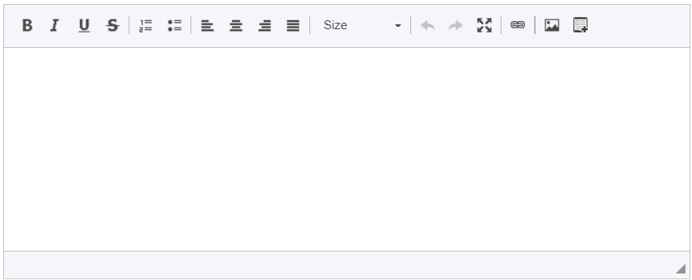
Programs / New Program
Description
Teams
Programs
Methods
Name
Description
Knowledge Hub
Tools
Cancel
Save

Slide 3
Programs / New Program
Link bloqueado
Description
Teams
Programs
Methods
Name
Description
Knowledge Hub
Tools
Cancel
Save

Slide 4

Programs / Group 1
Link para gestão equipas
Description
Teams
Programs
Methods
Group 1
Method: START
Description of group 1
Knowledge Hub
Tools

Slide 5
Programs / Group 1
Group 1
Teams
Programs
New Team
Methods
T
Team 1
Add Members
Knowledge Hub
T
Team 2
Add Members
Tools

Slide 6
Programs / Group 1
Group 1
Teams
New Team
Programs
Methods
Name
Description
Knowledge Hub
Tools
Cancel
Save

Slide 7
Programs / Group 1
Group 1
Teams
Team 1
Members
Programs
Methods
Knowledge Hub
Tools

Slide 8
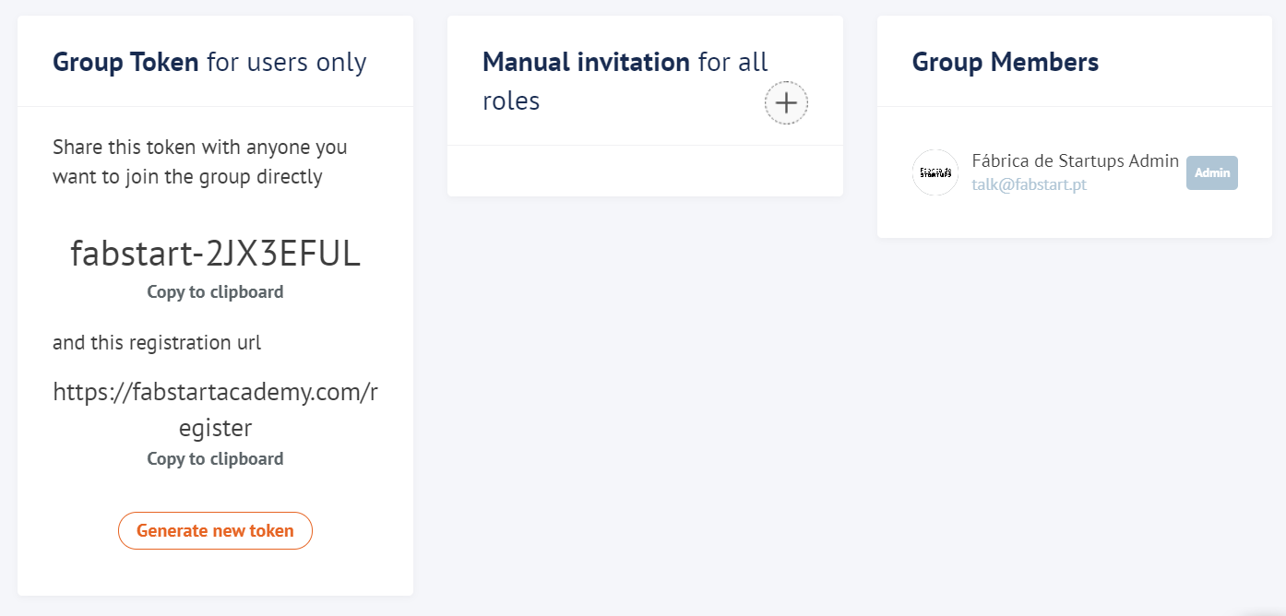
Programs / Group 1
Group 1
Teams
Team 1
Members
Programs
Methods
Team Token
Team
Knowledge Hub
Tools

