Slide 1
PRESENTATION
SUBJECT : INTRODUCTION TO SOFTWARE ENGINEERING
INSTRUCTOR : SIR SHAKIR RASHEED KHAN KHATTAK
GROUP MEMBERS
MUHAMMAD TARIQ : 4338-FBAS-BSSE-F21-B
YASIR ALI : 4343-FBAS-BSSE-F21-B
SIAM KHAN : 4333 -FBAS-BSSE-F21-B
SHAYAN UMAR : 4316-FBAS-BSSE-F21-B
USAMA KHAN : 4317 -FBAS-BSSE-F21B

Slide 2
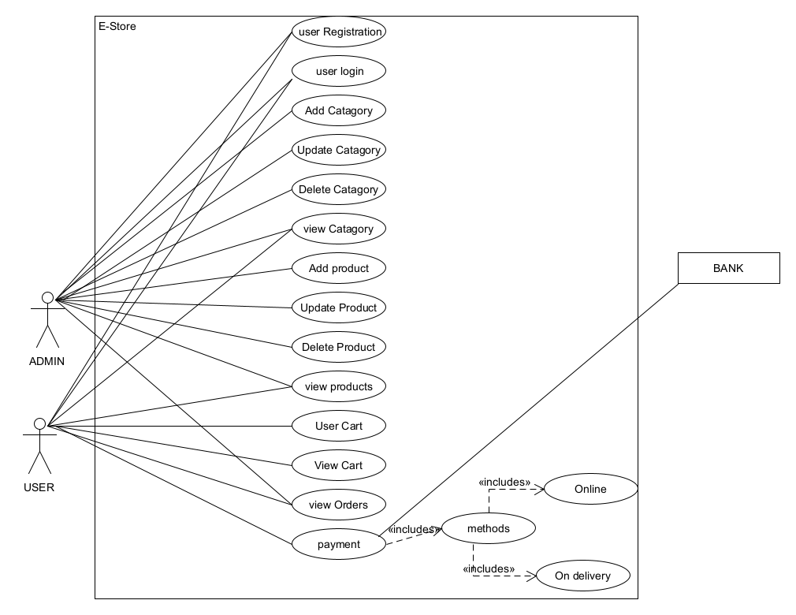

Slide 3
