Slide 1

Chapter 8
Association Rules

Slide 2
Content
Association rule mining
Mining single-dimensional Boolean association rules from transactional databases
Mining multilevel association rules from transactional databases
Mining multidimensional association rules from transactional databases and data warehouse
From association mining to correlation analysis
Constraint-based association mining
Summary

Slide 3
What Is Association Mining?
Association rule mining:
  Finding frequent patterns, associations, correlations, or causal structures among sets of items or objects in transaction databases, relational databases, and other information repositories.
Applications:
  Basket data analysis, clustering, classification

Slide 4
Association Rule: Basic Concepts
Given:
(1) database of transactions,
(2) each transaction is a list of items
(purchased by a customer in a visit)
Find: all rules that correlate the presence of one set of items with that of another set of items
  E.g., 98% of people who purchase tires and auto accessories also get automotive services done

Slide 5
Association Rule: Basic Concepts
Applications
  * ⇒ Maintenance Agreement (What the store should do to boost Maintenance Agreement sales)
  Home Electronics ⇒ * (What other products should the store stocks up?)
  Attached mailing in direct marketing

Slide 6
Rule Measures: Support and Confidence
Customer
buys both
Customer
buys diaper
Find all the rules X & Y ⇒ Z with minimum confidence and support
  support, s, probability that a transaction contains {X & Y => Z}
  confidence, c, conditional probability that a transaction having {X & Y} also contains Z
Customer
buys beer

Slide 7
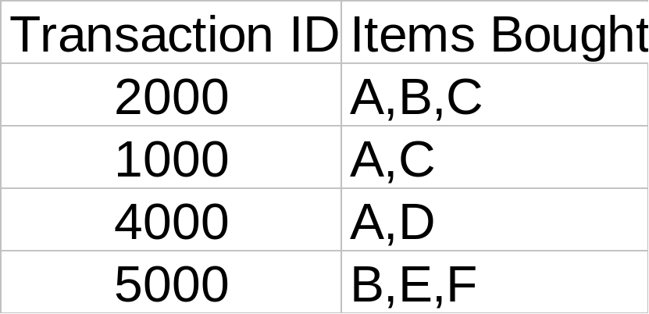
Rule Measures: Support and Confidence
Customer
buys both
Customer
buys diaper
Customer
buys beer
Let minimum support 50%, and minimum confidence 50%, we have
  A ⇒ C (50%, 66.6%)
  C ⇒ A (50%, 100%)

Slide 8
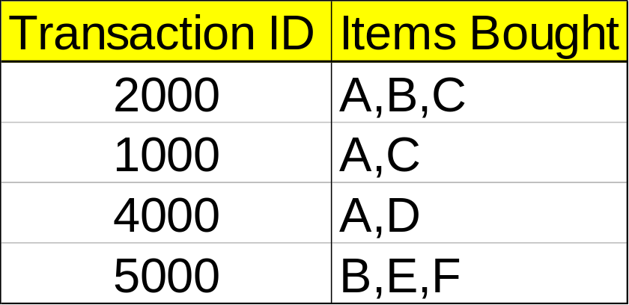
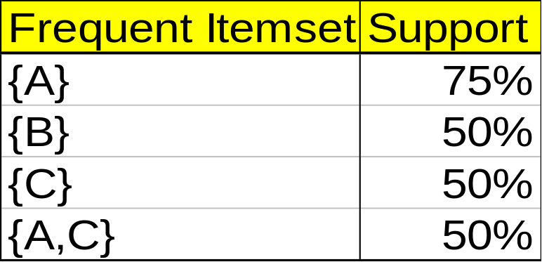
Mining Association Rules—An Example
Min. support 50%
Min. confidence 50%
For rule A ⇒ C :
  support = support({A &C}) = 2/4 = 50%
  confidence = support({A &C})/support({A})
  =2/3= 66.6%

Slide 9
Mining Frequent Itemsets: the Key Step
The Apriori principle:
  Any subset of a frequent itemset must be frequent

Slide 10
The Apriori Algorithm
Use the frequent itemsets to generate .............association rules.
Find the frequent itemsets: the sets of items that have minimum support
  A subset of a frequent itemset must also be a frequent itemset
    i.e., if {AB} is a frequent itemset, both {A} and {B} should be a frequent itemset
  Iteratively find frequent itemsets with cardinality from 1 to k (k-itemset)

Slide 11
The Apriori Algorithm
Join Step: C_{k} is generated by joining L_{k-1}with itself
Prune Step: Any (k-1)-itemset that is not frequent cannot be a subset of a frequent k-itemset

Slide 12
The Apriori Algorithm
Pseudo-code:
    C_{k}: Candidate itemset of size k
    L_{k} : frequent itemset of size k
    L₁ = {frequent items};
    for (k = 1; L_{k} !=∅; k++) do begin
    C_{k+1} = candidates generated from L_{k};
    for each transaction t in database do
      increment the count of all candidates in C_{k+1} that are contained in t
    L_{k+1} = candidates in C_{k+1} with min_support
    end
    return ∪_{k} L_{k};

Slide 13








The Apriori Algorithm — Example
Database D
L₁
C₁
Scan D
C₂
C₂
L₂
Scan D
C₃
Scan D
L₃

Slide 14
Generating Association Rules
Confidence and Support
-Milk -Cheese
-Bread -Eggs
Possible associations include the following:
1. If customers purchase milk they also purchase bread.
2. If customers purchase bread they also purchase milk.
3. If customers purchase milk and eggs they also purchase cheese and bread.
4. If customers purchase milk, cheese, and eggs they also purchase bread.

Slide 15
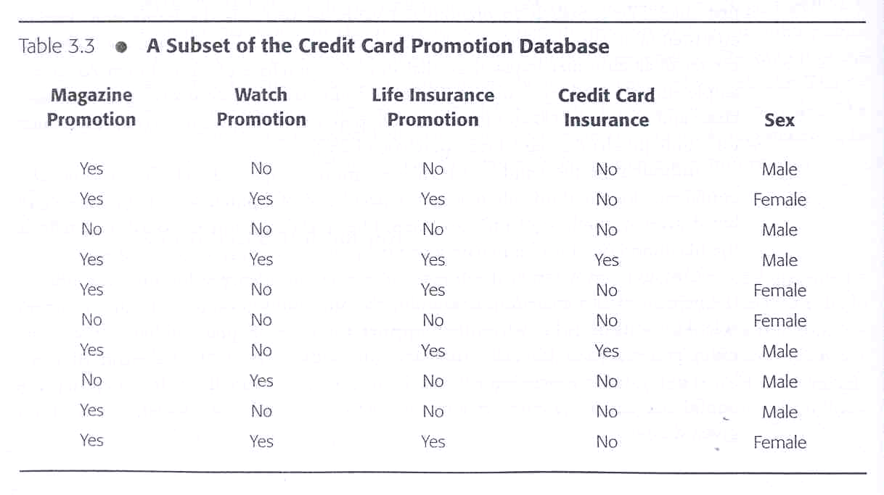
Generating Association Rules
Mining Association Rules: An Example

Slide 16
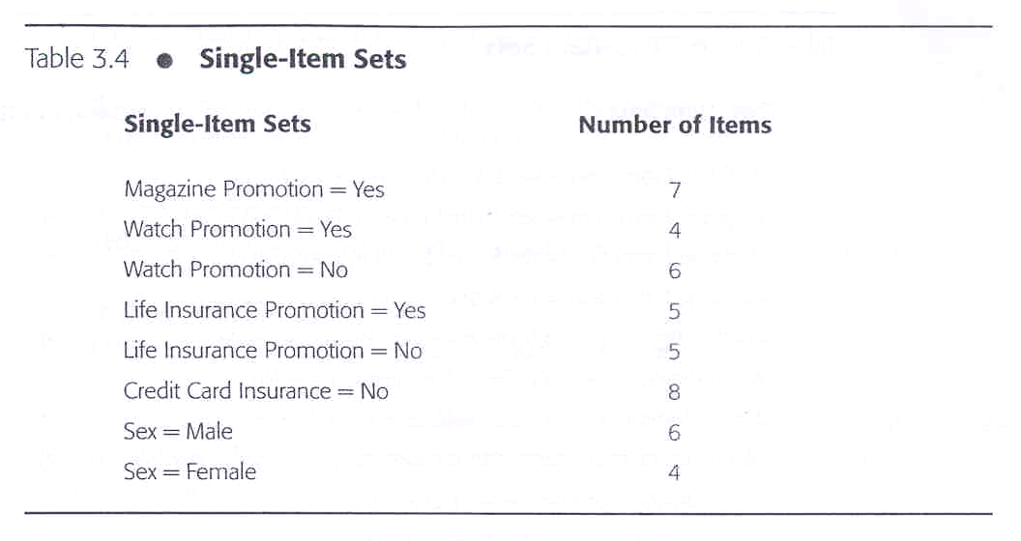
Generating Association Rules
Mining Association Rules: An Example

Slide 17
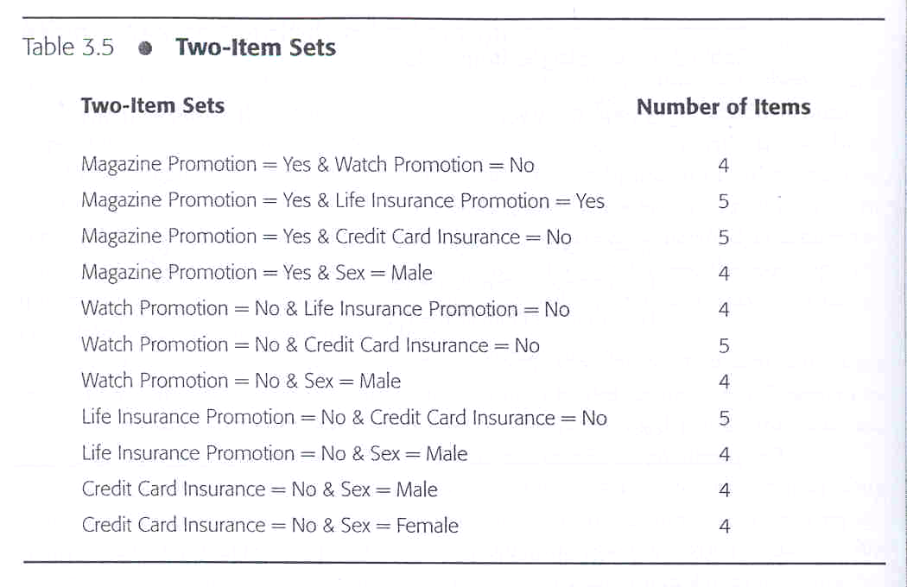
Generating Association Rules
Mining Association Rules: An Example

Slide 18
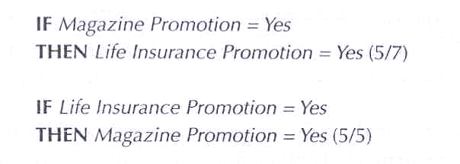
Generating Association Rules
Mining Association Rules: An Example
Two possible two-item set rule are:

Slide 19
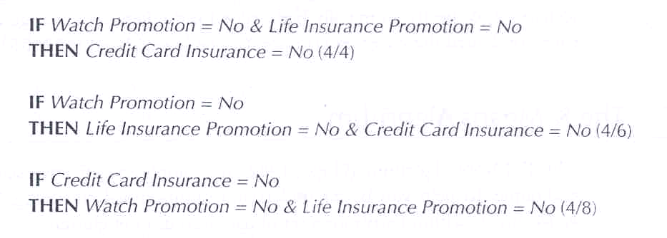
Generating Association Rules
Mining Association Rules: An Example
Here are three of several possible three-item set rules:

Slide 20
Reference
Data Mining: Concepts and Techniques (Chapter 6 Slide for textbook), Jiawei Han and Micheline Kamber, Intelligent Database Systems Research Lab, School of Computing Science, Simon Fraser University, Canada

