Slide 1
Gossip Protocol
in P2P Systems
"Imagine 20 machines that need to
agree on the order of events…
with no central server."
This is the challenge of distributed gossip protocols.
Epidemic Dissemination with Total Order
& Dynamic Sequencer Election
Epidemic Gossip
Adaptive Edges
probabilistic delivery
EMA + congestion blending
Total Order
Dynamic Core
Sequencer-based per channel
Auto join/leave group
Distributed Systems • Spring 2026
Oussama Laaroussi | Mounia Baddou
Elghali Benjelloun | Kawtar Labzae
Supervised by
Prof Robert Basmadjian | Prof Chaimae Jallouli
Leader Election
Crash Recovery
Quorum-based deterministic
SQLite + history catch-up

Slide 2
The Problem
Centralized (fragile)
Gossip Protocol (resilient)
N2
N5
N6
N1
N3
Server
N4
N1
N5
N4
N6
N3
N2
N8
N7
Single Point of Failure
Decentralized – No Point of Failure
If the server crashes, everyone is disconnected.
Each node talks to a few neighbors
→ message spreads like an epidemic.

Slide 3
Roadmap: Two Phases of Building
PHASE I — Core Protocol
PHASE II — Total Order & Enhancements
1
System Model & Assumptions
1
Lamport Clocks & Causal Ordering
2
Node Identity & Overlay Topology
2
Channel Sequencer & Total Order
3
Peer Discovery & Network Join
➡
3
Ordered Delivery Buffer
4
Heartbeat Failure Detection
4
Dynamic Core Node Group
5
Epidemic Gossip Dissemination
5
Sequencer Election Protocol
6
Adaptive Edge Reliability (EMA)
6
Crash Recovery & Monitoring

Slide 4
01
Phase I: Core Gossip Protocol
"How do nodes find each other, stay connected, and spread information?"

Slide 5
System Model & Assumptions
FOUNDATIONS
Partial Synchrony Network
Crash-Recovery Failures
Partial Connectivity
Not all pairs are connected
Overlay built via discovery
Seed nodes are bootstrap anchors
No bound on message delay
Messages may be lost or reordered
Nodes fail by halting
No adversarial or malicious behavior
Failed nodes eventually detected
Theoretical Backing
Epidemic Theory (Demers et al. 1987): Push gossip with fanout f reaches all n nodes (in O(log n))
Lamport Clocks (Lamport, 1978): Causal ordering without synchronized clocks
Failure Detectors (Chandra & Toueg, 1996): Eventually perfect means no false positives eventually

Slide 6
Node Identity & Overlay Topology
PHASE I
Each node has
Identity
Lamport Clock
Message Factory
Neighbor Table
Deduplication
Node
Identity Generation
127.0.0.1:7001
→
SHA-1
→
a3f2...8b1c

Slide 7
Node Identity & Overlay Topology
PHASE I
Node
Identity Generation
127.0.0.1:7001
→
SHA-1
→
a3f2...8b1c
Alive
Suspect
Dead
Each node has
Identity
Lamport Clock
Message Factory
Neighbor Table
Deduplication

Slide 8
Node Identity & Overlay Topology
PHASE I
Identity Generation
127.0.0.1:7001
→
SHA-1
→
a3f2...8b1c

Slide 9
Node Identity & Overlay Topology
PHASE I
Regular
Seed
Higher neighbor limit
Bootstrap anchor for new nodes
More permissive unaccepting connections
Criteria: address in discovery.seed_nodes
Participates in gossip dissemination
Maintains heartbeats
Forwards messages probabilistically
Criteria: 4>= Neighbor Count >= 2

Slide 10
Node Identity & Overlay Topology
PHASE I
Regular
Seed
Higher neighbor limit
Bootstrap anchor for new nodes
More permissive unaccepting connections
Criteria: address in discovery.seed_nodes
Participates in gossip dissemination
Maintains heartbeats
Forwards messages probabilistically
Criteria: 6>= Neighbor Count >= 2
Node

Slide 11
Node Identity & Overlay Topology
PHASE I
Seed
Higher neighbor limit
Bootstrap anchor for new nodes
More permissive unaccepting connections
Criteria: address in discovery.seed_nodes

Slide 12
Overlay Topology Properties
PHASE I
How Nodes Join this Overlay ?

Slide 13
Node Identity & Overlay Topology
PHASE I
Local Peer Cache

Slide 14
Node Identity & Overlay Topology
PHASE I
Local Peer Cache

Slide 15

Node Identity & Overlay Topology
PHASE I
Local Peer Cache

Slide 16


Node Identity & Overlay Topology
PHASE I
Local Peer Cache

Slide 17
Node Identity & Overlay Topology
PHASE I
Local Peer Cache
Seed Nodes

Slide 18
Node Identity & Overlay Topology
PHASE I
Seed Nodes

Slide 19
Node Identity & Overlay Topology
PHASE I
Peer Exchange

Slide 20
Node Identity & Overlay Topology
PHASE I
Peer Exchange

Slide 21
Epidemic Gossip Dissemination
PHASE I
Message Spreading Like an Epidemic (3 rounds)
Round 1: Origin
Round 2: Neighbors
Round 3: Full coverage
B
B
B
A
➡
A
➡
A
E
C
E
C
E
C
D
D
D
Convergence Theorem (Demers et al., 1987)
• P(all infected) = 1 − n·exp(−f^r / n)
• With fanout=6, nodes=30, rounds=3: P > 99.99% (P of everyone seeing the message at least once)
• Receipt threshold of 3 bounds overhead to O(n·f)
• Assumption: overlay connected (fmin + seeds)

Slide 22
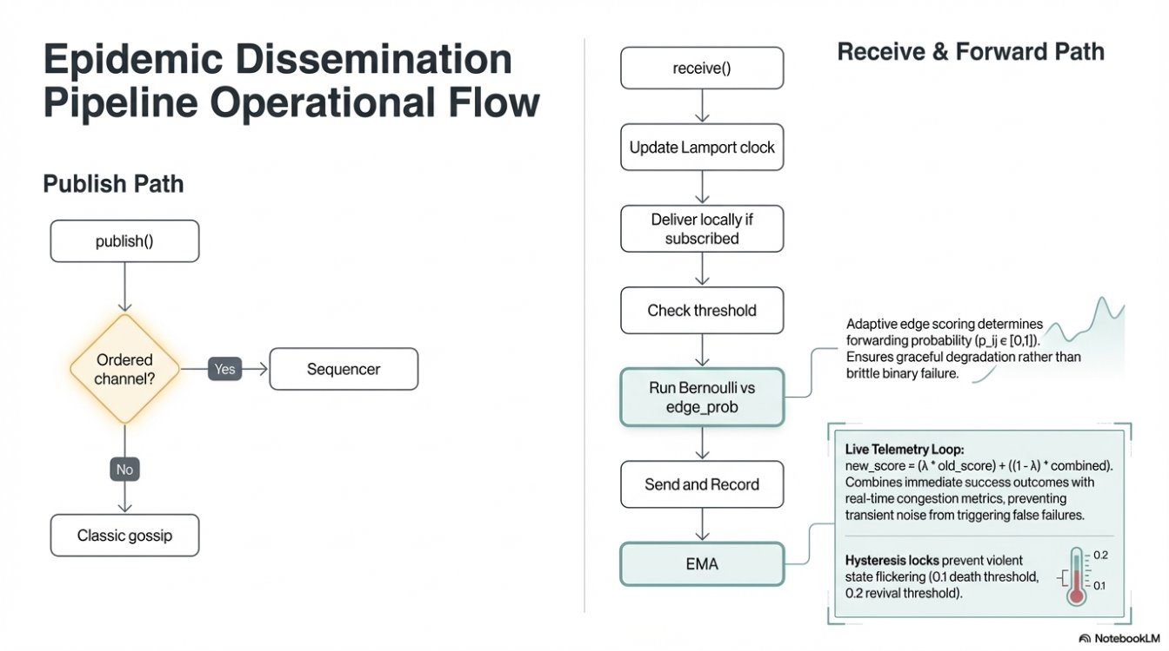
Epidemic Gossip Dissemination
PHASE I

Slide 23
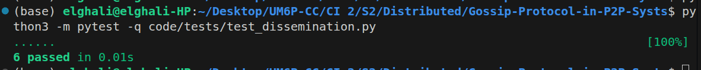
Epidemic Gossip Dissemination (Test)
PHASE I
Publish path works end-to-end: local subscriber receives once, and message is forwarded to neighbors.
Deduplication works: if the same message comes back (echo), it is not delivered twice.
Receipt threshold prevents over-forwarding: after threshold is reached, re-forwarding stops.
Probability gating is enforced: edge with p=1.0 forwards, edge with p=0.0 is blocked.
EMA reinforcement updates reliability: successful send increases edge probability (example: 0.3 -> 0.44 with lambda=0.8).
Channel filtering is correct: unsubscribed node does not deliver payload locally.

Slide 24
Heartbeat Failure Detection
PHASE I
Alive
Suspect
Dead
3 * 𝛅t
6 * 𝛅t
Recovery via heartbeat

Slide 25
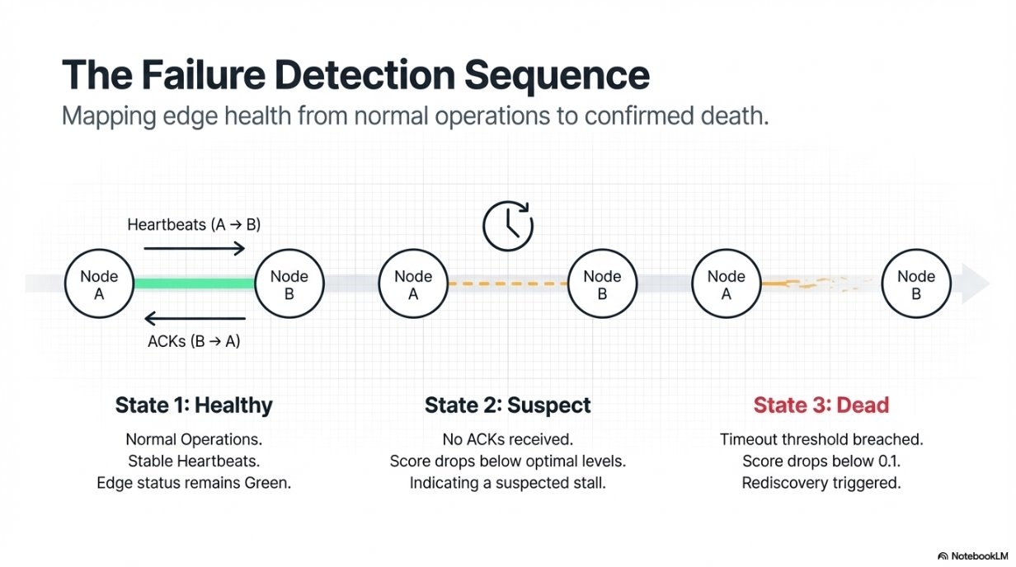
Heartbeat Failure Detection
PHASE I

Slide 26
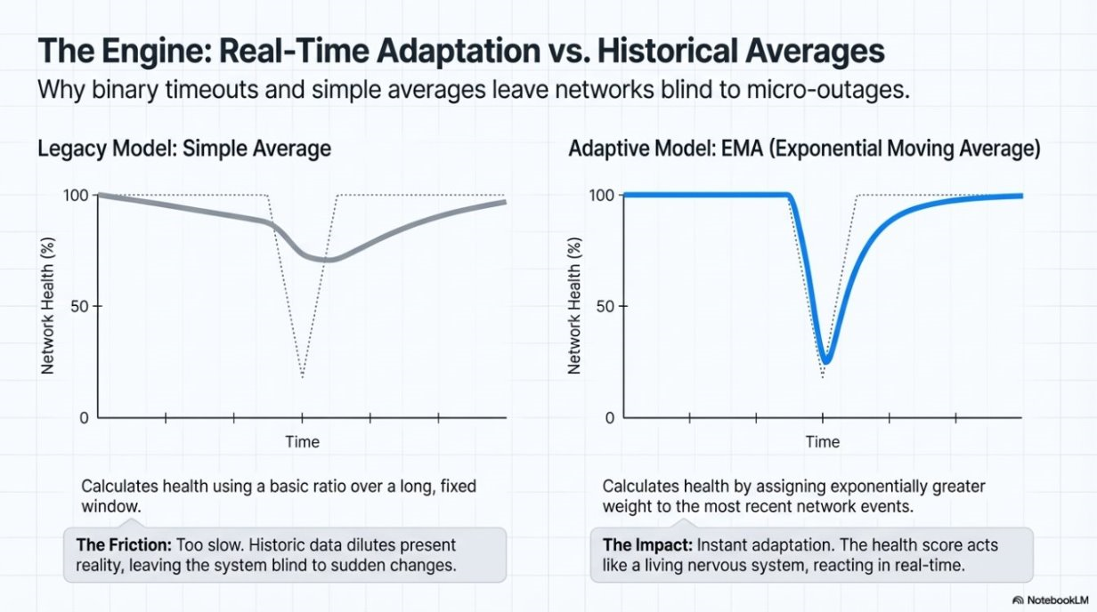
Adaptive Edge Reliability (EMA)
PHASE I

Slide 27
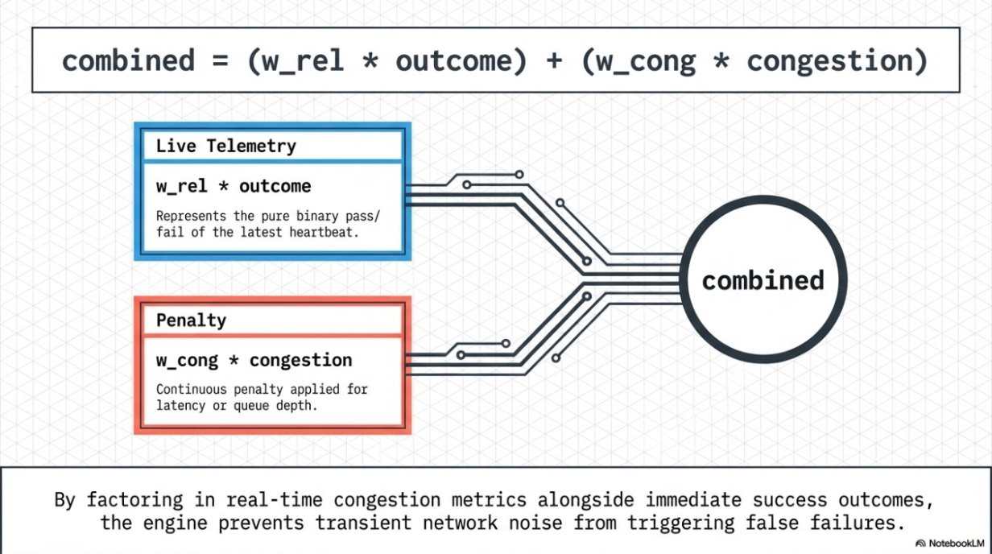
Adaptive Edge Reliability (EMA)
PHASE I

Slide 28
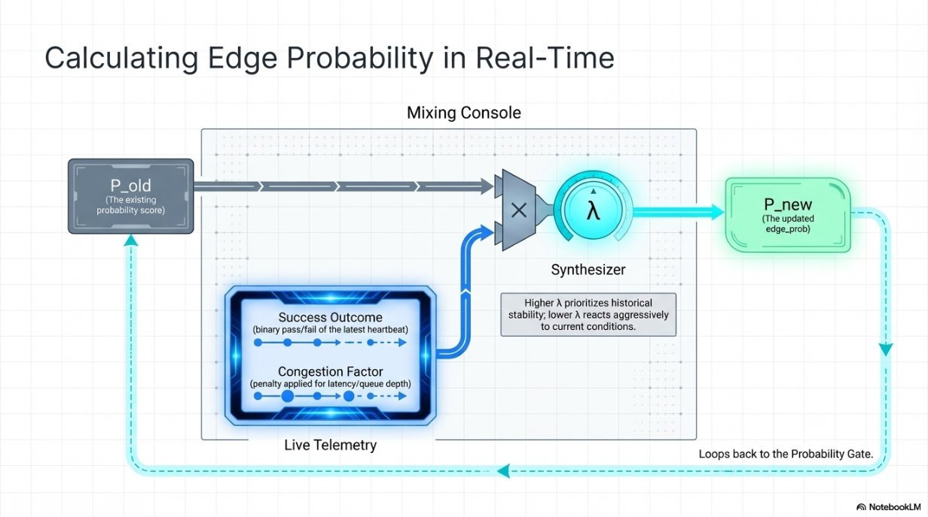
Adaptive Edge Reliability (EMA)
PHASE I

Slide 29
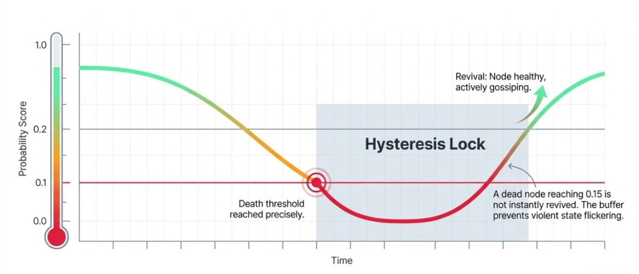
Adaptive Edge Reliability (EMA)
PHASE I

Slide 30
02
Phase II: Total Order & Enhancements
"How do we guarantee every node sees messages in the same order?"

Slide 31
Lamport Clocks
PHASE I
31, B
30, A
31, C

Slide 32

Lamport Clocks
PHASE I
31, B
30, A
31, C

Slide 33
Lamport Clocks
PHASE I
31, B
30, A
31, C

Slide 34
Lamport Clocks
PHASE I
31, B
30, A
31, C

Slide 35

Lamport Clocks
PHASE I
31, B
30, E
late
30, A
31, C
This will cause a problem!

Slide 36
Lamport Clocks
PHASE I
31, B
30, E
late
30, A
31, C
This will cause a problem!

Slide 37
Our System
PHASE II
Full + Absolute source of truth
Sequencer
Are up to date with the new messages
Cores
Need to catch up
Nodes

Slide 38
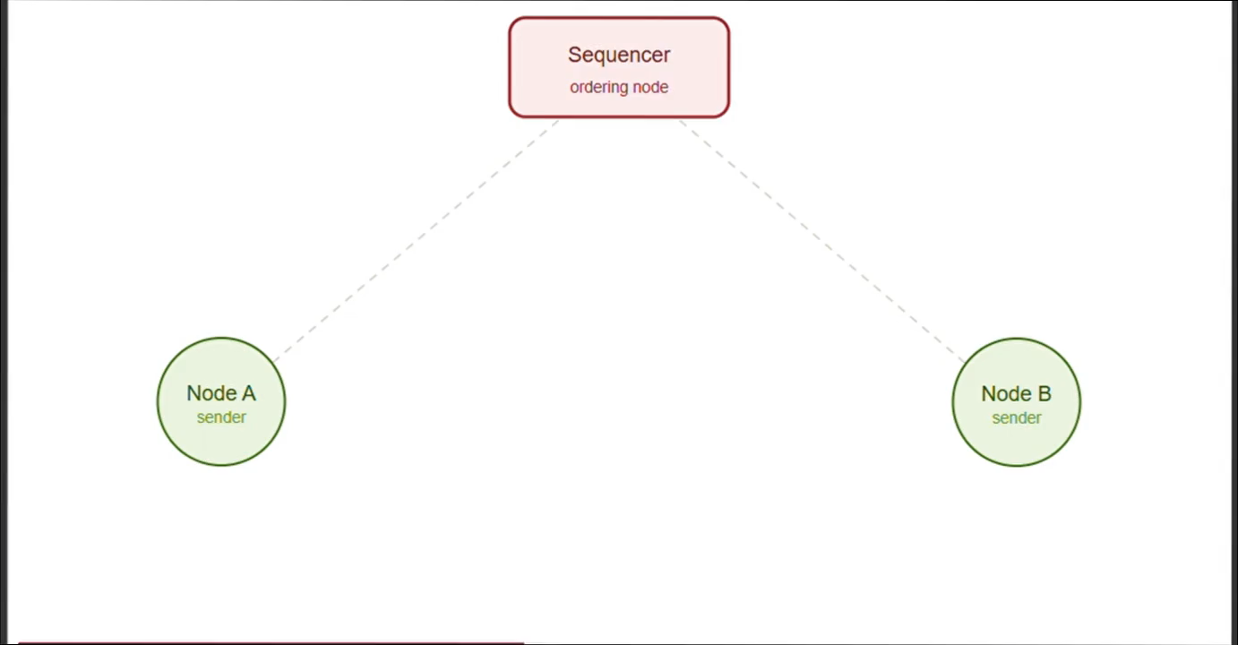
How it works
PHASE II

Slide 39
Core Joining and Leaving
PHASE I
Hello dear sequencer, can I become a core node , I am confident I have what is needed.
Hello node , no your sequence number is too low to be a core node.
I will try next time
Curr seq: 44
Node 1
Curr seq:32
Node 1
YaY I am a core node now
What about now :)))
Good job !
Curr seq:54
Node 1
Curr seq: 54
Node 1

Slide 40
Hello dear sequencer, can I become a core node , I am confident I have what is needed.
Core Joining and Leaving
PHASE II
Hello node , no your sequence number is too low to be a core node.
I will try next time
Curr seq:32
Node 1
Curr seq: 44
YaY I am a core node now
What about now :)))
Good job !
Curr seq:54
Node 1
Curr seq: 54
Node 1

Slide 41
Hello dear sequencer, can I become a core node , I am confident I have what is needed.
Core Joining and Leaving
PHASE I
Hello node , no your sequence number is too low to be a core node.
Good job! Yes you can join the core group now
What about now :)))
Curr seq:54
Curr seq: 44
Node 1
Curr seq: 54
YaY I am a core node now
Node 1

Slide 42
Hello dear sequencer, can I become a core node , I am confident I have what is needed.
Core Joining and Leaving
PHASE I
Hello node , no your sequence number is too low to be a core node.
What about now :)))
I will try next time
Good job! Yes you can join the core group now
Curr seq:54
Node 1
Curr seq:32
Node 1
Curr seq: 44
Curr seq: 54
YaY I am a core node now
Node 1

Slide 43
Core Joining and Leaving
PHASE I
Let's wait and see if I get the messages that I missed
Oh! I am leaving.
Message with seq 70
Node 1
Curr seq 56
Node 1
Curr seq 56

Slide 44
Ordered Delivery Buffer & Gap Recovery
PHASE II
Buffer State: Gap Detection & Recovery
seq=1
seq=3
seq=4
seq=5
seq=6
seq=7
seq=2
seq=2
GAP
GAP
delivered
delivered
delivered
buffered
buffered
delivered
↑ next_expected=4
↓ After 5s timeout: HISTORY_REQUEST(4, 5)
After recovery:
← filled by history
seq=1
seq=2
seq=3
seq=4
seq=5
seq=6
seq=7

Slide 45
Crash Recovery & Persistence
PHASE II
Recovery Flow: Node Restarts After Crash
✖ Crash
➡
Restart
➡
Load State
➡
Rejoin
➡
History
Node halts
Process starts
SQLite read
Discovery
HISTORY_REQUEST

Slide 46
Sequencer Election Protocol
PHASE II
Sequencer node
SEQ_HEARTBEAT
Core nodes
Regular nodes

Slide 47
Sequencer Election Protocol
PHASE II
Sequencer node offline
ELECTION_REQ
View number: 2
ELECTION_REQ
View number: 2
Core nodes
ELECTION_REQ
ELECTION_REQ
Old request still being forwarded with gossip !!!
View number: 1
Regular nodes

Slide 48
Sequencer Election Protocol
PHASE II
ELECTION_REQ
ELECTION_REQ
Quorum reached: N//2 + 1
Core nodes
ELECTION_REQ
ELECTION_REQ
Regular nodes

Slide 49
Sequencer Election Protocol
PHASE II
New Sequencer elected
Max(seq_numbers) + 1
New View number = 3
Winner: min(sorted(candidates))
Core nodes
Regular nodes

Slide 50
Sequencer Election Protocol
PHASE II
New Sequencer elected
Max(seq_numbers) + 1
New View number = 3
Core nodes
NEW_SEQUENCER​ : addr
NEW_SEQUENCER​ : addr
Regular nodes
NEW_SEQUENCER​ : addr

Slide 51
Sequencer Election Protocol
PHASE II
New Sequencer elected
Max(seq_numbers) + 1
New View number = 3
Find_seq:
Please who is the current sequencer in this channel
Core nodes
Regular nodes

Slide 52
Sequencer Election Protocol
PHASE II
Election Timeline: Sequencer Crash → New Leader
SEQ alive
SEQ crashes
1.5s timeout
ELECTION_REQ
Quorum!
NEW_SEQ
heartbeat
✖
SUSPECT
voting
n/2+1 votes
announced
Election Algorithm
Formal Properties
Theorems
• 1. Core suspects → ELECTION_REQ
• 2. Cores vote + cascade
• 3. Quorum: ⌊n/2⌋ + 1
• 4. Winner: min(sorted(candidates))
• Agreement: same winner at all cores
• Validity: only live cores eligible
• Termination: 3s timeout bound
• Continuity: next_seq = max+1
• Deterministic: sorted() identical at all
• No seq_num reuse across transitions
• Assumption: majority of cores survive
• Quorum ensures single winner

Slide 53
Message Type Catalog
PHASE II
Gossip
Heartbeat
Discovery
GOSSIP
App payload (pub/sub)
HEARTBEAT
Liveness probe
PEER_LIST_REQ
Give me your peers
SEQUENCE_ASSIGN
Sequencer assigns order
HEARTBEAT_ACK
Acknowledgment
PEER_LIST_RESP
Here are my peers
History
Core Nodes
Election
HISTORY_REQ
Fill my gaps
CORE_JOIN_REQ
Request membership
SEQ_HEARTBEAT
Sequencer alive
HISTORY_RESP
Batch of messages
CORE_JOIN_OK
Approved + broadcast
ELECTION_REQ
Vote request
CORE_LEAVE
Depart (gap found)
NEW_SEQUENCER
Election result
FIND_SEQ_*
Runtime discovery

Slide 54
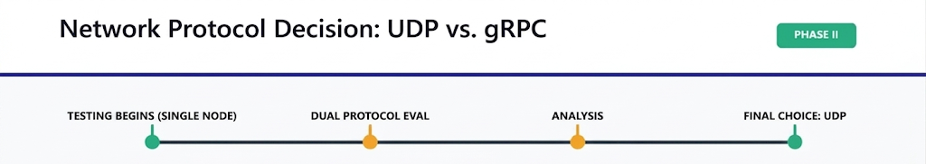
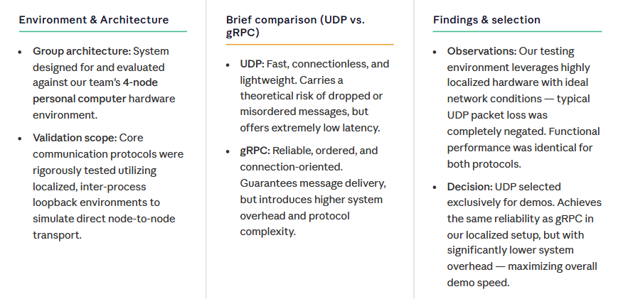

Slide 55
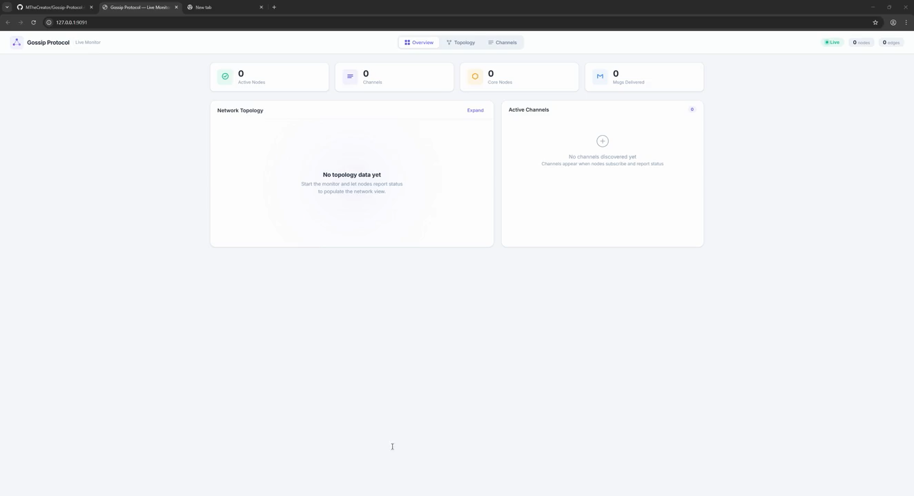
Demo: 20-Node Multi-Channel Scenario
DEMO

Slide 56
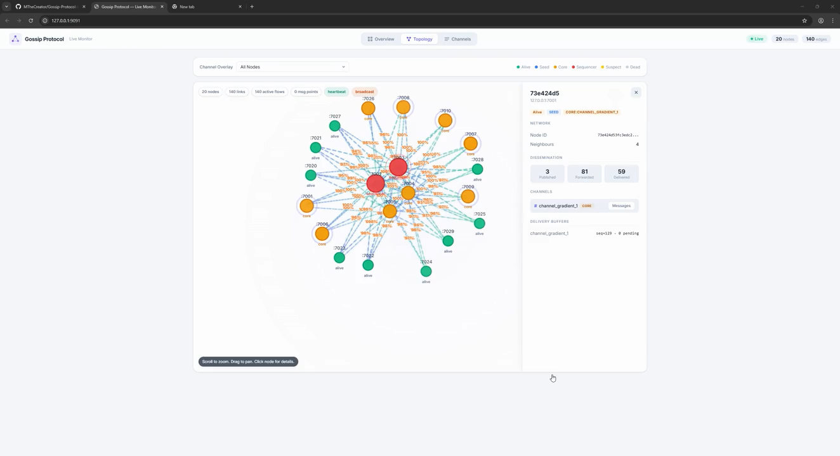
Demo: Robust Connectivity
DEMO

Slide 57
Summary of Guarantees & Theorems
SUMMARY
Deduplication
Per msg_id seen set + forward count ≤ 3
Total Order
Sequencer seq_num + OrderedDeliveryBuffer
Eventual Delivery
Epidemic O(log n) convergence + history
Failure Detection
◇P eventually perfect (δt-based heartbeat)
Election Agreement
Deterministic sort on identical core set
Election Termination
Quorum ⌊n/2⌋+1 with timeout
Seq Continuity
next_seq = max(last_known) + 1
Crash Recovery
SQLite WAL + history catch-up from core

Slide 58
"From chaos to order..."
We started with unreliable nodes and ended with total-order delivery, fault tolerance, and self-healing.
Phase I
Phase II
Result
We built the foundation
We added order & resilience
A production-grade protocol
• Epidemic gossip O(log n)
• Heartbeat ◇P detection
• EMA edge reliability
• Self-healing discovery
• Sequencer total order
• Delivery buffer (no gaps)
• Dynamic core nodes
• Quorum-based election
• 20 nodes, 3 channels
• Survives sequencer crashes
• History recovery for late join
• Real-time dashboard
Key Insight: Epidemic gossip + single sequencer per channel achieves total order + dynamic core nodes ensure availability.
decentralized delivery.

Slide 59
References
REFERENCES
Demers, A. et al. (1987)
"Epidemic Algorithms for Replicated Database Maintenance." ACM PODC.
Lamport, L. (1978)
"Time, Clocks, and the Ordering of Events in a Distributed System." CACM.
Chandra, T. & Toueg, S. (1996)
"Unreliable Failure Detectors for Reliable Distributed Systems." JACM.
Brakmo, L. & Peterson, L. (1995)
"TCP Vegas: End-to-End Congestion Avoidance." IEEE JSAC.
Birman, K. et al. (1999)
"Bimodal Multicast." ACM TOCS.
Kermarrec, A.-M. et al. (2003)
"Probabilistic Reliable Dissemination in Large-Scale Systems." IEEE TPDS.
Eugster, P. et al. (2004)
"Epidemic Information Dissemination in Distributed Systems." IEEE Computer.
Jelasity, M. et al. (2007)
"Gossip-based Peer Sampling." ACM TOCS.

Slide 60
Thank You
Questions & Discussion

