Slide 1
CALIBO AI ACADEMY • PATH 2 • KLU BATCH
FROM APPLICATION
CREDIT\nPRE-SCREENING ENGINE
TO INSIGHT
DATA
Loan Intake Optimisation with Supervised Classification
↓
MODEL
↓
A data-to-decision workflow for safer, faster loan application routing
POLICY
16-slide presentation\nBright • Professional • Evidence-led
Mini Use Case 02 | BFSI – Retail Lending

Slide 2
THE STORY IN 16 SLIDES
Presentation roadmap
01–04
Business problem & CBIM canvas
05–06
Dataset understanding & data cleaning
07–09
EDA, affordability & feature engineering
10–13
Model choice, training, evaluation & interpretation
14–16
Threshold, fairness, business takeaways & conclusion
Central question: which applications can safely leave the manual-review queue?
MUC02 | Credit Pre-Screening Engine | KLU
02

Slide 3
01 | PROBLEM FRAMING
The business problem: manual review is a capacity bottleneck
3,000
25 min
~50%
6 months
Applications / month
Per manual review
Historically declined
Historical decisions
Approximate volume
Analyst time per case
Close to half of intake
Available application history
Current-state challenge
Business opportunity
Every application enters a manual review queue. Some are declined quickly because the risk signals are already clear, while more nuanced cases still need analyst judgement.
Use historical decisions to build a pre-screening signal that prioritises analyst attention—without treating a model score as an unquestionable final decision.
Goal: improve review capacity while keeping the risk of wrongly declining a good applicant within the bank’s stated limit.
MUC02 | Credit Pre-Screening Engine | KLU
03

Slide 4
01 | PROBLEM FRAMING
CBIM Problem Canvas: define success before coding
SITUATION
COMPLICATION
~3,000 applications each month; each manual review takes ~25 minutes.
Analyst time is spent on clear-cut declines; complex applications wait for judgement.
QUESTION
SSOT
Which applications can safely leave manual review, and at what confidence threshold?
The supplied dataset. The decision field records past analyst judgement—not repayment outcome.
SUCCESS
STAKEHOLDER
Find a threshold with ≤5% historically approved among auto-declines, then quantify hours released.
Credit Policy Analyst, Head of Retail Lending, credit analysts and loan applicants.
MUC02 | Credit Pre-Screening Engine | KLU
04

Slide 5
02 | DATASET UNDERSTANDING
Understand the dataset before selecting a model
12,000
19
Apr–Sep 2026
52.9%
Applications
Columns
Date range
Approved
One row = one application
Applicant, loan & outcome fields
Six months of simulated history
47.1% declined
Applicant profile
Loan & repayment context
Outcome / target
Age • gender • city • city tier\nEmployment type • job tenure\nIncome • credit history
Loan amount • tenure • proposed EMI\nExisting EMI • active loans\nDelinquencies • loan purpose
`decision` = Approved or Declined\nUsed as the supervised target.\nNot a repayment/default label.
Data provenance: simulated MUC02 dataset supplied with the use case. Findings describe this dataset, not a real bank portfolio.
MUC02 | Credit Pre-Screening Engine | KLU
05

Slide 6
02 | DATA PREPARATION
Data quality and cleaning: retain information, document decisions
Missing monthly income
Blank credit score
Implausible income
441 rows (~3.7%) missing. Impute with median income within employment type; use overall median as fallback.
1,039 rows (~8.7%) retained. Check credit-history months and flag no-score applicants as new-to-credit (NTC).
12 values exceed ₹6,00,000/month; treat as likely annual income entered in monthly field and divide by 12.
Why not drop incomplete rows?
Blank credit scores can represent people with no formal credit history—not bad data. Removing them would erase a meaningful applicant group and could bias the model.
IDs, dates, city and gender are not model inputs; they are excluded to avoid leakage or inappropriate use.
MUC02 | Credit Pre-Screening Engine | KLU
06

Slide 7
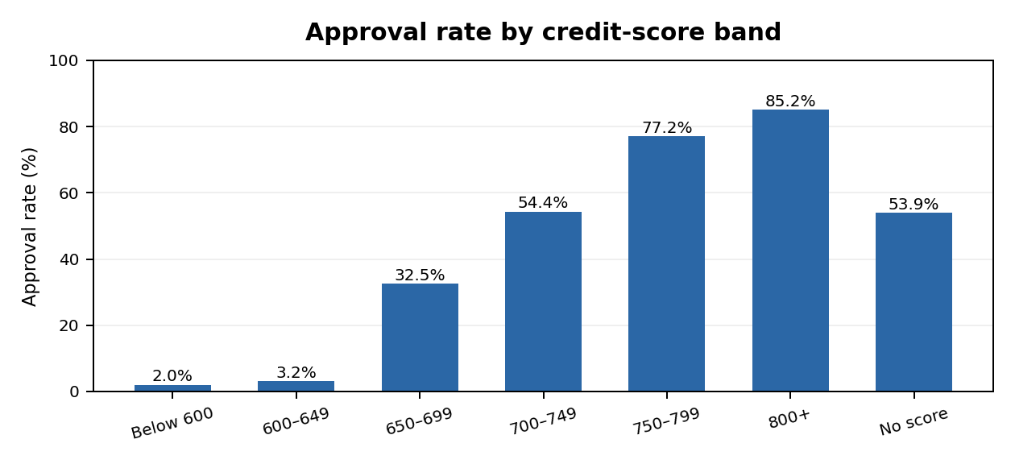
03 | EXPLORATORY ANALYSIS
EDA: credit score reveals a strong approval boundary
Below 650
Approval is only ~2.0% below 600 and ~3.2% in the 600–649 band.
650–699
Approval rises sharply to ~32.5%; this is a visible policy boundary.
No score
NTC applicants are approved ~53.9% of the time—human judgement matters.
Interpretation: historical approvals are strongly associated with credit score, but a score band alone should not decide every case.
MUC02 | Credit Pre-Screening Engine | KLU
07

Slide 8
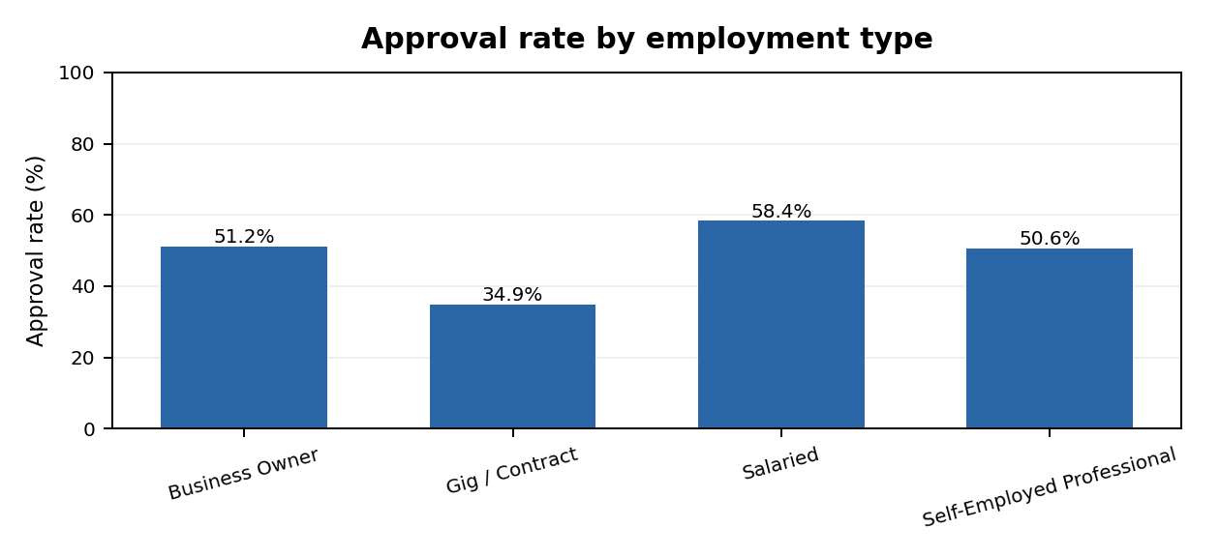
03 | EXPLORATORY ANALYSIS
EDA: employment type is associated with different outcomes
Salaried
Highest approval rate: ~58.4%.
Gig / Contract
Lowest approval rate: ~34.9%.
Policy implication
Employment type may capture income stability—but can also proxy for socioeconomic differences.
Use this as a diagnostic signal, not as proof that employment category causes approval or decline.
MUC02 | Credit Pre-Screening Engine | KLU
08

Slide 9
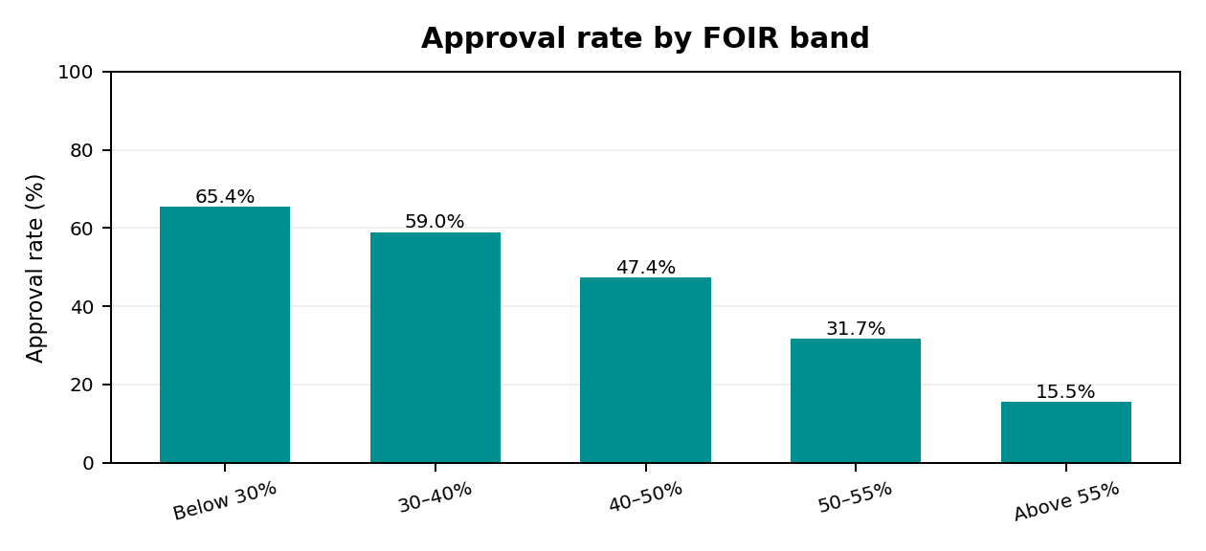
03 | AFFORDABILITY ANALYSIS
EDA & feature insight: affordability pressure rises with FOIR
Below 30% FOIR
~65.4% approval: lower EMI burden is associated with stronger outcomes.
50–55% FOIR
Approval falls to ~31.7%.
Above 55% FOIR
Only ~15.5% approved. The sharp drop occurs beyond 50%.
FOIR = (existing EMI + proposed EMI) ÷ monthly income. Historical data supports reviewing the 50–55% range as a policy guardrail.
MUC02 | Credit Pre-Screening Engine | KLU
09

Slide 10
04 | MODEL-READY FEATURES
Feature engineering: translate raw fields into lending signals
FOIR
Loan-to-income
is_ntc
(Existing EMI + Proposed EMI) ÷ Monthly income\nMeasures monthly repayment burden.
Loan amount ÷ (Monthly income × 12)\nPlaces requested borrowing in annual-income context.
1 when credit score is blank; otherwise 0.\nPreserves the distinction between no history and a low score.
Final feature set (12 inputs)
Numeric: credit_score, is_ntc, FOIR, loan_to_income, delinquencies_24m, num_active_loans, years_in_current_job, age, tenure_months, city_tier
Categorical: employment_type and loan_purpose — one-hot encoded
Excluded: application_id, application_date, city, gender and decision (target only)
MUC02 | Credit Pre-Screening Engine | KLU
10

Slide 11
05 | MACHINE-LEARNING METHOD
Why Logistic Regression? A deliberate, explainable baseline
Why classification?
Why Logistic Regression?
The output is one of two categories: Approved or Declined. We are predicting a label, not a continuous amount—so this is a supervised classification problem.
It estimates class probabilities, supports a clear decision threshold, trains efficiently, and provides coefficients that can be explained to credit-policy stakeholders.
Why this method fits the use case
Binary target and probability output align with Approved / Declined routing.
Coefficient direction helps explain which signals push predictions toward decline or approval.
Simple, reproducible baseline is suitable for a first policy discussion and later model comparison.
Trade-off: Logistic Regression assumes a linear relationship in log-odds; it may miss complex interactions. Compare alternatives before production.
MUC02 | Credit Pre-Screening Engine | KLU
11

Slide 12
05 | MODEL DEVELOPMENT
Training workflow: preprocessing and model are one pipeline
80 / 20
Impute
Transform
Fit
Evaluate
→
→
→
→
Stratified train–test split\nrandom_state = 42
Numeric median\nCategorical mode
Scale numeric values\nOne-hot encode categories
Logistic Regression\nmax_iter = 2,000
Hold-out test set\n2,400 applications
Why keep preprocessing inside the pipeline?
Deployment-ready artifact
The same imputing, scaling and encoding rules are learned on training data and applied consistently to test and future applications.
The full fitted pipeline is saved with joblib, so the API can load the exact preprocessing + classifier together.
Feature order and feature engineering must remain identical between notebook training and the Streamlit/API application.
MUC02 | Credit Pre-Screening Engine | KLU
12

Slide 13
06 | TEST-SET PERFORMANCE
Model evaluation: 79.1% accuracy is only the starting point
79.1%
79.1%
75.5%
0.867
Accuracy
Declined precision
Declined recall
ROC–AUC
Overall correct predictions
Predicted declines that were declines
Actual declines identified
Ranking separation
Confusion matrix (2,400 test applications)
Business meaning
Actually Approved
Actually Approved
Predicted Approved
1,046
Predicted Declined
225
225 applicants historically Approved were predicted Declined at the default 0.50 threshold. These false positives represent potentially good customers turned away.\n\n277 historical declines were missed and predicted Approved.
Actually Declined
Actually Declined
Predicted Approved
277
Predicted Declined
852
The model is weaker for NTC applicants: ~56.7% accuracy vs ~81.2% for applicants with a credit score.
MUC02 | Credit Pre-Screening Engine | KLU
13

Slide 14
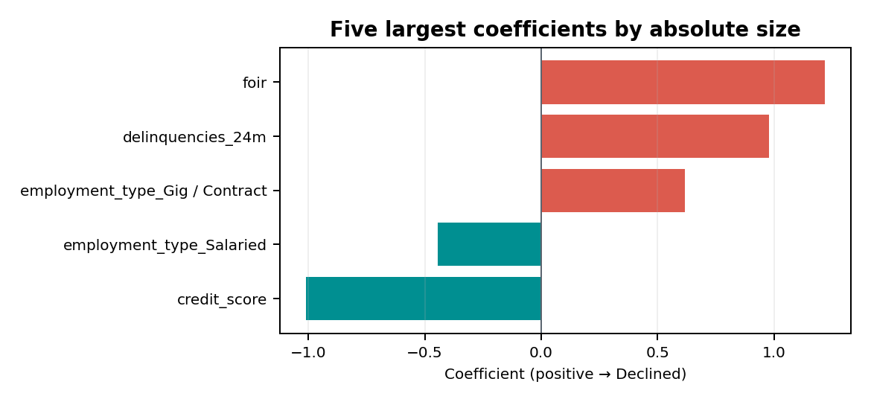
06 | MODEL INTERPRETATION
What drives the model? Read coefficients as directional signals
Higher FOIR (+1.22)
Strongest positive coefficient: higher repayment burden pushes toward Declined.
Higher credit score (−1.01)
Strong negative coefficient: stronger scores push toward Approved.
More delinquencies (+0.98)
Recent missed payments push predictions toward Declined.
Employment signals
Coefficients are on the transformed feature scale; association is not causation.
Gig / Contract (+0.62) vs Salaried (−0.44): model captures historical differences.
MUC02 | Credit Pre-Screening Engine | KLU
14

Slide 15
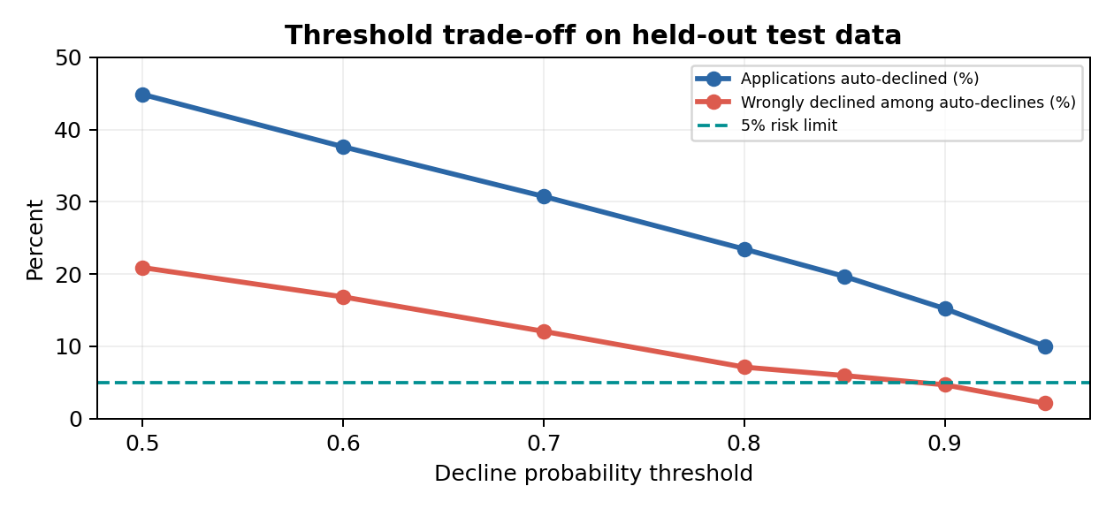
07 | BUSINESS DECISION
Threshold selection: the bank sets the risk appetite
Risk rule
No more than 5% of auto-declined cases may be historically Approved.
Selected threshold
0.90 is the lowest tested threshold meeting the limit: 4.7% wrongly declined.
Why not 0.50?
At 0.50, 20.9% of auto-declines were historically Approved—too risky.
15.2%
~456
~190 hrs
4.7%
Test applications auto-declined
Monthly applications
Potential time released
Wrongly declined
365 of 2,400
Of 3,000
25 minutes per review
Among auto-declines
MUC02 | Credit Pre-Screening Engine | KLU
15

Slide 16
08 | RECOMMENDATION
Business takeaways, fairness & conclusion
1 Start narrow
2 Protect NTC applicants
3 Monitor fairness
Use 0.90 only as a high-confidence pre-screening lane; it may route ~456 cases/month for policy-approved handling.
NTC accuracy is only ~56.7%. Keep applicants without credit scores in human review.
Gender excluded from features, but income and employment can act as proxies.
Fairness evidence from the dataset
Historical approval: Male 54.1% vs Female 50.4%. Median income: ₹55K vs ₹45K; Gig / Contract share: 11.6% vs 21.4%.
Model auto-decline rates at 0.90 are relatively close: Male 14.8% vs Female 16.2%. Excluding gender alone does not remove proxy effects.
Conclusion: Logistic Regression provides an interpretable first pre-screener—not a final credit authority. Before real deployment, validate against actual repayment/default outcomes, test on newer data, review fairness and compliance, and preserve human oversight.
Key next data needed: repayment performance / default outcomes linked to the applications.
MUC02 | Credit Pre-Screening Engine | KLU
16

