Slide 1


Group 8
Chu Manh Hai
Nguyen Thanh Long
Nguyen Manh Tien

Slide 2
Topic 1: Basic data structure simulator
Problem statement:
stack, queue, list are basic data structures that are frequently used in computer science
to student, there is a little bit difficulty to comprehend their definitions
=> need an application to display and explain some basic operations on these structures

Slide 3
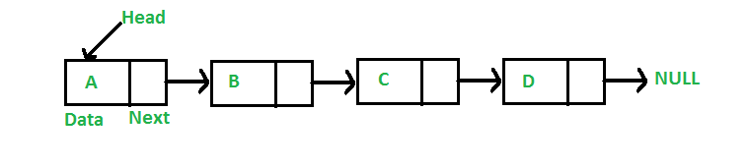
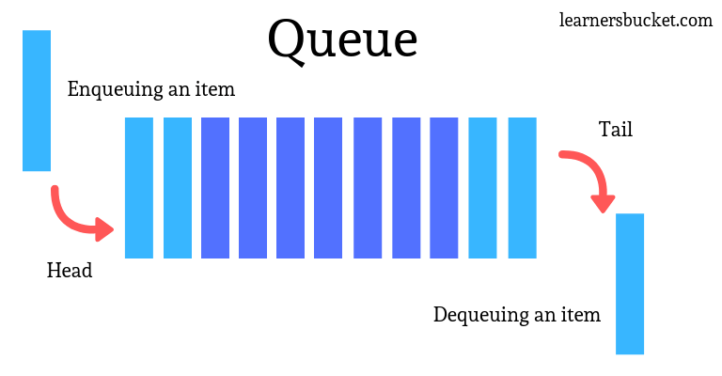
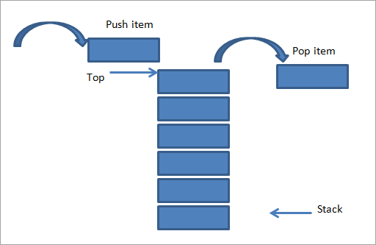
Overview about these data structures
Linked list
Queue
Stack

Slide 4
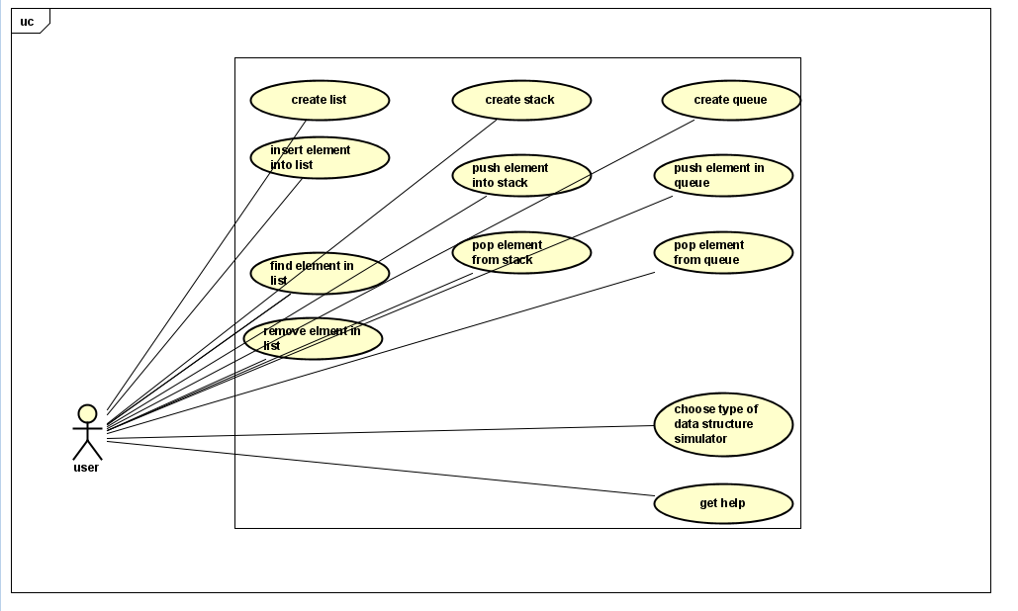
Usecase diagram

Slide 5
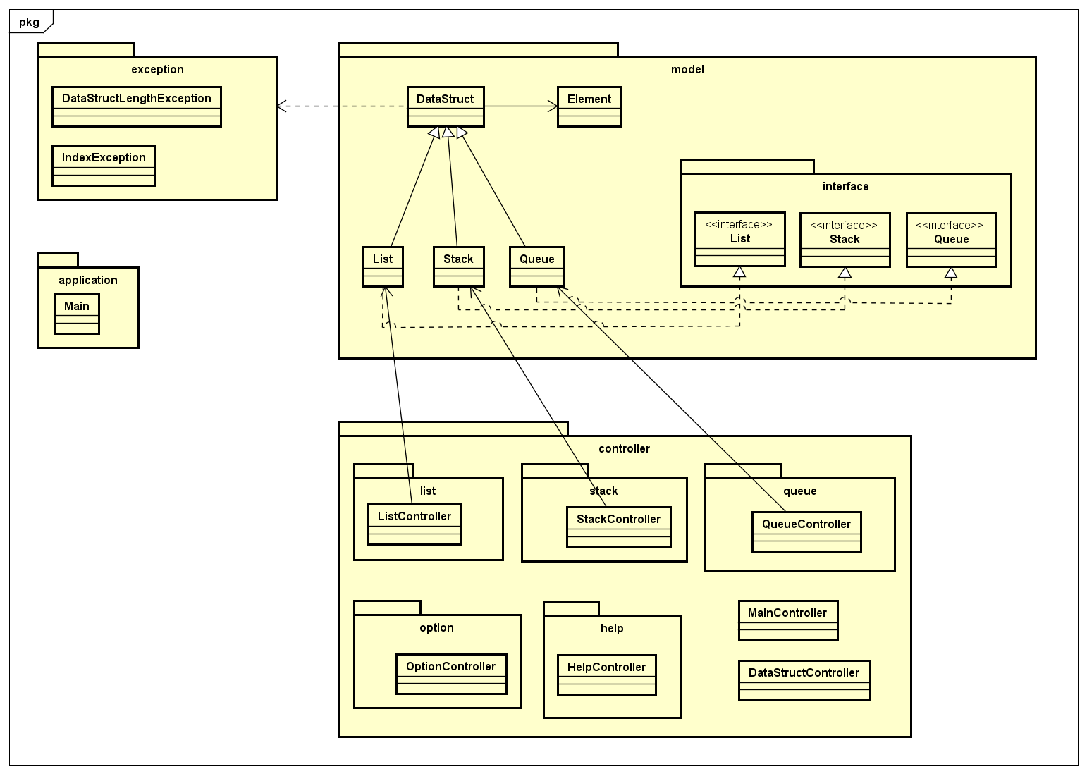
General class diagram

Slide 6
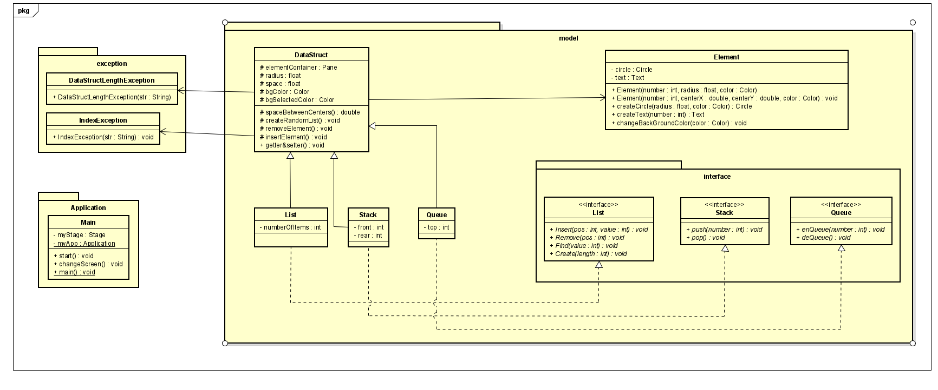
Detail class diagram

Slide 7
OOP techniques: Inheritance + Interface
List inherits from DataStruct and implements IList
Stack inherits from DataStruct and implements IStack
Queue inherits from DataStruct and implements IQueue

Slide 8
OOP techniques: Association
ListController uses List object as attribute
StackController uses Stack object as attribute
QueueController uses Queue object as attribute

Slide 9

OOP techniques: Polymorphism
In DataStructController, DataStruct object is added as an attribute
Purpose: To handle ‘create random list’ and ‘reset’ operations in Linked List, Stack, Queue screen (all three screens has ‘create random list’ and ‘reset’ operations)

Slide 10
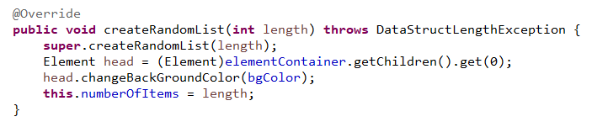
OOP techniques: Others
Encapsulation: implement Element, List, Queue, … classes with private attributes and get/set method
Override: ‘createRandomList’ method is override in all List, Stack, Queue
Overloading: Element has 2 constructors

Slide 11
Thank you for listening

