Slide 1

OUR FOCUS AREAs
Mehmet Tiras-2020

Slide 2
Our leading company wants to invest in new business areas. What should be the best way to decide?
.
As a startup company, we have a limited human and financial capital source. | 1)Which industries have the most revenue. 2) What is the role of increasing or decreasing employees by sectors? 3)Which states will be critical in terms of the company’s operational base?

Slide 3
Regression Equation shows that large workers do not support more revenue.

Slide 4
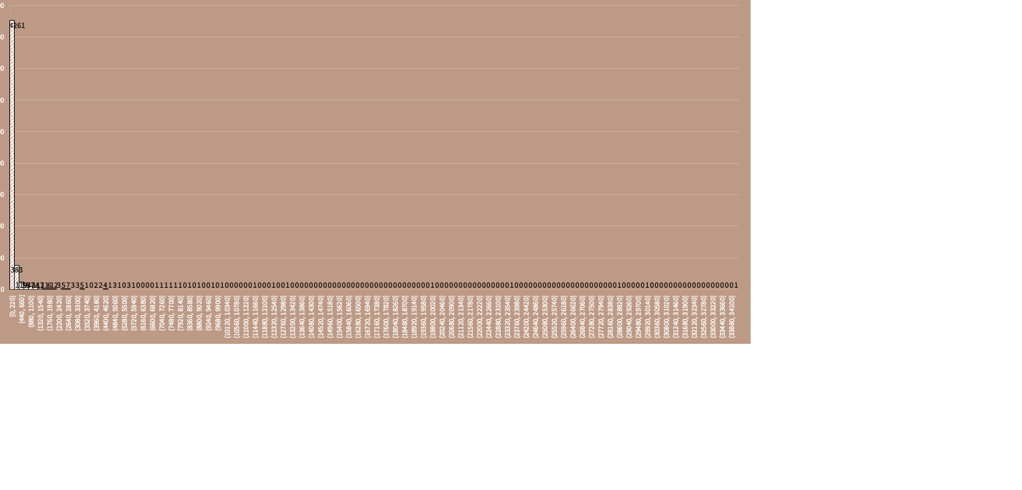
Worker numbers cluster in between 0-220 mostly.

Slide 5
While Mean ~ M$40, outliers are many on Revenue Section

Slide 6
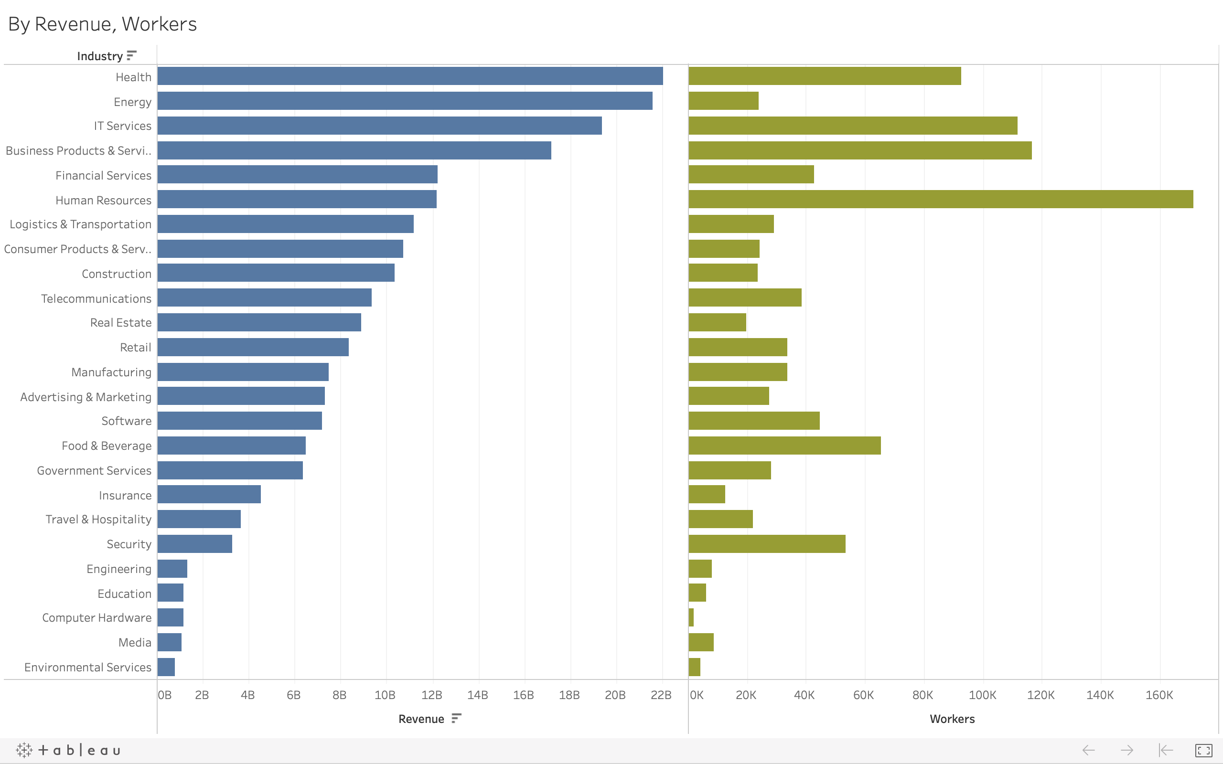
While there is no strong correlation workers&revenue, such as Energy, Finance, and Logistics sectors give more opportunities to invest with limited workers companies.

Slide 7
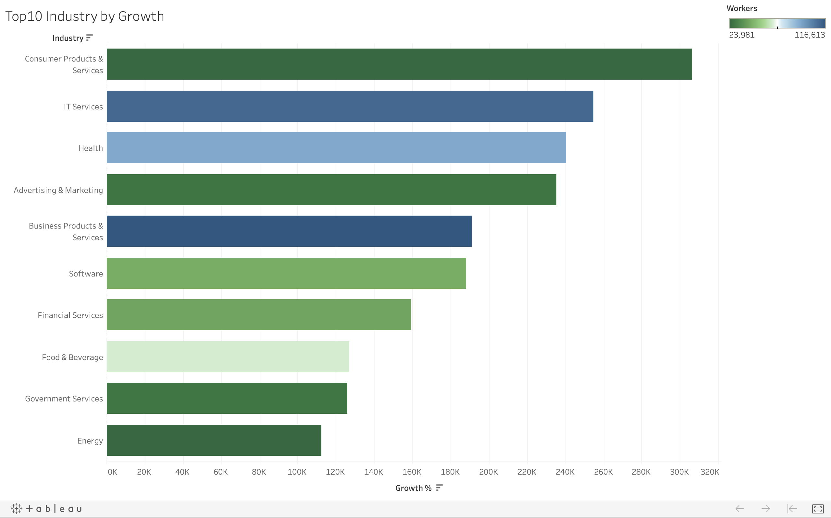
Here are Top10 industries by growth. Green one's most appropriate areas to focus on.

Slide 8
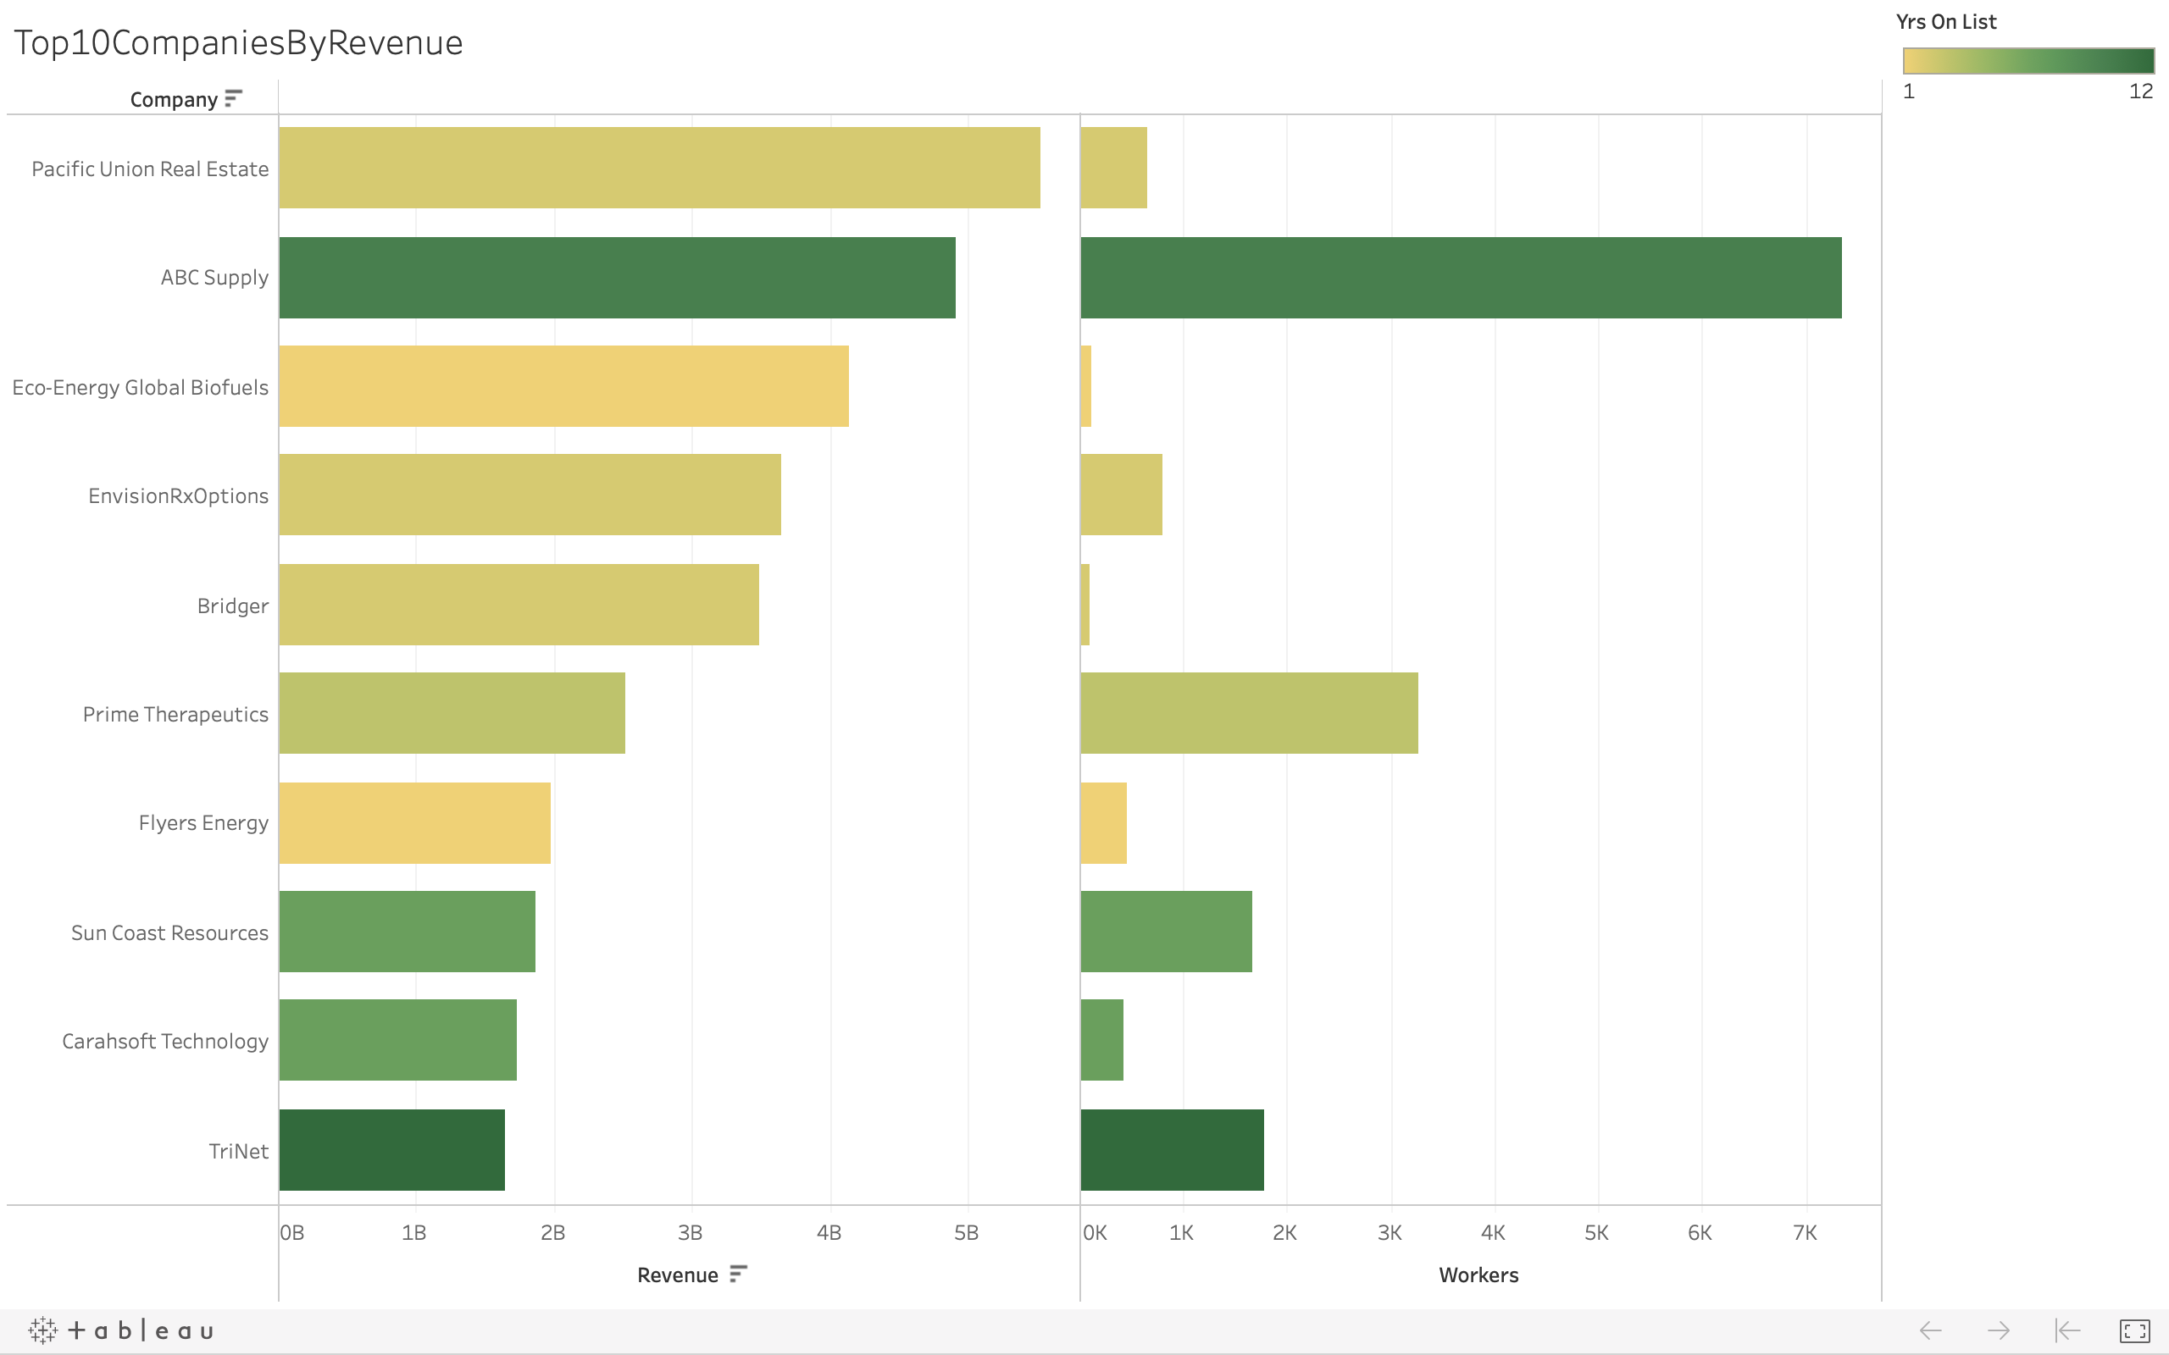
When we look at the top10 companies by revenue, some companies have a broad income range with limited workers such as Pacific Union Real Estate, which is the number one.

Slide 9
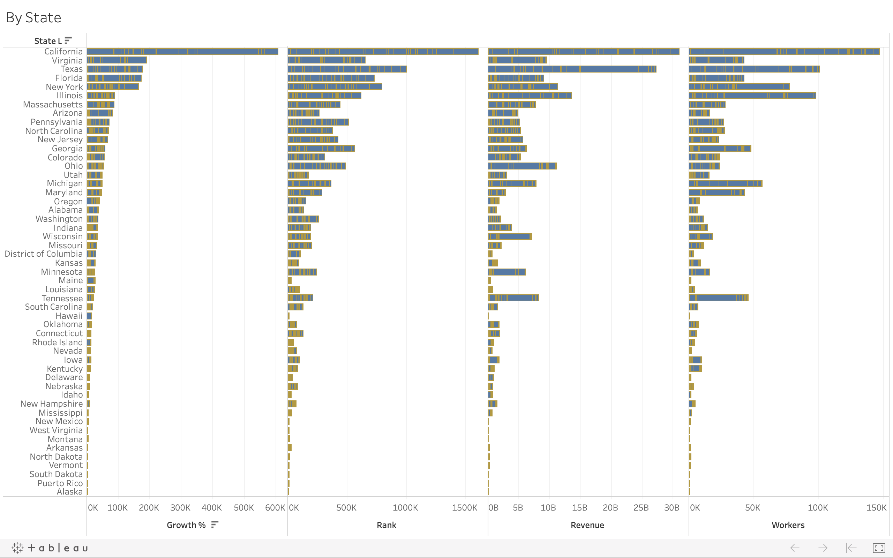
California has more opportunities in investments for startups by growth and revenue.

