Slide 1

Melbourne House Market - Executive Presentation
Mehmet Tiras – December 2020

Slide 2

Is the Melbourne real estate market big enough to invest in?
What's the best strategy to return a 2% profit for a $100 million investment for 2019 in the market?

Slide 3
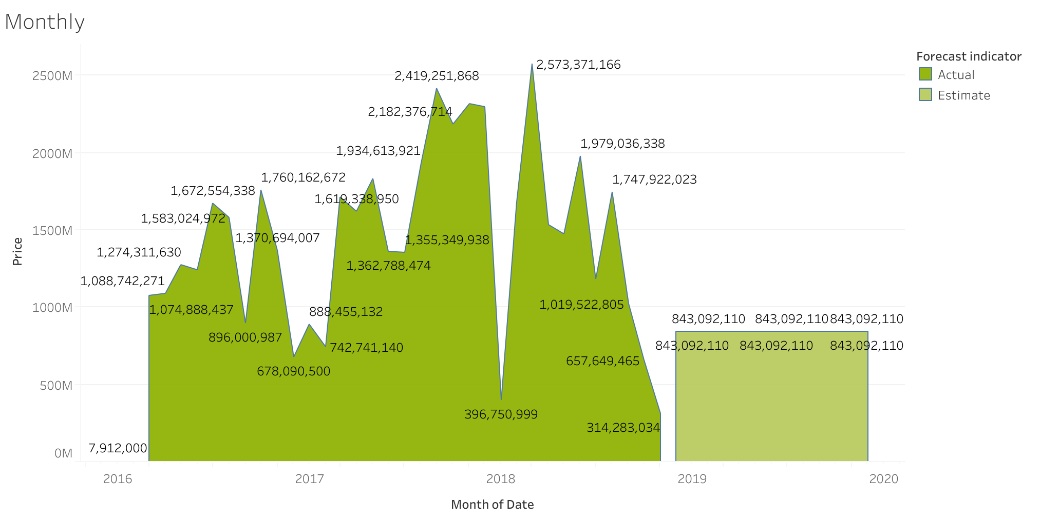
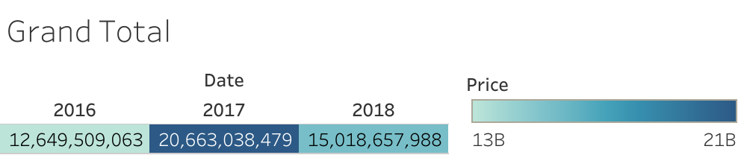
Melbourne House Market’s sales volume is over $48 billion for three years (2016,2017,2018). The market’s actual in 2018 is $15 billion. Total sales boosted in 2017, and the average sale is $16 billion for three years.
2016-17-18 Total Sales:
$48,331,205,530
2016-17-18 Average:
$16,110,401,843
2018 Actual:
$15,018,657,988
2019 Forecast:
$10,117,105,320
1. During winter months the market has lowest sales volume generally.
2. 2017 has the most significant sales volume while 2016 is the lowest.

Slide 4
Strategy to return the targeted profit
The best price range option(s)?
The high-volume capacity location(s)?
Property types of the most selling?
Type of room the most desired?
The best range for distances?
The best real estate companies to work with?

Slide 5
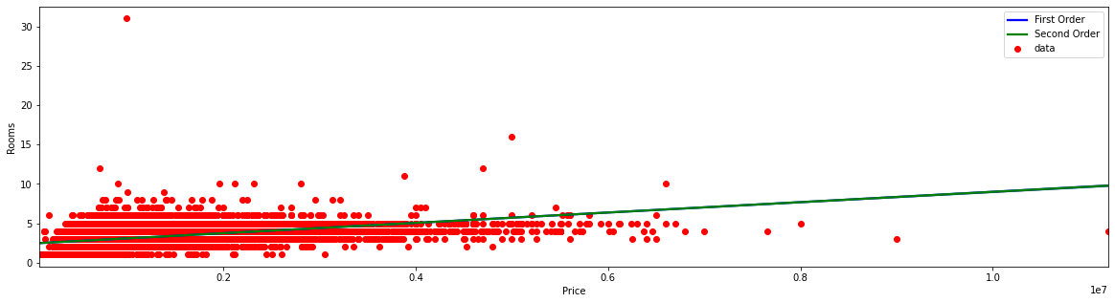
Price Range (2016-17-18) Property Sold
0-$500,000 5512
$500,000 - 1,000,000 24990
$1,000,000 - 3,000,000 16623
> $3,000,000 608
The high-volume capacity proves the market’s profitable. One of the best strategies for 2% profit is the price range.

Slide 6
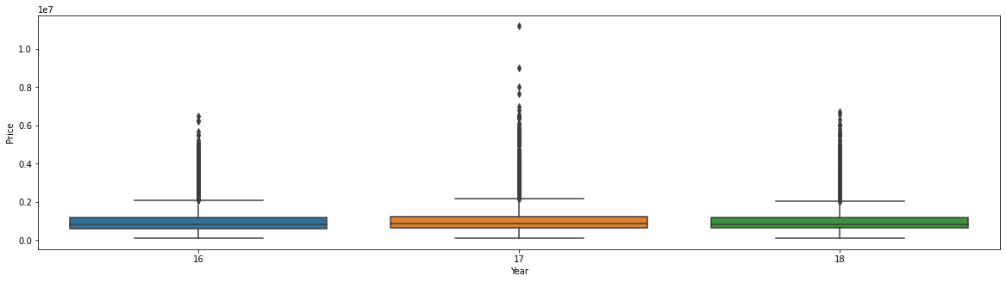
Both price frequency and box plot graphs show the price range opportunities in the Melbourne Real Estate Market. Easy-going sales can be caught in this price range to reduce the cost to the operating budget.

Slide 7
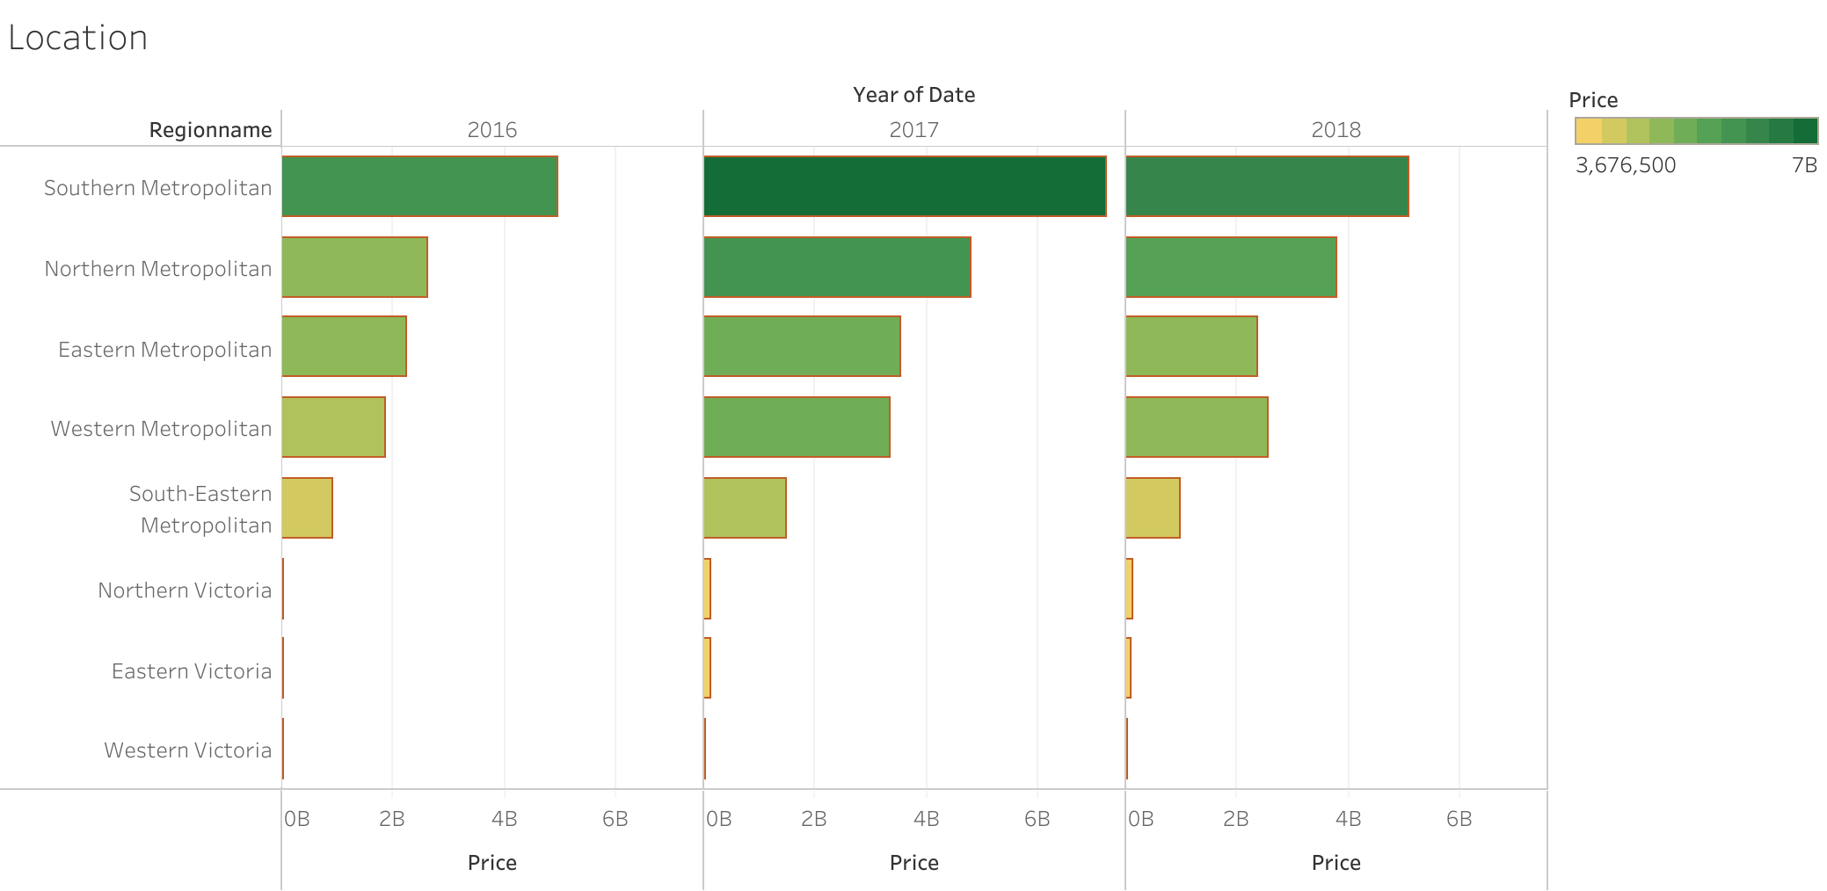
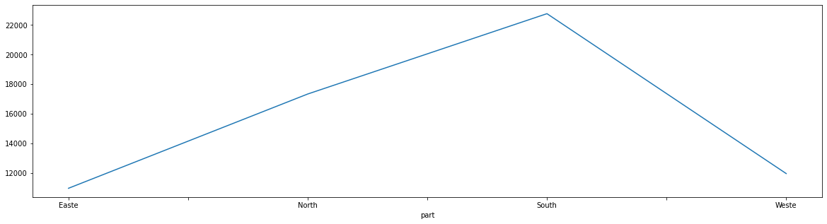
Location knowledge is crucial while looking for where is the best region for profit. Here are the best profitable locations for the market.
Zones (3 years total unit)
East 10960
North 17337
South 22771
West 11955

Slide 8
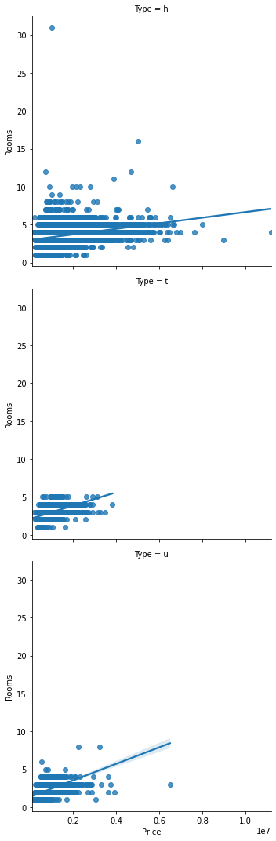
The type of properties is the key area to reach targeted returns. The chart illustrates that the best option is single house (h).

Slide 9
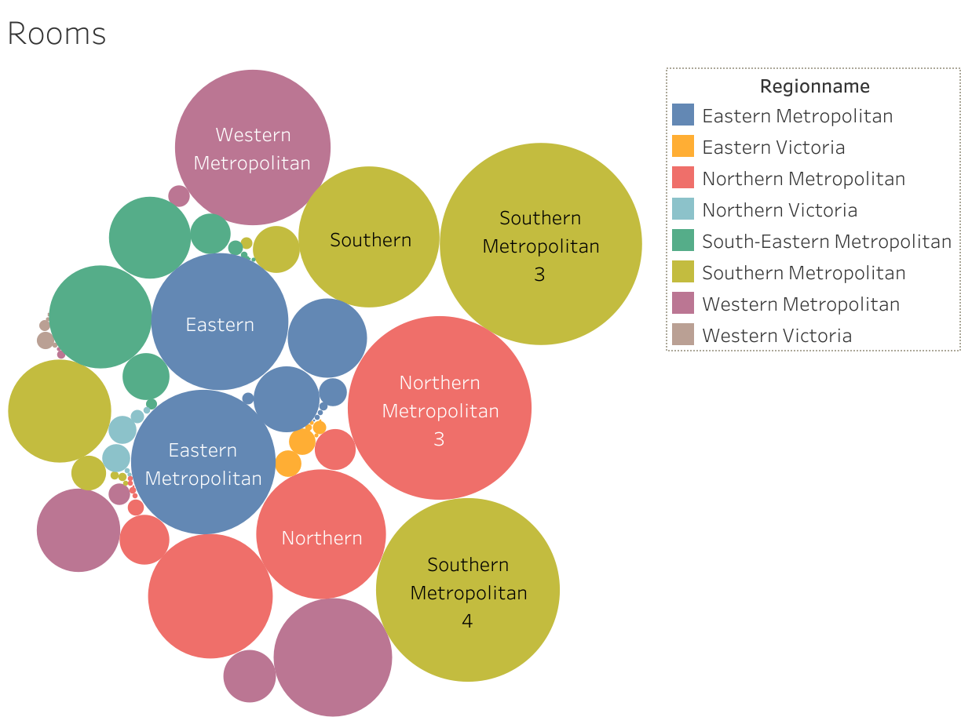
The properties that have 3 and 4 rooms are the most fast-selling units. Investment on these would accelerator affect sales volume rather than others.

Slide 10
Another strategy for targeted profit is the distance range in terms of city councils and properties. There is no strong correlation between distance and price. However, the range is not recommended for more than 20 miles.

Slide 11
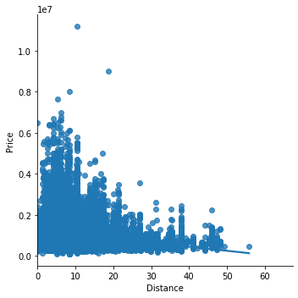
This chart proves the previous graph from a different point that the best range is between 2 to 20 miles in comparison with City Councils. More distance means hard to sell properties and an additional burden on the budget.

Slide 12
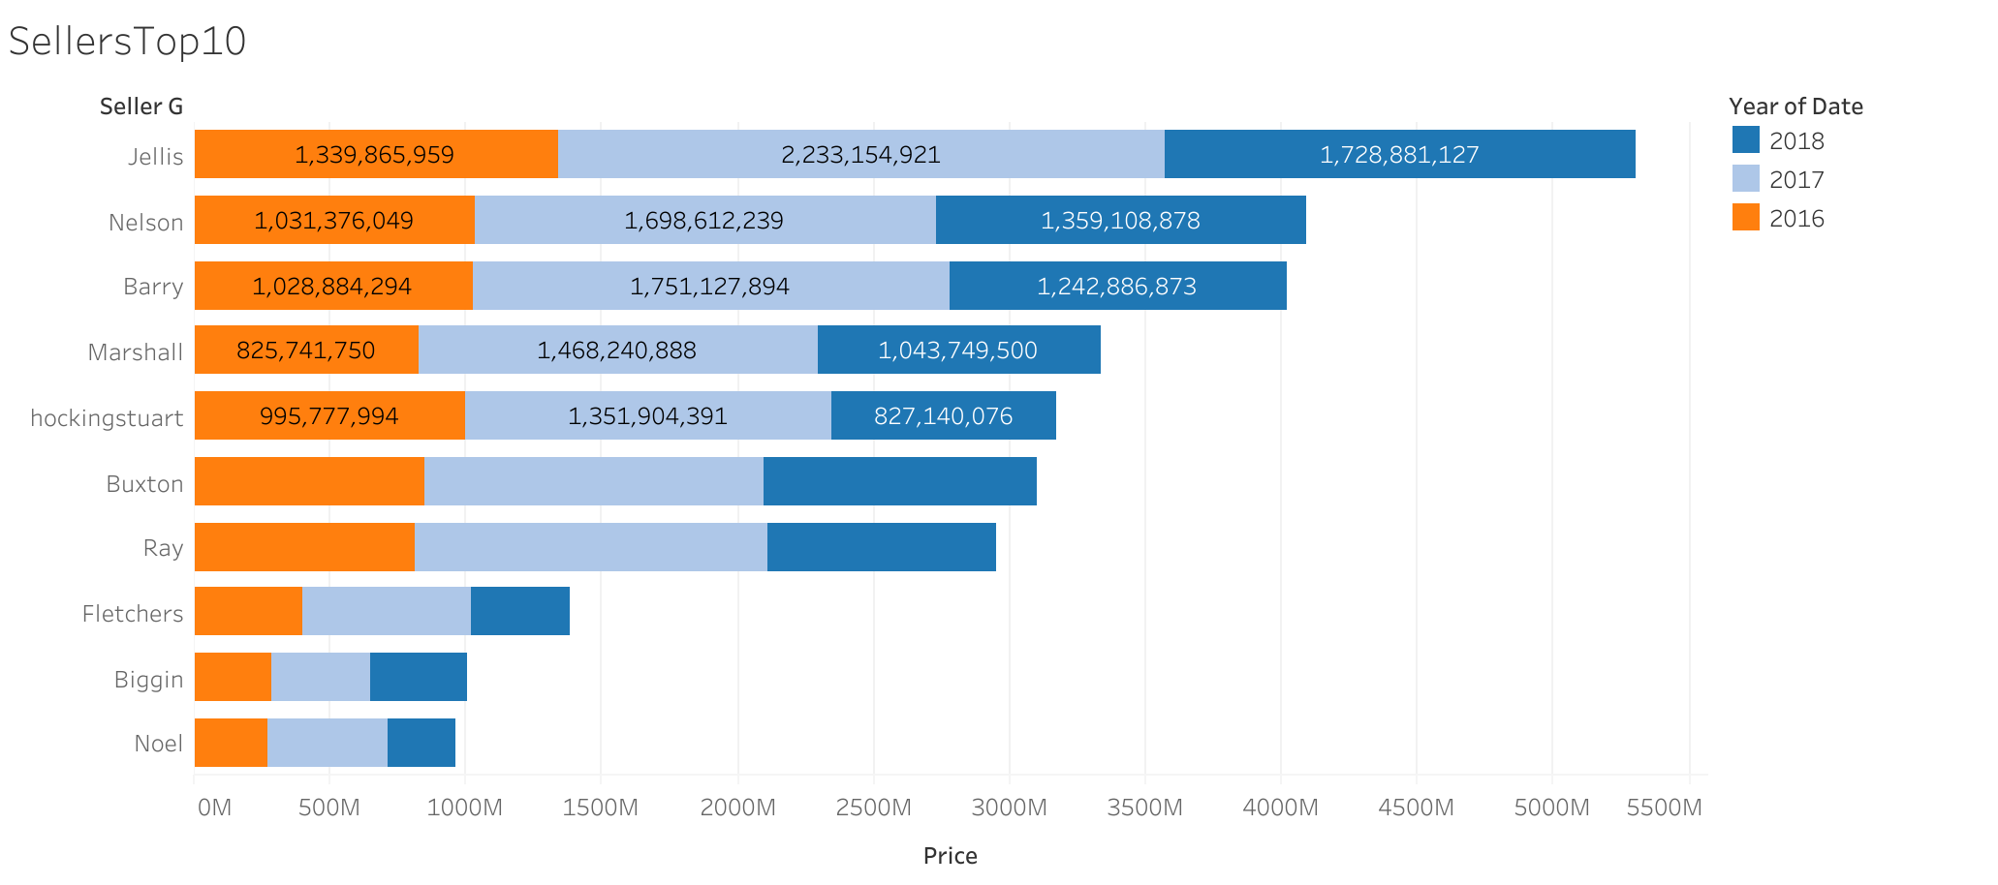
The Company can work with these Top10 real estate companies in Melbourne to reach quick sales volume.

Slide 13

Recommendations
The company must follow the primary strategy as “Price Range,” “Region” “Type of Property,” “Rooms,” “Distances,” and “Real Estate Companies” to invest.
Sales and marketing departments should be reinforced with their budgets and people to achieve the company’s target for the 2019 term.
The Melbourne real estate market gives enormous opportunities with its high-volume capacity to get targeted 2% profit.

