Slide 1

MCP in Action
Building Smarter AI-Driven Applications with LLMs and Agents.

Slide 2


Discover how MCP enables LLMs and agents to interact with your application logic.
We’ll break down the basics of LLMs and agents, introduce the MCP model, and showcase a practical demo.

Slide 3
01
02
03
The History That Led to MCP
Why MCP
Demo
Pag. 4
Pag. 11
Pag. 15

Slide 4
The History That Led to MCP
01

Slide 5
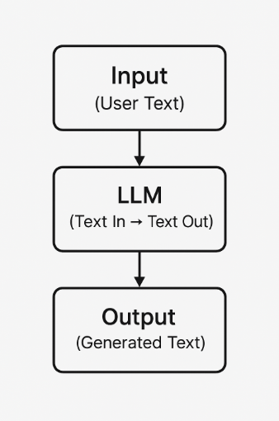
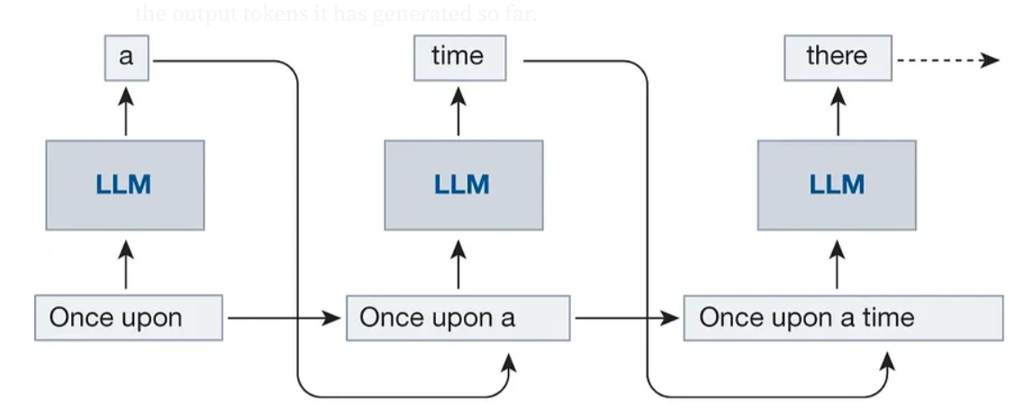
The History That Led to MCP
Early LLM Capabilities
From Static Models to Interactive AI
LLMs are enormous neural networks (probabilistic model) that predict the next token/word
LLMs were originally "text-in, text-out"
No way to access live data
No awareness of external systems
No way to take actions

Slide 6
The History That Led to MCP
Fine-Tuning
Trains the pre-trained LLM model with our specialized dataset: Helpful, but Limited
Customization via training
Expensive, slow iteration
Still no access to external systems
Still no way to take actions

Slide 7
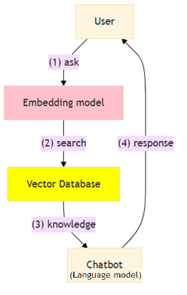
The History That Led to MCP
RAG
Retrieval-Augmented Generation: Giving LLMs Knowledge
Adds knowledge beyond training
Still limited to passive retrieval
Read-only access
Still cannot act

Slide 8
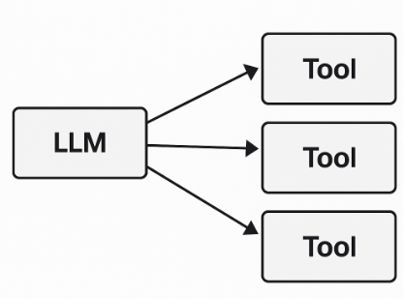
The History That Led to MCP
Tool Use / Function Calling
LLMs Begin Taking Actions
LLMs call functions/tools via JSON schemas
Enabled real actions (APIs, DB calls, file ops)
But… every system defined tools differently
No standard, no permissions, no portability

Slide 9
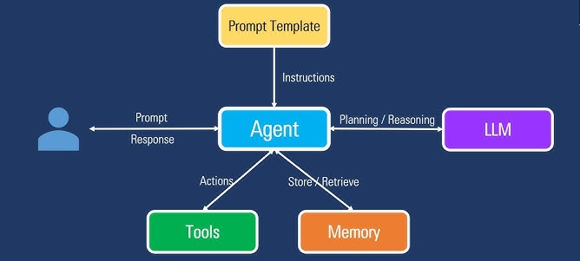
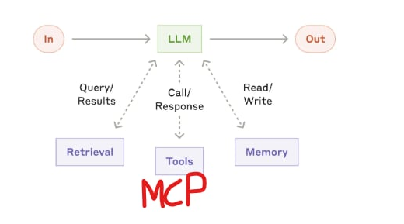
The History That Led to MCP
Agents
Reasoning + Tools
Systems where large language models (LLMs) dynamically direct their
own processes and tool usage, maintaining control over how they accomplish tasks
https://www.anthropic.com/engineering/building-effective-agents
Multi-step decision-making
Chains of tool calls
Increased power = increased integration chaos
Every tool → custom integration (tools lacked standards)

Slide 10
The History That Led to MCP
The Problem
The Integration Mess
No shared protocol for tools
No standard permissions
Hard to build, hard to secure
Hard to reuse tools across platforms

Slide 11
Why MCP
02

Slide 12
Why MCP
Why MCP Exists
Model Context Protocol: A Standard for Agent–Tool Interaction
Created by Anthropic: https://www.anthropic.com/news/model-context-protocol
Uniform protocol for tools
Strong permission + security model
Works locally or remotely
Clear access control
Designed for LLMs and agents
Portable integrations (one server, many clients)

Slide 13
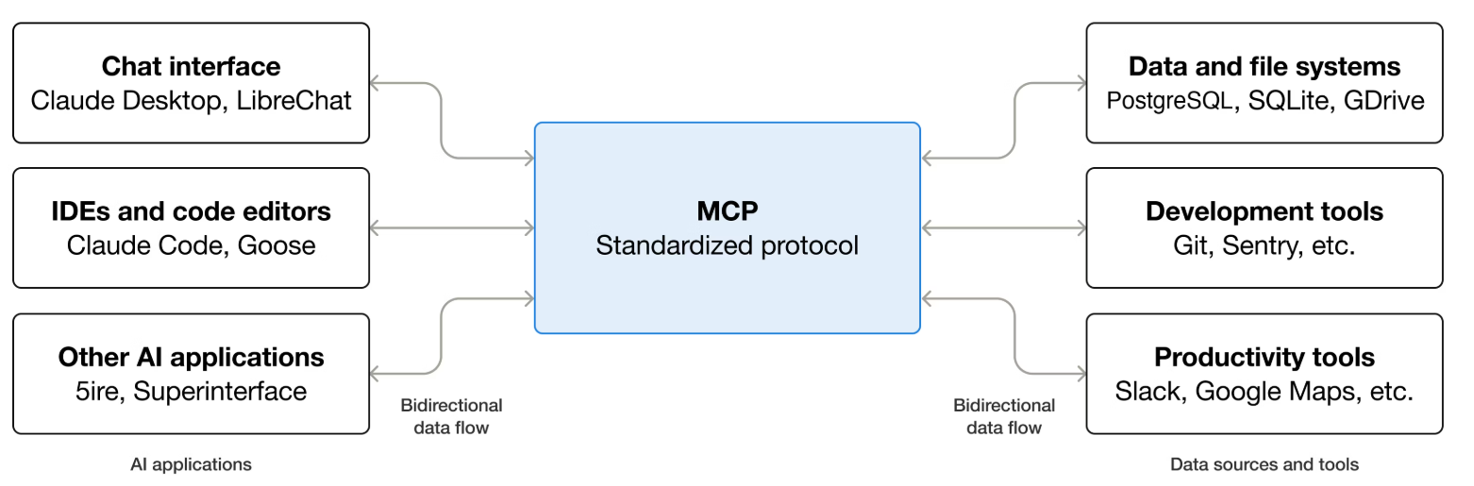
Why MCP
MCP Architecture
The MCP Model
Servers expose tools, resources, prompts
Clients (LLMs/Agents) interact over a shared protocol

Slide 14
Why MCP
MCP in Practice
How MCP Changes Development
Build once → use across platforms
Safe control of system resources
Makes apps "AI-ready"

Slide 15
Demo
03

Slide 16
Demo
Demo 1
Using an Existing Node.js MCP Server
Walkthrough Clude Desktop
MCP Server config JSON file
Import AirBnb MCP server
All available MCP servers: https://github.com/modelcontextprotocol/servers
AirBnb MCP server: https://github.com/openbnb-org/mcp-server-airbnb

Slide 17
Demo
Demo 2
Create a simple .NET MCP server that shows the local machine time
Code walkthrough
Install Microsoft.Extensions.AI.Templates template : https://learn.microsoft.com/en-us/dotnet/ai/quickstarts/build-mcp-server
Show the template in the Visual Studio
MCP Server config JSON file – dotnet command
Import LocalTime MCP server

Slide 18
Demo
Demo 3
Create a simple .NET MCP server that manipulates the files on the local machine time
Code walkthrough
Import LocalFile MCP server

Slide 19
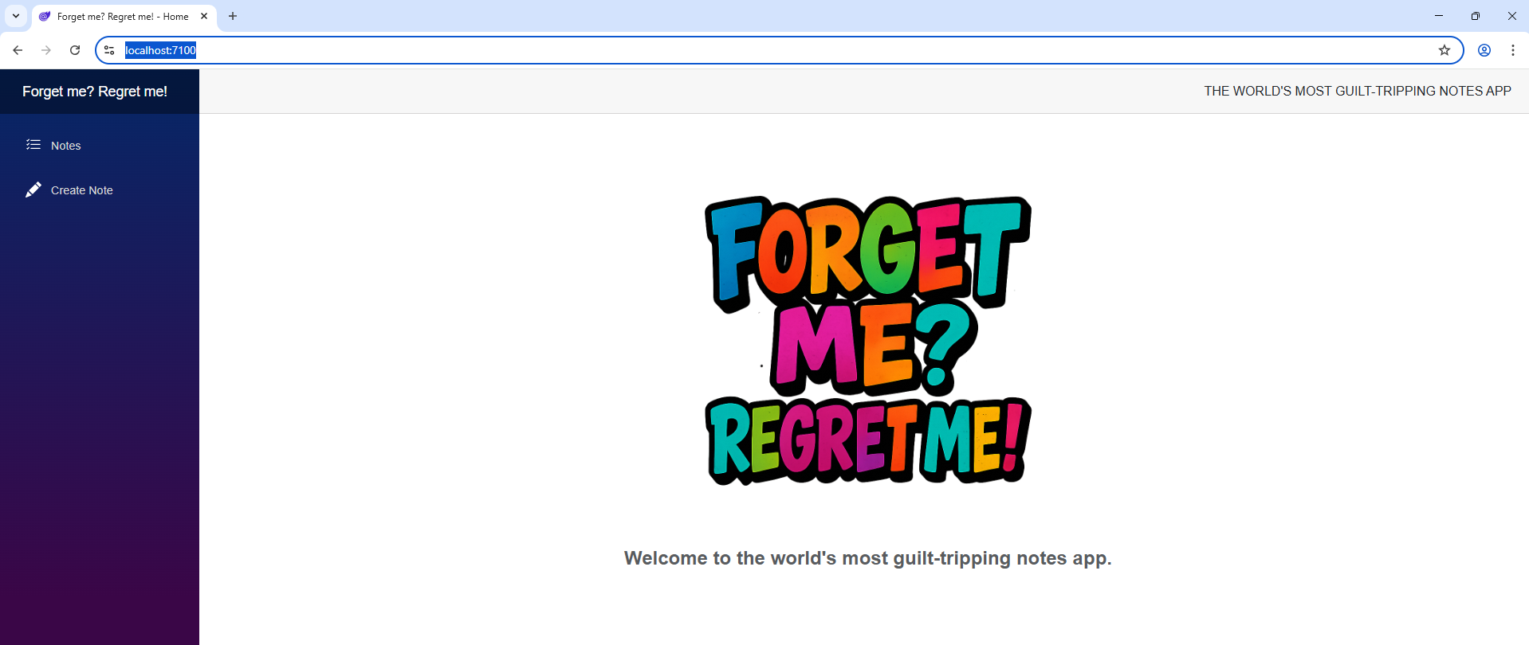
Demo
Demo 4
Create a .NET MCP server that uses our application
Application walkthrough
Code walkthrough
Import LocalFile MCP server
Import one more MCP server and see how these 2 are working together

Slide 20
End
Resources
Official MCP documentation: https://modelcontextprotocol.io/docs/getting-started/intro
MCP Implementation: https://github.com/modelcontextprotocol
MCP Servers: https://github.com/modelcontextprotocol/servers or https://mcp.so/servers
MCP Clients: https://modelcontextprotocol.io/clients or https://mcp.so/clients
MCP Csharp SDK: https://github.com/modelcontextprotocol/csharp-sdk
Microsoft MCP for beginners: https://github.com/microsoft/mcp-for-beginners

Slide 21
Thank you!
Notes:
Presentation Matters
This slide provides justification for caring about how your presentations look and feel.
It can also be used as a template slide. Change the header (and footer) to reflect the client, presentation name, and chapter title. To change the header and footer, click “edit master” and change the header and footer on all the master slides to have the same client and presentation name across all pages.

