Slide 1

Building AI Agents Turning LLMs into Decision Makers.

Slide 2


Discover how LLMs evolve from prompt responders into systems capable of decision-making, tool execution, and coordination.
Illustrated through practical implementations in .NET using Microsoft Agent Framework.

Slide 3
01
02
03
The History that Led to Agentic Systems
Technologies for Building Agentic Systems Demo
Pag. 4
Pag. 14
Pag. 19

Slide 4
The History that Led to Agentic Systems
01

Slide 5
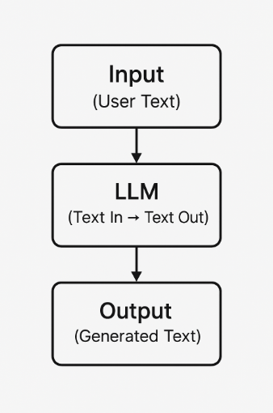
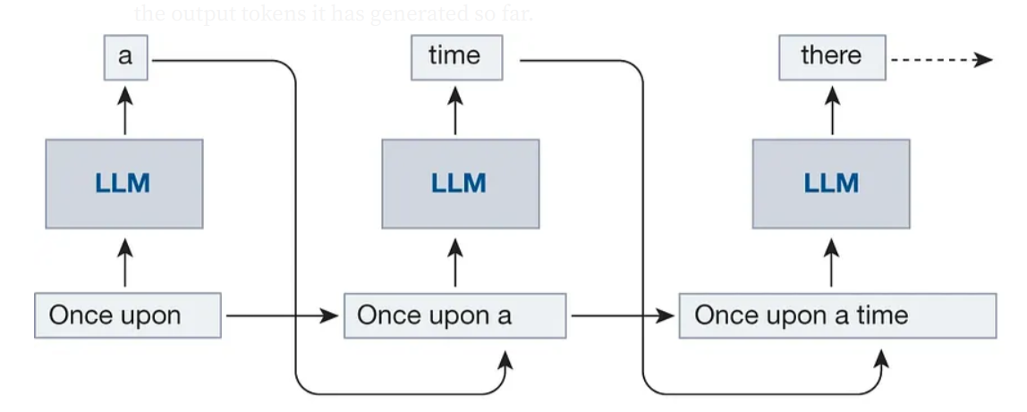
The History that Led to Agentic Systems
Early LLM Capabilities
From Static Models to Interactive AI
LLMs are enormous neural networks (probabilistic model) that predict the next token/word
LLMs were originally "text-in, text-out“
Single-shot, stateless
No way to access live data
No awareness of external systems
No way to take actions

Slide 6
The History that Led to Agentic Systems
Fine-Tuning
Trains the pre-trained LLM model with our specialized dataset: Helpful, but Limited
Customization via training
Expensive, slow iteration
Still no access to external systems
Still no way to take actions

Slide 7
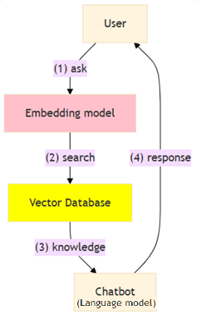
The History that Led to Agentic Systems
RAG
Giving LLMs Knowledge - Retrieval-Augmented Generation
Adds knowledge beyond training
Still limited to passive retrieval
Read-only access
Still cannot act

Slide 8
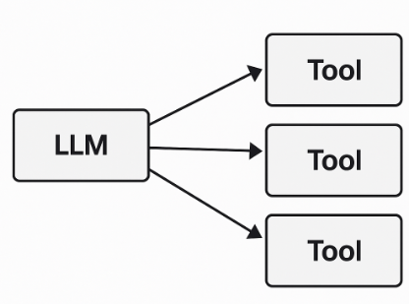
The History that Led to Agentic Systems
Tool Use / Function Calling
LLMs Begin Taking Actions
LLMs call functions/tools via JSON schemas
Enabled real actions (APIs, DB calls, file ops)
But… every system defined tools differently
No standard, no permissions, no portability

Slide 9
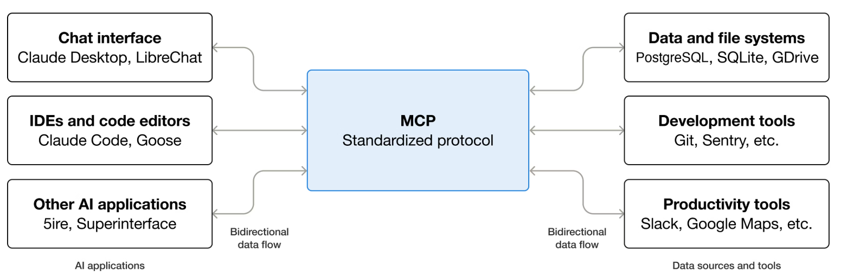
The History that Led to Agentic Systems
MCP
LLMs now has a standardized protocol for tools use / function calling Model Context Protocol: Created by Anthropic https://www.anthropic.com/news/model-context-protocol
Uniform protocol for tools
Strong permission + security model
Works locally or remotely
Clear access control
Build once → use across platforms
Portable integrations (one server, many clients)

Slide 10
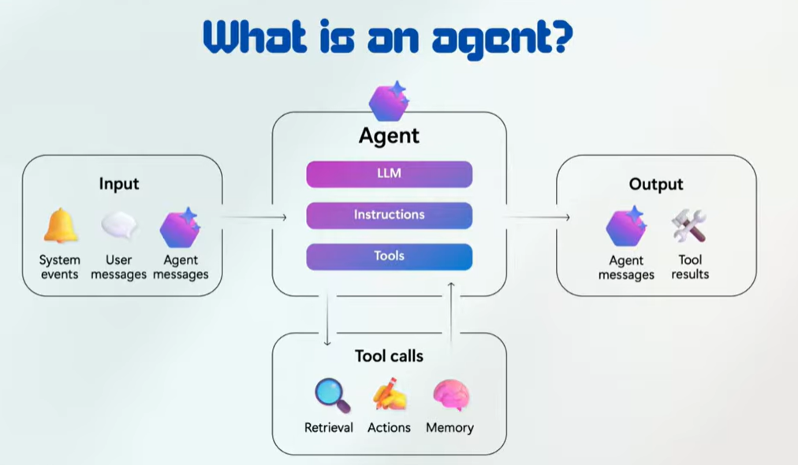
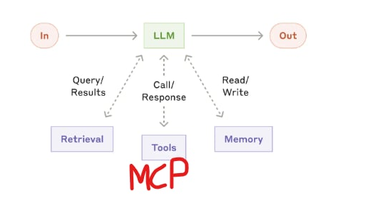
The History that Led to Agentic Systems
AI Agents
LLM is now a part of a bigger system. LLM is the brain of the AI Agent. Systems where large language models (LLMs) dynamically direct their own processes and tool usage, maintaining control over how they accomplish tasks
ReAct - reasoning and acting
Maintains state across steps (memory, session, scratchpad)
Selects tools, evaluates results, and adapts plans dynamically
Autonomy increases risk → requires constraints, observability, and limits

Slide 11
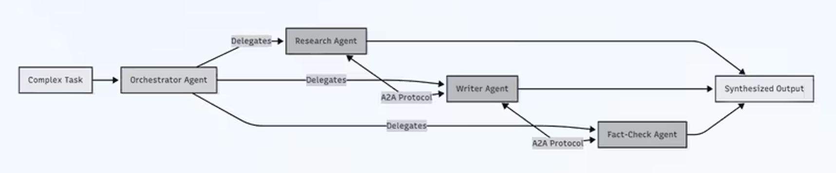
The History that Led to Agentic Systems
Multi-Agentic Systems
From Single Decision-Maker to Coordinated Intelligence
Multiple agents collaborate, each with a specialized role or responsibility
Tasks are decomposed and delegated (planner, executor, verifier, etc.)
Agents coordinate via messaging, shared memory, or orchestration layers
Increased capability, but higher complexity: latency, cost, and failure modes multiply

Slide 12
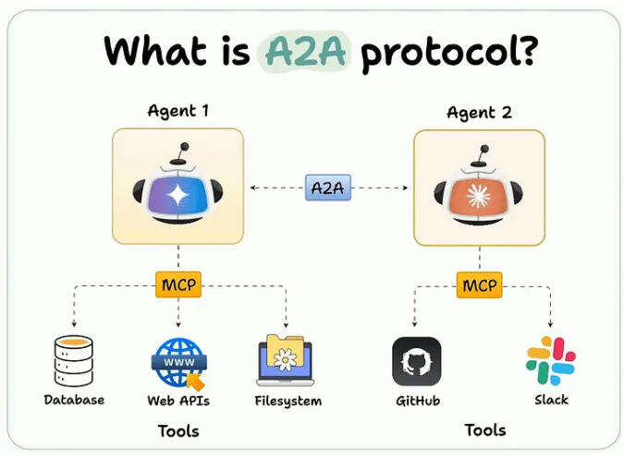
The History that Led to Agentic Systems
A2A
Standardized Communication Between Agents Agent 2 Agent: Created by Google http://a2a-protocol.org/
Enables agents to communicate across frameworks, runtimes, and deployments
Defines message formats, handshakes, and capability discovery
Supports interoperability in distributed, multi-vendor agent systems
Becomes critical as systems scale beyond single frameworks

Slide 13
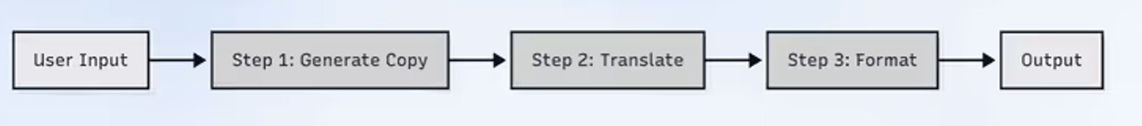
The History that Led to Agentic Systems
Workflows
Deterministic Orchestration Over Autonomy
Predefined steps with explicit control flow (sequential, branching, parallel)
Deterministic, testable, and easier to debug than agents
Ideal for stable business logic and well-known processes

Slide 14
Technologies for Building Agentic Systems
02

Slide 15
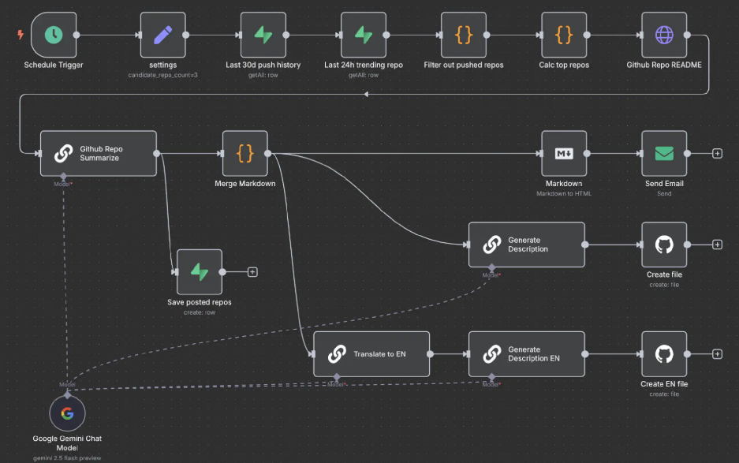


Technologies for Building Agentic Systems
No-code Agentic System Builders
No-code, or more precisely low-code, based on drag and drop.
Zapier
n8n
OpenAi Agent Builder

Slide 16
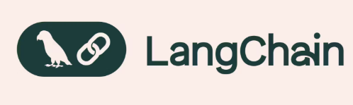


Technologies for Building Agentic Systems
It's a Python's World
2025 was game changer. Everyone was building AI Agents. In 2025 many of these were received official release status. And yes, AI development is Python’s world, all the news are coming from the Python community.
LangChain
LangGraph
PydanticAI
CrewAI
Google Agent Development Kit (adk-python)
OpenAI Agents (openai-agents-python)
Anthropic Claude Agents (claude-agent-sdk-python)

Slide 17
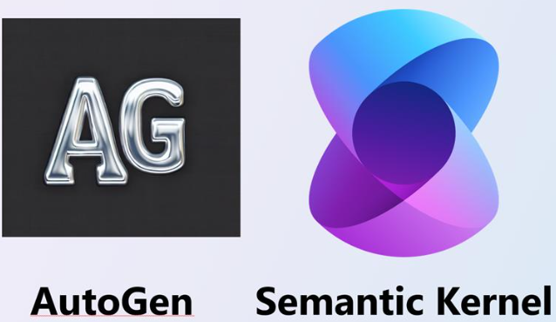
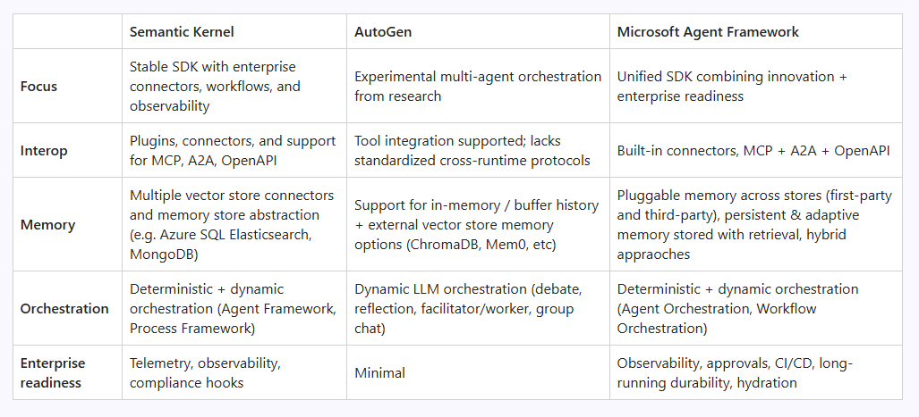
Technologies for Building Agentic Systems
Microsoft AI Frameworks
Microsoft actively develops AI frameworks in both .NET and Python.
Semantic Kernel
AutoGen
Microsoft Agent Framework

Slide 18
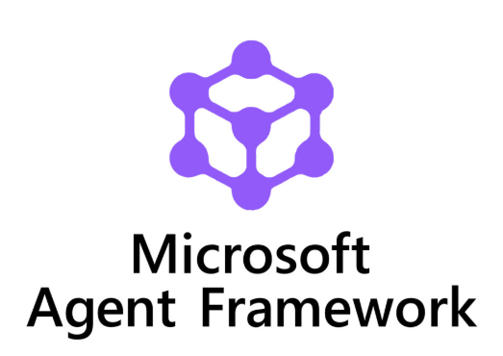
Technologies for Building Agentic Systems
Microsoft Agent Framework
The best from both worlds: Semantic Kernel + AutoGen. MAF offers two primary categories of capabilities:
AI agents
Workflows

Slide 19
Demo
03

Slide 20
Demo
Deploy LLM in Azure AI
My Visual Studio Benefits: https://my.visualstudio.com/Benefits
Azure AI (Microsoft Foundry): https://ai.azure.com/
AI Azure catalog: https://ai.azure.com/catalog
Models: https://ai.azure.com/catalog/models
Providers: https://ai.azure.com/catalog/publishers

Slide 21
Demo
Simple AI Agent
Model
Instructions
Execute AI Agent
Session
Structured output

Slide 22
Demo
AI Agent using RAG
Just a simple mock RAG.

Slide 23
Demo
AI Agent using Tools
Functions as Tools
MCP as Tools

Slide 24
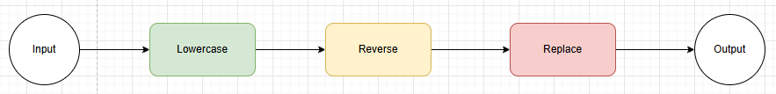
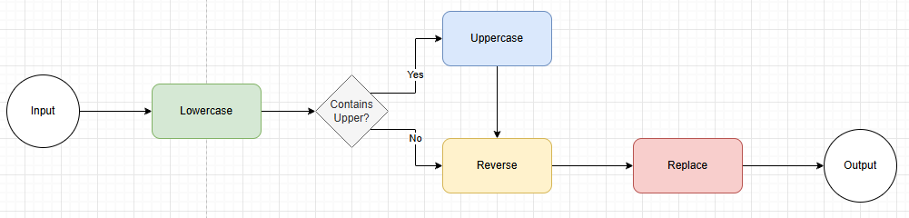
Demo
Workflows
Sequential Workflow
Branching Workflow

Slide 25
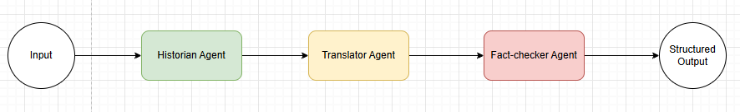
Demo
AI Agent Workflow
Workflow from 3 agents: Historian, Translator, Fact-Checker.

Slide 26
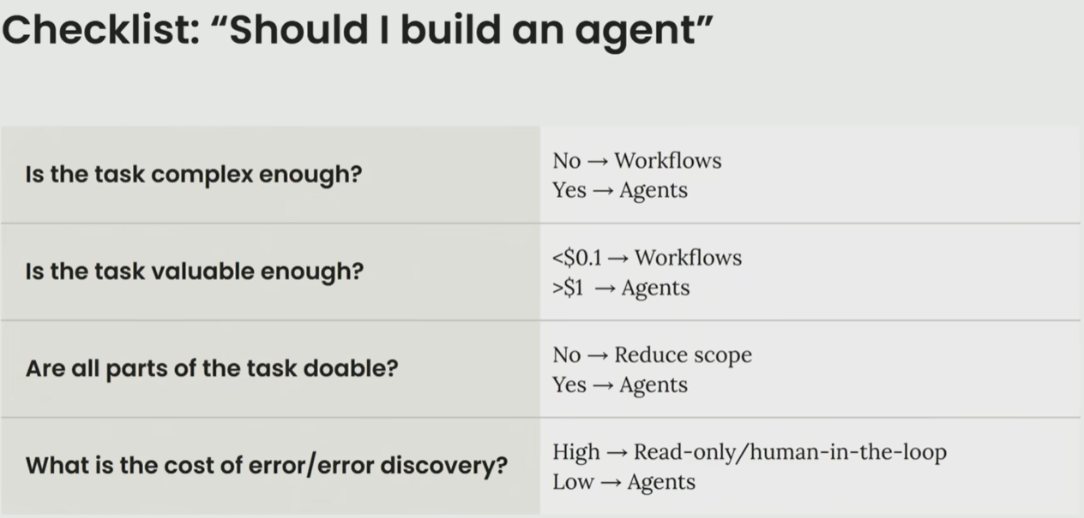
End
Final Notes
Don't build AI Agents for everything!!!
Keep it simple
Think like your agents

Slide 27
End
Resources
Official Microsoft Agent Framework documentation:
https://learn.microsoft.com/en-us/agent-framework/

Slide 28
Thank you!
Notes:
Presentation Matters
This slide provides justification for caring about how your presentations look and feel.
It can also be used as a template slide. Change the header (and footer) to reflect the client, presentation name, and chapter title. To change the header and footer, click “edit master” and change the header and footer on all the master slides to have the same client and presentation name across all pages.

