Slide 1
Isabelle and Regex Fun
William Spencer
Mukerrem Tufekcioglu

Slide 2

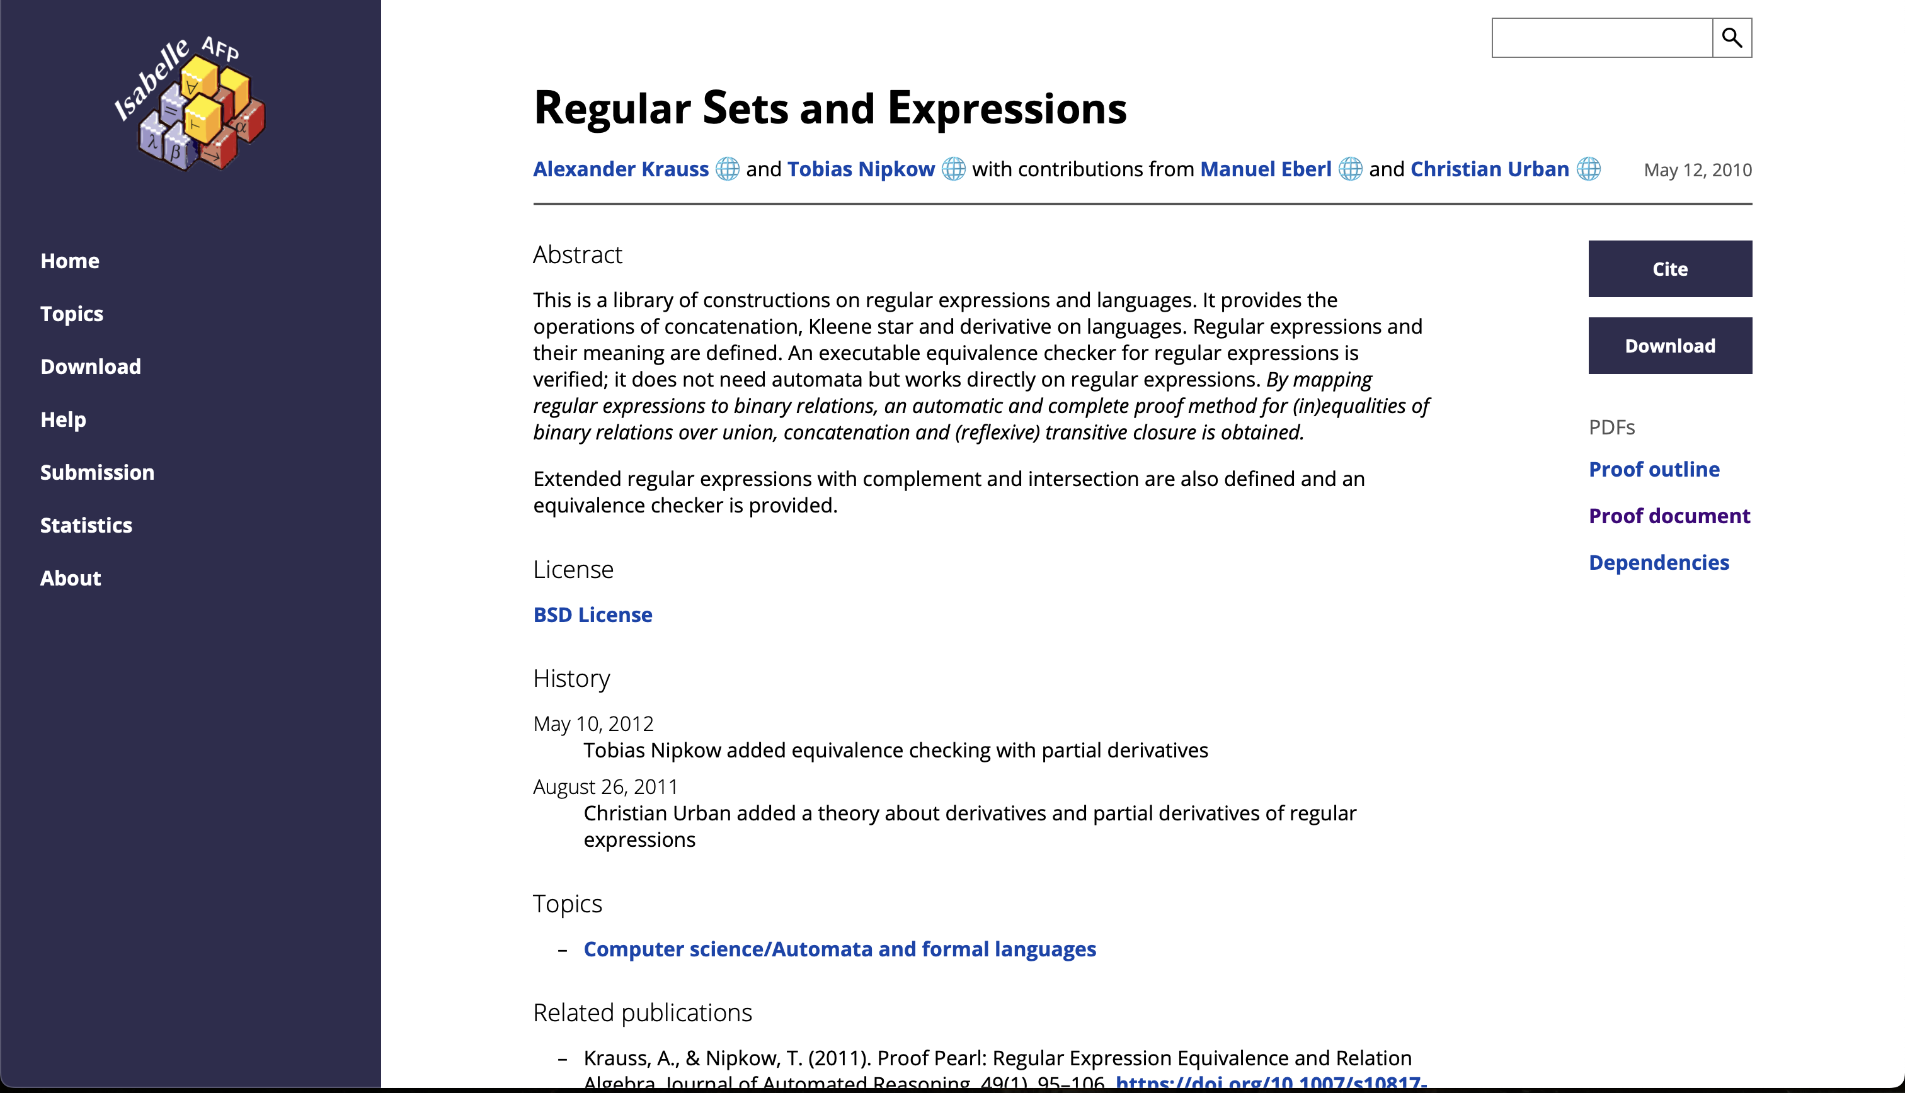
A bit of history
Developed by Larry Paulson, Tobias Nipkow, and Makarius Wenzel
Written in Standard ML and Scala
Archive of Formal Proofs (AFP)
Lightweight Java was proven type-sound, and the seL4 microkernel was proved functionally correct using Isabelle (more on https://isabelle.in.tum.de/community/Projects)

Slide 3
Isabelle
Generic meta-logic – FOL, HOL, ZFC all possible
Tactic Language
Theories: collection of types, functions, theorems, lemmas
Type variables: ‘a, ‘b
[t₁, t₂ , t₃] => t₁ is the same as t₁ => t₂ => t₃ => t₁
λx λy λz. t is equivalent to λ x, y, z
Definition before use
Quotations around terms

