Slide 1
National Research Platform Nautilus Research Cluster
MORENet Technical Summit
20 Feb 2023

Slide 2



NSF NRP Nautilus HyperCluster
The NSF Nautilus HyperCluster is a Kubernetes cluster with vast resources that can be utilized for various research purposes:
Prototyping research code
S3 cloud storage for data and models
Accelerated small-scale research compute
Scaling research compute for large scale experimentation
Resources Available:
CPU Cores: 14,462
RAM: 69 TB
NVIDIA GPUs: 1150
Nautilus Logo: https://portal.nrp-nautilus.io/
Docker Logo: https://developers.redhat.com/blog/2014/05/15/practical-introduction-to-docker-containers
Kubernetes Logo: https://commons.wikimedia.org/wiki/File:Kubernetes_logo_without_workmark.svg

Slide 3
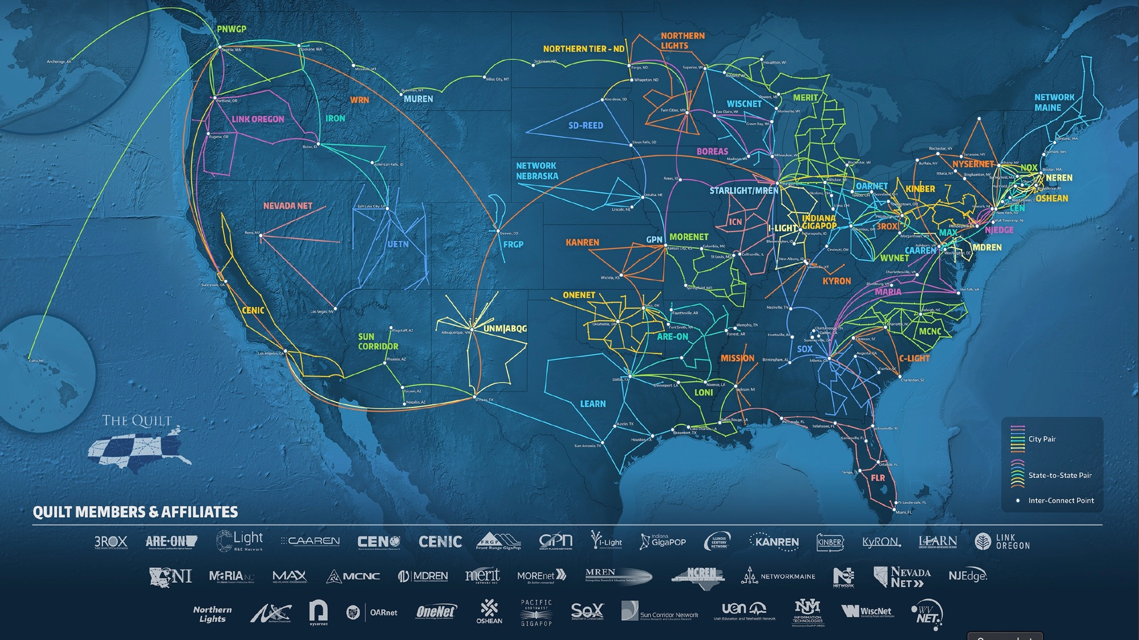

Nautilus ~1,100 GPUs Distributed over US Networks—Fall 2022
U S. Dakota + SD State
U. Nebraska-L
MGHPCC
160 GPUs over GPN
GPUs over NEREN
9 GPUs over GPN
UCI + UCR + UCM + UCSC + UCSB
NYU
99 GPUs over CENIC
U Oklahoma
UIC
12 GPUs over NYSERNet
8 GPUs over GPN
21 GPUs over MREN
U Delaware
CSUSB + SDSU
CWRU
12 GPUs over NYSERNet
U Hawaii
1 GPU over CENIC/PW
48 GPUs over CENIC
2 GPUs over OARnet
Clemson U
21 GPUs over SCLR
UCSD
612 GPUs over CENIC
U New Mexico
FAMU
4 GPUs via Albuquerque GigaPoP
8 GPUs over FLR (pending)
U Guam
1 GPU over CENIC/PW
Minority Serving Institutions
EPSCoR
Institutions
Non-MSI
Institutions

Slide 4
5 PB Nautilus Ceph Storage Over Networks—2022
UN-L
UCR + UCSC + UCSB
400 TB over GPN
940 TB over CENIC
U Kansas
UIC
NYU + NYSERNet
USC + Stanford + Caltech
200 TB over GPN
175 TB over MREN
400 TB over NYSERNet
737 TB over CENIC
SDSU
109 TB over CENIC
OneNet
U Delaware
U Hawaii
200 TB over GPN
200 TB over NYSERNet
266 TB over CENIC/PW
UCSD + UCLA
901 TB over CENIC
U Arkansas
FAMU + FIU
200 TB over GPN
318 TB over FLR
U Guam
118 TB over CENIC/PW
Minority Serving Institutions
EPSCoR
Institutions
Non-MSI
Institutions

Slide 5
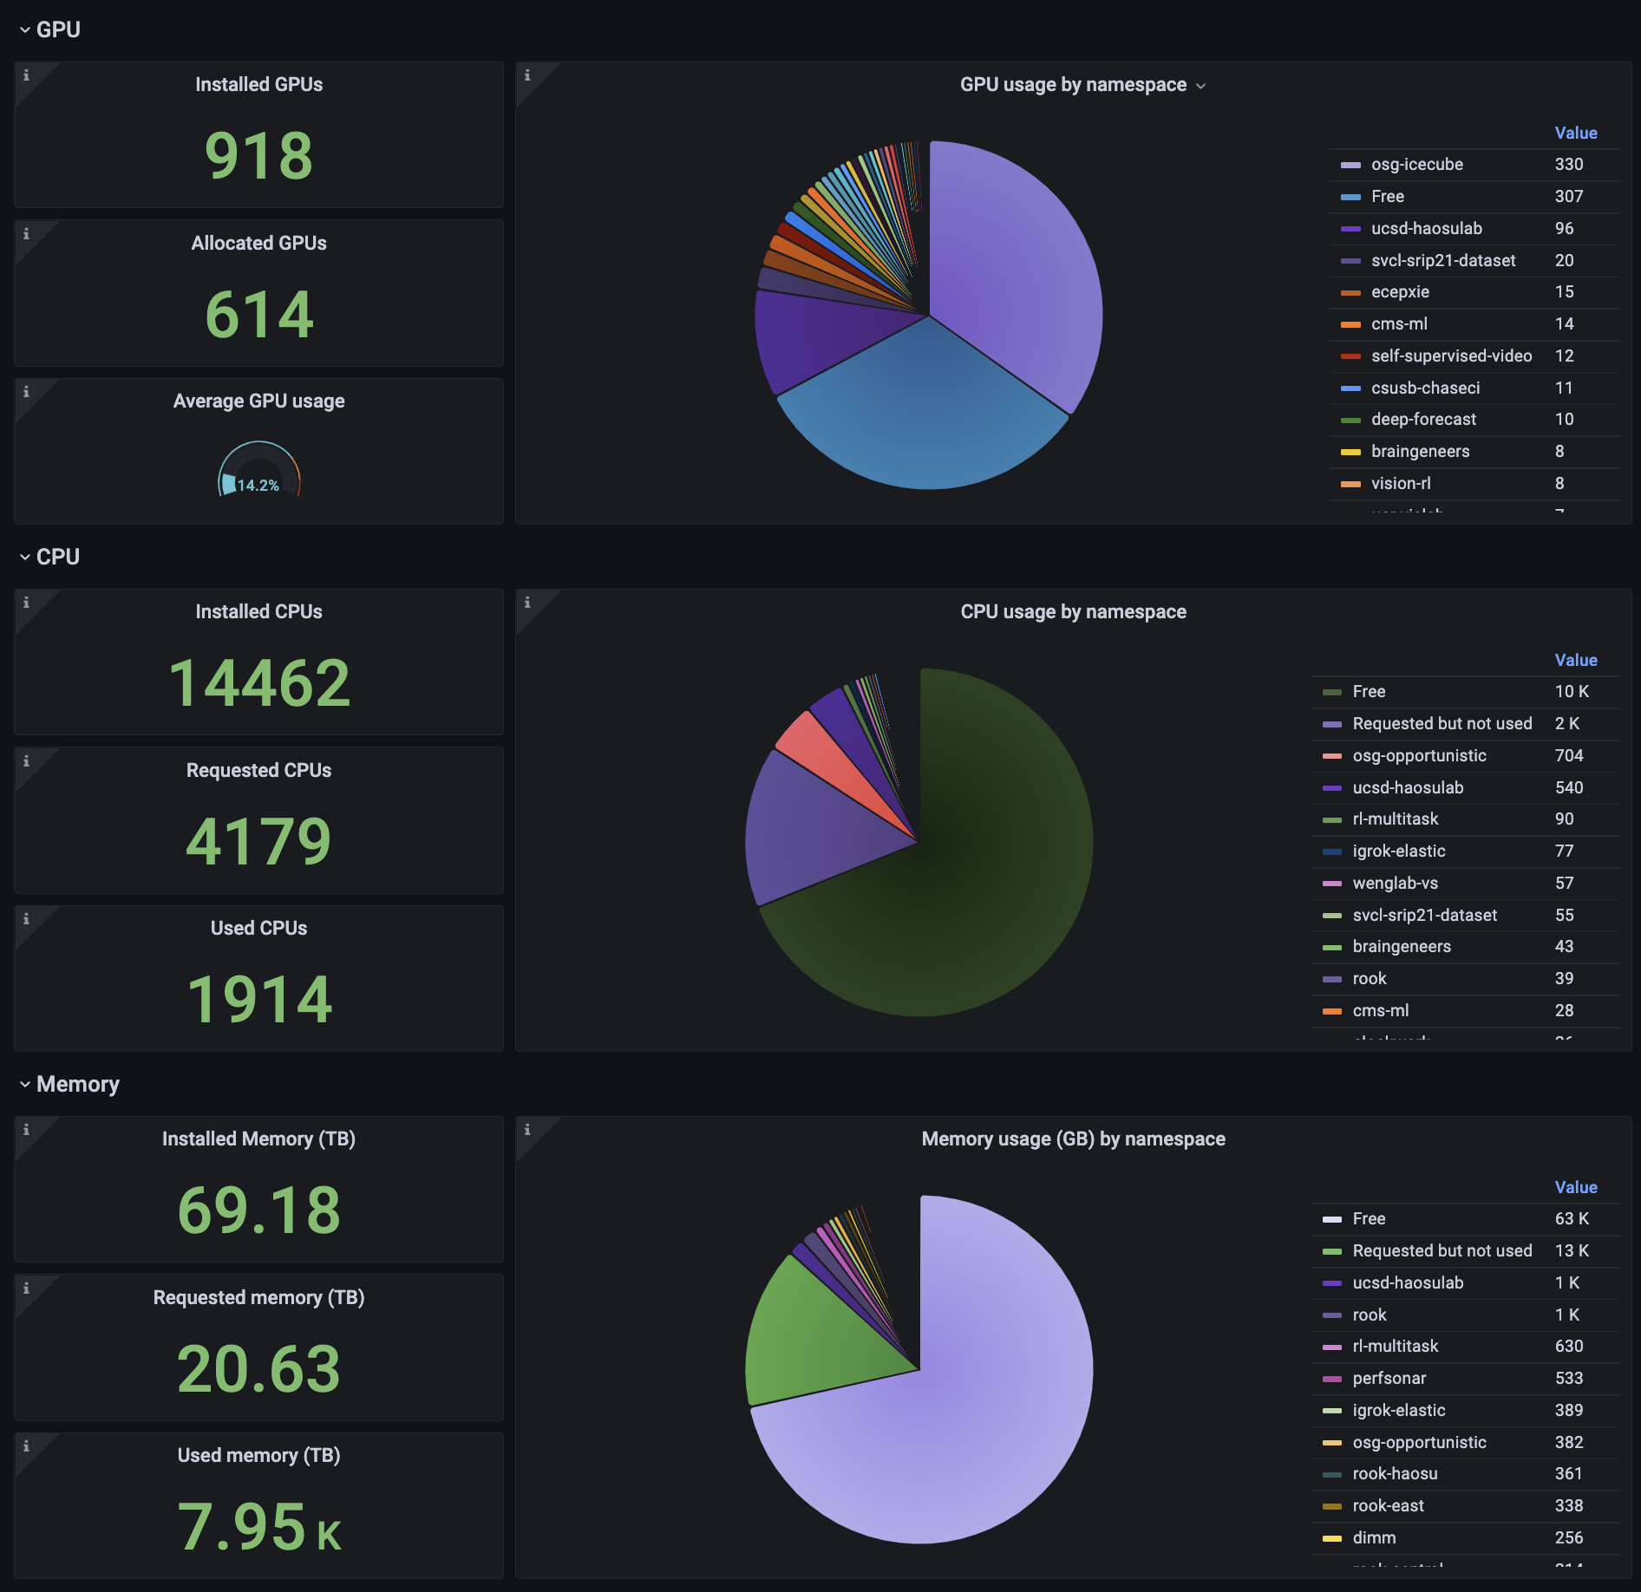
Resource Dashboard

Slide 6
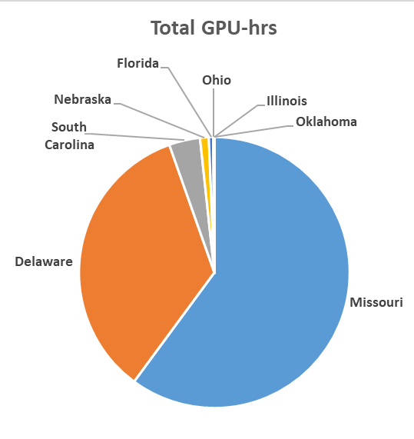
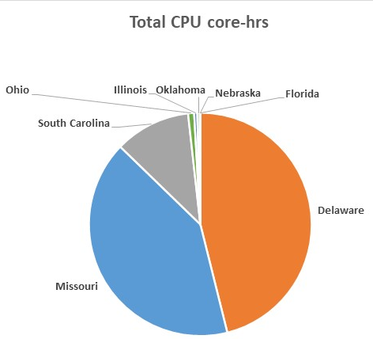
Non-California Nautilus PI Namespace 2021 Usage by State: “Big MO!”
Data/Plots provided by Larry Smarr (PI, National Research Platform & father of US Super Computing Centers)
17,217 GPU-hrs
28,088 CPU core-hrs
University of Missouri - Columbia:
42,000 GPU-hrs in 2022!
Grant Scott, UMC
Helped Organize the UMC PRP Usage

Slide 7
How MU is using Nautilus: Teaching & Research
JupyterHub integration enables creation of an interactive learning environment for STEM Education:
Data Science
Mathematics
High Performance Computing
Access to vast amount of RAM, CPU Cores, and NVIDIA GPUs can accelerate research in various fields:
Bioinformatics
Remote Sensing
Materials Science
Computer Vision
Machine Learning

Slide 8
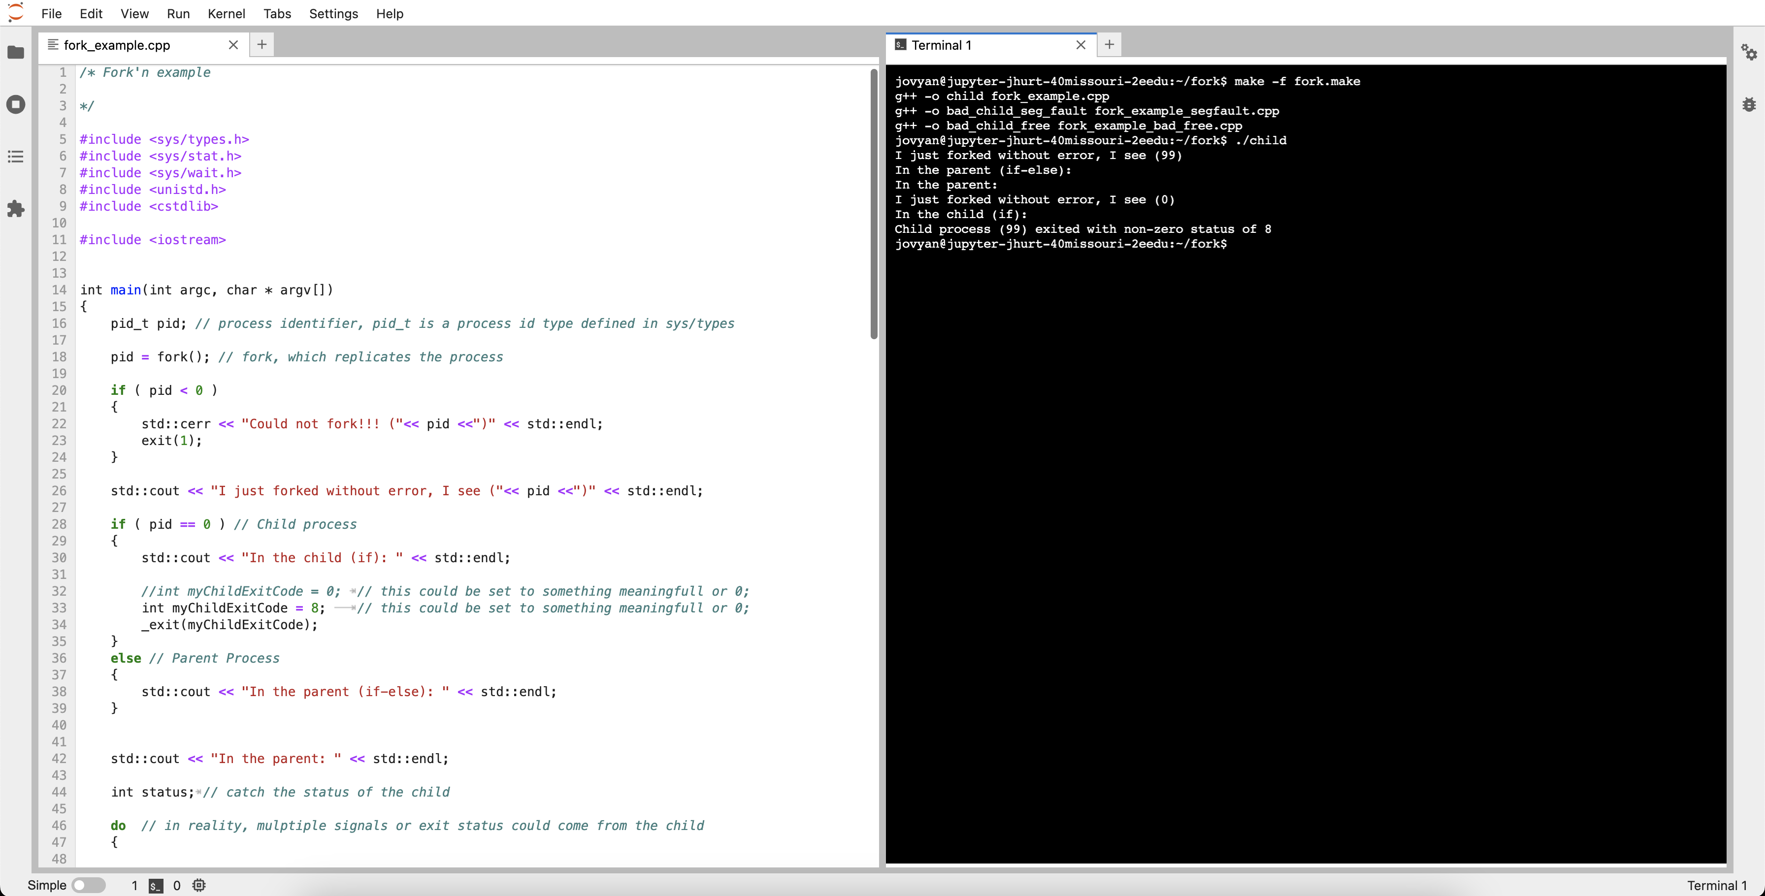
HPC Interactive Learning Environment

