Slide 1
Jupyter User Interface in Nautilus
MORENet Technical Summit
20 Feb 2023

Slide 2
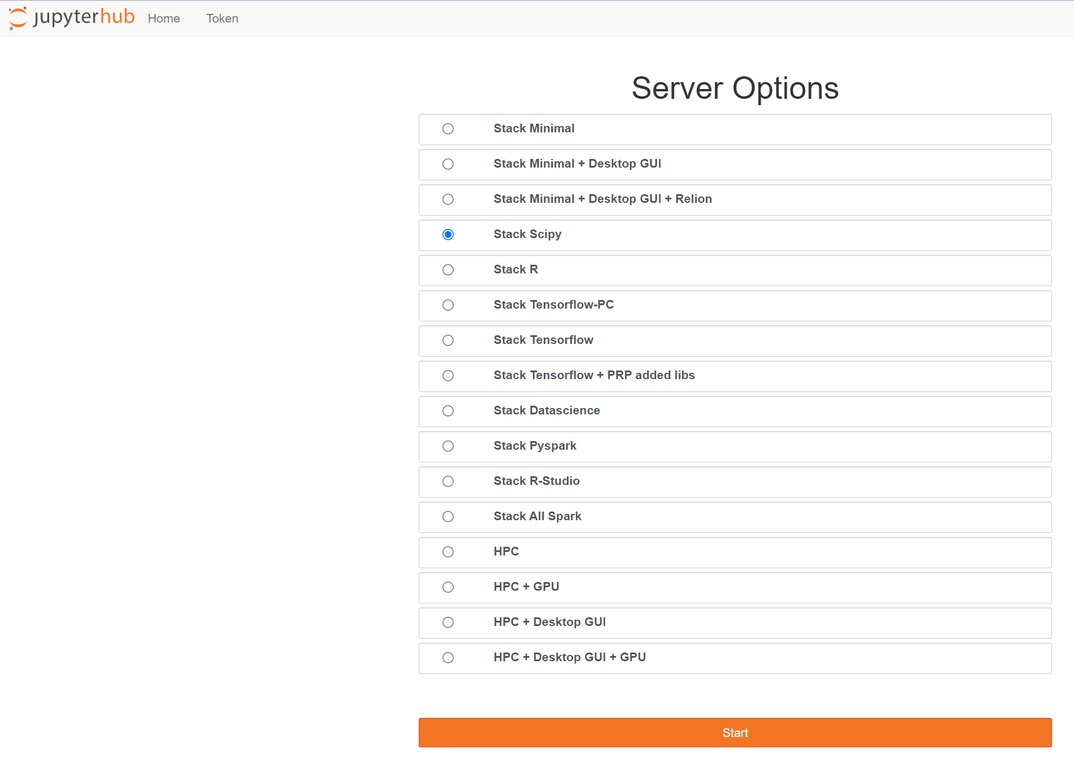
Jupyter User Interface (UI) in Nautilus pod spinning
Each container contains a set of software and libraries pre-installed
Any container can be spawn by any student who is a member of the namespace
List of containers
Press to spin up a pod

Slide 3
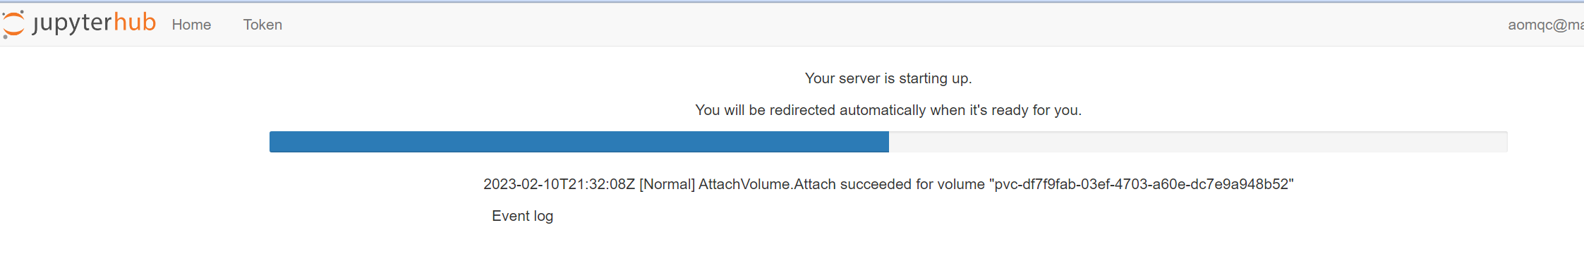
Jupyter User Interface (UI) in Nautilus pod spinning
After pressing start the container will be spun up
It may take time depending on the size of the container and the internet connection

Slide 4
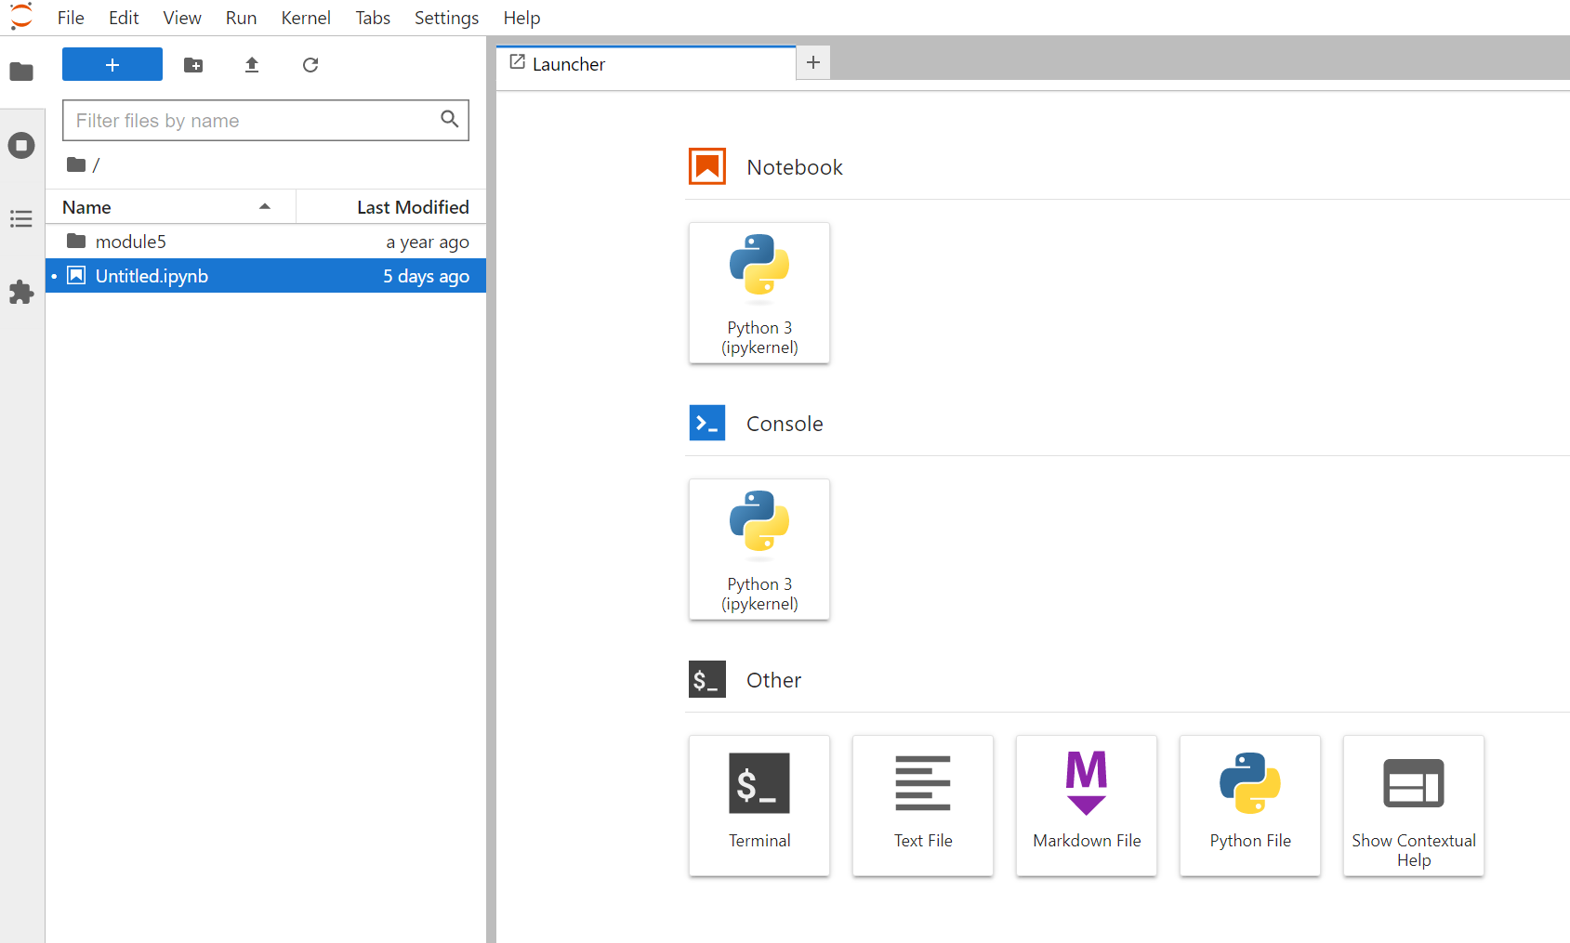
Jupyter User Interface (UI) in Nautilus container elements
Upload files/folders
Create new folder
launch new jupyter notebook
launch new python console
launch new terminal
launch new markdown file
launch new text file
launch new python file

Slide 5
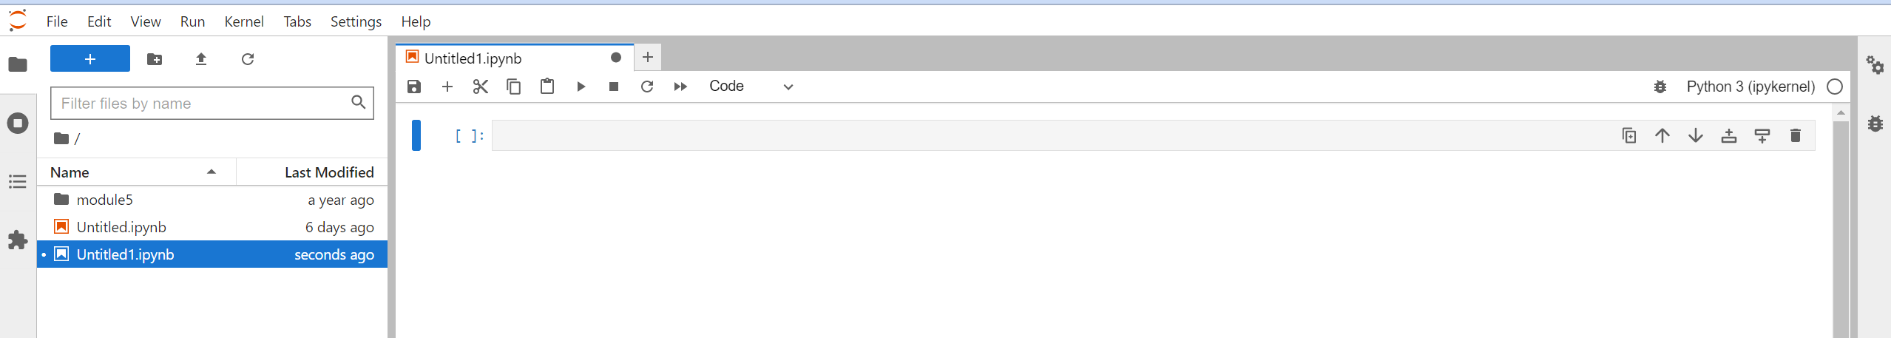
Jupyter User Interface (UI) in Nautilus container elements
This is an example of jupyter notebook as described above from within the container

Slide 6
Jupyter User Interface (UI) in Nautilus container
Can I make this?
How hard it is?
How to do it?

