Slide 1
Running JupyterHub in Kubernetes
MORENet Technical Summit
20 Feb 2023

Slide 2





The Problem: Scalability & Reproducibility
How do we ensure reliable portability of software developed on local development machines to other computational environments?
How do we move code from local development on one machine to hundreds/thousands of machines?
Local Machine
Compute Server
Cloud

Slide 3
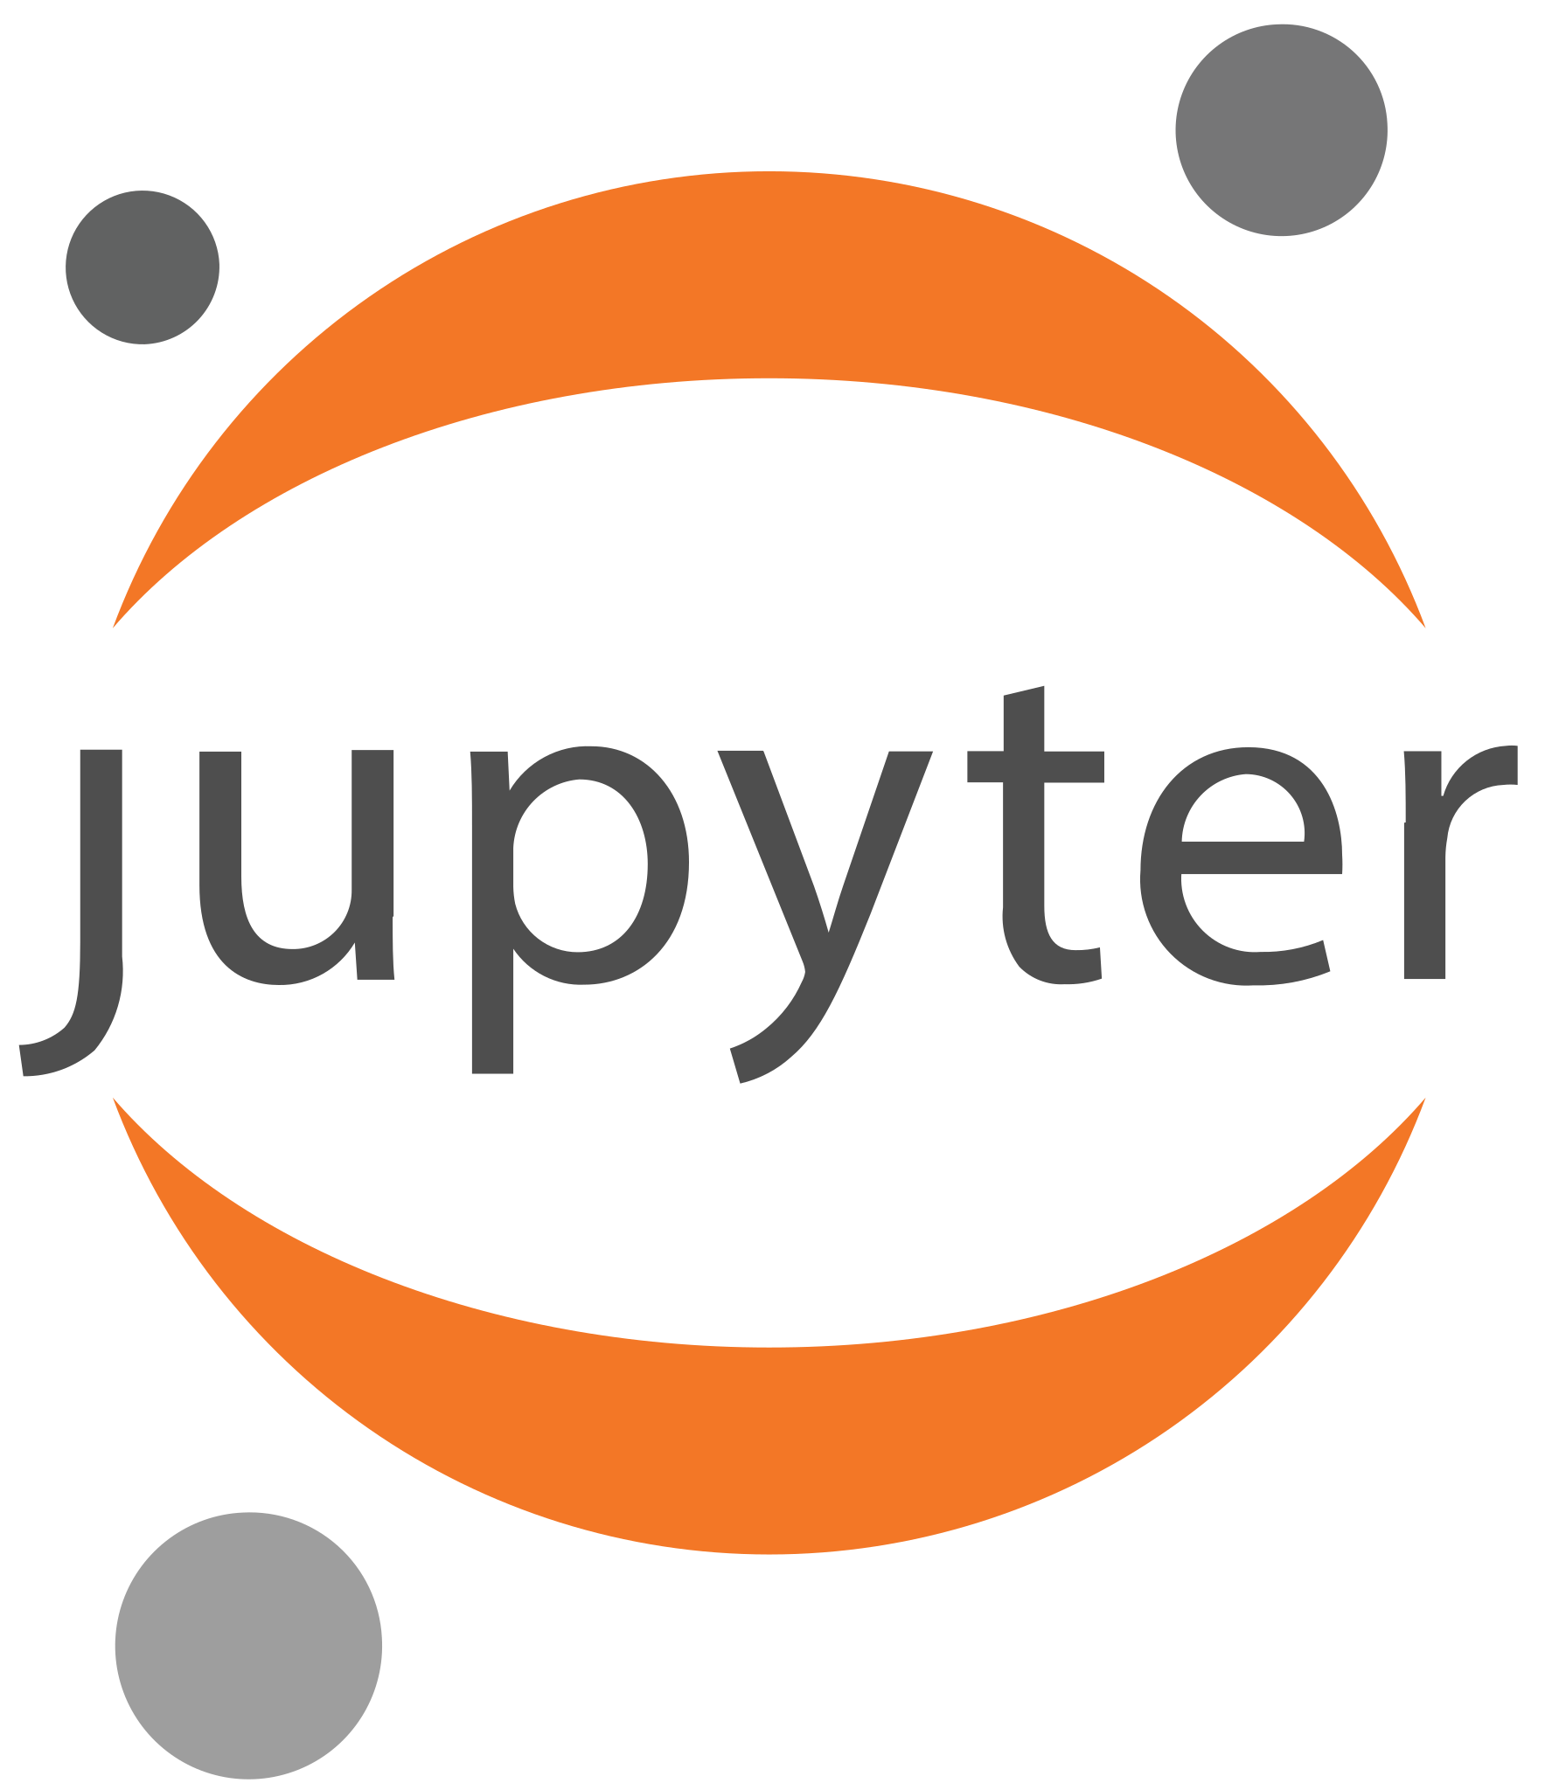
JupyterHub
JupyterHub is a browser-based interactive environment that can be utilized for many different applications
Teaching
Research
Using JupyterHub for STEM instruction provides an opportunity for hands-on, interactive education
JupyterHub can authenticate with CILogin, meaning no additional authentication management is necessary

Slide 4
Running JupyterHub on Nautilus
Register CiLogon Application
Create Kubernetes Namespace
Request removal of Pod Limitations
Install Helm
Build Configuration YAML
Deploy JupyterHub

Slide 5
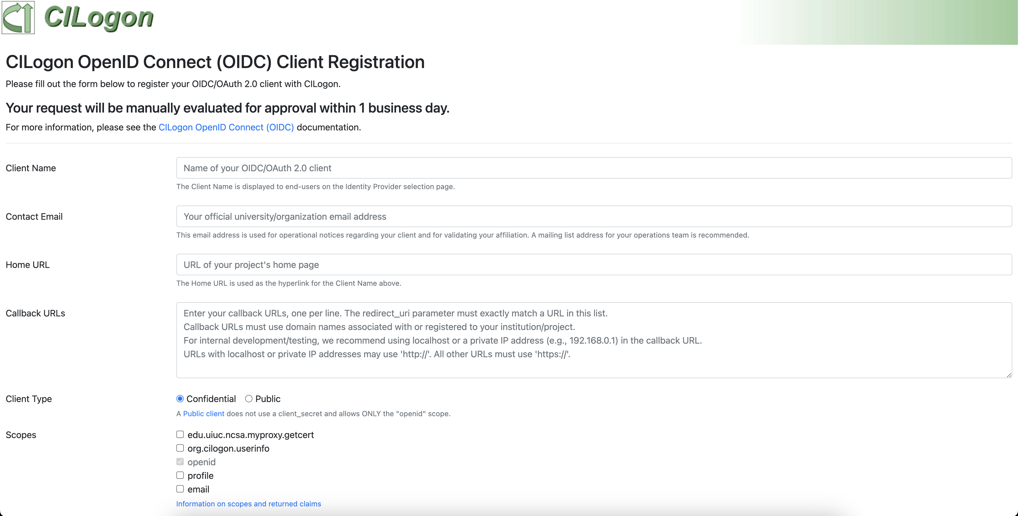
Step 1: Register CiLogon Application
https://cilogon.org/oauth2/register
Callback URL: https://YOURNAME.nrp-nautilus.io/hub/oauth_callback
Client Type: Confidential
Scopes:
org.cilogon.userinfo
openid
Profile
Email
Refresh Tokens: No
Important: Keep the Client ID and Client Secret!

Slide 6
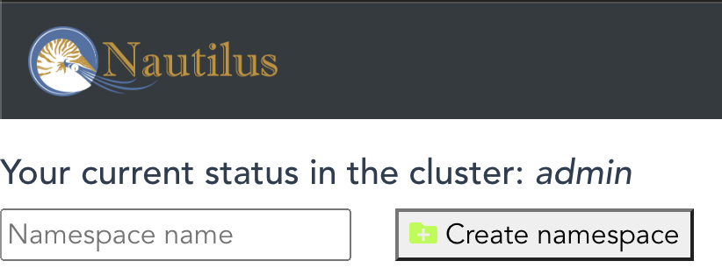
Step 2: Create a Kubernetes Namespace
Recall: Namespaces provide a way for K8s to partition cluster resources across multiple or many users in an exclusive way.
All of the instances of Jupyter Hub running will be in a separate pod in a namespace
To create the namespace on the Nautilus cluster, a cluster administrator will need to go to the following URL: https://portal.nrp-nautilus.io/profileN

Slide 7
Step 3: Request Removal of Pod Restrictions
By default, pods on the Nautilus cluster can only run for 6 hours
If you have users that may use their Jupyter Hub environment for more than 6 hours, their resources will be released at the 6 hour mark
You can request that pod restrictions be removed on your namespace by going to the [Matrix] chat for PRP Nautilus here: https://element.nrp-nautilus.io/#/welcome
Once you have access to the server, send a message in Nautilus Support channel containing the name of the namespace you are using for Jupyter Hub

Slide 8
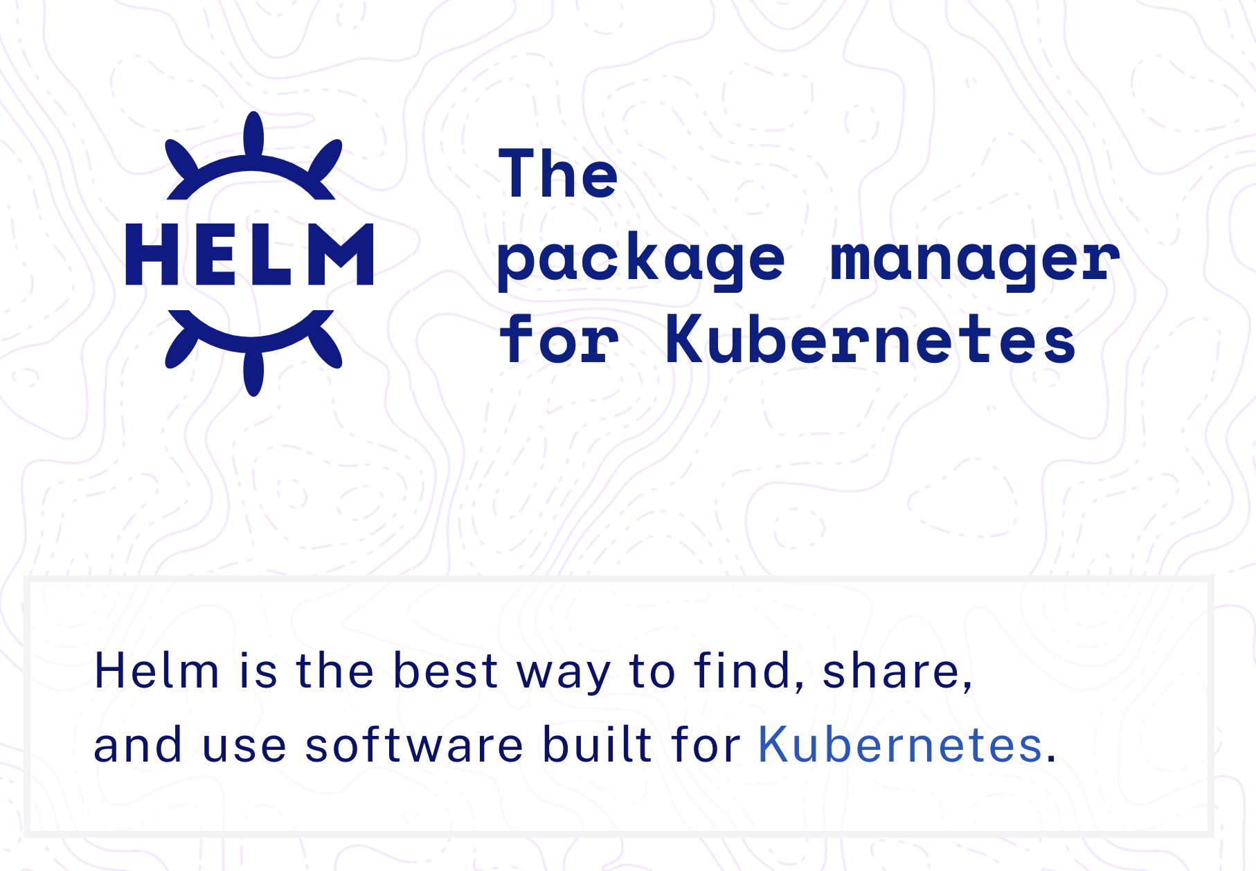
Step 4: Install Helm
Helm is a package manager for Kubernetes, and enables software deployment on K8s Clusters
We will use helm to manage our JupyterHub installation
To download and install: https://helm.sh/docs/intro/install

Slide 9
Step 5: Build Configuration YAML File
Helm is configured, similarly to K8s, with YAML files
We need to build a YAML config file to tell Helm how we want our JupyterHub application configured
We can download the template for JupyterHub on Nautilus here:
https://ucsd-prp.gitlab.io/userdocs/jupyter/values.yaml
Fields to Update in the Template:
secret_token should be updated to the output of this command: openssl rand -hex 32
client_id and client_secret should be updated to match what you received when you registered you CiLogon client
admin_users should be set to who you’d like to have administrative access inside Jupyter Hub
oauth_callback_url should updated to: https://YOURNAME.nrp-nautilus.io/hub/oauth_callback
ingress.hosts should be updated to: https://YOURNAME.nrp-nautilus.io/

Slide 10
Step 6: Deploy JupyterHub with Helm
Add the Jupyter Hub repository:
Bash
$ helm repo add jupyterhub https://jupyterhub.github.io/helm-chart/ &&
helm repo update
Deploy the application:
Bash
$ helm upgrade --cleanup-on-fail --install jhub jupyterhub/jupyterhub
--namespace <namespace> --version=1.2.0 --values config.yaml
where config.yaml is the configuration file you setup in Step 5 and <namespace> is the namespace you created in Step 2.

