Slide 1
Kinematics

Slide 2
Acquiring knowledge of kinematics

Slide 3
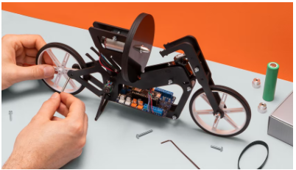
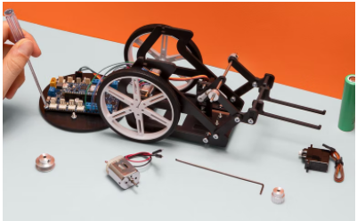
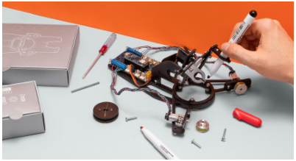

Introduction
Competencies
Kinematics
Learning with Arduino Engineering Kits…
SELF-BALANCING MOTORCYCLE
WEBCAM CONTROLLED ROVER
DRAWING ROBOT
Required files:

Slide 4
Fundamentals
1

Slide 5
Curvilinear movement
1.1

Slide 6

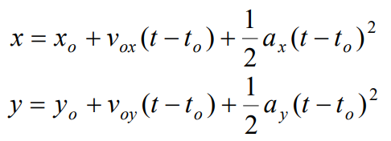
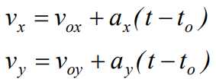
Two-dimensional movement
This study of the motion of an object moves with constant acceleration, that is, they do not change during movement.
The position vector of an object moving in the XY plane is a function of time, written as:
The expressions of position as a function of time in each x and y direction:
The velocity of the moving particle in the XY plane is, the change of position over time and can be determined by:

Slide 7
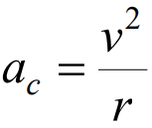
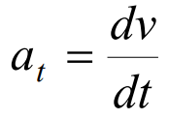

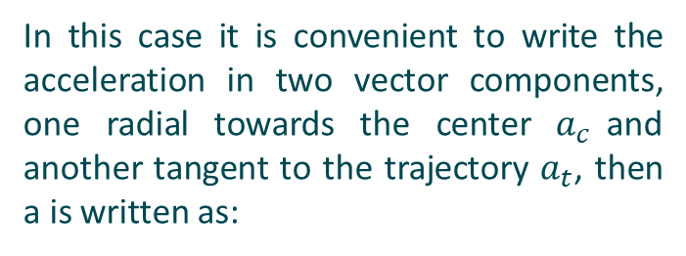





Circumferential motion
A two-dimensional motion is that of an object moving by describing a circumferential path.
If during the circumferential motion of an object the velocity changes, it will be tangent to the trajectory.
In this case it is convenient to write the acceleration in two vector components, one radial towards the center $a_{c}$and another tangent to the trajectory $a_{t}$, then a is written as:
$$a=\sqrt{a_{t}^{2}+a_{c}^{2}}$$
$$r$$
$$a_{c}$$
$$a$$
$$v$$
$$a_{t}$$

Slide 8
Rotational movement
1.2

Slide 9





Rotational movement
Circular motions are those in which the trajectory is a circumference of radius R.
The space traveled s is expressed as a function of the angle θ.
The angular velocity is expressed as a function of ω.
Angular acceleration is expressed as a function of the α.
Angular velocity and angle traveled with respect to time:

Slide 10










Rotational movement
The circular path of a point in the solid around the axis of rotation.
$$Δθ: Angle traveled$$
$$O: Solid center$$
$$r$$
$$P: Lineal observation point$$
$$O$$
𝛥θ
$$r: Radio$$
𝟂
$$a_{c}$$
$$ΔS:Linear displacement$$
𝛥S
$$v$$
$$P$$
$$ω: Angular velocity$$
$$a_{c}: Circumferential or normal acceleration$$

Slide 11
Case study
2
Transmission engine - wheel

Slide 12
Transmission engine - wheel
2.1

Slide 13
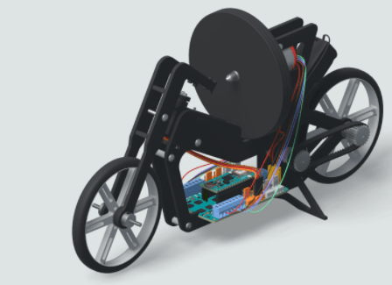











Transmission by pulleys
The circular path of a point in the solid around the axis of rotation.
v
$$r$$
$$R$$
$$V´$$
$$R´$$
$${\text{ω} }_{1}$$
$${\text{ω} }_{2}$$
$$v={\text{ω} }_{1}⋅r$$
$${\text{ω} }_{1}⋅r={\text{ω} }_{2}⋅R$$
$$v={\text{ω} }_{2}⋅R$$
$$V^{′}=\frac{{\text{ω} }_{1}⋅r}{R}⋅R^{′}$$
$$V´={\text{ω} }_{2}⋅R´$$

Slide 14
Case in practice
3
Self-balancing Motorcycle

Slide 15
Introduction to the robot
3.1

Slide 16

Self-balancing Motorcycle
The self-balancing motorcycle consists of a two-wheeled robot that can balance and move with a rotary disc or flywheel.

Slide 17
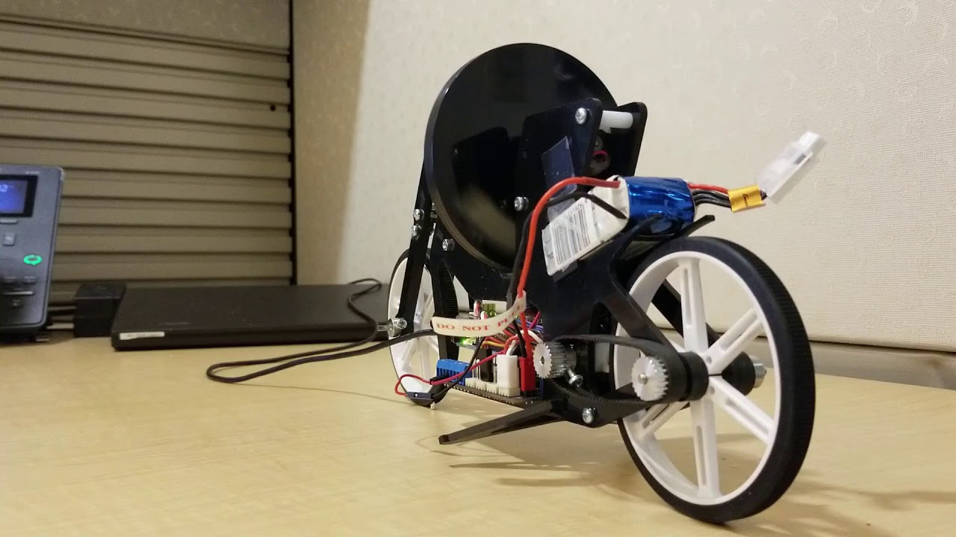
Self-balancing Motorcycle
The transmission is carried out by means of two interconnected toothed pulleys with a timing belt.

Slide 18
Working with MATLAB & Simulink
3.2

Slide 19
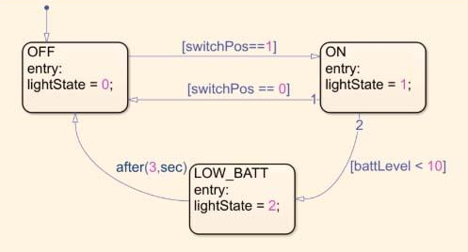


Simulink Stateflow as modeling tool
Graphic design of state machines
Model the logic of systems using state machines.
Define states and joins connected by transitions to create state machines graphically.
Runs and displays system behavior for analysis and debugging.
Control logic design using Simulink Stateflow

Slide 20
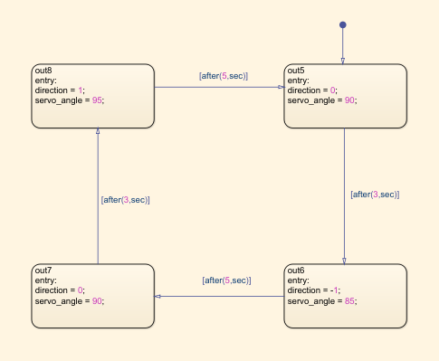
Motion modeling with Stateflow
Exercise proposal:
Compile the Simulink “Motorcycle with motion” model and upload it to your Arduino Engineering Kit.
The model will allow you to make the motorcycle move in one direction. Modifies the model so that it moves by making curves. Use the diagram to help you in your steps.
Control logic design using Simulink Stateflow

Slide 21
Eskerrik asko
Muchas gracias
Thank you
Loramendi, 4. Apartado 23
20500 Arrasate – Mondragon
T. 943 71 21 85
info@mondragon.edu

