Slide 1
Computational mathematics

Slide 2
Acquiring knowledge for computational calculus with MATLAB

Slide 3
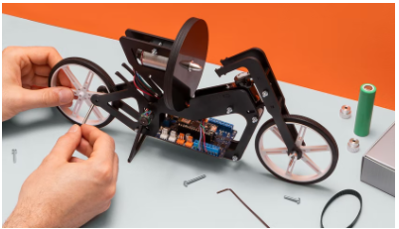


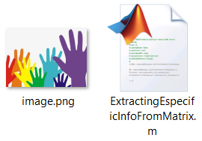
Introduction
Competencies
Computational mathematics
Learning with Arduino Engineering Kits…
SELF-BALANCING MOTORCYCLE
WEBCAM CONTROLLED ROVER
DRAWING ROBOT
Required files:

Slide 4
Elementary mathematics
1

Slide 5
Arithmetic operations
1.1

Slide 6
Basic arithmetic
Arithmetic functions include operators for simple operations, such as addition and multiplication, as well as functions for common calculations.
plus, +
C = A + B C = plus (A,B) | A = [0 1; 1 0]; C = A + 2 | C = plus (A + 2) | C => [2 3; 3 2]
sum
S = sum(A) | A = 1:10; S = sum(A) | S => 55
minus, -
C = A - B C = minus (A, B) | A = [2 1; 1 3]; C = A - 2 | C = minus (A, 2) | C => [0 -1; -1 1]
diff
S = diff (A) | A = [3 5]; S = diff (A) | C => -2

Slide 7
Priority rules
1.2

Slide 8
Priority rules
Arithmetic operations are NOT always performed in the order in which they are written. The order is determined by the following rules:
Exponentiation.
Multiplications and divisions.
Additions and subtractions.
Within each group, from left to right. To change this order, the parentheses are used.
If there are parentheses, their contents are calculated before the rest. If there are nested parentheses, the innerst parentheses are performed first.

Slide 9
Mathematical functions
1.3

Slide 10
Mathematical functions
There is a long list of mathematical functions built into MATLAB. these The functions are called built-in. Many standard mathematical functions, such as sin(x), cos(x), and log(x) are evaluated using the sin, cos, tan, and log functions respectively in MATLAB.
cos(x) | Cosine |  | abs(x) | Absolute value
sin(x) | Sine |  | sign(x) | Signum function
tan(x) | Tangent |  | max(x) | Maximum value
acos(x) | Arc cosine |  | min(x) | Minimum value
asin(x) | Arc sine |  | ceil(x) | Round towards +∞
atan(x) | Arc tangent |  | floor(x) | Round towards −∞
exp(x) | Exponential |  | round(x) | Round to nearest integer
sqrt(x) | Square root |  | rem(x) | Remainder after division
log(x) | Natural logarithm |  | angle(x) | Phase angle
log10(x) | Common logarithm |  | conj(x) | Complex conjugate

Slide 11
Mathematical constants
1.4

Slide 12
Mathematical constants
Some numeric constants are predefined:
pi | The π number, π = 3.14159 . . .
i, j | The imaginary unit i, √ −1
Inf | The infinity, ∞
NaN | Not a number

Slide 13
Data management
2

Slide 14
Numeric data types
2.1

Slide 15
Numeric data types
By default, MATLAB stores all numeric values as double-precision floating-point values. If desired, you can choose to store any number, such as integer or single-precision values. To do this it is necessary to use the following functions:
double(x) | Double-precision arrays
single(x) | Single-precision arrays
int8(x) | 8-bit signed integer arrays
int16(x) | 16-bit signed integer arrays
int32(x) | 32-bit signed integer arrays
int64(x) | 64-bit signed integer arrays
uint8(x) | 8-bit unsigned integer arrays
uint16(x) | 16-bit unsigned integer arrays
uint32(x) | 32-bit unsigned integer arrays
uint64(x) | 64-bit unsigned integer arrays

Slide 16
Variables
2.2

Slide 17
Variables
When you have to do long calculations, it is interesting to save intermediate results for later use. A variable is a symbolic name that identifies a portion of memory, in which numbers or other data can be stored. The contents of a variable can be retrieved and modified as many times as desired. In MATLAB, variable names must be formed as follows:
By letters and numbers Up to a maximum of 19 characters Start with a letter.
It should be noted that it is case-sensitive.

Slide 18
Arrays
2.3

Slide 19
Arrays
Two-dimensional arrays of real or complex numbers are the basic objects that works with. Vectors and scalars are particular cases of matrices.
The most elementary way to introduce matrices into MATLAB is to describe their elements exhaustively (by rows and in straight brackets [ ]): elements of one row are separated from each other by commas and one row from the next by semicolons.
>> v = [1, -1, 0, abs(var)] % vector fila longitud 4
>> w = [0; 1.003; 2; 3; 4; 5*pi] % vector columna longitud 6
>> a = [1, 2, 3, 4; 5, 6, 7, 8; 9, 10, 11, 12] % matriz 3x4

Slide 20
Arrays
Transposed arrays
>> A = [1, 2; 3, 4];
>> B = A’; B --> [1 3; 2 4;]
ans =
1 3
2 4
>> A = [1 2 3 4];
>> B = A’; B --> [1; 2; 3; 4;]
ans =
1
2
3
4

Slide 21
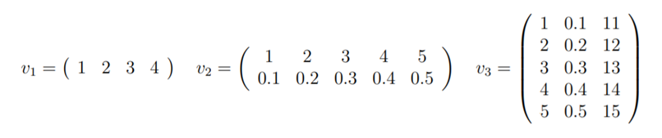
Arrays
Block-constructed arrays
>> v1 = 1:4;
>> v2 = [v1, 5; 0.1:0.1:0.5]
>> v3 = [v2', [11,12,13,14,15]']

Slide 22
Arrays
Accessing individual elements of an array
>> A = [1, 2, 3; 6, 3, 1; -1, 0, 0; 2, 0, 4]
A =
1 2 3
6 3 1
-1 0 0
2 0 4
>> A(2, 3)
ans = 1
>> A(4, 2) = 11
A =
1 2 3
6 3 1
-1 0 0
2 11 4

Slide 23
Arrays
Last index of a vector
>> w = [5, 3, 1, 7, 3, 0, -2];
>> w(end)
ans =
-2
>> w(end-1) = 101
w =
5 3 1 7 3 101 -2

Slide 24
Arrays
Accessing entire rows or columns
>> A = [1, 2, 3; 6, 3, 1; -1, 0, 0; 2, 0, 4];
>> A(:, 3)
ans =
3
1
0
4
>> A(2, :)
ans =
6 3 1

Slide 25
Factoring expressions and solving equations
3

Slide 26
Factoring Expressions
3.1

Slide 27
Factoring Expressions
By default, MATLAB stores all numeric values as double-precision floating-point values. If desired, you can choose to store any number, such as integer or single-precision values. To do this it is necessary to use the following functions:
f (x) = x^5 - 15*x^4 + 85*x^3 - 225*x^2 + 274*x - 120
>> syms x
>> f = x^5 - 15*x^4 + 85*x^3 - 225*x^2 + 274*x - 120
>> factor(f)
ans =
[x - 5, x - 1, x - 2, x - 3, x - 4]

Slide 28
Solving equations
3.2

Slide 29
Solving equations
By default, MATLAB stores all numeric values as double-precision floating-point values. If desired, you can choose to store any number, such as integer or single-precision values. To do this it is necessary to use the following functions:
f (x) = x^5 - 15*x^4 + 85*x^3 - 225*x^2 + 274*x - 120
>> sysms x
>> f = x^5 - 15*x^4 + 85*x^3 - 225*x^2 + 274*x – 120
>> solve (f)
ans =
1
2
3
4
5

Slide 30
Expand equations
3.2

Slide 31
Expand equations
By default, MATLAB stores all numeric values as double-precision floating-point values. If desired, you can choose to store any number, such as integer or single-precision values. To do this it is necessary to use the following functions:
f (x) = (x-1)*(x-2)*(x-3)*(x-4)*(x-5)
>> syms x
>> f = (x-1)*(x-2)*(x-3)*(x-4)*(x-5)
>> expand(f)
ans =
x^5 - 15*x^4 + 85*x^3 - 225*x^2 + 274*x - 120

Slide 32
Case in practice
4
Webcam controlled rover

Slide 33
Introduction of the robot
4.1

Slide 34
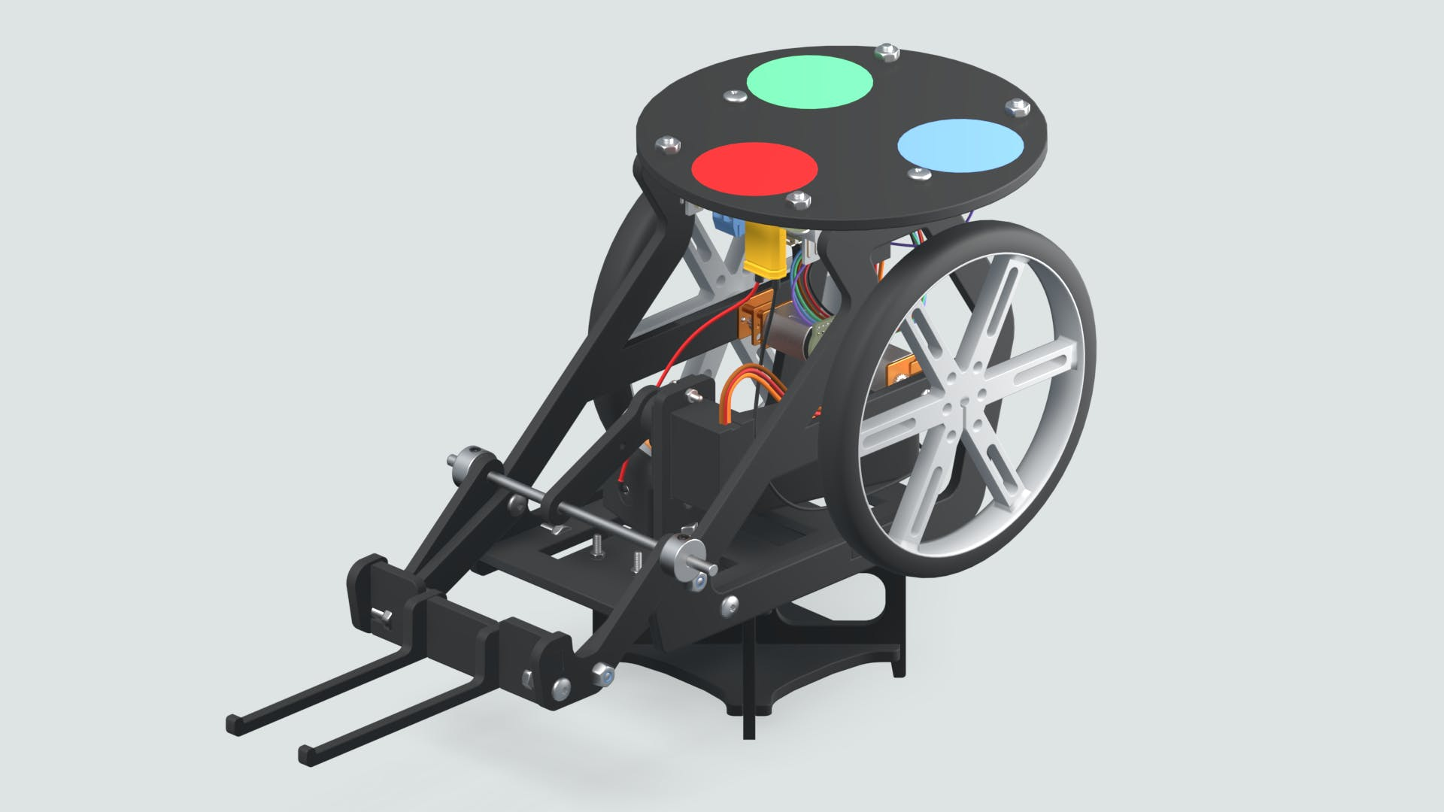

Webcam Controlled Rover
The webcam-controlled rover is about a programmable robot that with the help of an image processing algorithm can be targeted.
A colour-coded sticker will be installed on top of the rover, which will serve as a marker that will help the image processing algorithm and its webcam detect the robot's location and orientation.

Slide 35
Working with MATLAB & Simulink
4.2

Slide 36




Extraction of specific information from a matrix
Exercise proposal:
The MATLAB Script “Extracting Specific Info From Matrix” generates 3 matrices, one for each RGB color. The script shows two examples of how to extract only the desired segments from the arrays that refer to the figures in the image.
From the two examples, extract the following 5 figures by analyzing the composition of the colors. You will see how by executing a single command, massive operations are performed on all the elements of the arrays.

Slide 37
Eskerrik asko
Muchas gracias
Thank you
Loramendi, 4. Apartado 23
20500 Arrasate – Mondragon
T. 943 71 21 85
info@mondragon.edu

