Slide 1
Model-based design

Slide 2
Acquiring knowledge of model-based design

Slide 3
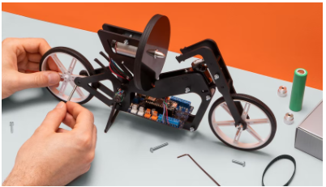
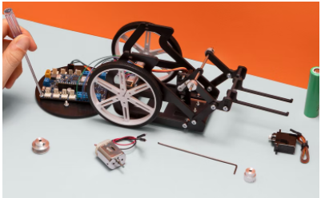
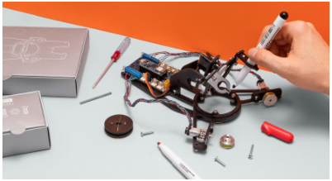
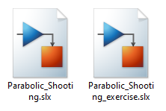
Introduction
Competencies
Model-based design
Learning with Arduino Engineering Kit …
SELF-BALANCING MOTORCYCLE
WEBCAM CONTROLLED ROVER
DRAWING ROBOT
Required files:

Slide 4
Fundamentals
1

Slide 5
Model-based design
1.1

Slide 6
Model-based design
Modeling is a way to create a virtual representation of a real-world system. Allows simulation of virtual representation under a wide range of conditions to see behavior.
Modeling and simulation are valuable for testing conditions that are difficult to reproduce only with hardware prototypes, especially in the early phase of the design process when hardware is not yet available. Iteration between modeling and simulation can improve the quality of the system design from the beginning by reducing the number of errors encountered later in the design process.
The use of a model-based approach has been shown to dramatically reduce development times.

Slide 7
Model-based design
Model-based design allows you to:
Use a common design environment across all project teams. Link designs directly to requirements.
Continuously identifies and corrects errors when integrating tests with the design.
Refine algorithms through simulation. Automatically generate documentation and integrated software code. Develop and reuse the test suite.

Slide 8
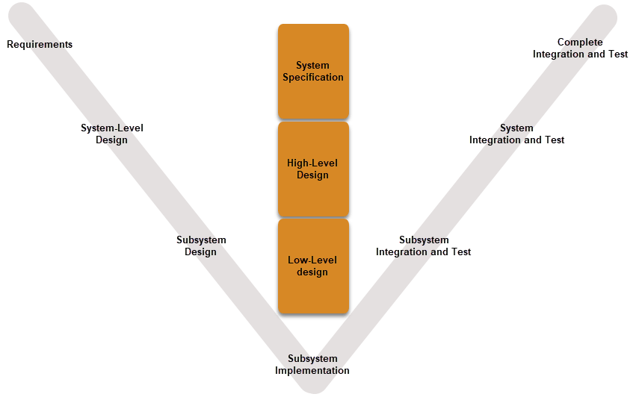
Model-based design

Slide 9
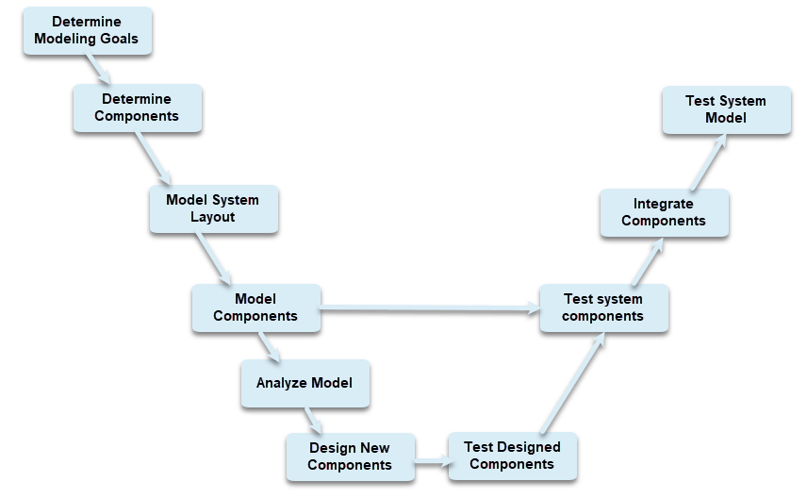
Model-based design with Simulink

Slide 10
Modeling with Simulink
2

Slide 11
Systems Dynamic Modeling with Simulink
2.1

Slide 12


Simulink
Simulink is a graphical editing tool with customizable block libraries and a set of solvers, to model and simulate dynamical systems.
You work in a multidomain block diagram environment under a model-based design.
Simulink enables system-level design and simulation, automatic code generation, as well as continuous testing and verification of embedded systems.
The integration of Simulink with MATLAB, allows you to incorporate algorithms of this language within simulink models, and export the results of the simulation to MATLAB for analysis.

Slide 13
Simulink and dynamical systems
Simulink allows you to model and simulate dynamical systems:
In most cases, these involve time-dependent linear or nonlinear processes (continuous time and discrete time).
Another common way to describe dynamical systems is by using block diagrams.
Block diagrams is a way to understand the behavior of the system by means of a graphical representation:
Representation of individual system components using blocks together with a signal flow between these components.
Simulink's graphical interface allows you to convert a block diagram directly into a Simulink model and with the ability to simulate the operation of the system.
Dynamical systems are described by differential equations by the representation of blocks.
In the simulation process, the reaction of the system to an input signal is obtained.
The reaction of the system can be understood as the solution of the differential equation of the system.

Slide 14
Main features of Simulink
Creation and management of hierarchical block diagrams using graphical editor Predefined block library for modeling continuous and discrete systems Simulation engine using differential equations Elements for observing results (scopes, displays...) Project management and file manager Model analysis tools Importing MATLAB algorithms. Ability to import C/C++ code Model conversion tools to C/C++ Add-ons manager to add new libraries and tools

Slide 15
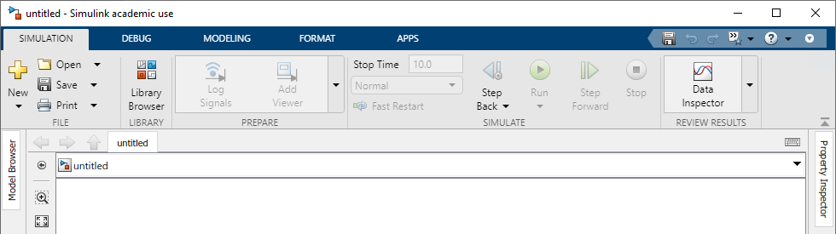
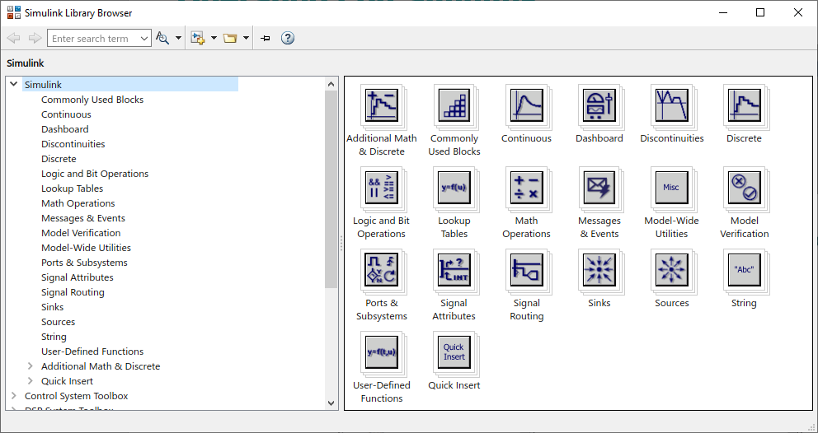
Operating with Simulink
Simulink Library Brower (SLB) displays the available block libraries. Depending on the add-ons and tools installed, more or less items will be available in the library.

Slide 16
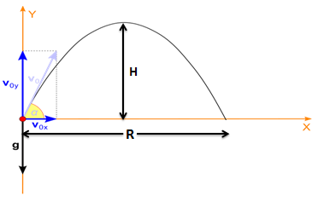
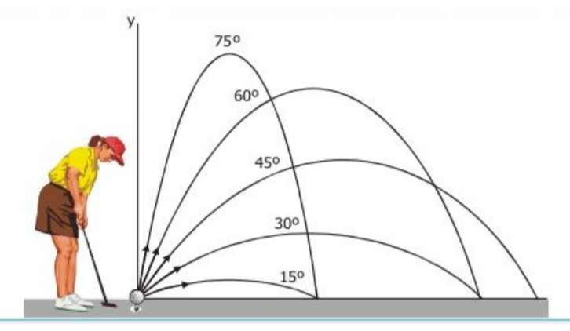
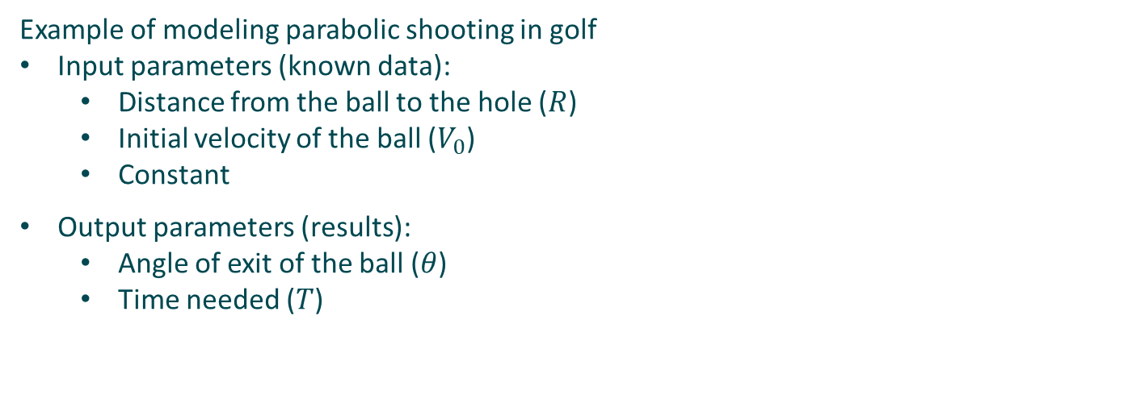


Operating with Simulink
Example of modeling parabolic shooting in golf
Input parameters (known data):
Distance from the ball to the hole ($R$)
Initial velocity of the ball ($V_{0}$)
Constant
Output parameters (results):
Angle of exit of the ball ($θ$)
Time needed ($T$)
$$T=\frac{2V_{0}\sin{θ}}{g}$$
$$θ=\frac{\arcsin\left(\begin{matrix}gR \\ \overline{V_{0}^{2}}\end{matrix}\right)}{2}$$

Slide 17
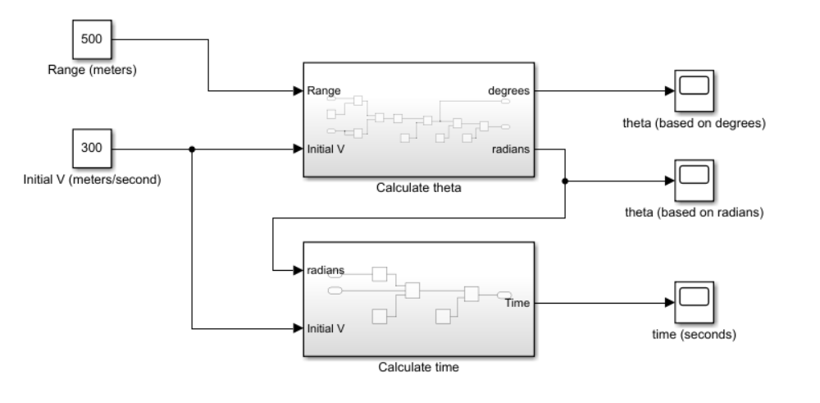
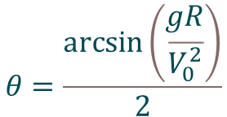

Operating with Simulink
General model
$$θ=\frac{\arcsin\left(\begin{matrix}gR \\ \overline{V_{0}^{2}}\end{matrix}\right)}{2}$$
$$T=\frac{2V_{0}\sin{θ}}{g}$$

Slide 18
Case in practice
3
Parabolic shot modeling

Slide 19
Working with MATLAB & Simulink
3.1

Slide 20
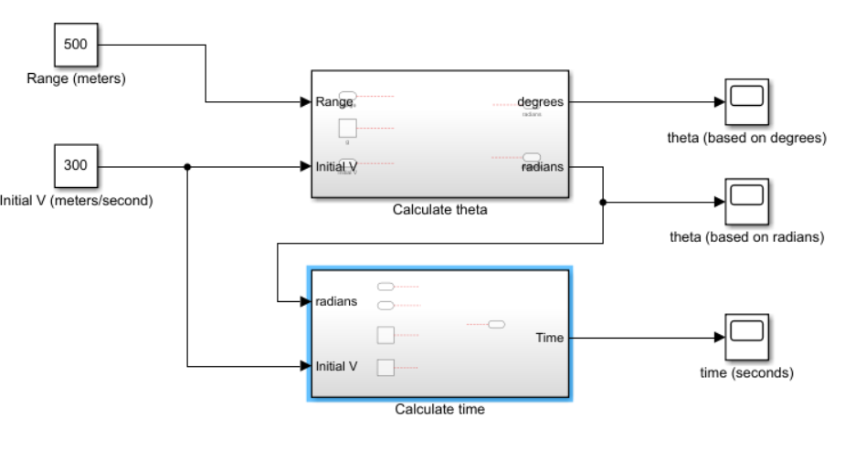
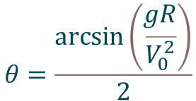

Parabolic shot modeling
Propuesta de ejercicio:
Use the “Parabolic Shooting exercise” model as a base and incorporates the necessary blocks for the subsystems that calculate, firstly, the initial angle of the parabolic shot, and secondly, the time it will take to cover the indicated distance.
Compare the results of your model with the “Parabolic Shoting” model. If the results are not as expected, you can always consult the internal blocks of this latest model.
$$θ=\frac{\arcsin\left(\begin{matrix}gR \\ \overline{V_{0}^{2}}\end{matrix}\right)}{2}$$
$$T=\frac{2V_{0}\sin{θ}}{g}$$

Slide 21
Eskerrik asko
Muchas gracias
Thank you
Loramendi, 4. Apartado 23
20500 Arrasate – Mondragon
T. 943 71 21 85
info@mondragon.edu

