Slide 1
Path following algorithm

Slide 2
Acquiring knowledge of path following algorithm

Slide 3
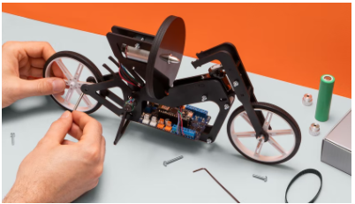
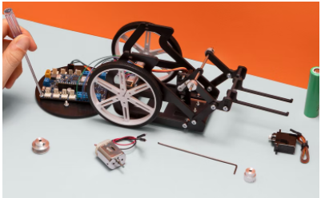
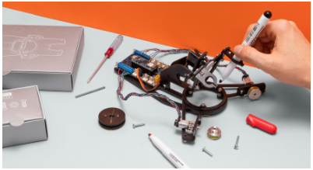
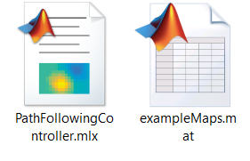
Introduction
Competencies
Path following algorithm
Learning with Arduino Engineering Kits…
SELF-BALANCING MOTORCYCLE
WEBCAM CONTROLLED ROVER
DRAWING ROBOT
Required files:

Slide 4
Before we begin...
The following algorithm shows how to control a robot to follow the desired path using a robot.
This algorithm uses the pure chase route tracking controller to drive a robot along a predetermined route.
A default route is a set of waypoints explicitly defined or calculated by a route planner.
It creates a Pure Pursuit path controller for a differential unit robot and calculates the control commands to follow a given path.

Slide 5
Route tracking for a differential drive robot
1

Slide 6
Algorithm
1.1

Slide 7
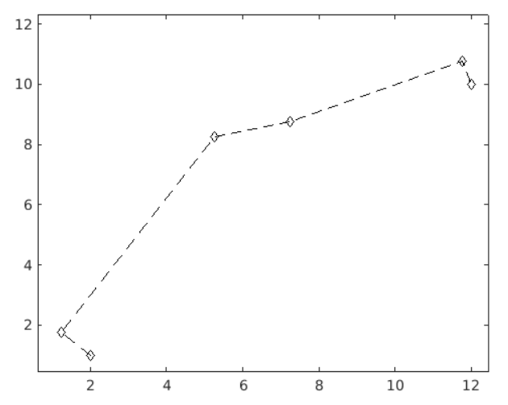
Define waypoints and initial preración
Define a set of reference points for the desired path for the robot.
path = [
2.00 1.00;
1.25 1.75;
5.25 8.25;
7.25 8.75;
11.75 10.75;
12.00 10.00
];
Set the current location and target location of the robot as defined by the route.
robotInitialLocation = path(1,:);
robotGoal = path(end,:);

Slide 8
Definir waypoints y preración inicial
Define an initial orientation of the robot (the orientation of the robot is the angle between the robot's bearing and the positive x-axis).
initialOrientation = 0;
Create the object that defines the current position and orientation for the robot [x and theta].
robotCurrentPose = [robotInitialLocation initialOrientation];

Slide 9
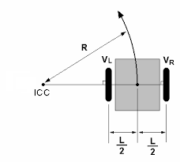


Create a kinematic robot model
Definition of the robot model with differential drive
trackWidthToAxis = 1;
wheelRadius = 1;
linearVelocity = 2;
$$ω$$
$$V$$

Slide 10
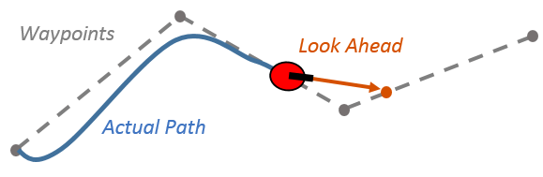
Define the route tracking handler: Pure Pursuit
Pure Pursuit is a route tracking algorithm.
Calculates the angular velocity that moves the robot from its current position to reach some point forward in the robot's path. The linear velocity is assumed constant.
We may think that the robot will constantly be chasing a new position on the path in front of it, but the LookAheadDistance property decides how far the lookahead is placed.
LookAheadDistance calculates a search point on the defined route, which is a local target for the vehicle. The angular velocity is calculated based on this target.

Slide 11
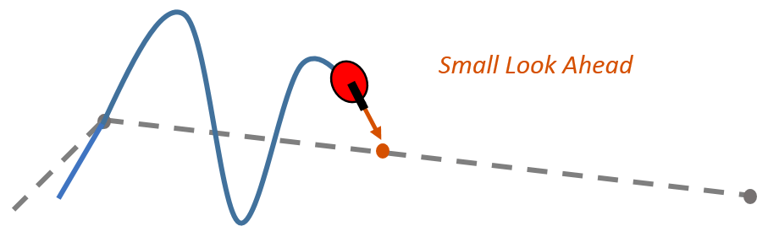
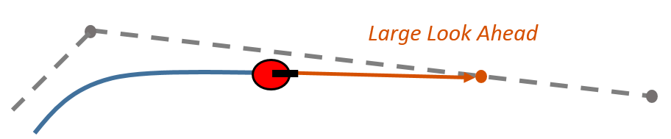
Define the route tracking handler: Pure Pursuit
Depending on the value defined it can have a significant impact on the performance of the algorithm.
A longer forward search distance results in a smoother trajectory for the vehicle but can cause the vehicle to cut corners along the path.
A low look-ahead distance can lead to oscillations in route tracking, causing unstable behavior.

Slide 12
Route Tracking Driver: Pure Pursuit - Limitations
There are limitations to keep in mind about this pure search algorithm:
The controller cannot exactly track the direct paths between the points that define the route. Parameters must be adjusted to optimize performance.
This pure pursuit algorithm does not stabilize the robot at one point. During application, a permissive distance threshold (GoalRadius) should be applied in order to stop the robot as close as possible to the final destination position.

Slide 13
Defining the Route Trace Handler
The route tracking controller model provides input control data for the robot, which the robot uses to drive itself along the desired route.
A target radius is defined, which is the desired distance threshold between the robot's final location and the target location. Once the robot is at this distance from the finish line, it will stop.
GoalRadius = 0.5;
In addition, it calculates the current distance between the location of the robot and the location of the target. This distance is continuously compared to the radius of the goal and the robot stops when this distance is less than the radius of the goal.
distanceToGoal = norm(robotInitialLocation - robotGoal);

Slide 14
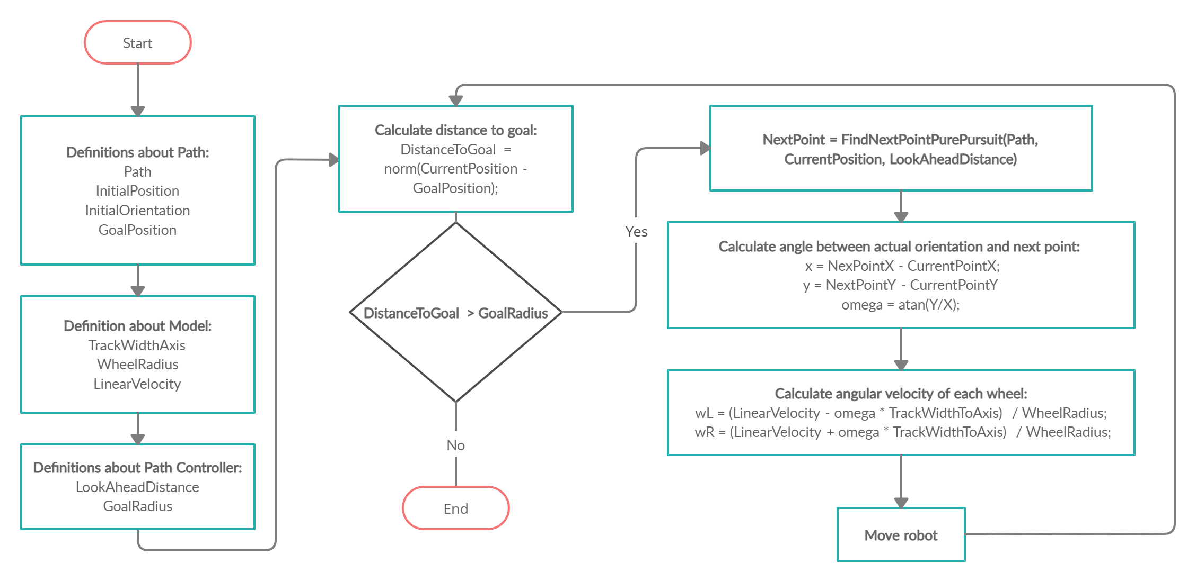
Driving the robot over the desired route points

Slide 15
Path Following with MATLAB & Simulink
2

Slide 16
Available models
2.1

Slide 17
Models and algorithms available online
Path following model
https://es.mathworks.com/matlabcentral/fileexchange/64902-path-following-using-matlab-and-simulink
Path Following for a Differential Drive Robot
https://es.mathworks.com/help/robotics/ug/path-following-for-differential-drive-robot.html
Pure Pursuit based path following algorithm
https://es.mathworks.com/help/robotics/ug/pure-pursuit-controller.html?searchHighlight=Pure%20Pursuit%20&s_tid=srchtitle
Path following algorithm with obstacle detection and collision avoidance
https://es.mathworks.com/help/nav/ug/path-following-with-obstacle-avoidance-in-simulink.html
Vision-based path following algorithms
https://es.mathworks.com/matlabcentral/fileexchange/91475-vision-based-path-following-algorithm

Slide 18
Case in practice
3
Webcam controlled rover

Slide 19
Introduction of the robot
3.1

Slide 20
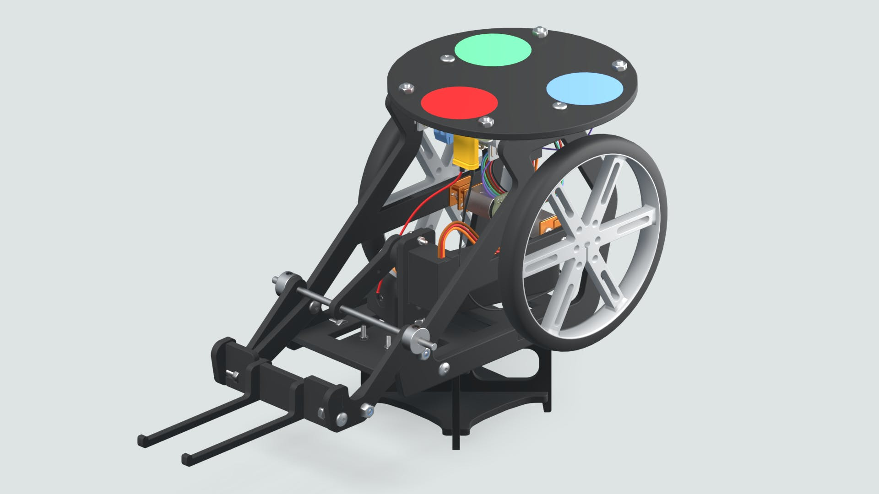

Webcam Controlled Rover
The webcam-controlled rover is about a programmable robot that with the help of an image processing algorithm can be targeted.
A colour-coded sticker will be installed on top of the rover, which will serve as a marker that will help the image processing algorithm and its webcam detect the robot's location and orientation.

Slide 21
Working with MATLAB & Simulink
3.2

Slide 22


Definition of points on the path
Exercise proposal:
Opens the MATLAB Live Script “Path Following Controller” and the “Example Maps” data holder. In the latter it defines a map in binary form inside an array. The '1' define obstacles, the '0' define the traversable area. Below you can choose two ways to define the points that will make up the route that the rover 1- You can define the route by specifying the points where the rover will travel.
2- Or you can simply define the origin and destination and run the PRM path planning algorithm to create the route points.
As a curiosity, if in both methods you define the same origin and the same destination, you will be able to assess if the route you defined by hand is as optimal as the one generated by the PRM algorithm.

Slide 23
Eskerrik asko
Muchas gracias
Thank you
Loramendi, 4. Apartado 23
20500 Arrasate – Mondragon
T. 943 71 21 85
info@mondragon.edu

