Slide 1
Simulations

Slide 2
Acquiring knowledge about simulation

Slide 3
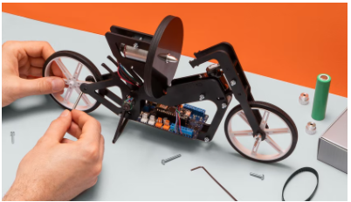
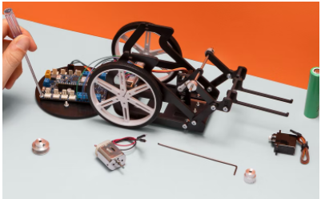
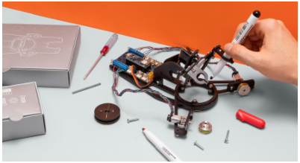
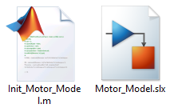
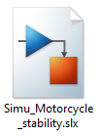
Introduction
Competencies
Simulation of control systems using models
Aprendiendo con Arduino Engineering Kit …
SELF-BALANCING MOTORCYCLE
WEBCAM CONTROLLED ROVER
DRAWING ROBOT
Required files:

Slide 4
Simulation with Simulink
1

Slide 5
Model simulation
It allows the simulation of virtual representation in a wide range of conditions to see behavior. Modeling and simulation are valuable for testing conditions that are difficult to reproduce with hardware prototypes alone, especially in the initial phase of the design process when hardware is not yet available. Iteration between modeling and simulation can improve the quality of the system design from the start, by reducing the number of errors found later in the design process.

Slide 6
Phases during simulation
The simulation of a model in Simulink is carried out in three phases:
Building the model Link phase Simulation loop

Slide 7

Build phase
The build phase starts when the "Run" button is pressed
The startup event causes the Simulink engine to invoke the compiler The compiler converts the model to an executable shape

Slide 8
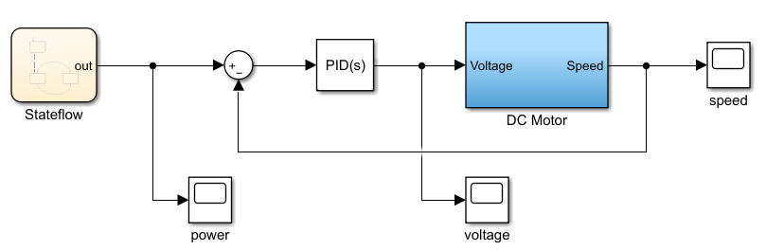
Compiler Functions
Evaluate the expressions of the parameters of the model blocks to determine their values Determine signal attributes:
Name, data type, dimensionality Check that each block can accept the signals connected to its inputs

Slide 9
Link phase
In the binding phase, the Simulink engine:
Allocates the necessary memory for the workspaces required for block diagram execution. Please note:
Signals, states, and runtime parameters
Allocates and initializes memory for the data structures that store runtime information for each block. The Simulink engine creates the execution lists of the methods. These lists list the most efficient order of invoking the methods of the blocks of the model to calculate their outputs.

Slide 10
Simulation loop phase
At the beginning of the simulation (start),
the model specifies the initial states and outputs of the system to be simulated.
In each step (step time), new values are calculated for,
system inputs, states, and outputs
and updates the model to reflect the calculated values.

Slide 11
The simulation loop
In each step time the Simulink engine:
Calculate model outputs Calculate model states Check for discontinuities in continuous blocks Calculate the time for the next time step
Simulink repeats steps 1 to 4 until you reach the end time (stop)

Slide 12
Calculating outputs
In each step time the Simulink engine:
Calculate model outputs Calculate model states Check for discontinuities in continuous blocks Calculate the time for the next time step
Simulink repeats steps 1 to 4 until you reach the end time (stop)

Slide 13
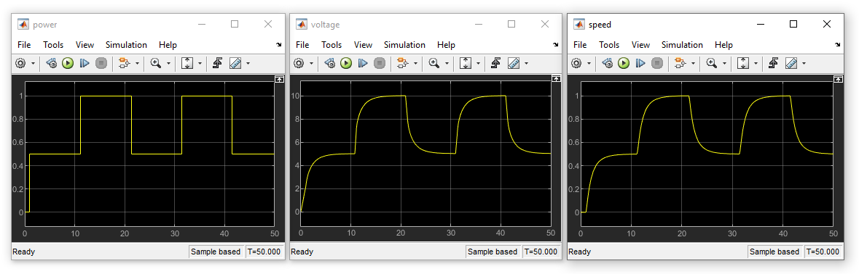
Showing the outputs
The outputs calculated during the simulation are stored and are visible through the "Scopes", so that it is possible to check the operation of the model
Use these files to run this model in simulation

Slide 14
Case in practice
2
Simulation of stability control

Slide 15
Simulation of stability control
2.1

Slide 16
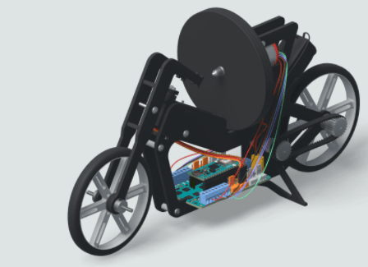

Self-balancing Motorcycle
The self-balancing motorcycle consists of a two-wheeled robot that can balance and move with a rotating disc or flywheel.

Slide 17
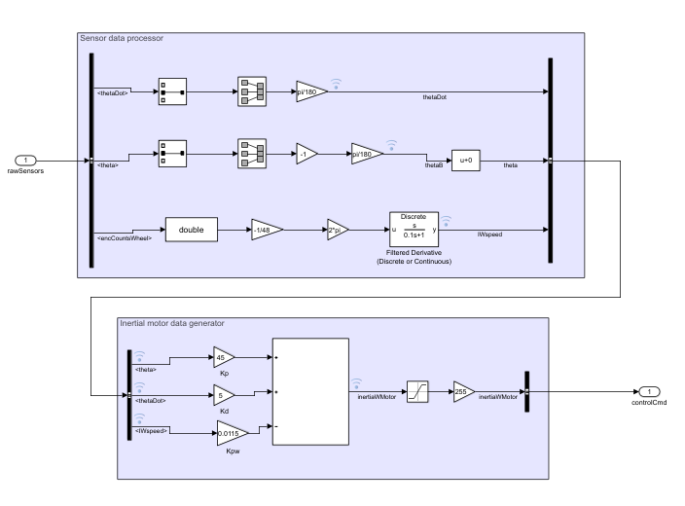
Control for motorcycle stability
The controller subsystem:
processes inertial sensor data generates an output using a proportional-derivative control

Slide 18
Working with MATLAB & Simulink
2.2

Slide 19
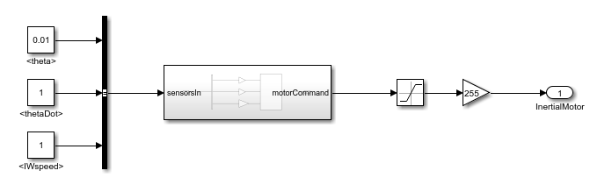


Simulation of stability control
Exercise proposal:
It uses the "Simu Motorcycle stability" model and incorporates signal viewers or "Scopes" at the inputs and outputs of the different elements linked to the control system.
Compile the new model and simulate it.
The viewers will allow you to make an exhaustive analysis of the signals produced, with which you will be able to validate the movement of the inertial motor before uploading it to your Arduino Engineering Kit.

Slide 20
Eskerrik asko
Muchas gracias
Thank you
Loramendi, 4. Apartado 23
20500 Arrasate – Mondragon
T. 943 71 21 85
info@mondragon.edu

