Slide 1
Robot movement

Slide 2
Acquiring knowledge of robot movement

Slide 3
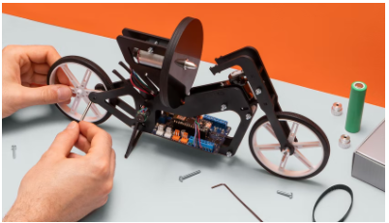
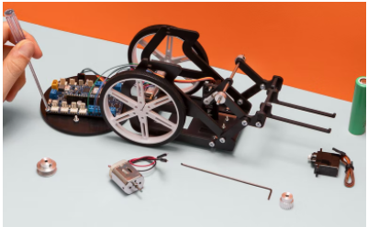
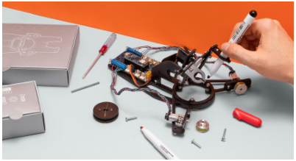
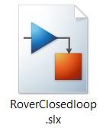
Introduction
Competencies
Robot movement
Learning with Arduino Engineering Kits…
SELF-BALANCING MOTORCYCLE
WEBCAM CONTROLLED ROVER
DRAWING ROBOT
Required files:

Slide 4
Fundamentals
1

Slide 5
Robot movement
Autonomous robots in general do not move with perfect precision. Its displacement is usually affected by its environment and its own mechanics.
When a person drives a car, bicycle... you can constantly self-correct to make sure you're driving in a straight line or turning at the right angle to make a curve.
From a point of view of the movement that a robot must perform at each moment or moment, how can we indicate a robot to perform this correction?
If we have a desired route or movement for the robot to perform, it is possible to implement an algorithm called "PID Controller".

Slide 6
Open loop vs closed loop
1.1

Slide 7
Open loop
If a robot is directed by an open loop controller, the output of the system will have no effect on the input control action and therefore no effect on the motion controller.
Robot
Desired distance
Current position
Velocity
CONTROL
PROCESS

Slide 8
Closed loop
Si un robot es dirigido por un sistema de lazo cerrado, la salida se retroalimenta como entrada para reducir errores y aumentar la estabilidad. La arquitectura es similar a la de un sistema de lazo abierto pero se diferencia en que parte de la salida proporciona datos de entrada (retroalimentación).
En este tipo de sistemas, la señal de referencia se puede comparar el valor medido, proporcionando un valor de error.
Robot
Desired distance
Current position
Velocity
CONTROL
PROCESS
SENSORS
+
-

Slide 9
Control via PID
1.2

Slide 10

PID: Proportional Integral Derivative
PID stands for Proportional Integral Derivative and is the different methods for dealing with the error between the process variable and the reference signal, which will be used to drive the system.
One way to look at PID is to break it down in terms of looking at the error using past (comprehensive) information, present information (proportional), and future information (derived).
Each answer of the mathematical expression of PID has a coefficient of gain K that adjusts the sensitivity of the system to each term. Terms can be denied by setting the winnings to 0. For example, you could create a P controller by setting I and D to 0.

Slide 11
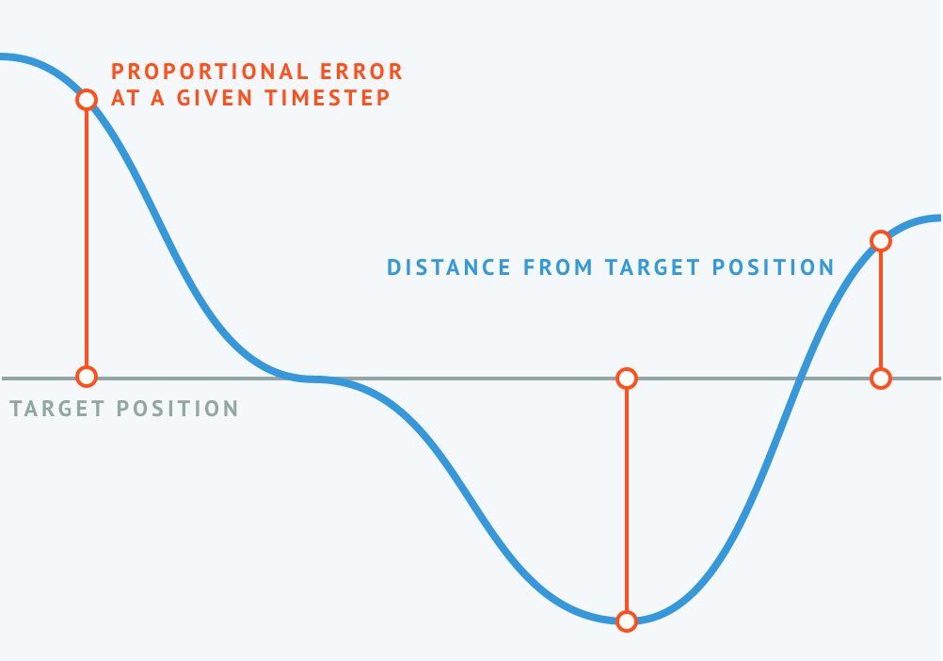
Term P, proportional response
The proportional response examines an error in the present, as it evaluates the distance error proportionally from a given time interval. In other words, if the amount of error is low, there is a small correction. On the contrary, if there is a lot of error, there is a much greater correction.

Slide 12
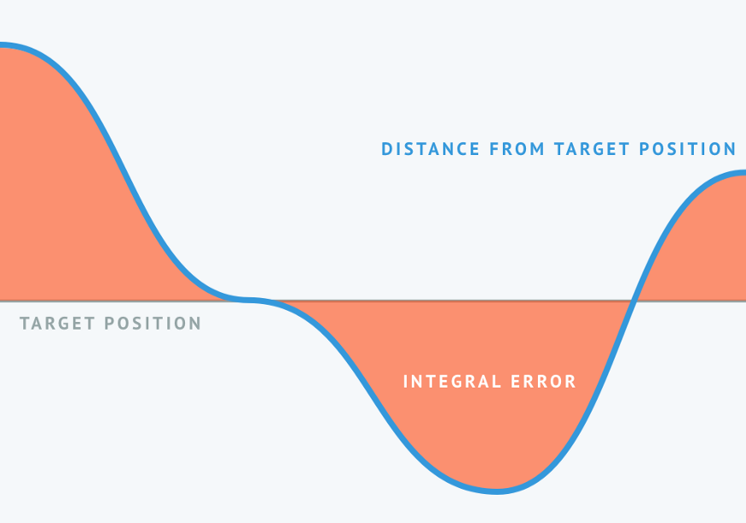
Term I, integral response
The integral helps to see data from the past since it adds up past errors. Even a small error will result in a progressive increase in the comprehensive response, taking into account that something has not been properly corrected over time.

Slide 13
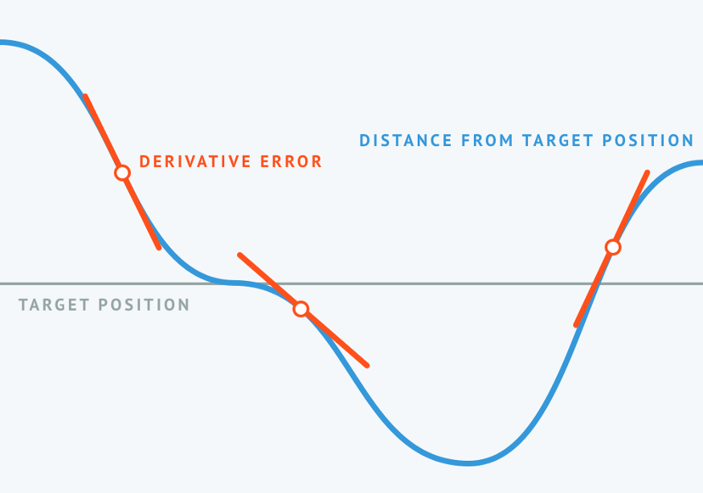
Term D, derived response
The derived response anticipates the future by examining the rate of change of the contributing error in a given time interval. The derived response is proportional to the rate of change of the process variable. When the error change moves slowly, the derived trajectory is small. The faster the error changes, the higher the derived path. It is sometimes called anticipatory control.

Slide 14
Case Study
2
Control the position of the robot using PID

Slide 15
Introduction of the robot
2.1

Slide 16
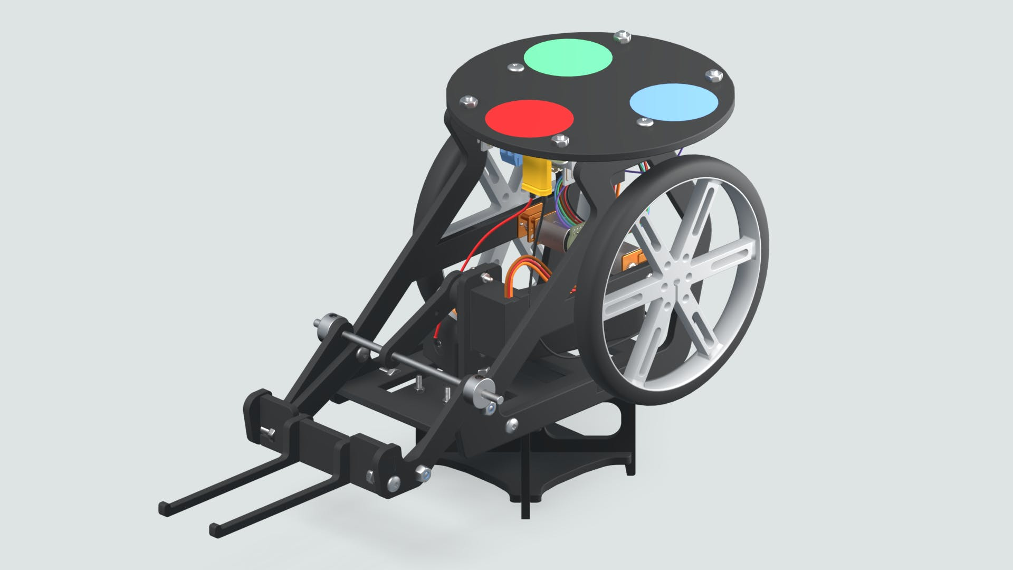

Webcam Controlled Rover
The webcam-controlled rover is about a programmable robot that with the help of an image processing algorithm can be targeted.
A colour-coded sticker will be installed on top of the rover, which will serve as a marker that will help the image processing algorithm and its webcam detect the robot's location and orientation.

Slide 17
Working with MATLAB & Simulink
2.2

Slide 18
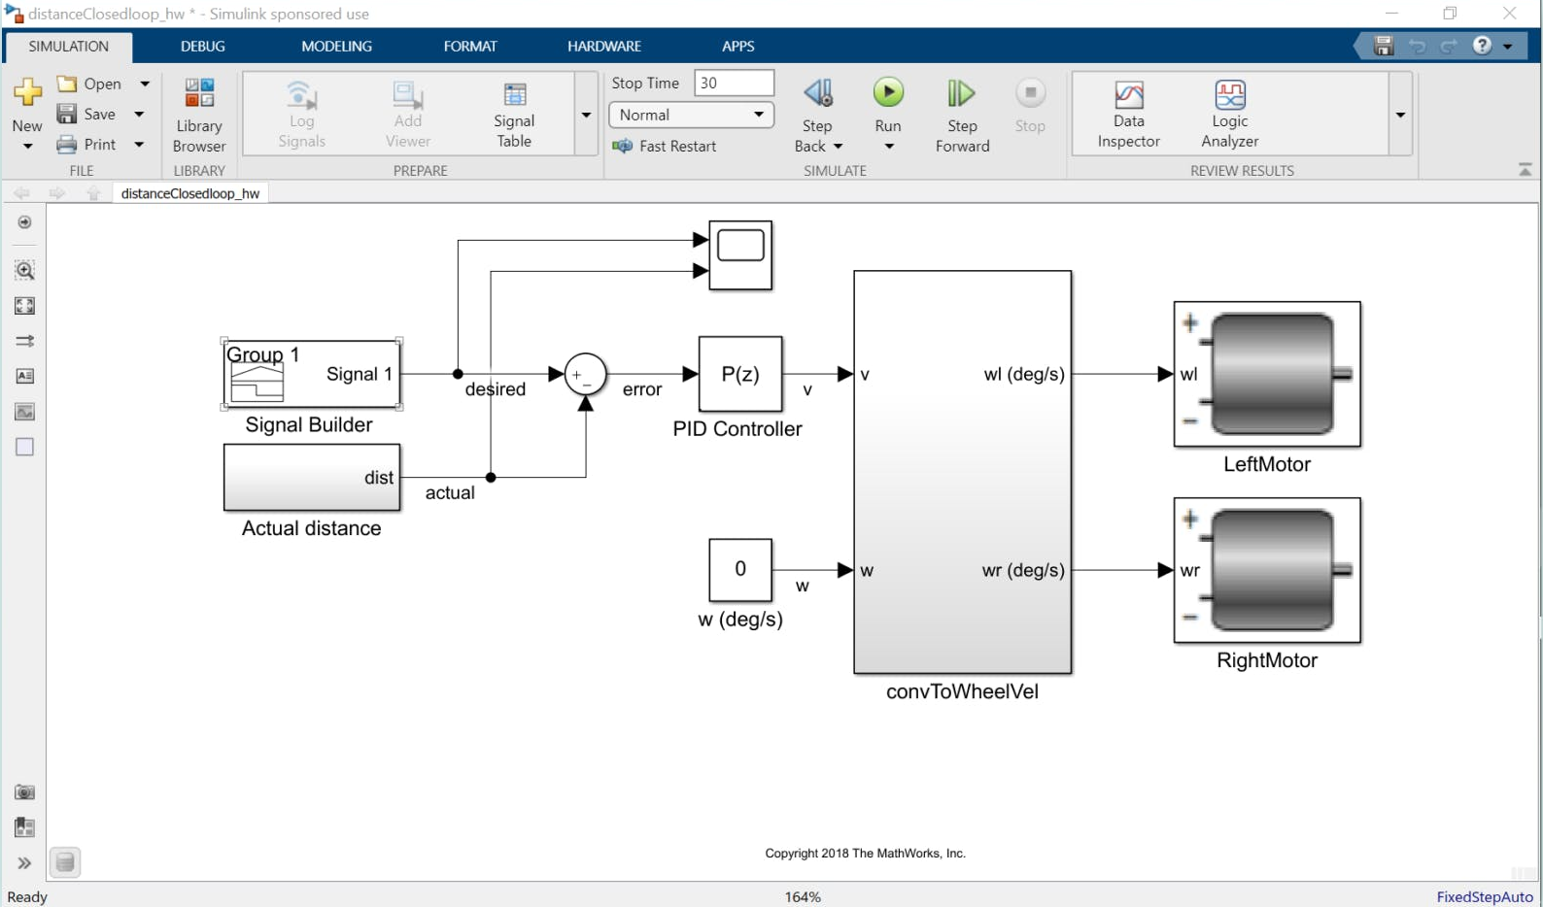
Position control of a robot
The following model is based on a closed loop system where the error term between the current distance of the robot and the desired one is calculated. The current distance is calculated using a sensor device of the robot (rotary encoder).

Slide 19
Position control of a robot
The values of the encoder are multiplied by a constant to convert the encoder readings to distance. The constant is based on the characteristics of the system, more specifically on the radius of the wheel. The result is calculated and subtracted with the desired distance. In this way you get the error (or displacement to be made)

Slide 20

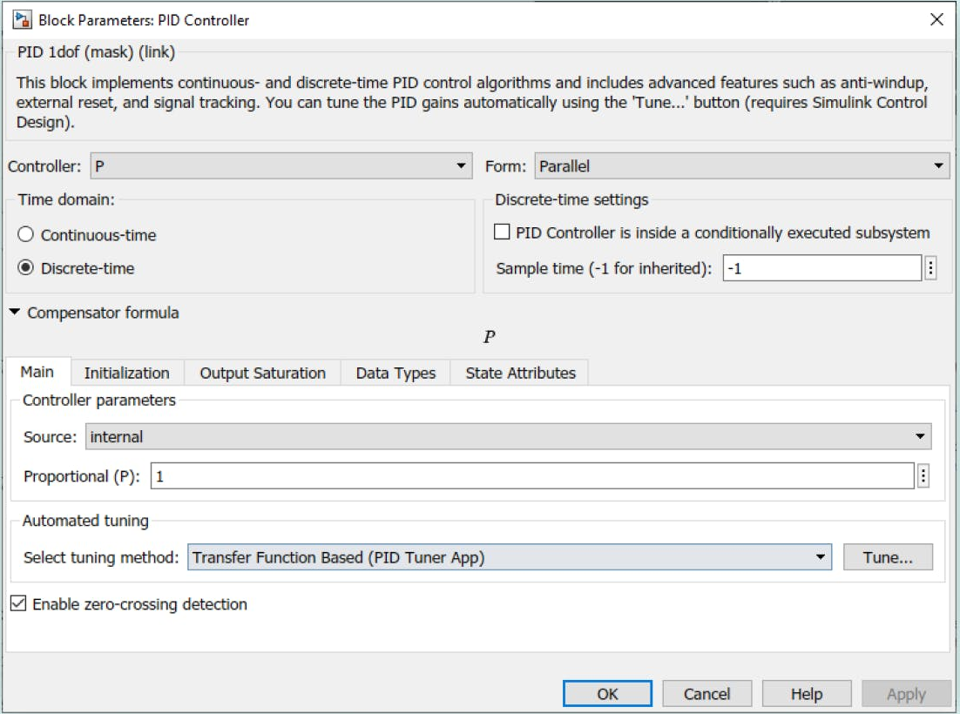
Position control of a robot
The mentioned error is delivered to the PID controller to get the desired output. The PID controller requires the adjustment of the 3 coefficients described above. If the coefficients are chosen incorrectly, the process to be controlled may be unstable. A manual adjustment method consists of:
Set the I and D values to zero first.
Then increase P until the loop output is incile.
Then set P to about half of the previously configured value.
Then increase I until the process adjusts in the required time (beware, raising too much I can cause instability).
Finally, increase D, if necessary, until the loop is fast enough to reach its reference after a sharp variation in load.

Slide 21

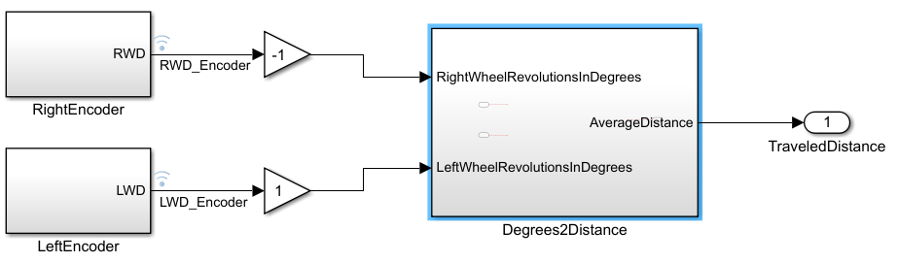


Feedback for control loop
Exercise proposal:
Open the “Rover Closed Loop” model and go to the “Actual distance” subsystem. This will be in charge of calculating the average distance traveled by the rover and therefore acting accordingly by calculating the error and the PID.
The RightEncoder and LeftEncoder blocks read data counts from the wheel encoders and convert them to degrees.
The exercise consists of modeling the "Degrees2Distance" subsystem to convert encoder degrees to the average distance traveled by the rover. To do this, use the following equations:
dr and dl indicate the distance the right and left wheels have moved, respectively, and r is the radius of the wheel

Slide 22
Eskerrik asko
Muchas gracias
Thank you
Loramendi, 4. Apartado 23
20500 Arrasate – Mondragon
T. 943 71 21 85
info@mondragon.edu

