Slide 1
Diferential Kinematics

Slide 2
Acquiring knowledge of kinematics with robots with differential unit

Slide 3
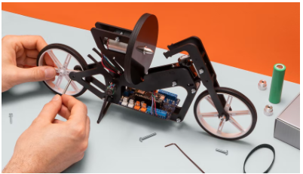
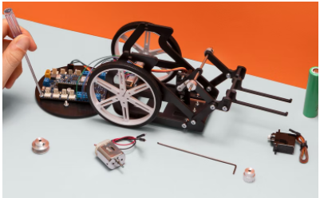
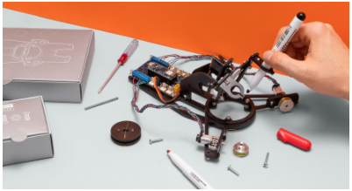

Introduction
Competencies
Diferential Kinematics
Learning with Arduino Engineering Kits…
SELF-BALANCING MOTORCYCLE
WEBCAM CONTROLLED ROVER
DRAWING ROBOT
Required files:

Slide 4
Fundamentals
1

Slide 5
How a differential works
1.1

Slide 6
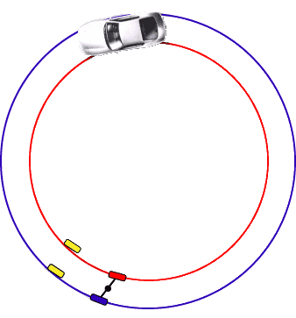
The differential
Generally, a differential fulfills the function of allowing the transmission of turning force to a pair of axles that do not turn solid, this serves to compensate for the difference of meters that travels one wheel with respect to the other in a curve.

Slide 7
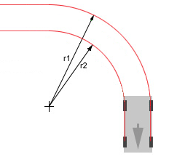
Trayectoria circular
During the movement of the vehicle the wheels move at different speeds in order to maintain a circular trajectory
The speed of the outer wheel of the curve will rotate at a higher speed than the wheel on the inside. This difference in speeds is given by the difference in displacement that must be given by having different radii based on the positions of the wheels with respect to the center of the curve.

Slide 8
Kinematics of the robot differential
1.3

Slide 9
Advantages and disadvantages of differential kinematics
Cheap system Easy to implement Simple design
Difficult to control Requires precision control for straight trajectories

Slide 10
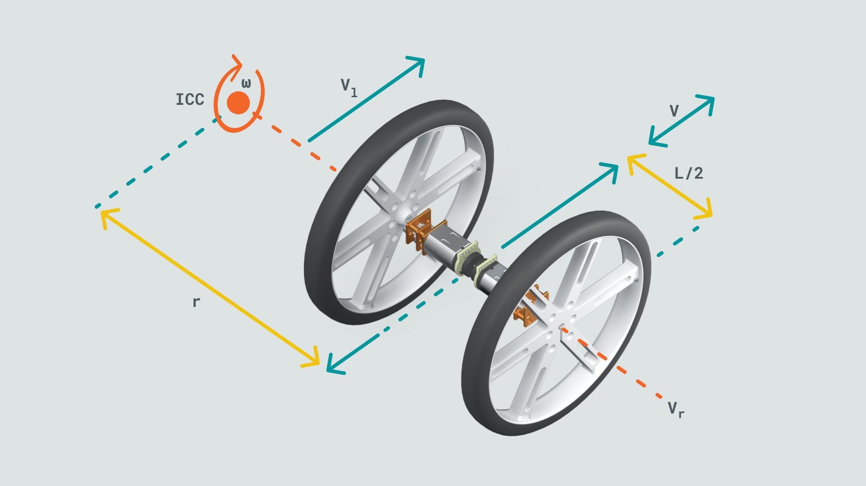
Kinematic modeling of differential robots
Many mobile robots use a drive mechanism known as differential drive. This consists of 2 drive wheels mounted on a common axle, and each wheel can be driven independently forward or backward.
While we can vary the speed of each wheel, for the robot to perform a circular motion, the robot must rotate around a point that lies along its common left and right wheel axes. The point on which the robot rotates is known as ICC (Instantaneous Center of Curvature)

Slide 11
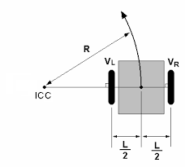







Kinematic modeling of differential robots
By varying the speeds of the two wheels, we can vary the trajectories that the robot takes. Since the rotation over the ICC must be the same for both wheels, the following equations are achieved:
$$V=\frac{V_{R}+V_{L}}{2}$$
$$ω\left(R+\frac{L}{2}\right)=V_{R}$$
$$ω$$
$$V$$
$$R=\frac{L}{2}\frac{V_{R}+V_{L}}{V_{R}−V_{L}}$$
$$ω\left(R−\frac{L}{2}\right)=V_{L}$$
$$ω=\frac{V_{R}−V_{L}}{L}$$

Slide 12

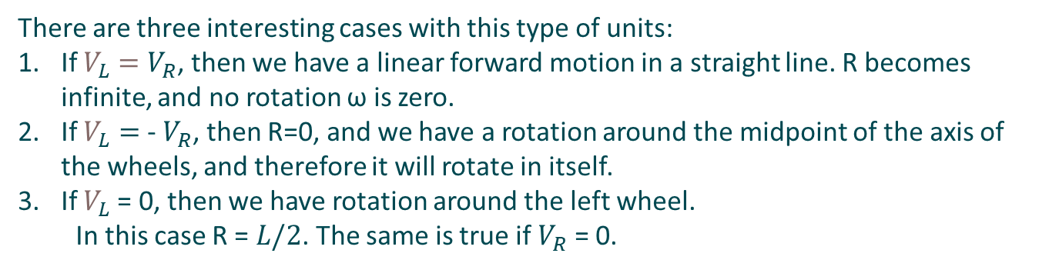


Kinematic modeling of differential robots
There are three interesting cases with this type of units:
If $V_{L}$ $=V_{R}$, then we have a linear forward motion in a straight line. R becomes infinite, and no rotation ω is zero. If $V_{L}=$ - $V_{R}$, then R=0, and we have a rotation around the midpoint of the axis of the wheels, and therefore it will rotate in itself. If $V_{L}$= 0, then we have rotation around the left wheel.
In this case R = $L/2$. The same is true if $V_{R}$ = 0.
$$ω$$
$$V$$
$$V=\frac{V_{R}+V_{L}}{2}$$
$$R=\frac{L}{2}\frac{V_{R}+V_{L}}{V_{R}−V_{L}}$$
$$ω=\frac{V_{R}−V_{L}}{L}$$

Slide 13
Case study
2
Forward kinematics for differential drive robots

Slide 14
Forward kinematics for differential drive robots
2.1

Slide 15

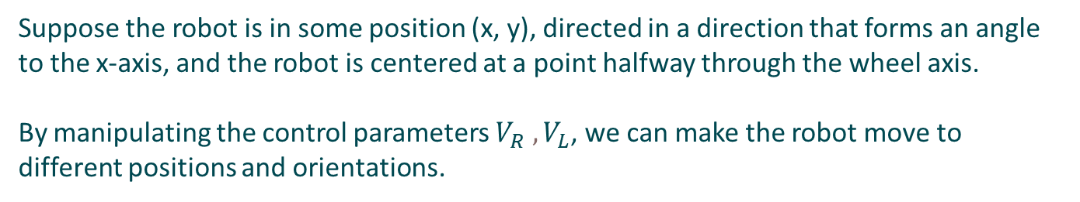



Kinematic modeling of differential robots
Suppose the robot is in some position (x, y), directed in a direction that forms an angle to the x-axis, and the robot is centered at a point halfway through the wheel axis.
By manipulating the control parameters $V_{R}{ ,V}_{L}$, we can make the robot move to different positions and orientations.
$$ω$$
$$V$$
Knowing the speeds $V_{R}{ ,V}_{L}$, we can calculate the ICC point using:
$ICC=$ $[x−R\sin\left(θ\right), y+R\cos\left(θ\right)]$

Slide 16











Kinematic modeling of differential robots
One way to understand the movement of the robot is as follows:
1 – Moving the ICC point to the origin of the coordinate system
a) Starting position:
b) Translation to origin
$$y$$
$$ICC(2, 3)$$
$$y$$
$$ICC(2, 3)$$
P$(2, 1)$
$$ω$$
$$x$$
$$x$$
$$V$$
P$(0, −2)$

Slide 17








Kinematic modeling of differential robots
2 – Rotating around the origin by an angle$θ$ $(ωdt)$
b) Transferred to origin
c) Rotation of 90º with respect to the Z axis
$$y$$
$$ICC(2, 3)$$
$$y$$
$$ICC(2, 3)$$
$$ω$$
$$x$$
$$x$$
$$V$$
P$(2, 0)$
P$(0, −2)$

Slide 18








Kinematic modeling of differential robots
3 – Rotating around the origin by an angle $θ$ $(ωdt)$
c) Rotated 90º
d) Translation to the BCI
$$y$$
$$ICC(2, 3)$$
$$ICC(2, 3)$$
$$y$$
P$(4, 3)$
$$ω$$
$$x$$
$$x$$
$$V$$
P$(2, 0)$

Slide 19
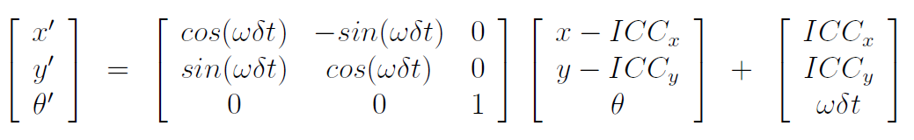










Kinematic modeling of differential robots
The following equation describes the motion of a robot that rotates a distance R around its ICC with an angular velocity of ω
$$ICC(2, 3)$$
$$ω$$
$$y$$
$$ICC(2, 3)$$
$$y$$
$$V$$
P$(4, 3)$
P$(2, 1)$
$$x$$
$$x$$

Slide 20
Case in practice
3
Webcam controlled rover

Slide 21
Introduction of the robot
3.1

Slide 22
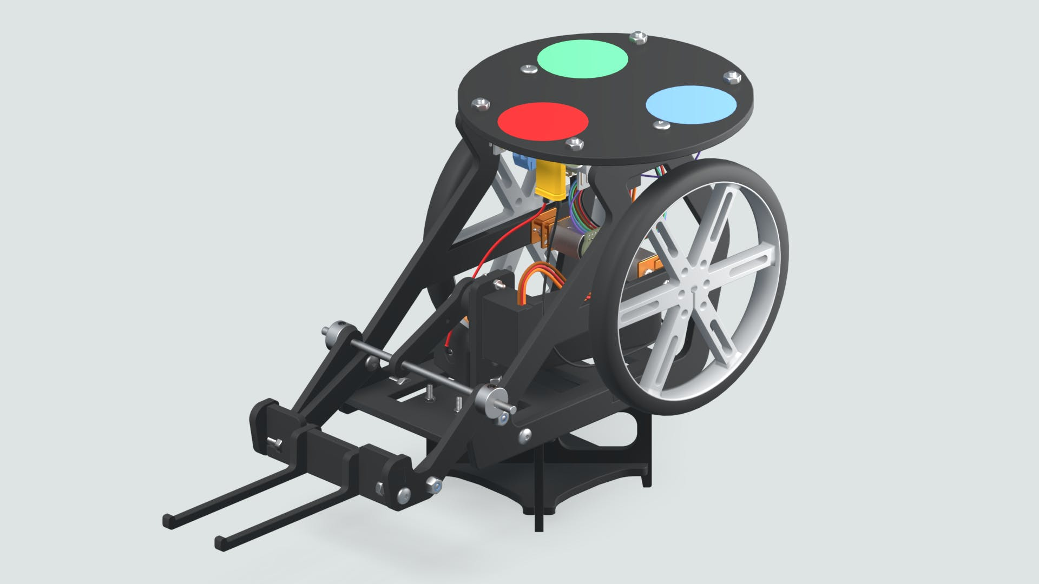

Webcam Controlled Rover
The webcam-controlled rover is about a programmable robot that with the help of an image processing algorithm can be targeted.
A colour-coded sticker will be installed on top of the rover, which will serve as a marker that will help the image processing algorithm and its webcam detect the robot's location and orientation.

Slide 23
Working with MATLAB & Simulink
3.2

Slide 24
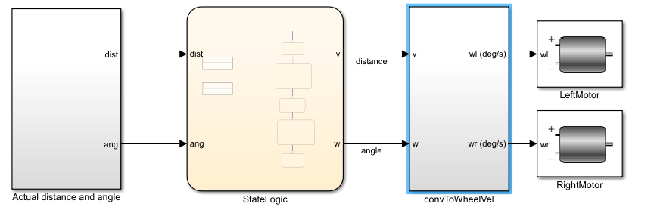


Libraries and functions

Slide 25
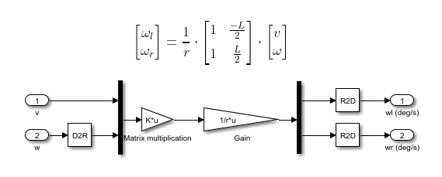
Libraries and functions

Slide 26
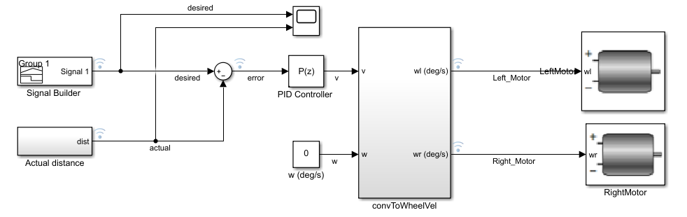
Differential motion modeling
Exercise proposal:
Open the Simulink model “Rover Differential Drive”. In it you will find a block called "Signal Builder" with which you can define the distance that the rover will travel. Runs the model with or without angle of rotation. The model will perform the necessary calculations to increase or decrease the speed of each axis.

Slide 27
Eskerrik asko
Muchas gracias
Thank you
Loramendi, 4. Apartado 23
20500 Arrasate – Mondragon
T. 943 71 21 85
info@mondragon.edu

