Slide 1
Wireless networks

Slide 2
Acquiring knowledge for wireless communication

Slide 3
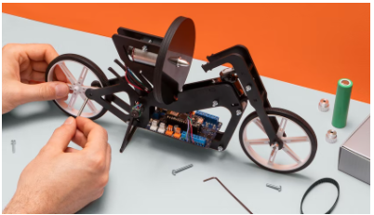
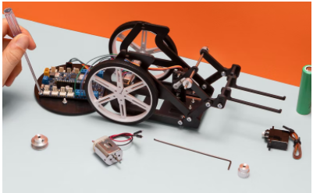
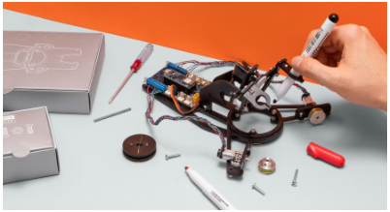
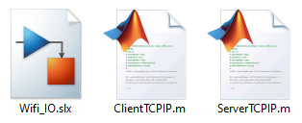
Introduction
Competencies
Wireless networks
Learning with Arduino Engineering Kits…
SELF-BALANCING MOTORCYCLE
WEBCAM CONTROLLED ROVER
DRAWING ROBOT
Required files:

Slide 4
Fundamentals
1

Slide 5
Wireless technologies
1.1
Classification of wireless networks

Slide 6
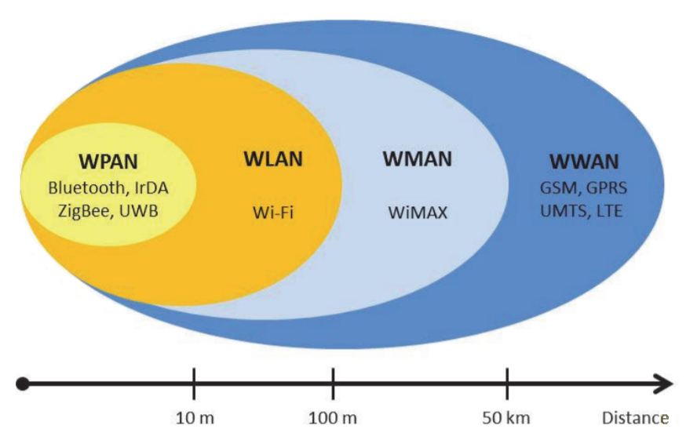
Classification of wireless networks
Wireless networks can be classified into four specific groups according to the application area and signal range:
Wireless Personal-Area Networks - WPAN
Wireless Local-Area Networks - WLAN
Wireless Metropolitan-Area Networks - WMAN
Wireless Wide-Area Networks - WWAN

Slide 7
Classification of wireless networks
In addition, wireless networks can also be divided into two large segments, short-range and long-range:
In short-range networks it refers to networks confined to a limited area.
Applies to local area networks (LANs) and personal area networks (PAN)
They operate on an unlicensed spectrum reserved for industrial, scientific and medical use (ISM band).
The frequencies used differ from country to country. The most common frequency bands are 2.4 GHz and 5 GHz and are available in most of the world.
The availability of these frequency bands allows users to operate without obtaining a license and has therefore facilitated the expansion of such networks.

Slide 8
Classification of wireless networks
In long-range networks connectivity is typically provided by marketing companies as a service.
Applies to metropolitan area networks (WMAN) or wide area networks (WWAN) The goal of this type of network is to provide wireless coverage worldwide

Slide 9
WPAN Networks
1.2
Wireless personal area networks

Slide 10
Wireless personal area networks
Wireless personal area networks are based on the IEEE 802.15 standard. PAN wireless networks allow communication over a very short range of distances, close to 10 meters.
Maintaining a connection requires little or no infrastructure. This enables small, energy-efficient and low-cost solutions. They are characterized by their low power consumption and also a low transmission speed.
From an application point of view:
Bluetooth is intended for a mouse, a keyboard, a hands-free…
IrDA is intended for point-to-point links between two devices for simple data transfer and file synchronization. ZigBee is designed for reliable wireless networks for process tracking and control.
UWB is geared towards high-bandwidth multimedia links.

Slide 11
IrDA
The Infrared Data Association or IrDA specifies a complete set of standards for infrared communications. Low-power, low-cost, and unidirectional (point-to-point) ad-hoc data transmission standard.
It operates at distances of up to 1 meter and at speeds of 9600 bps at 4 Mbps

Slide 12

Bluetooth
Bluetooth belongs to the IEEE 802.15.1 standard. It uses the 2.4GHz band, with transmission speeds between 720Kbps and 5Mbps.
Designed for omnidirectional communications (point to multipoint), low power consumption, short range and replacing the use of cables through an ad hoc radio connection. Devices incorporating this technology are classified into three groups:
Class 1, 100m range Class 2, 10m range Class 3, 1m range

Slide 13

ZigBee
ZigBee is based on the IEEE 802.15.4 standard It is an open global standard that addresses:
Easy-to-apply needs High reliability
Low cost Low consumption Low transmission speeds (250 Kbps) Wireless, operates in unlicensed bands (2.4GHz, 900MHz, 868MHz)
It allows the creation of larger wireless networks that do not require a large amount of data transmission.
Two different types of devices can participate in a ZigBee network:
Full Function Device - FFD
Reduced Function Device - RFD
Supports three different network topologies: star, mesh, and tree

Slide 14

UWB
UWB is based on the IEEE 802.15.3 standard UWB allows the transmission of large amounts of data at high speeds over short distances (110 Mbps - 480 Mbps in a few meters) In Europe it uses frequencies that include two bands: 3.4 GHz to 4.8 GHz and 6 GHz to 8.5 GHz.

Slide 15
WLAN networks
1.3
Wireless local area networks

Slide 16
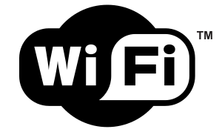
Wireless local area networks
Wireless local area networks (WLANs) are designed to provide wireless access in areas with a typical range of up to 100 meters and are used in both home, school, and/or office environments. WLANs are based on the IEEE 802.11 standard and are marketed under the Wi-Fi brand. Depending on the standard, they use the 2.4GHz and 5GHz bands, which do not require a license. The IEEE 802.11 family of standards has evolved:
IEEE 802.11b: 11Mbps at 2.4GHz
IEEE 802.11g: 54Mbps at 2.4GHz IEEE 802.11n: 600Mbps at 2.4GHz and 5GHz

Slide 17
Architectures
There are two ways to configure the architecture of a WiFi or WLAN: Ad hoc mode:
In this mode all devices on the wireless network communicate directly with each other, in peer-to-peer communication mode. The BSSID is used as the identifier for this network. Suitable for a small group of devices close to each other.
The network has no structure or fixed points. No access point is required for communication between devices. Network performance suffers if the number of devices increases
Cannot connect to a wired local area network

Slide 18
Arquitecturas
Infrastructure mode
In this mode, all devices are connected to the wireless network with the help of an access point or AP (Access Point) Access points have the ESSID identifier. APs are usually routers or switches that transfer data from the wireless network to a wired Ethernet network as a bridge is concerned. Connecting multiple access points over a wired Ethernet backbone can extend the coverage of the wireless network by allowing a mobile device to move out of the coverage range of one access point and into the range of another (free movement without cuts).

Slide 19
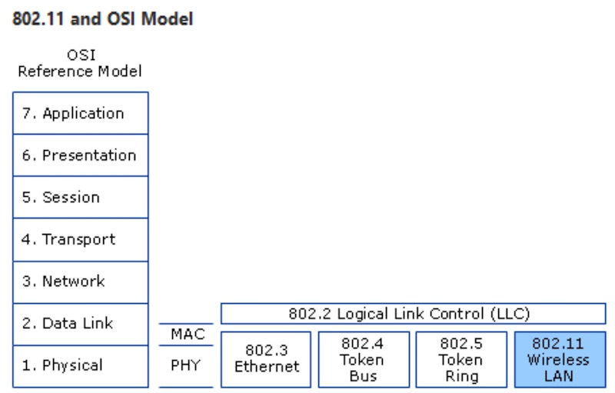
OSI model and IEEE 802.11 layers
The IEEE 802.11 standard implements the first two layers of the OSI model:
1 - The physical layer (PHY or Physical) 2 - The link layer (MAC or Data Link)

Slide 20
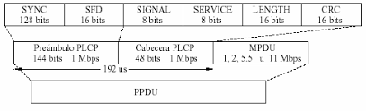
The physical layer (PHY or Physical)
The physical layer defines the modulation and signalling characteristic of the data transmission. It operates in the 2.4 GHz frequency band, occupying 83 MHz of bandwidth between 2,400 and 2,483 GHz. This bandwidth is subdivided into 5 MHz channels, making a total of 14 independent channels (direct sequence spread spectrum or DSSS).
The data frame in the DSSS format is as follows:
Synchronism: It contains a 128-bit encoding that ensures pre-synchronization of the receiver.
Frame start delimiter (SFD): Signals the beginning of the actual plot after the preamble.
Signal: Indicates to the physical layer what type of modulation will be used in the transmission. The speed will be equal to the value of this field multiplied by 1000Kbps.
Service: Reserved for future use. Length: A 16-bit unsigned integer that indicates the number of microseconds required to transmit the data. CRC: Header fields are protected by a CRC-16 frame check sequence.

Slide 21
The link layer (MAC or Data Link)
The main function of this layer is the control of access to the medium, also performing functions such as fragmentation, encryption, power management, synchronization and roaming support between multiple APs. The 802.11 standard uses CSMA/CA as a basic access mechanism
Time
Season
A
A completes the transmission of its frame
B
B and C detect that the media is busy and both wait for a random time
B detects free media and sends its frame
C
C detects busy medium and waits

Slide 22
The Network layer
This layer provides routing and better routing
Allows connectivity and selects the path between two end systems Maintains the routing domain Protocols:
IPv4, IPv6, IPX, Apple talk, IPSec, ICMP, IGMP.

Slide 23
The transport layer
End-to-end connection
Deals with aspects of transport between hosts Reliability of data transport Establish, maintain, and terminate virtual bindings between hosts Fault detection and recovery Control of the flow of information Protocols:
TCP, UDP, SPX
Feature | UDP | TCP
Connection status | Connectionless protocol required | Requires an established connection to transmit data
Guarantee | Does not guarantee delivery | Ensures delivery to the destination router
Data stream | No data stream | It streams data
Transfer method | UDP packets with defined limits; sent and verified in its entirety | The data is treated as a stream of bytes; messages are transmitted depending on the limits set
Data relay | Does not retransmit lost packets | It retransmits lost packets
Error checking | Very basic | Powerful error checking and data recognition
Broadcasting | Yes | No
Speed | Fast | Slow
Recommended use | Video conferencing, streaming, DNS, VoIP, and more | HTTPS, HTTP, SMTP, POP, FTP, and more

Slide 24
The session layer
Communication between hosts
Establishes, manages, and terminates sessions between applications
Protocols:
NetBIOS, L2TP, SAP

Slide 25
The presentation layer
Data representation
Ensure that data is readable by the receiving system
Data format Data structure Negotiates data transfer syntax to the application tier Protocol:
SSL, TLS

Slide 26
The application layer
Network processes to applications
Provides network services to application processes Protocols:
HTTP, POP3, SMTP, IMAP, FTP

Slide 27
Case in practice
2
Webcam controlled rover

Slide 28
Introduction of the robot
2.1

Slide 29
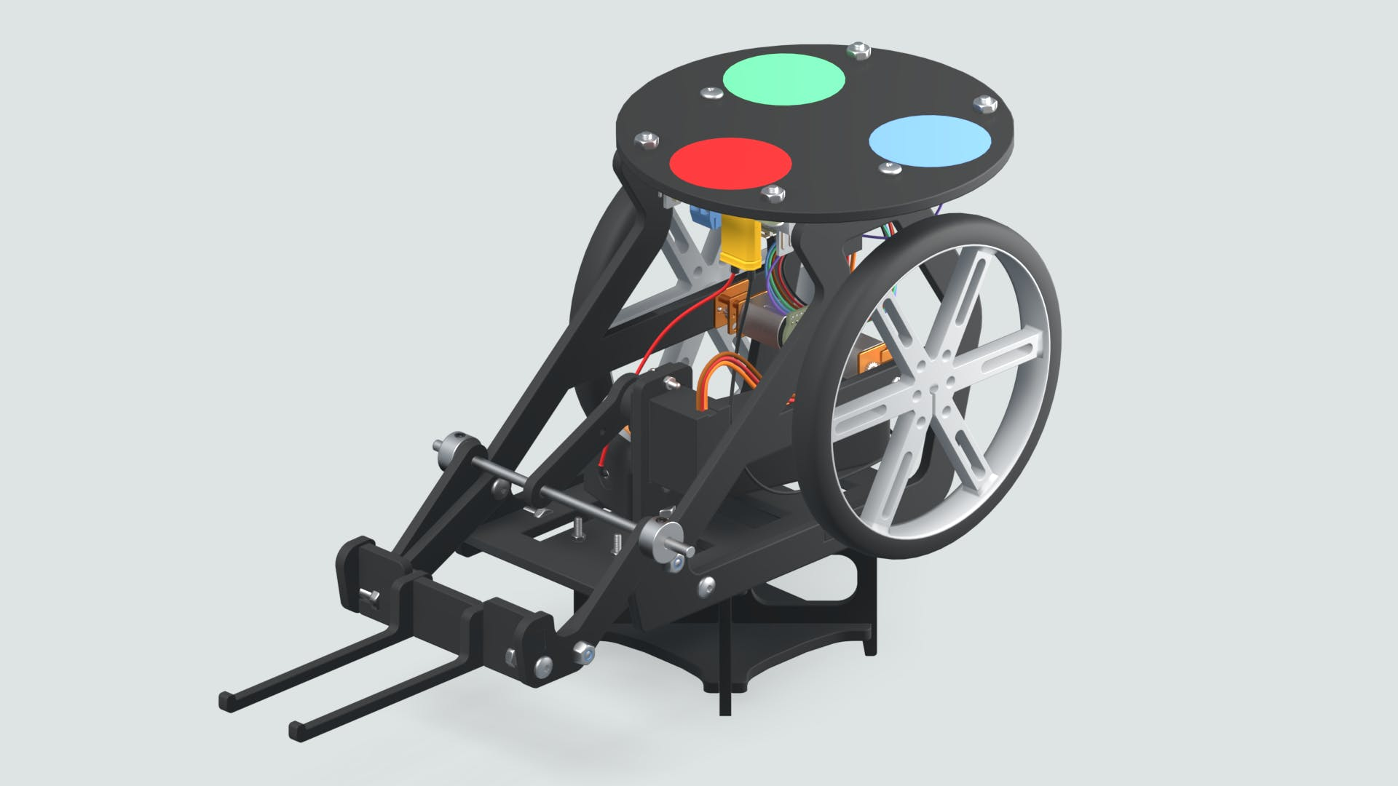

Webcam Controlled Rover
The webcam-controlled rover is about a programmable robot that with the help of an image processing algorithm can be targeted.
A colour-coded sticker will be installed on top of the rover, which will serve as a marker that will help the image processing algorithm and its webcam detect the robot's location and orientation.

Slide 30
Working with Matlab/Simulink
2.2

Slide 31


Control the Rover by Wi-Fi
Configuring the Simulink Model to Send and Receive MATLAB Data over a Wi-Fi Network
In this way it is achieved:
Establish Wi-Fi communication between the rover and MATLAB.
Send instructions from MATLAB to the rover over Wi-Fi.
Receive information from rover sensors in Matlab.

Slide 32
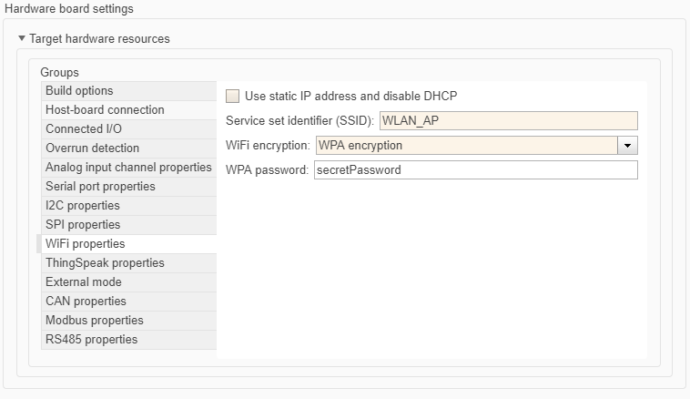
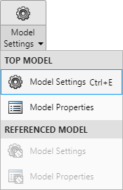
Establishing Wi-Fi communication between the rover and MATLAB
To establish communication the rover and Matlab must be located in the same network. Using the model configuration, you record the data of the Wi-Fi access point to which you will connect.

Slide 33
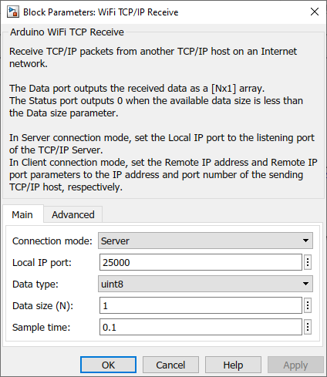
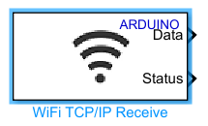
Send instructions from MATLAB to the rover over Wi-Fi
Simulink offers two models that allow you to send information to the rover over a Wi-Fi connection. One mode using the TCP/IP protocol and the second using the UDP protocol.
Block data receiver for the Arduino using TCP/IP protocol
Settings to highlight:
TCP port to which it listens
Type of data to receive

Slide 34
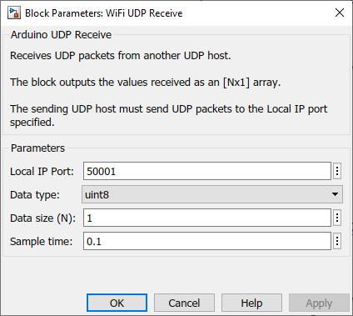
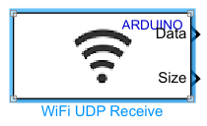
Send instructions from MATLAB to the rover over Wi-Fi
Block data receiver for the Arduino via UDP protocol
Settings to highlight:
UDP port listening to Type of data to receive

Slide 35
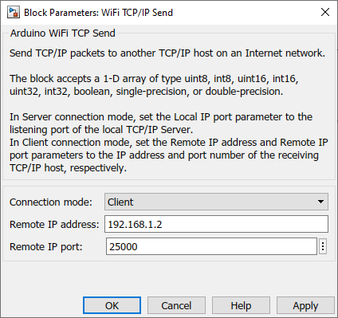
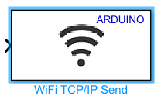
Receive information from rover sensors in Matlab
Configure the Simulink model to send and receive matlab data over a Wi-Fi network. One mode using the TCP/IP protocol and the second using the UDP protocol.
Data sender block for the Arduino using TCP protocol
Settings to highlight:
IP of the host receiving the data (PC running Matlab) TCP port to send data to

Slide 36
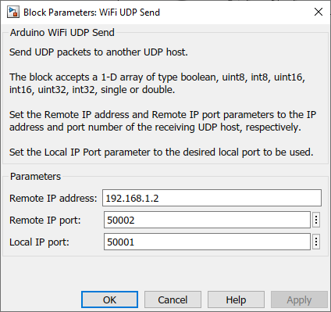
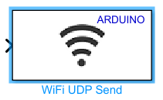
Receive information from rover sensors in Matlab
Configuring the Simulink Model to Send and Receive MATLAB Data over a Wi-Fi Network
Block data sender for the Arduino via UDP protocol
Settings to highlight:
IP of the host receiving the data (PC running Matlab) TCP port to send data to

Slide 37
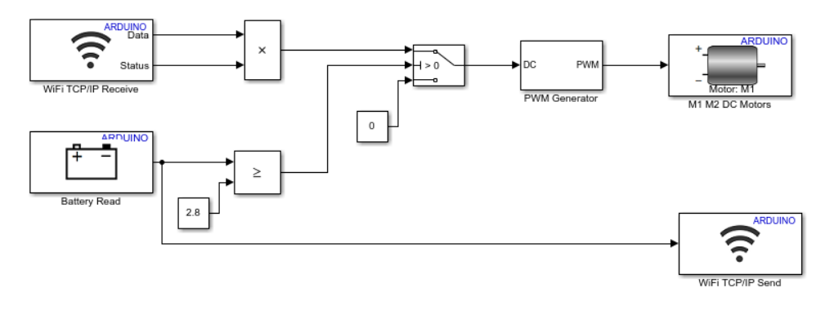
Example receiver – sender
Motor speed control and battery level transmission
Exercise proposal:
Compile the Simulink “Wifi IO” model and upload it to your Arduino Engineering Kit. From the client's MATLAB script you can send the necessary information to remotely drive the motor. Using the server script you will be able to receive the battery voltage.

Slide 38
Eskerrik asko
Muchas gracias
Thank you
Loramendi, 4. Apartado 23
20500 Arrasate – Mondragon
T. 943 71 21 85
info@mondragon.edu

