Slide 1
Coordinate geometry

Slide 2
Gaining knowledge to coordinate geometry

Slide 3
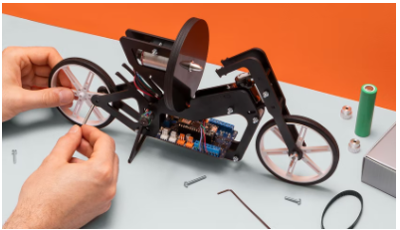
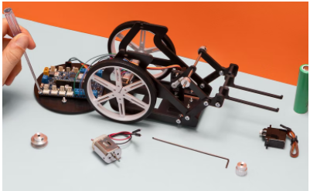
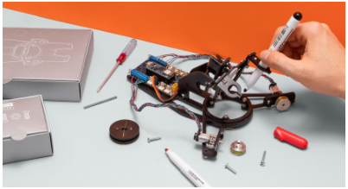

Introduction
Competencies
Coordinate geometry
Learning with Arduino Engineering Kits…
SELF-BALANCING MOTORCYCLE
WEBCAM CONTROLLED ROVER
DRAWING ROBOT
Required files:

Slide 4
Fundamentals
1

Slide 5
Coordinate system
1.1
Cartesian coordinates

Slide 6
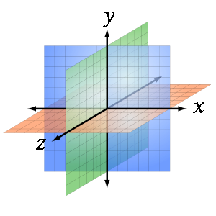
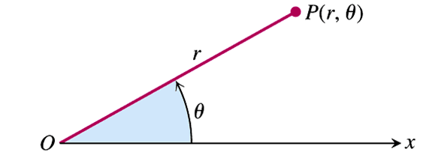
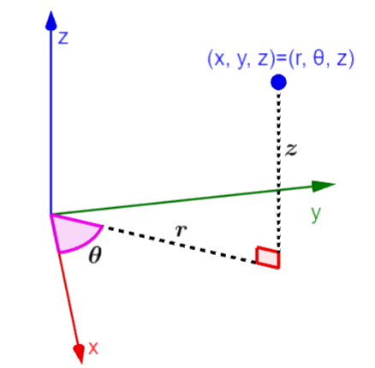
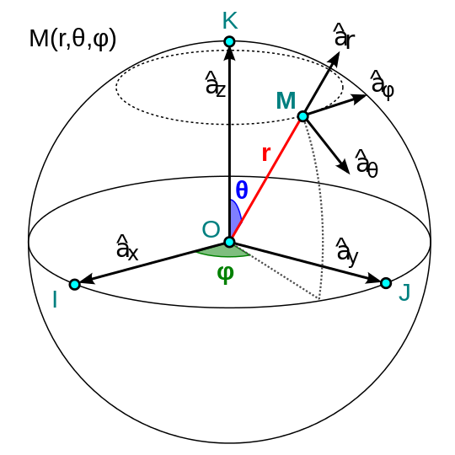
Coordinate system
A coordinate system is the basis of analytic geometry. There are four types of coordinate systems in general:
Coordenadas cartesianas
Polar coordinates
Cylindrical coordinates
Spherical coordinates

Slide 7
Cartesian coordinate system
The Cartesian coordinate system is a system for locating a point in space characterized by having as a reference orthogonal axes that concur at the point of origin.
You usually work with Cartesian coordinates in spaces of one dimension or two, three and four dimensions, but you can express Cartesian coordinates in spaces of more dimensions (d-dimensions).

Slide 8
Reference system
1.2

Slide 9
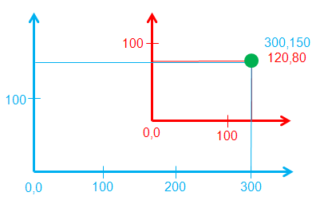
Reference system
A reference frame is a set of conventions used by an observer to measure the position and other physical magnitudes of a physical or mechanical system..
The measured trajectories and the numerical value of the magnitudes are relative to the reference system being considered.

Slide 10
Coordinate geometry in two dimensions (2D)
1.3

Slide 11
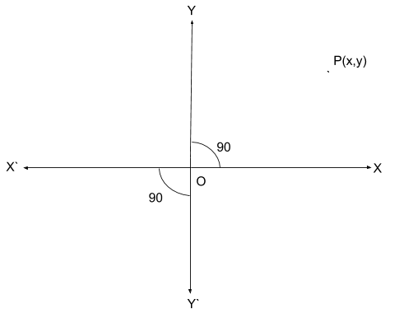
Coordinate axes in 2D
Distances measured along OX and OY are taken as positive or negative.
The O point is called Origin. O is always supposed to be the starting point. To find the position of any point in the coordinate plane we always have to start the journey from the origin.

Slide 12
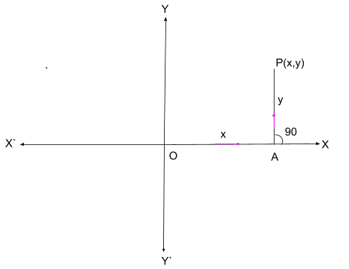
2D coordinates
The coordinate is a pair of numbers or letters by which the position of a point in the coordinate plane is located.
The coordinates of the point P are symbolized by P(x, y) where x is the distance of P from the Y axis along the X axis and y is the perpendicular distance of P from the X axis respectively. Here x is called abscissa or coordinate x and y is called ordinate

Slide 13
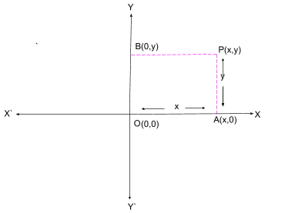
Plot a point
Starting from the origin and first traversing to the right or left along the x-axis to cover the distance of the x-coordinate or abscissa. Then up or down perpendicular to the x-axis to cover the distance of and or ordinate. Always using units and their signs accordingly. These measurements represent the location of any point in the Cartesian coordinate system.

Slide 14
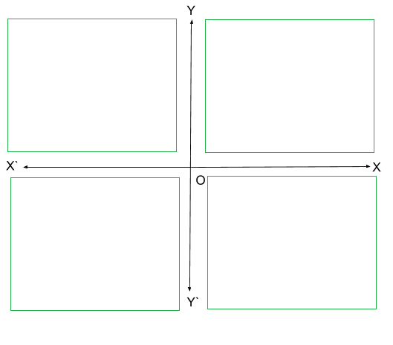
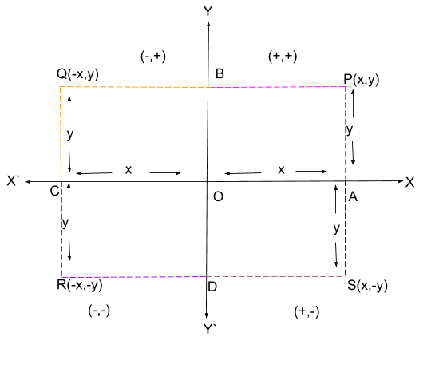
The quadrant
The coordinate plane is divided into four equal sections by the coordinate axes.
Each section is called quadrant.
Turning counterclockwise or counterclockwise from the top right, the sections are named 1st quadrant, 2nd quadrant...
Depending on the quadrant where a point is located, you will meet the following:
Quadrant I: (+, +) Quadrant II: (-, +) Quadrant III: (-, -) Quadrant IV: (+, -)

Slide 15




Changing the origin of coordinates
The origin is at the point (0,0) which is the point of intersection of the axes in the plane.
It is possible to move the origin in all quadrants of the drawing with respect to the origin, which will give a new set of axes through it.
$$x_{1}=x−a$$
$$x_{1}=300−180=120$$
$$y_{1}=y−b$$
$$y_{1}=150−70=80$$
Where (a, b) = O(0,0) – O`(180,70)

Slide 16
Working with Matlab
2
Creating and displaying geometric data

Slide 17
2D graphics
2.1

Slide 18
The plot(x, y…) function
Syntax
plot(X,Y):
Creates a 2D line chart of the Y data versus the corresponding X values. X and Y can be simple data or a list of data
plot (X,Y,LineSpecs…):
Sets the line style, marker symbol, and color.

Slide 19
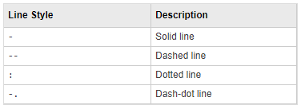
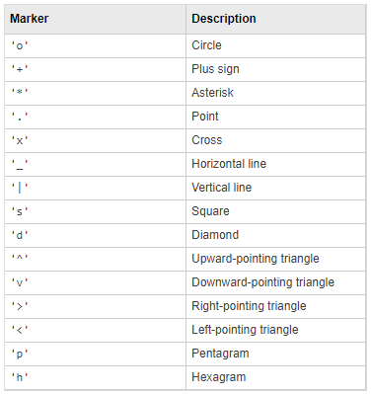
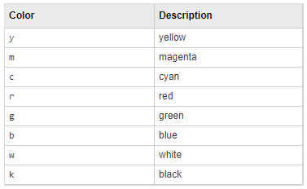
The plot(x, y…) function
LineSpecs

Slide 20
Drawing points
2.2

Slide 21
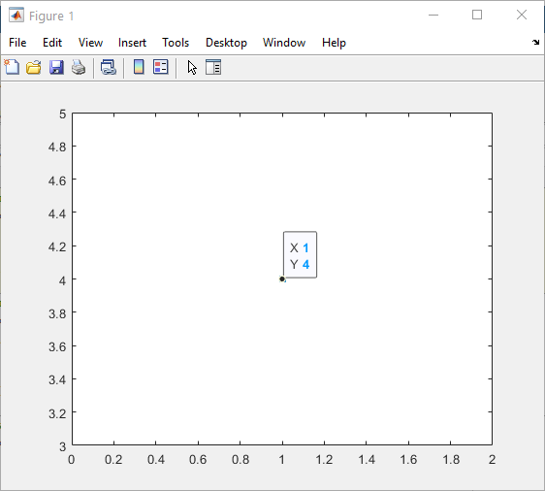
Dibujando puntos
%% Drawing a point
clc; clear; close all;
x = 1;
y = 4;
plot(x,y, 's');

Slide 22
Drawing a function
2.3

Slide 23
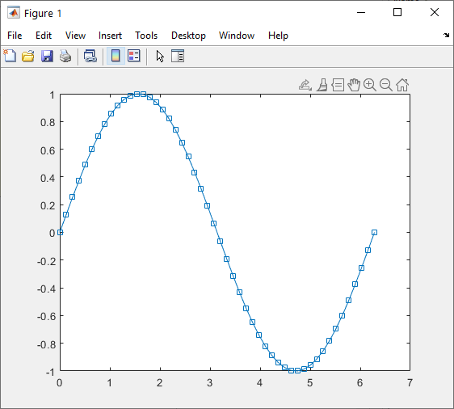
Drawing a function
%% Drawing a function
clc; clear; close all;
x = linspace(0, 2*pi, 50);
y = sin(x);
plot(x,y, '-s');

Slide 24
Drawing multiple functions
2.4

Slide 25
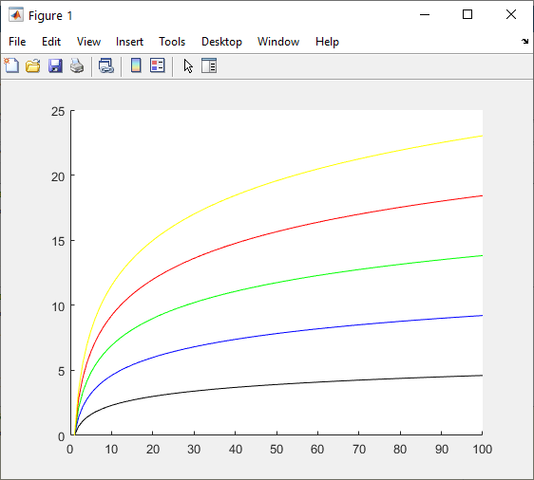
Dibujando varias funciones
%% Multiple curves on the same graph
clc; clear; close all;
colorstring = 'kbgry';
x = [1:100];
for i=1:5
y(:,i) = i*log(x);
end
figure(1); cla;
hold on
for i = 1:5
plot(x,y(:, i), 'Color', colorstring(i))
end

Slide 26
Changing the origin of coordinates
2.1

Slide 27
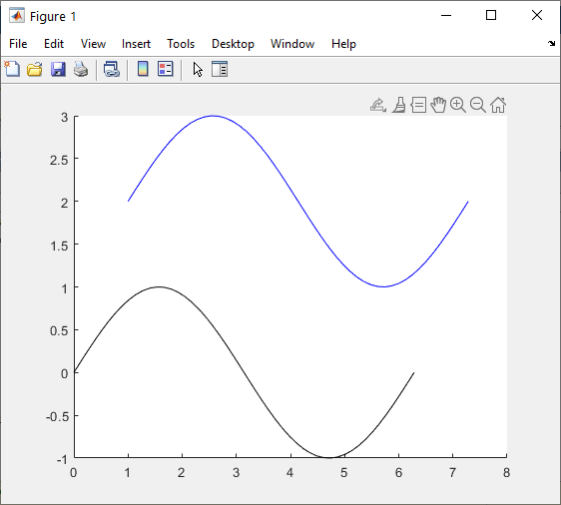
Changing the origin of coordinates
%% Changing coordinates
clc; clear; close all;
colorstring = 'kbgry';
%Coordinate origin (0,0)
x = linspace(0,2*pi,50);
y = sin(x);
%New coordinate origin
(1,2) relative to (0,0)
a = 0 - 1;
b = 0 - 2;
x1 = x - a;
y1 = y - b;
figure(1); cla;
hold on
plot(x,y, 'Color', colorstring(1));
plot(x1,y1, 'Color’, colorstring(2));

Slide 28
Case in practice
3
Drawing robot

Slide 29
Introduction of the robot
3.1

Slide 30
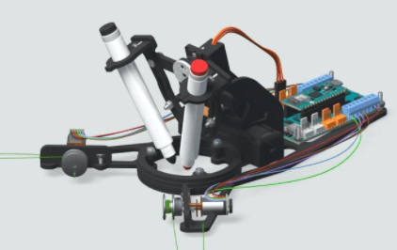

Drawing Robot
Robot draughtsman on a blackboard. The robot works on an image and extracts the line drawing from that image and scales the drawing to the extent of the whiteboard on which it subsequently makes the drawing.
Finally, it plays the drawing by moving a marker pen and following the path.

Slide 31
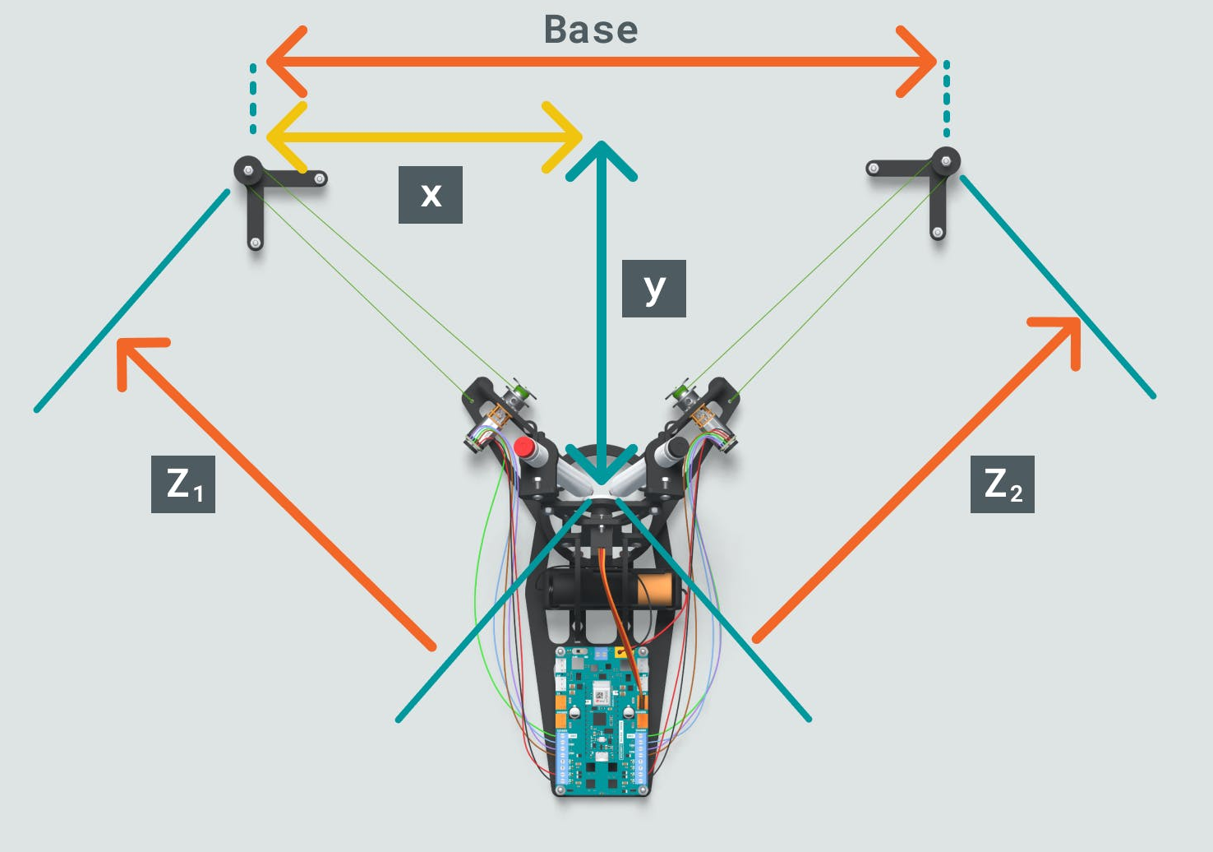
Drawing Robot
The black circles on either side of the diagram represent the pulleys from which the robot hangs.
The robot hangs from two wires that are connected to the eastern arms, which is where the motors are located. The threads go from the robot's arm to the pulley and back to the engine.
The reference frame is located in the pulley on the left, and the distances x and y from the slate are measured in reference to that point.
Drawing Robot hanging on the blackboard

Slide 32
Working with MATLAB & Simulink
3.2

Slide 33
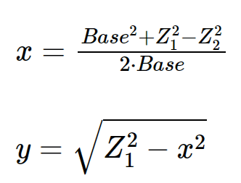


Initial position of the robot on the whiteboard
Exercise proposal:
The new position of the robot is defined by the variables Base, Z₁ and Z₂.
Use these values to calculate the current values of x and y adding the necessary in the Live Script “Calculate Drawing Robot Position”.

Slide 34
Eskerrik asko
Muchas gracias
Thank you
John Smith
email@email.com
Loramendi, 4. Apartado 23
20500 Arrasate – Mondragon
T. 943 71 21 85
info@mondragon.edu

