Slide 1
Trigonometry

Slide 2
Acquiring knowledge of trigonometry

Slide 3
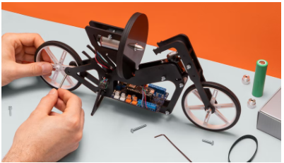
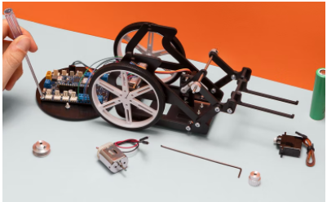
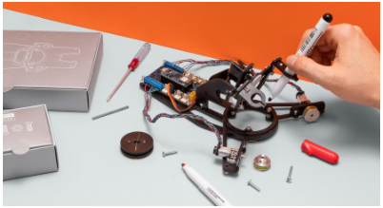

Introduction
Competencies
Trigonometry
Learning with Arduino Engineering Kits…
SELF-BALANCING MOTORCYCLE
WEBCAM CONTROLLED ROVER
DRAWING ROBOT
Required files:

Slide 4
Fundamentals
1

Slide 5
Coordinate system
1.1
Cartesian coordinates

Slide 6
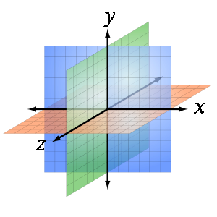
Coordinate system
The Cartesian coordinate system, is a system to locate a point in space characterized by having as reference orthogonal axes to each other that concur at the point of origin.
Usually, we work with Cartesian coordinates in one-dimensional or two-, three- and four-dimensional spaces, but Cartesian coordinates can be expressed in more dimensional spaces (d-dimensions).

Slide 7
Reference system
1.2

Slide 8
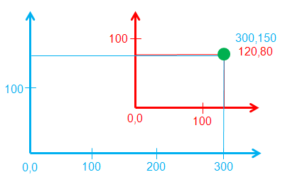
Reference system
A reference frame is a set of conventions used by an observer to be able to measure the position and other physical quantities of a physical or mechanical system.
The measured trajectories and the numerical value of the quantities are relative to the reference system under consideration.

Slide 9
Trigonometry
1.3

Slide 10
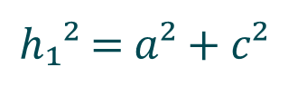
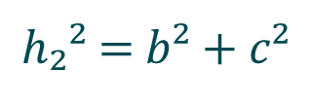
Pythagorean theorem:
h₁
h₂
c
a
b
$h₁$² = $a²+c²$
$h₂$² = $b²+c²$

Slide 11








Trigonometric ratios
a
b
h₁
c
h₂
α
β
$$sⅇnα=\frac{a}{h_{1}}$$
$${a=h}_{1}·sⅇnα$$
$$sⅇnβ=\frac{b}{h_{2}}$$
$${b=h}_{2}·senβ$$
$$cosα=\frac{c}{h_{1}}$$
$${c=h}_{1}·cosα$$
$$cosβ=\frac{c}{h_{2}}$$
$${c=h}_{2}·cosβ$$

Slide 12




Razones trigonométricas
$$T_{1r}$$
$$T_{2r}$$
T₁
T₂
α
β
$$T_{1r}=T_{1}\operatorname{tg}{α}$$
$$T_{2r}=T_{2}\operatorname{tg}{\text{β}}$$

Slide 13
Case study
2
The move of a free body in a finite vertical plane

Slide 14
Balance
2.1

Slide 15
A mass hung from two points.
Trigonometry allows to divide each force T₁ and T₂ into its components x and y, as shown below.
T₁
T₂
P

Slide 16









Trigonometric ratios allow forces to be decomposed based on a specific reference frame.
T₁
$$T_{2x}$$
T₂
$$T_{1x}$$
$$T_{1y}$$
$$T_{2y}$$
α
β
$$T_{1x}=−T_{1}\operatorname{sen}{α}$$
$$T_{2x}=T_{2}\operatorname{sen}{\text{β}}$$
$$T_{1y}=T_{1}\cos{α}$$
$$T_{2y}=T_{2}\cos{\text{β}}$$
$$+y$$
$$+x$$

Slide 17
Starting position
2.2

Slide 18
The object takes as a reference the two upper corners so that it can define its positions in the plane.
Z₁
Z₂

Slide 19
By applying the Pythagorean theorem together with the base and diagonals its Cartesian coordinates can be calculated with respect to the reference system.
Z₁
Z₂
Basis

Slide 20





$$Z_{1}^{2}=x^{2}+y^{2}$$
$$Z_{2}^{2}={(Basis−x)}^{2}+y^{2}$$
Z₁
Z₂
$$Z_{1}^{2}=x^{2}+[Z_{2}^{2}−{\left(Basis−x\right)}^{2}]$$
$$x=\frac{Basis^{2}+Z_{1}^{2}−Z_{2}^{2}}{2Basis}$$
$$y=\sqrt{Z_{1}^{2}−x^{2}}$$
Basis

Slide 21
Target position
2.3

Slide 22


Given the $P_{d}(x, y)$ target in the plane with respect to the coordinate system, the basis and the Pythagorean theorem, it is possible to calculate the new values of the diagonals.
Z’₁
Z’₂
$$P_{d}(x, y)$$
Basis

Slide 23




$$Z_{1}^{′2}=x^{2}+y^{2}$$
Z’₁
$$Z_{2}^{′2}={(Basis−x)}^{2}+y^{2}$$
Z’₂
$$Z_{1}^{′}=\sqrt{x^{2}+y^{2}}$$
$$P_{d}(x, y)$$
$$Z_{2}^{′}=\sqrt{{\left(Basis−x\right)}^{2}+y^{2}}$$
Basis

Slide 24

By differentiating the diagonals of the original position and the new position, the values that define how much their modules have been increased or decremented are obtained.
Z’₁
Z’₂
Z₁
Z₂
$$ΔZ=Z_{2}^{′} − Z_{1}^{′}$$

Slide 25
Case in practice
3
Drawing robot

Slide 26
Introduction of the robot
3.1

Slide 27
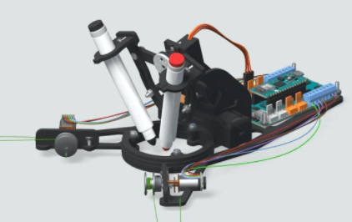

Drawing Robot
Robot draughtsman on a blackboard. The robot works on an image and extracts the line drawing from that image and scales the drawing to the extent of the whiteboard on which it subsequently makes the drawing.
Finally, it plays the drawing by moving a marker pen and following the path.

Slide 28
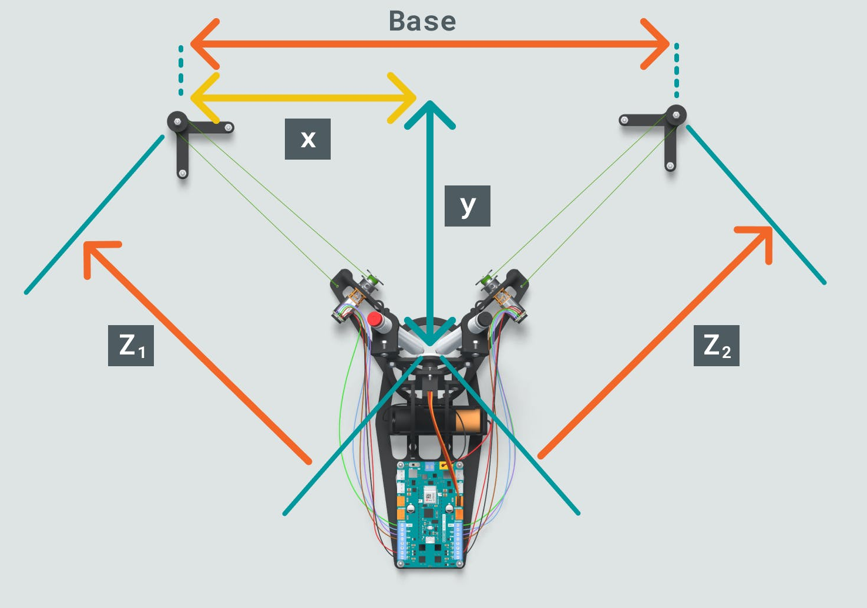
Drawing Robot
The black circles on either side of the diagram represent the pulleys from which the robot hangs.
The robot hangs from two wires that are connected to the eastern arms, which is where the motors are located. The threads go from the robot's arm to the pulley and back to the engine.
The reference frame is located in the pulley on the left, and the distances x and y from the slate are measured in reference to that point.
Drawing Robot hanging on the blackboard

Slide 29
Working with MATLAB & Simulink
3.2

Slide 30
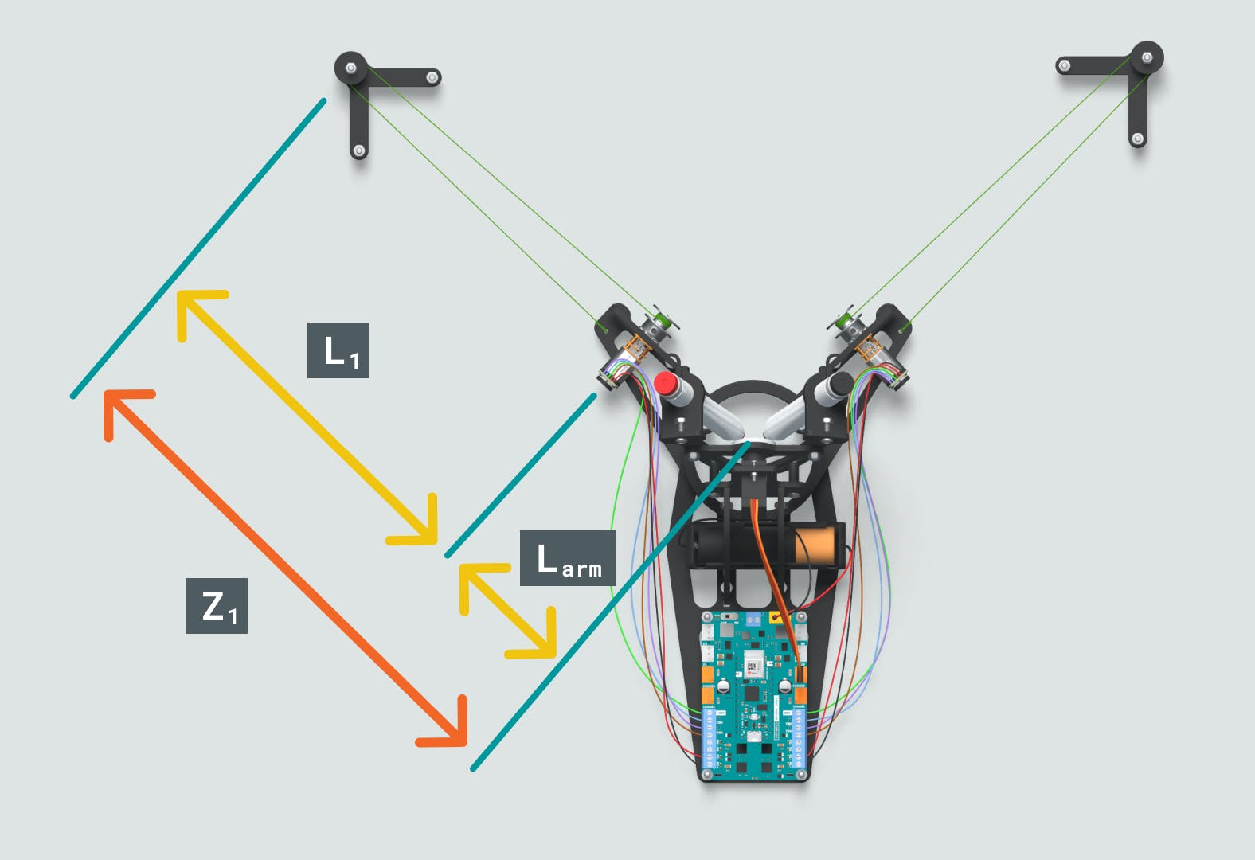


Distance to a Specified Point
Exercise proposal:
Open the MATLAB Live Script “CalculateDistance2Point” and enter the destination x-y point and the length of the chords L1 and L2.
The script calculates the lengths of the two robot arms to the destination point.
Now add the necessary calculations to get the distance from the central axis to the destination point (in red) and run it. You will be able to measure the distance to the point on the board and check that your calculations are correct.
Graphical representation of the distances

Slide 31
Eskerrik asko
Muchas gracias
Thank you
Loramendi, 4. Apartado 23
20500 Arrasate – Mondragon
T. 943 71 21 85
info@mondragon.edu

