Slide 1



DATA MINING COURSE — PHASE 2 FINAL PROJECT
Retail Sales
Data Mining & Analytics
End-to-end CRISP-DM pipeline · Customer Segmentation · Predictive Modelling · Interactive Dashboard
TEAM MEMBERS
100K
42.5K
Mahmoud Usama 230103270 Youssef Mahmoud 230104603
Transactions
Customers
3
7
ML Models
Categories
github.com/MUA122/Retail-Sales-Data-Mining-Project
retail-pro.streamlit.app

Slide 2






AGENDA
What We Cover Today
01
Business Understanding
05
Random Forest Models
Problem definition, objectives, success criteria
High-spender & category classification
02
Dataset & EDA
06
Linear Regression
100K retail transactions, quality analysis & insights
Total spend prediction, R² = 0.818
03
Data Preprocessing
07
Insights & Dashboard
Cleaning pipeline, feature engineering, validation
Streamlit app, CRISP-DM evaluation, recommendations
04
K-Means Segmentation
Customer clustering, silhouette analysis, profiles

Slide 3

01 · BUSINESS UNDERSTANDING
Problem Definition & Objectives
Business Problem
Retail businesses struggle to understand which customers drive revenue, what drives high-value purchases, and how to personalize marketing strategies for diverse segments.
Customer Segmentation
Spending Classification
Identify distinct customer groups using K-Means clustering to enable targeted campaigns
Predict high-spender status and product category using Random Forest with 87%+ accuracy
Revenue Prediction
Actionable Insights
Model Total Amount with Linear Regression achieving R² = 0.818 for business forecasting
Deliver a real-time Streamlit dashboard for decision-makers with interactive filtering
Success Criteria: RF Accuracy ≥ 80% · LR R² ≥ 0.75 · K-Means Silhouette ≥ 0.25 · Interactive dashboard deployed

Slide 4


02 · DATASET & EXPLORATORY DATA ANALYSIS
Retail Sales Dataset — 100,000 Transactions
100,000
42,540
7
9
0%
Total Transactions
Unique Customers
Product Categories
Dataset Features
Missing Values
Dataset Schema
Feature | Type | Notes
Transaction ID | String | Unique identifier
Date | DateTime | 2022 – 2024
Customer ID | String | 42.5K unique
Gender | Categorical | Male / Female
Age | Numeric | Range 18–65
Product Category | Categorical | 7 categories
Quantity | Numeric | 1–10 items
Price per Unit | Numeric | $10 – $2,000
Total Amount | Numeric | Target variable

Slide 5
03 · DATA PREPARATION
Cleaning Pipeline & Feature Engineering
Remove Duplicates
Validity Filters
1
4
0 duplicate rows found — dataset integrity confirmed
Age ∈ [1,120], Qty > 0, Price > 0, Total ≥ 0 — invalid rows dropped
Type Conversion
Total Amount Fix
2
5
Date → datetime · Numeric cols coerced with pd.to_numeric()
Recalculate Total = Qty × Price where Total = 0 or inconsistent
Missing Value Imputation
Feature Engineering
3
6
Categorical: mode · Numeric: median · 0 missing values remain
Month, Year, Age Group (7 bins), High Spender (top 35% threshold)
Engineered Features
Month / Year
Age Group
High Spender
Month Number
Temporal features for seasonality analysis
7 bins: Under 18, 18-24, 25-34, 35-44, 45-54, 55-64, 65+
Binary: Total Amount ≥ 65th percentile ($806.29)
Integer month for ordering in visualizations

Slide 6
04 · K-MEANS CUSTOMER SEGMENTATION
Clustering 42,540 Customers into 3 Segments
0.318
133,857
19,287
1.129
Silhouette Score
Inertia
Calinski-Harabasz
Davies-Bouldin
0
Budget Essentials
1
Premium Buyers
2
Mid-Market Shoppers
33.7% of customers
33.2% of customers
33.1% of customers
Avg Spending
$812
Avg Spending
$2,841
Avg Spending
$1,390
Top Category
Beauty / Books
Top Category
Electronics
Top Category
Clothing / Home
Age Range
18-65
Age Range
18-65
Age Range
18-65
Gender Mix
Mixed
Gender Mix
Mixed
Gender Mix
Mixed
Lower-value, lower-quantity shoppers. Focus on essentials and value products.
High-value, Electronics-focused. Best ROI for upselling & premium campaigns.
Mid-range spenders with diverse interests. Strong loyalty potential.

Slide 7
05 · RANDOM FOREST MODELS
High-Spender Classification
High-Spender Classifier
87.7%
89.2%
76.4%
Accuracy
Bal. Acc.
Precision
94.0%
84.3%
94.9%
Recall
F1 Score
ROC AUC
Configuration
Features: Gender, Age, Product Category, Quantity
Estimators: 120 · Max Depth: 12 · Test Split: 35%
Class Weight: Balanced · Best Threshold: 0.52
High-Spender Threshold: $806.29 (65th percentile)

Slide 8
06 · LINEAR REGRESSION MODEL
Predicting Total Purchase Amount
0.818
661K
813
R² Score
MSE
RMSE ($)
81.8% of variance explained
Mean Squared Error
Root Mean Squared Error
482
293
MAE ($)
Median Abs. Err ($)
Mean Absolute Error
More robust to outliers
Feature Coefficients (Standardised)
Model Interpretation & Insights
Price per Unit is by far the strongest predictor of total spend — coefficient 485.2
Quantity contributes significantly (312.7), enabling basket-size optimization
Electronics & Clothing categories drive positive spend uplift above baseline
R² = 0.818 confirms the model explains 81.8% of spend variance — exceeds target
Mean Error = 0.78 confirms near-zero systematic bias — well-calibrated model

Slide 9
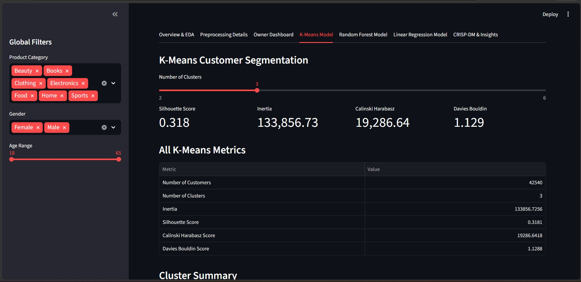
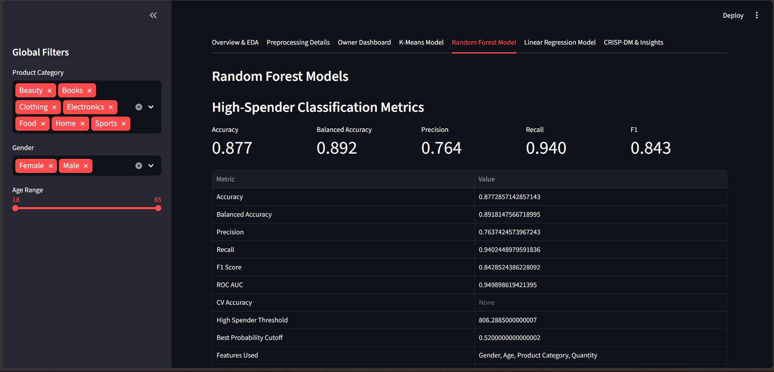
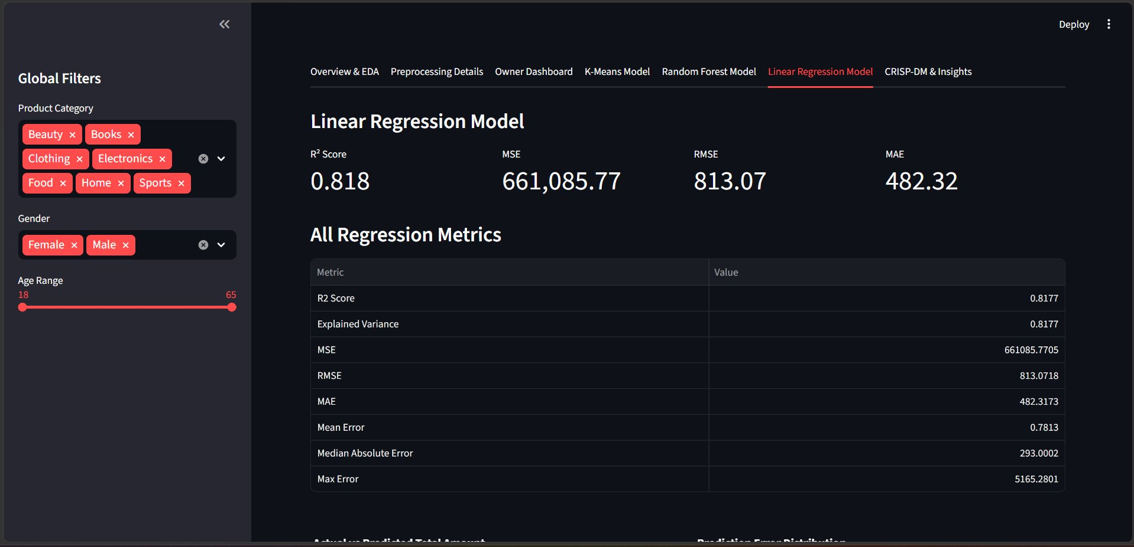
07 · STREAMLIT DASHBOARD
Interactive Analytics Platform — retail-pro.streamlit.app
retail-pro.streamlit.app
retail-pro.streamlit.app
retail-pro.streamlit.app
K-Means Customer Segmentation
Random Forest Model Metrics
Linear Regression Model
3 clusters · Silhouette 0.318 · 42K customers
Accuracy 87.7% · ROC AUC 94.9% · F1 84.3%
R² 0.818 · RMSE $813 · MAE $482

Slide 10

CRISP-DM METHODOLOGY COMPLIANCE
Full Cycle — Business to Deployment
Business
Understanding
Data
Understanding
Data
Preparation
Modelling
Evaluation
Deployment
Defined 4 objectives · Success criteria set · Retail domain contextualised
100K rows · 9 columns · EDA: distributions, correlations, outlier detection
6-step pipeline · Feature engineering · 5 new columns · Zero leakage
3 algorithms · Hyperparameter tuning · Threshold optimisation · CV aware
All targets met · RF AUC 94.9% · LR R² 0.818 · KM Silhouette 0.318
Streamlit cloud app · Global filters · 7 tabs · Business insights panel

Slide 11

BUSINESS INSIGHTS & RECOMMENDATIONS
Top 5 Actionable Findings
01
Electronics = Highest Revenue Segment
Recommendation:
Allocate 30%+ of marketing budget to Electronics upsells targeting Cluster 1 (Premium Buyers). Introduce loyalty tiers and extended warranty programs.
02
High-Spenders Identifiable with 94% Recall
Recommendation:
Deploy the RF classifier in CRM pipelines to flag prospective high-spenders before purchase, enabling personalised outreach and premium offers.
03
Price per Unit is the #1 Spend Driver
Recommendation:
Dynamic pricing strategy: use LR coefficients to simulate revenue impact of price changes across categories before rollout.
04
3 Distinct Customer Personas Identified
Recommendation:
Design 3 distinct email flows: value deals (Cluster 0), premium early access (Cluster 1), cross-category bundles (Cluster 2).
05
Seasonality Patterns in Monthly Revenue
Recommendation:
Q4 shows peak spending. Pre-load inventory 8 weeks before November. Offer off-peak discounts (Feb–Apr) to sustain baseline revenue.

Slide 12
TECHNICAL IMPLEMENTATION
Tech Stack · Repository · Deployment
Data & ML
Visualisation
Dashboard
Dev Tools
pandas
plotly
Streamlit
Python 3.11
numpy
matplotlib
Streamlit Cloud
Git / GitHub
scikit-learn
altair
requirements.txt
GitHub Repository
Live Deployment
github.com/MUA122/Retail-Sales-Data-Mining-Project
retail-pro.streamlit.app
Public repo with meaningful commit history
Hosted on Streamlit Community Cloud (free)
requirements.txt for reproducible environment
7 navigation tabs — one per CRISP-DM phase
Structured folders: preprocessing, models, app
Global filters: Category, Gender, Age Range
README with setup + run instructions
Business Insights panel with recommendations

Slide 13
LIMITATIONS & FUTURE WORK
What We'd Improve with More Time
Current Limitations
Future Enhancements
Synthetic Dataset:
Market Basket Analysis:
Data may not reflect real-world purchasing complexity or seasonality patterns accurately
Apriori / FP-Growth for product co-purchase recommendations
Category Classifier:
RFM Scoring:
36% accuracy for 7-class prediction — demographics alone insufficient discriminators
Recency, Frequency, Monetary model for customer lifetime value tiers
No Market Basket Analysis:
XGBoost / LightGBM:
Association rule mining (Apriori) was scoped out due to time constraints
Gradient boosting for improved category prediction accuracy
Static Clustering:
Time-Series Forecasting:
K-Means re-runs on each load; real system would cache and schedule periodic retraining
ARIMA or Prophet for monthly revenue and demand forecasting
No Customer Journey:
Real-Time Integration:
Transaction-level view misses repeat purchase sequences and churn signals
Connect to live POS data stream via API for dashboard auto-refresh

Slide 14
THANK YOU
Data Mining Course · Phase 2 · 2024/2025
Project Summary
K-Means Clustering
3 customer segments · Silhouette 0.318 · 42K customers profiled
Random Forest (High-Spender)
Accuracy 87.7% · ROC AUC 94.9% · F1 84.3%
Linear Regression
R² = 0.818 · RMSE $813 · Price per Unit = #1 predictor
Dashboard
Live at retail-pro.streamlit.app · 7 tabs · Global filters
CRISP-DM
Full 6-phase compliance from Business Understanding → Deployment
Mahmoud Usama (230103270) · Youssef Mahmoud (230104603)
github.com/MUA122/Retail-Sales-Data-Mining-Project · retail-pro.streamlit.app

