Slide 1
Decoding Indian Premier League: Match Analysis
Mid-Semester Report

Slide 2


Motivation (1/2)
In India, cricket is treated like a religion, one that brings
culturally diverse people together. This unifying
characteristic of the game motivated us to explore and
analyze the Indian Premier League (IPL)
In 2019, IPL had a viewership of 462 million, and in 2015, it contributed Rs. 11.5 billion (US $160 million) to the Indian GDP. This enormous impact of IPL on different facets of the Indian community and the economy makes it an interesting and lucrative problem to explore further.

Slide 3

Motivation (2/2)
With the advancement in technology, successful teams have started incorporating machine learning techniques to process data from matches to help them make decisions, which elevate the team’s performance.
Having such data-driven approaches to model a given match, give captivating insights into the players’ performance to better understand the dynamics of the game and also help the team management make informed decisions.

Slide 4
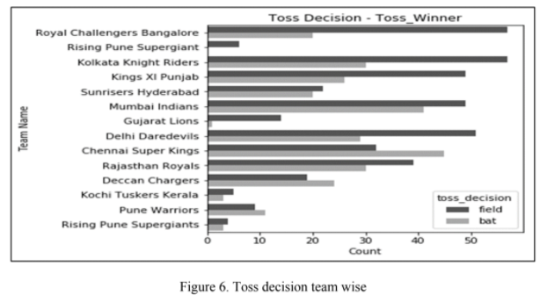
Literature Review (1/2)
Data Visualization and Toss Related Analysis of IPL Teams and Batsmen Performances
The performance of cricket players
and toss related analysis in IPL, from 2008-2018
was visualized.
The paper highlighted player performance
and used statistics from 696 matches to address
the analysis done for awards like Man of the
Match, maximum Centuries Scored by Batsmen
and Top Batsmen.
The authors concluded that CSK is the only
team that prefers to bat after winning the toss. Out of 147 matches, 77 times Chennai won the toss and 45 times they decide to bat first and 32 times to bowl.

Slide 5
Literature Review (2/2)
Predicting Outcome of Indian Premier League (IPL) Matches Using Machine Learning
Factors that significantly affect result of an IPL match were identified, namely - home team, away team, toss winner, toss decision, stadium and team weight.
A multivariate regression-based model was formulated to calculate the points for each player based on their past performances.
Various classification based machine learning algorithms were trained (Naive Bayes, Extreme Gradient Boosting, Logistic Regression, Random Forests and SVM) on the IPL dataset (from 2008 to 2017), which were then used to predict the outcome of each 2018 IPL match, immediately after the toss- with an accuracy of 71.67% using MLP.

Slide 6
Dataset Description (1/5)
File Name | Number of Features | Attribute Name | Number of Samples
Matches.csv Data for matches across all IPL seasons | 18 | ['id', 'season', 'city', 'date', 'team1', 'team2', 'toss_winner', 'toss_decision', 'result', 'dl_applied', 'winner', 'win_by_runs', 'win_by_wickets', 'player_of_match', 'venue', 'umpire1', 'umpire2', 'umpire3’] | 756
Deliveries.csv Ball-by-ball data of all matches | 21 | ['match_id', 'inning', 'batting_team', 'bowling_team', 'over', 'ball', 'batsman', 'non_striker', 'bowler', 'is_super_over', 'wide_runs', 'bye_runs', 'legbye_runs', 'noball_runs', 'penalty_runs', 'batsman_runs', 'extra_runs', 'total_runs', 'player_dismissed', 'dismissal_kind', 'fielder'] | 179078
Player_stats_year.csv* Player points for each player in a particular season based on 7 categories | 12 | ['pos', 'name', 'team_no', 'team_name', 'pts', 'mat', 'wkts', 'dots', '4s', '6s', 'catches', 'stumpings'] | 1988
*Scraped from the official website

Slide 7
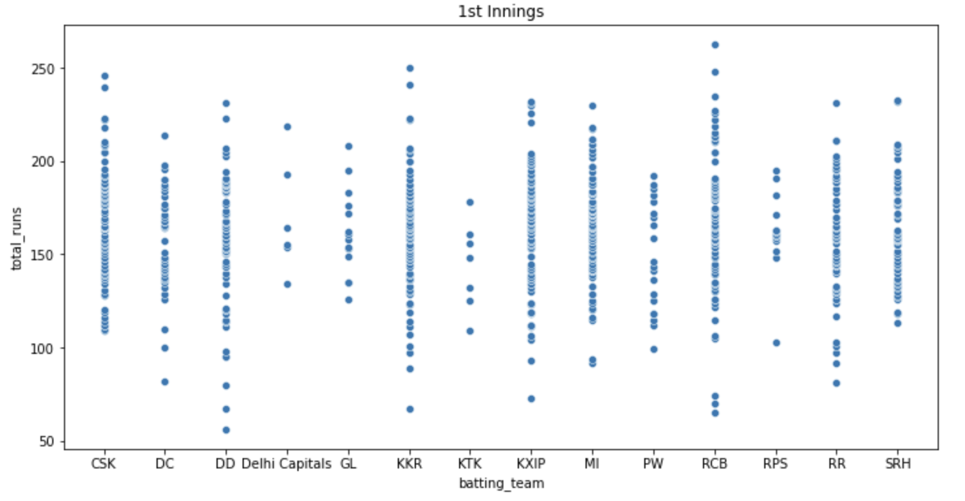
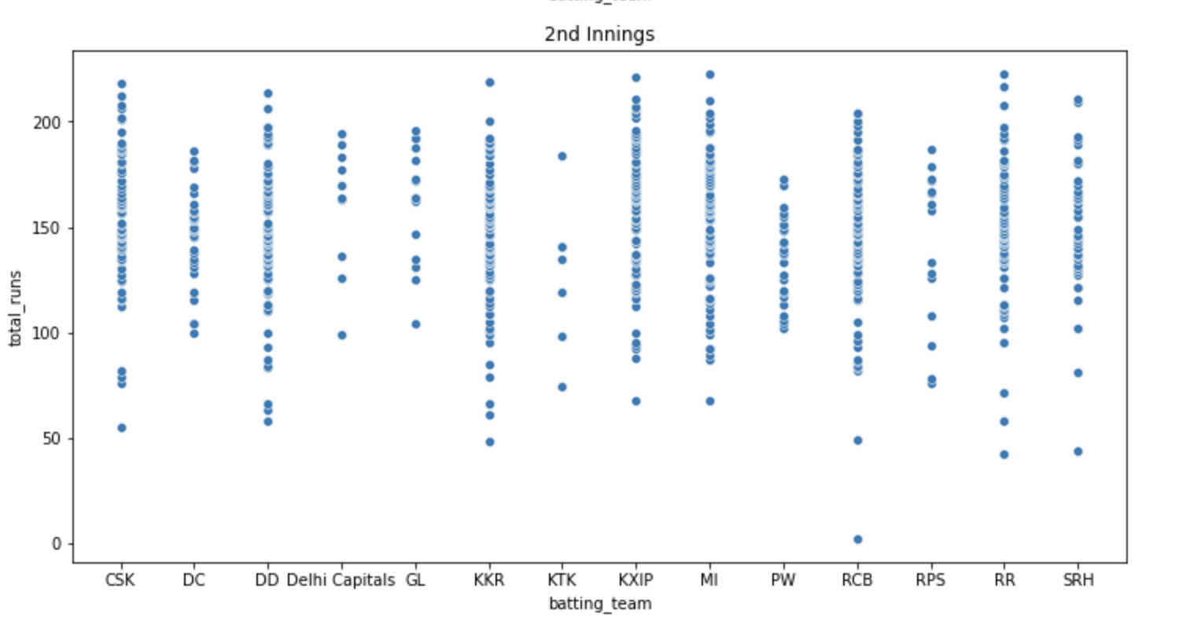
Dataset Description (2/5)
Scatter plots (total_runs vs batting_team) to show the performance of all the teams in both the innings:
(A)
(B)

Slide 8
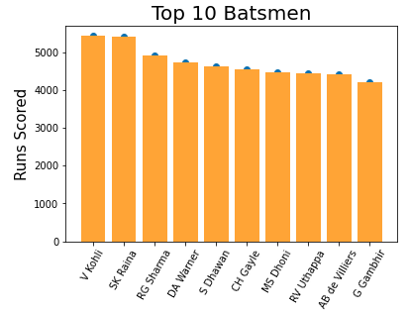
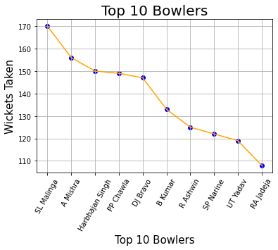
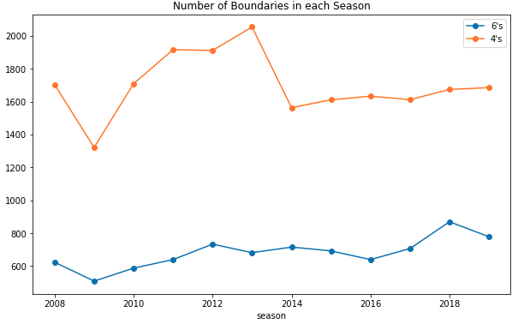
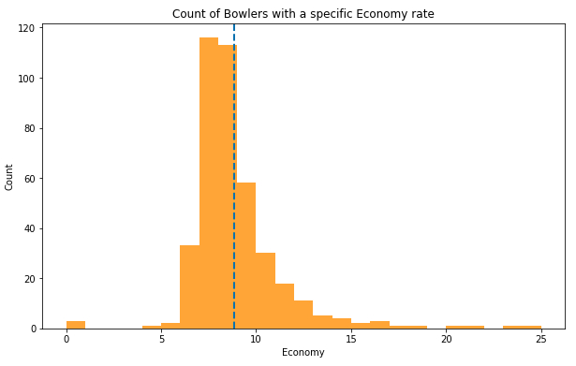
Batsmen’s Performance (figures C & D)
Bowlers’ Performance (figures E & F)
(C)
(E)
(D)
(F)

Slide 9
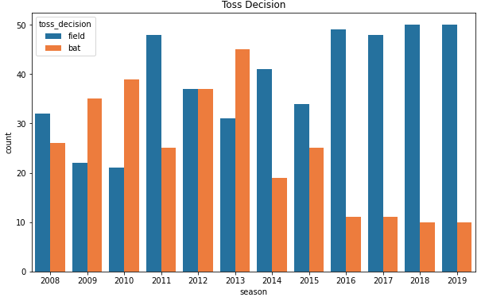
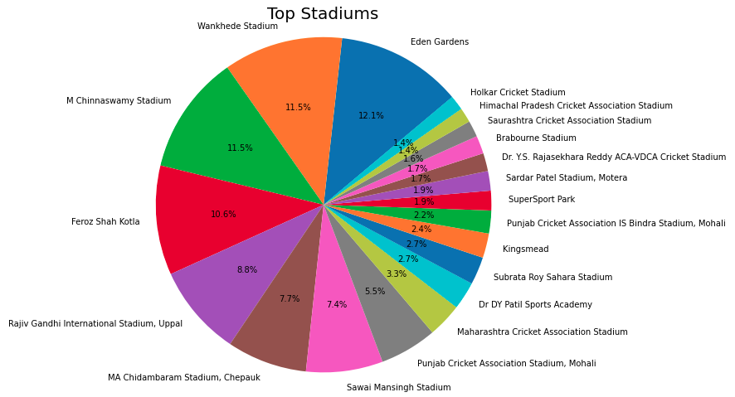
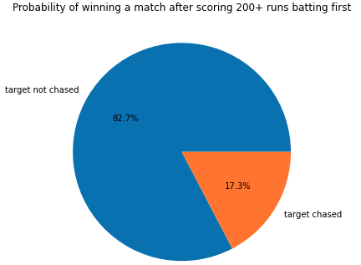
(H)
(G)
(I)

Slide 10
Dataset Description (5/5)
Dataset Preprocessing & Cleaning
Converted string features to a numeric encoded format. We tried methods:
Label Encoding
One Hot Encoding
Vector Embedding
Removed redundant features. Eg: each city in the dataset had only one corresponding venue, thus the variable ‘venue’ was dropped.
We noticed that only one sample has ‘dl_applied’ = 1, for all other samples, the value is 0.

Slide 11
Methodology (1/2)
Data Collection:
We have collected data from:
cricsheet.org and
scraped player points from IPL’s official website using python libraries like BeautifulSoup and requests. We then used pandas and csv libraries to store this data in separate csv files for each season from 2008-2019.
Data Preprocessing:
Majority of our data was in the string format (eg: venue, toss_decision, etc), hence some form of encoding was required. Currently, we have used label encoding, one-hot encoding and vector embedding.

Slide 12
Methodology (2/2)
(i) Data Cleaning:
The column ‘Umpire 3’ in matches.csv only had NaN values, hence we dropped this column. This column generally does not have a big impact on the outcome of a match.
(ii) Choosing Required Attributes:
We collected ‘player points’ because IPL teams are often dynamic in selection of players and thus using the player points (calculated using the performance of the player in a season) we can find the average points of a team and use in our analysis.
(iii) Hyperparameter tuning:
We have done hyperparameter tuning using gridsearch and found the best hyperparameters for our models.

Slide 13
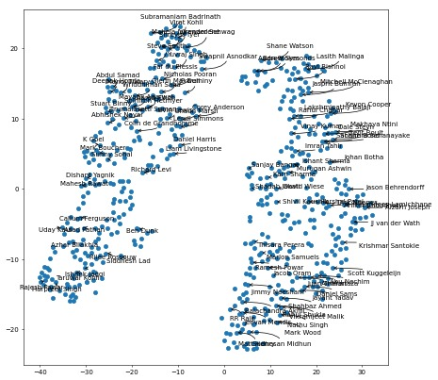
Player Embeddings
Player_vector = (1/mat) *[pts,
wkts,
dots,
4s,
6s,
catches,
stumpings]

Slide 14
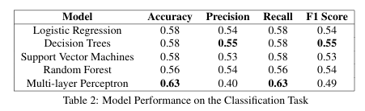
Results & Analysis (1/4)
The attached table shows our results for the match prediction task.
We can see that Multi-Layer Perceptron had the best testing accuracy amongst all the models at 63%.

Slide 15
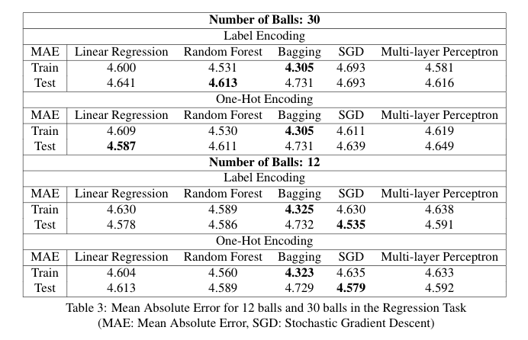
Results & Analysis (2/4)
The table attached shows the results of our run prediction task. Here we have predicted the runs scored in 30 ball and 12 ball intervals.
We have also used two different methods of encoding i.e. Label Encoding and One Hot Encoding.

Slide 16
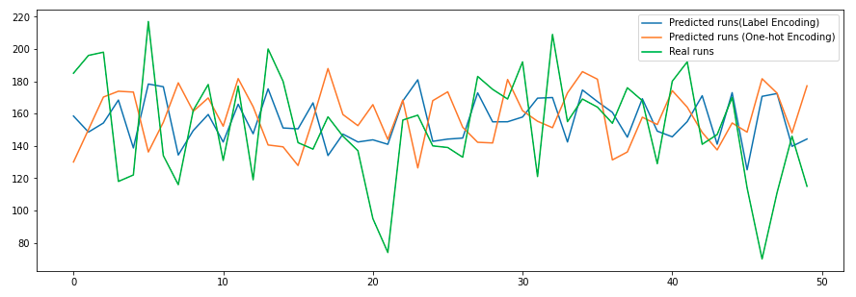
Results & Analysis (3/4)
Predicted scores for 50 random test samples using Linear Regression

Slide 17
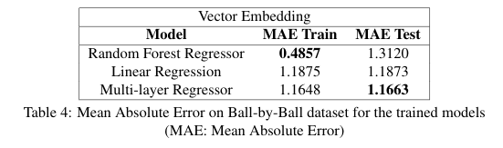
Results & Analysis (4/4)
The attached table shows the results for ball by ball prediction using vector embedding.
MLP Regressor had the best testing MAE.

Slide 18
Conclusion
The Data-Preprocessing step is an integral part of a Machine Learning Pipeline.
String-based features provide important information for the models and finding a good encoding technique to convert it into a machine-readable numeric format enhances the quality of input data.
Understanding the pros and cons of Label and One-hot encoding and Vector Embedding helps in using the best technique for a given problem statement.
Vector embeddings are able to capture the intrinsic meaning of the categorical data and improves the feature extraction from such string based features.
We learned that hyperparameter tuning is important in achieving the best results.

Slide 19
Future Direction
We were able to create an embedding for our player names, which is able to capture the player’s performance. This helped to encode inherent logical information.
Our future efforts would be in the direction of extending these embeddings to entire teams and help us encode the true value of the team based on the squad.

Slide 20
Individual Team Member’s Contribution
Mudit Dhawan EDA Vector Embedding SGD Regression Random Forest Analysis & Results | Samik Prakash EDA Linear Regression MLP Decision Tree Data Preprocessing Analysis & Results | Shivangi Dhiman EDA Logistic Regression SVM Bagging Regressor Analysis & Results

