Slide 1





Week 8: Theory of Generalisation

Slide 2

Overview
Generalisation
The learning problem
Probabilistic assumption
Proofs – way to solution
Learning is possible!
Notes:
Everyone likes stories, personally, I have been fascinated by myths, Greek myths for example.
To me, after doing some research and study in this topic, I truly feel like this whole process of the problem assimilates to a hero’s journey
The hero’s journey according Vogler
Ordinary world, call for adventure - Generalisation
Approach to the inmost cave, the trial – The learning problem
Reward, the road back – Probabilistic assumption
The final ordeal, resurrection - Proofs
Return and way to home – Learning is possible

Slide 3
Acknowledgement
Content from Dr. Yaser Abu-Mostafa, Caltech, 2012
“Learning From Data”
https://www.youtube.com/watch?v=mbyG85GZ0PI
Notes:
First of all, some acknowledgement. The content of this workshop heavily relies on a course from this professor, Yaser Abu-Mostafa, from Caltech university
If anyone wants to dig a bit deeper, please follow his book called learning from data
I also highly recommend his course on YouTube, which is a series of video that will surely empower your machine learning understanding and skills

Slide 4
Generalisation
Predict unknown result from known data
TARGET FUNCTION
FINAL HYPOTHESIS
TRAINING DATA
LEARNING ALGO
HYPOTHESIS SET
Notes:
Generalisation is really a very wide concept. It is simply an action of concluding some knowledge after certain experience or information.
Put into machine learning, it is basically what machine learning is about, to predict some unknown result from a given known data. It is a easy and simple purpose, and once we know this, we can elaborate the specific parts of process. We can visualise this with a graph and a simple example. Lets imagine a bank needs a model to decide whether or not give loan to different people. I know, the typical example ☺
Our ultimate goal, what we want to know, but we will never know, the target function. We can think it is the most correct model, omnisciently, that gives the perfect suggestion to the bank. Again, we can never know this function as there is no way we can verify it with all possible combination
But what we can know about this target function, that it produces the training data. So we can say somehow the historical data of the bank reflects the result of this target function, because the data, in this case supervised, is considered correct no matter the loan was given or not. So we say that our training data comes from the target function
Once we have the data, we elaborate a learning model, which consists of learning algorithm and hypothesis set. This model can be a logistic regression, perceptron, etc. In each case, the form or the equation of the model is the hypothesis set. It is a set because you can change the coefficients of the equation to form a new equation. The learning algorithm is the sharpener of the hypothesis, it corrects and shifts the hypothesis extracted from the hypothesis set to a better prediction
After enough sharpening and optimization, we give our final hypothesis, the final hypothesis which we think make the best prediction.

Slide 5
Is generalisation really POSSIBLE?
Notes:
Once we understand the underlying mechanism of learning, can we really generalise? Can our model really learn? This may sound ridiculous, but lets think about it.
We obtain some instances of the mysterious target function, which is then used to train our new model. We can see how this inverse engineering actually has no guarantee that this process is double directional. In fact, as the target function can literally have infinitive outputs, so we theoretically need to include all those infinity outputs to be sure we have the ultimate correct model. And of course, that is not possible

Slide 6
Bin-ball visualisation
Possible?
with replacement
Notes:
Maybe we can understand it better with a simple example. We have a bin containing orange and blue balls, with replacement. That means that the fact of taking one ball doesn’t decrease this number of balls of this colour.
Then, of course, we don’t know anything about the bin distribution of balls, so we start taking some balls out, and we get this. Is it possible to have this result, of course yes.

Slide 7
Bin-ball visualisation
Possible?
with replacement
Notes:
Then what about this bin? Is it possible to draw this result? Note how we have the same data but can had come from a different target function

Slide 8
Bin-ball visualisation
Possible?
with replacement
Notes:
And what about this extreme case? Can we ignore this case? We realice that actually a infinity of possibilities given a know dataset

Slide 9
Guess the sequence
1, 2, 3, 4,
Notes:
Now lets have a look to another example. This time we want to guess the formula of the following sequence, what would you say?

Slide 10


Guess the sequence
1, 2, 3, 4, 5, …
Final hypothesis: $a_{n}=n$
Target function: $a_{n}=n$
Notes:
It seems obvious to be 1 2 3 4 5, and that is what exactly a model would compute. This process is called generalisation, then the final hypothesis that we give after learning is that each number is given by n. We Will be correct if the target function actually says that the next number is 5
But, wait a minute, I want to put an objection, what if the following numbers are not 5? What if the target function returns -365 for the next number?

Slide 11
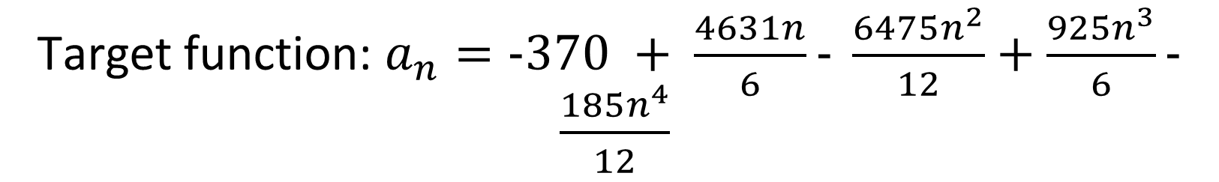
Guess the sequence
1, 2, 3, 4, -365, …
Final hypothesis: $a_{n}=n$
Target function: $a_{n}=−370 + \frac{4631n}{6}− \frac{6475n^{2}}{12}+\frac{925n^{3}}{6}− \frac{185n^{4}}{12}$
Notes:
You might think it is impossible that a formula can give that sequence, in fact yes you can. We can go even further, the target function returns pi for the next number

Slide 12
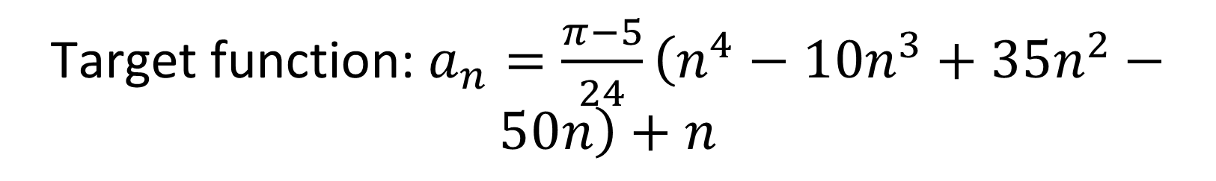
Guess the sequence
1, 2, 3, 4, π, …
Final hypothesis: $a_{n}=n$
Target function: $a_{n}=\frac{π−5}{24}\left(n^{4}−10n^{3}+35n^{2}−50n\right)+n$
Notes:
Here you go, and we can have more possibilities that we shouldn’t ignore.
The whole point here is not to write tricky formulas to compute absurd sequence, the point I try to say, is that target function can be literally anything, it is unpredictable, and we mustn’t assume that the one that looks better is in fact the correct target function, we haven’t assumed anything.

Slide 13
Hopeless: Learning is impossible, … right?
Notes:
So, we can conclude now that we cannot learn anything, and generalisation is not possible. Phew, this has been a short workshop!
Or…, wait a minute, what I said is correct, right? Well, it is correct, we cannot know anything about the target function if we don’t make any assumptions. Here, the keyword is assumption. In order to make learning possible, we must compromise and sacrifice a little bit. Maybe not everything is lost.

Slide 14
Probabilistic Assumptions
Data is the indispensable part to build the “window”
TARGET FUNCTION
FINAL HYPOTHESIS
P(X)
TRAINING DATA
LEARNING ALGO
HYPOTHESIS SET
Notes:
And that is to suppose that the target function produces training data obeying the probabilistic distribution. This means that the training data actually follows some probabilistic distribution from the target function.
A interesting feature of probability is that it is usually bidirectional, therefore, by knowing the training data produced by the target function, we can indirectly get closer to the target function if we use the training data correctly.
That’s why the data is indispensable and essential for learning, because it is the window that communicates the our finite hypothesis to the infinity possibilities

Slide 15



How to nail down the assumptions?
$$≈$$
$$f_{in}$$
$$f_{out}$$
Notes:
Now, we can say that there is a fine line to link target function and real data. But how do we use the characteristics of probability to prove whether learning is feasible or not? And here is the second half and the hard part of the journey.
First, we want to make some annotations. Taking the bin-ball example again
We call out frequency the frequency of a balls colour inside the bin because they are out of our samples, and the frequency of balls in our samples as the in sample frequency.
And as we made the probabilistic assumption in this process, we think fin and fout will assimilate, fin will approximate to fout because it comes from the same distribution

Slide 16

The Hoeffding’s Inequality
Tolerance: $t$
Data size: $N$
Notes:
Is there anyway to gather these concepts together into an expression? The answer is yes, the Hoeffding’s Inequality. We will see how it is used in a minute.
Another concept that we need is the tolerance, this is pretty straightforward, it expresses the margin of difference we can tolerate between the in sample frequency fin and out sample frequency fout. The smaller we set it, the closer estimate is our in sample hypothesis to the out sample hypothesis.
Of course, everything has its trade off. N is the number of data given. As you might thinking, if we want to have a low tolerance, we need a higher N.
Now, we start composing our formula. It is called the Hoeffding’s Inequality, and expresses about a probability that a bad thing happening. It is going to bound at most the probability that this bad event happen

Slide 17
The Hoeffding’s Inequality
Tolerance: $t$
Data size: $N$
$P\left( bad event \right)≤$
Notes:
This is what we have now, right? A probability of a bad event happening less than a quantity, because it wont make sense to limit the bad event in lower band. And what exactly is the bad event?

Slide 18
The Hoeffding’s Inequality
Tolerance: $t$
Data size: $N$
$P\left(\left|f_{in}−f_{out}\right|>t\right)≤$
Notes:
The bad event is that the difference between of in sample frequency and out sample frequency is higher than the tolerance we set. Pretty is straightforward, isn’t it?
The next step is to know what is it bounded by, this probability is hopefully smaller than something small, as we don’t want the probability of this bad event be high.

Slide 19
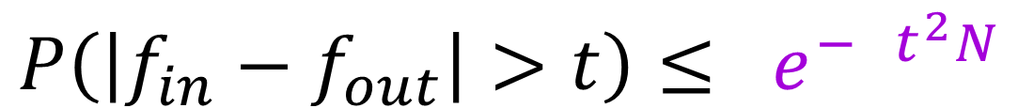
The Hoeffding’s Inequality
Tolerance: $t$
Data size: $N$
$$P\left(\left|f_{in}−f_{out}\right|>t\right)≤ e^{− t^{2}N}$$
Notes:
Oh! So we have this expression at right hand side. It is a exponential with e as base and N and t in the exponent. So this tells us one good news and one bad news.
The good new is that as this is a negative exponential expression, the number decreases very fast when we increase N. That is good because according to this inequality, the probability of bad event will be compressed to be low.
The bad new is that our tolerance appears as squared in the exponent. So if we want to lower our tolerance we will need much more data to decrease unwanted events.
We need some coefficients more to make it complete but doesn’t really affect the general structure

Slide 20
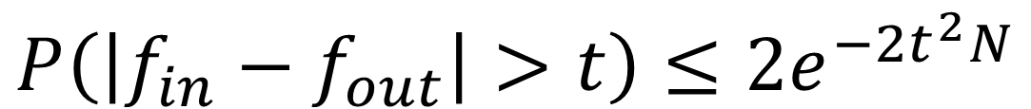
The Hoeffding’s Inequality
Tolerance: $t$
Data size: $N$
$$P\left(\left|f_{in}−f_{out}\right|>t\right)≤2e^{−2t^{2}N}$$
Notes:
And tada! We have it! This is the Hoeffding’s Inequality, we won’t go into the proof of this inequality, but you are interested you can have a look on internet.
To summarise what this is saying, is that the probability that the difference between out sample and in sample frequency is bigger than our tolerance, it’s upper bound is limited by this exponential expression.
So, have we finished demonstrating that learning is feasible? Not so fast

Slide 21



Two lines left
error out sample $≈$ error in sample, for multiple hypothesis
error in sample to $≈0$
Memorisation VS Generalisation
$$E_{in}$$
$$E_{out}$$
0
Notes:
We need to demonstrate two lines more.
The first line is that, ok, now we have linked two quantities in and out sample in the same formula, but how can we approximate them while learning, this is trying and sharpening the hypothesis
The second line is a bit easier, which is to try to reduce the error of our data, and that was the main focus of all previous workshops. They show methods to train our data with less error possible.
Once we have these two lines clear it is easy. Interestingly, these two effects pulls the string into opposite sites. Given same data, if we train too good within the know data, it may perform worse with new data. Some of you maybe is already thinking this. It is called overfitting, and the bad performance is due to it is only memorising, and not truly learning to generalise.

Slide 22

$$E_{in}≈0$$
Loss function
Optimizer
Notes:
The second line is relatively easy, we already learned a couple of ways. The general guideline to reduce the error in sample is to have a better performance when testing. One way to achieve this is that given any hypothesis (model) that we obtain, we compare the predicted values to the correct values by the loss function. And the loss function will tell how good or how bad our hypothesis is, this result can be seen as in sample error.
To reduce this quantity, each model normally has an optimizer, to improve the performance once the errors are detected. In this way, we work out this line to reduce in sample error.

Slide 23

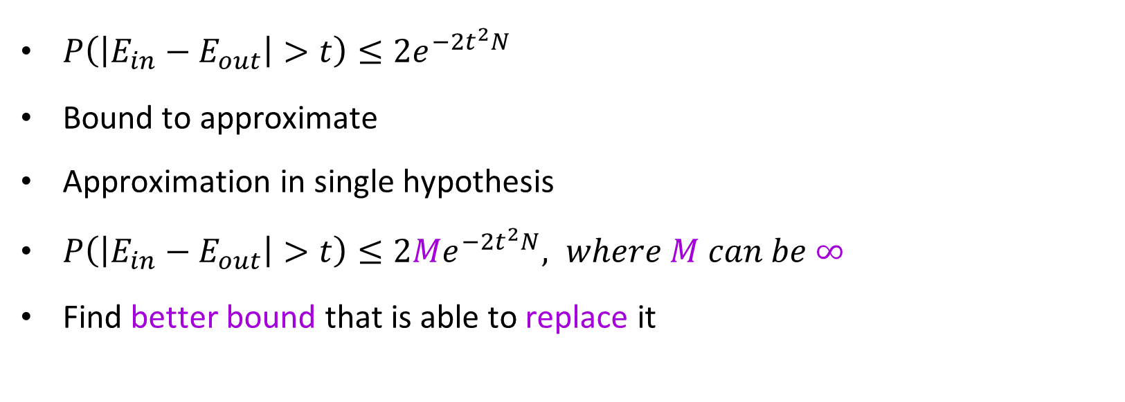
$$E_{in}≈E_{out}$$
$P\left(\left|E_{in}−E_{out}\right|>t\right)≤2e^{−2t^{2}N}$
Bound to approximate
Approximation in single hypothesis
$P\left(\left|E_{in}−E_{out}\right|>t\right)≤2Me^{−2t^{2}N}, where M can be ∞$
Find better bound that is able to replace it
Notes:
What is more difficult is the first line. In this line, we must make use of the Hoeffding’s Inequality. This inequality fills our need, why, because if we understood this correctly, this inequality bounds the difference between the Ein and Eout, and this leads their approximation. Imagine if our bound is small, then the difference between Ein and Eout is also small, hence approximate to each other
Nevertheless, this inequality has a deficit, and that is it is only useful to bound in single hypothesis. What does that mean, so if I choose a specific model, with specific parameter, Hoeffding’s Inequality is able to tell me the upper bound of bad performance. But if I have two hypothesis from the same model, say y = 2x and y = 3x, then the Hoeffding’s Inequality effects.
Why? If we consider the worse case as this is the upper bound, the upper bound will turn twice big. So, even in very simple model, perceptron, the number of possible hypothesis in the hypothesis set is infinite, and therefore the upper bound turns into infinitive… Thank you very much, now we know that our probability will not exceed infinitive ☺.
So the next step is to find tighter bound than infinitive, because this is a bit useless. And here comes the hardest battle of the hero’s journey, finding a better estimation of upper limit

Slide 24

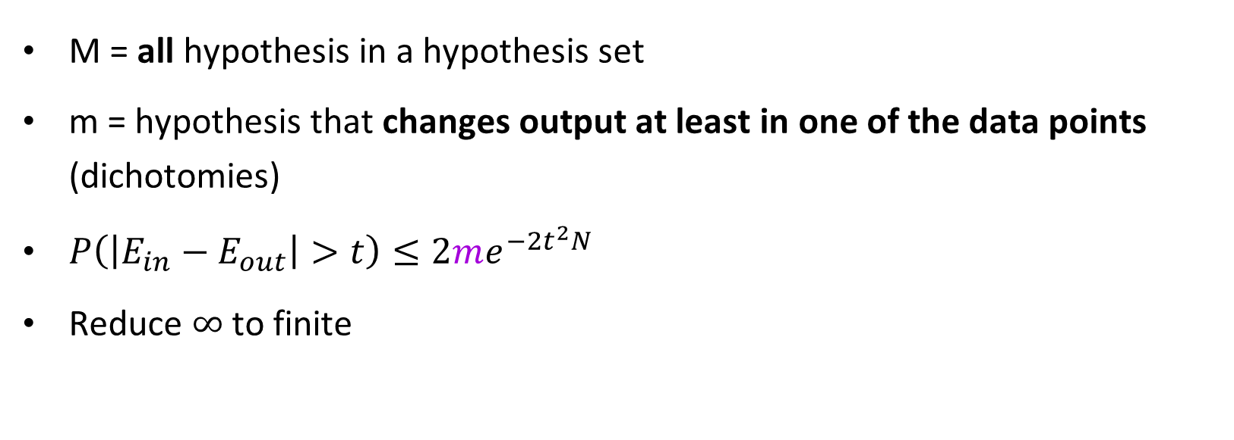
$$M to m$$
M = all hypothesis in a hypothesis set
m = hypothesis that changes output at least in one of the data points (dichotomies)
$P\left(\left|E_{in}−E_{out}\right|>t\right)≤2me^{−2t^{2}N}$
Reduce $∞$ to finite
Notes:
Hands on, the first thing of course, is try to get rid of that uncomfortable infinity.
If we think about it, we don’t actually have to care about the infinity hypothesis of hypothesis set, because it can only be reflected in data. For instance, if two hypothesis that differ in very little, and they don’t cause different predictions for the data points, they should be considered as one in our bounding formula
Therefore we can substitute the big M into a small m where it means the number of hypothesis that at least differ the output in one of the results in one of the data points, to separate this with hypothesis, we can call this separation dichotomies
So, in the end we want to have some formula like this one, only that this formula has also another problem.
From now on, we will rely in the example of perceptron model, which only classifies a point into either 1 or 0
Taking perceptron as example, the given n data points, there can be 2 to the n possible combinations of the result. This will result an exponential big number, and remember, our e to the N is also an exponential, and there is not guarantee that they will cancel out to a number below 1. Remembering that in this equation, we are trying to minimize the boundary, and therefore if we can’t guarantee a number below 1, that is certainly not a good proof that we can approximate error in sample to error out sample. In short, it is not reduced enough!

Slide 25
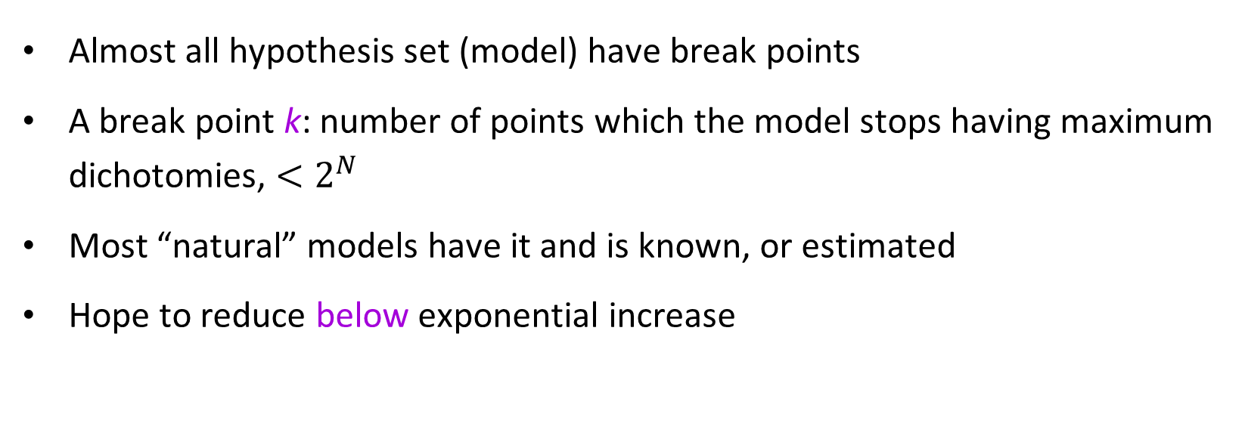
Break points
Almost all hypothesis set (model) have break points
A break point k: number of points which the model stops having maximum dichotomies, $<2^{N}$
Most “natural” models have it and is known, or estimated
Hope to reduce below exponential increase
Notes:
It is hard to tackle this problem from top, lets find anther way of penetrating it. We will introduce a new concept, called break points.
This is a feature that almost all models have, what it means, is that till this number of points and further, 2 to n dichotomies wont be possible, and will start to reduce its increase.
For example, if I have a model that has a break point of 6, then it means that for 1 point, it will have two dichotomies. For 2 points – 4, 3-8, 4-16, 5-32, 6-, something less than 64 from 2 to power of 6, and it will be true for any N bigger than 6, it will be lower than 2 to N power
Normally all common models of machine learning have known breakpoints, and recalling that break points are only dependent on the model, not on the number of data points, which is a useful property to bound
And by this, we will try to reduce the m below exponential increase, so that it can be cancelled by the exponential decrease.

Slide 26

Break point in perceptron
$$k=1 ?$$
Notes:
Lets have a look at this example now, to understand break points better. We will try to find the break point in perceptron. Could it be 1?

Slide 27
Break point in perceptron
$$k=1 ?$$
Notes:
To find out, we suppose that we have a point, is this point resulting correct or incorrect? That will depend on the dichotomies we draw.

Slide 28
Break point in perceptron
$$k=1 ?$$
Notes:
We find a dichotomy that can give it a label, that is good, can we find any more?

Slide 29
Break point in perceptron
$$k=1 ?$$
Notes:
Of course we can, the other possible outcome is the opposite. So if orange were correct, then this outcome means incorrect.

Slide 30
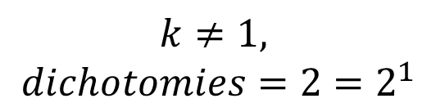
Break point in perceptron
$$k≠1,$$
$$dichotomies=2=2^{1}$$
Notes:
And we can’t find any dichotomy that gives different result from these two. So we have 2 dichotomies, which is 2 to the 1st power. As it doesn’t break this law, k = 1 is not the break point of preceptron

Slide 31

Break point in perceptron
$$k=2 ?$$
Notes:
What about k = 2? Will that be the break point?

Slide 32
Break point in perceptron
$$k=2 ?$$
Notes:
Alright, we find one

Slide 33
Break point in perceptron
$$k=2 ?$$
Notes:
Ok, we can find another one, which is a similar dichotomy but with inverse result. Remember that the line is just to symbolise the dichotomy, there is not a strict relation between the output of the points and the orientation of the space.

Slide 34
Break point in perceptron
$$k=2 ?$$
Notes:
We find a third one, it divides the points in this way.

Slide 35
Break point in perceptron
$$k=2 ?$$
Notes:
In the same way, there is another dichotomy for the inverse

Slide 36
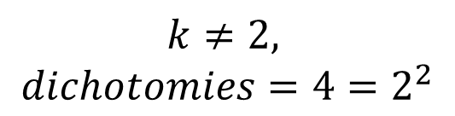
Break point in perceptron
$$k≠2,$$
$$dichotomies=4=2^{2}$$
Notes:
As we have found 4 dichotomies and it still matches 2 raise to the 2nd, it is not the break point in perceptron

Slide 37

Break point in perceptron
$$k=3 ?$$
Notes:
What about k = 3? Will that be the break point?

Slide 38
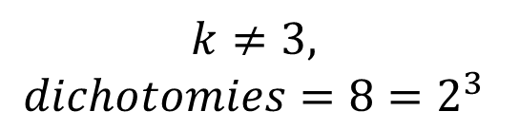
Break point in perceptron
$$k≠3,$$
$$dichotomies=8=2^{3}$$
Notes:
Note the way I collocated the points, if I had put them aligned, then there will be 2 possibilities less because there won’t be anyway to separate the mid point from the rest.
In k = 3 we observe that the number of dichotomies are 8, because we draw 4 lines plus its reverse, it sums 3

Slide 39

Break point in perceptron
$$k=4 ?$$
Notes:
Now, I want to propose a mini challenge, do the same thing with 4 points, and try to say if k = 4 is a break point for perceptron or not. Of course, you can place the points as you want to maximize the space efficiency

Slide 40
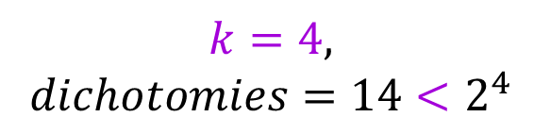
Break point in perceptron
$$k=4,$$
$$dichotomies=14<2^{4}$$
Notes:
And this is the answer, we can create 14 dichotomies at most. Regardless how we position the points, dichotomies won’t exceed 14. And here we have, the break point, because it is not possible to have a line that groups the apposite corner pair as a group, that would imply for example to have left-top point having same output as right bottom, and right-top has same as left-bottom. Eventually, we find out that it is not possible, so we conclude that the break point for perceptron is k=4, when there are 4 points

Slide 41
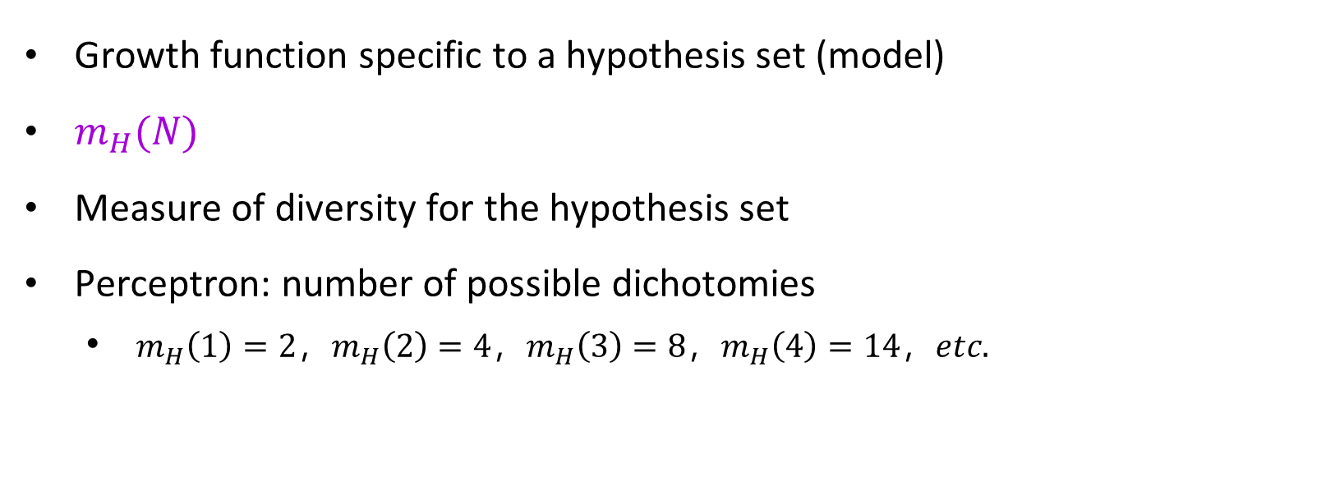
Growth function
Growth function specific to a hypothesis set (model)
$m_{H}(N)$
Measure of diversity for the hypothesis set
Perceptron: number of possible dichotomies
$m_{H}\left(1\right)=2，m_{H}\left(2\right)=4，m_{H}\left(3\right)=8，m_{H}\left(4\right)=14，etc.$
Notes:
Alright, now that we understand what break point is, we need another helpful concept, the growth function
Like break points, it is specific to a particular type of hypothesis set, that is all hypothesis from the same hypothesis set will use the same function
As it is a function, its value depends on a variable, and that is N, the size of the size of data points.
And what does growth function represent? What does it mean?
It is just a way to represent the quantity we have just calculated with dichotomies. So, it’s a measure of how diverse a hypothesis set can be given the number of data points
With the perceptron, we can say that the growth function when N was 1 is 2, when N is 2 mH(N) is 4, etc.

Slide 42
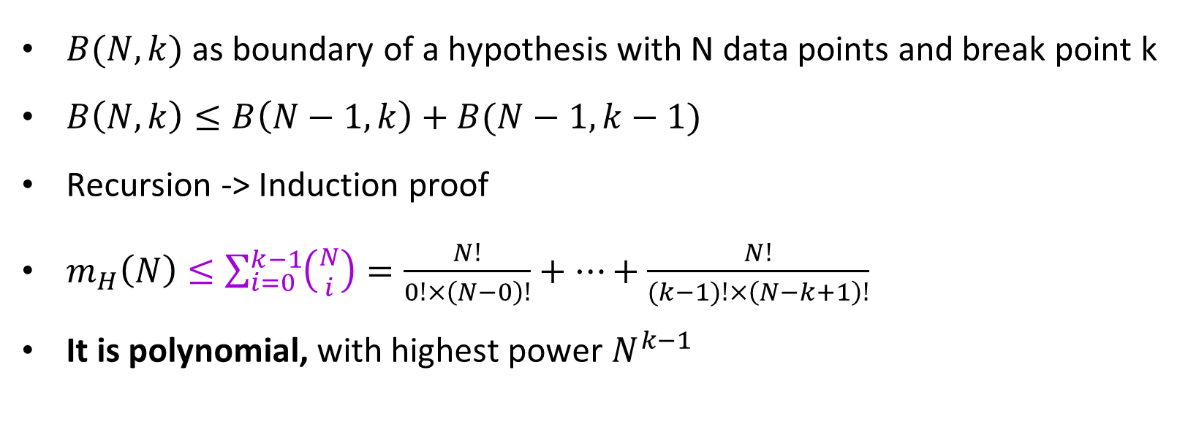
Polynomial growth function
$B(N, k)$ as boundary of a hypothesis with N data points and break point k
$B\left(N, k\right)≤B\left(N−1,k\right)+B(N−1,k−1)$
Recursion -> Induction proof
$m_{H}\left(N\right)≤\sum_{i=0}^{k−1}{\left({N \atop i}\right)}=\frac{N!}{0!×\left(N−0\right)!}+⋯+\frac{N!}{(k−1)!×\left(N−k+1\right)!}$
It is polynomial, with highest power $N^{k−1}$
Notes:
Now, why we struggle so much with the break points and the growth function? The final goal we are going to see it in a minute.
Remember that the break points effectively decreases the exponential increase of the growth function, we are calling the possibilities of different dichotomies as growth function from now on. And if you have a distinctive smell for logic, you might have noticed that if we can proof that the growth function is a polynomial function, not exponential function, that will be a crucial advance for our journey to proof learning is possible.
In this step, we won’t go deep through the proof of that growth function, it may be an interesting topic for a future workshop. But we can have a quick look on the general proofing procedure.
The key thing is that if we look at the combination of the data points as we have done with the perceptron, then we find out that it is possible to bound it with a sum of its smaller kind.
This is a perfect recursion that can be proven by induction proof, that will finally state the growth function will be actually limited by a sum of combinatory number, which is polynomial! Its highest power is N to k-1
We finally found a better boundary! We started from infinity, then two an exponential function, and finally we prove it is polynomial!

Slide 43

$$E_{in}≈E_{out}$$
Find better bound that is able to replace it
$m_{H}\left(N\right)$ corresponds to multi-hypothesis
$M$ corresponds to multi-hypothesis
Equivalent?
Notes:
Great! We are close to the solution. In the approximation of Ein and Eout, we have just solved better bound solution, and now the question is how can we replace it, can we replace it with our findings?
Note that the growth function is not single-hypothesis, meaning that it bounds effectively for the whole hypothesis set
And the big M which included infinitive hypothesis corresponded to multi-hypothesis too
But are they interchangeable? Are they equivalent

Slide 44
VC bound
Yes we can
But not exactly equivalent
Notes:
And the answer is yes! But not exactly equivalent
This is proven by help of VC bound, we wont go through in much detail neither, but let’s have a quick visual look of its main point

Slide 45
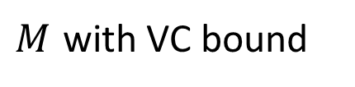

VC bound
$$M$$
$M$ with VC bound
Notes:
Now we are going to explore how the VC bound makes a difference here. Imagine this being the canvas of the input space, and as we have mentioned in the beginning, there is a probability that a bad event happens.
This is represented with this black spot of paint in the canvas.
The problem with M was that we may work with a hypothesis set with infinite hypothesis, and as we are loading with more hypothesis that can lead to a bad event, the canvas end with full of black clouds, bad events, that finally drives the probability of bad event to 1 or even more, which has no sense at all.
How can we reduce this probability? One idea is that the bad events may be overlapping, are they? It results that the bad events are extremely overlapping, in fact, they all coincide and are bounded by a stack-like event. It is more visual with the canvas.
The bad events here, is effectively bounded into a much reduced area, and this is achieved by VC bound

Slide 46


VC bound
From $P\left(\left|E_{in}−E_{out}\right|>t\right)≤2Me^{−2t^{2}N}$
TO
$$P\left(\left|E_{in}−E_{out}\right|>t\right)≤4m_{H}(2N)e^{−\frac{1}{8}t^{2}N}$$
$The$ VC Inequality
Notes:
Finally we reached to this jewel formula, one of the most important theoretical results in machine learning
What this formula says is that, the probability of difference between in sample performance and out sample performance exceeds our tolerance (bad event) is going to be equal or smaller than 4 times the growth function chosen of the model chosen times a exponential decrease given N.
This formula is hugely important, because it tells us the possibility of learning, as long as we have enough data, the polynomial growth function will be cancelled by the exponential decrease until a point lower than one, and that is when we can say for sure, our conclusions inside sample works also outside the sample.
Hurray!!!!!

Slide 47
Is learning feasible?
YES!
Probabilistic assumption
Model has break point
Machines can learn!
Notes:
We have reached the end of our journey, so, is learning feasible?
Yes, with probabilistic assumption and as long as the model has a break point
Here is when we can conclude, yes, machines can learn and can generalise!

Slide 48
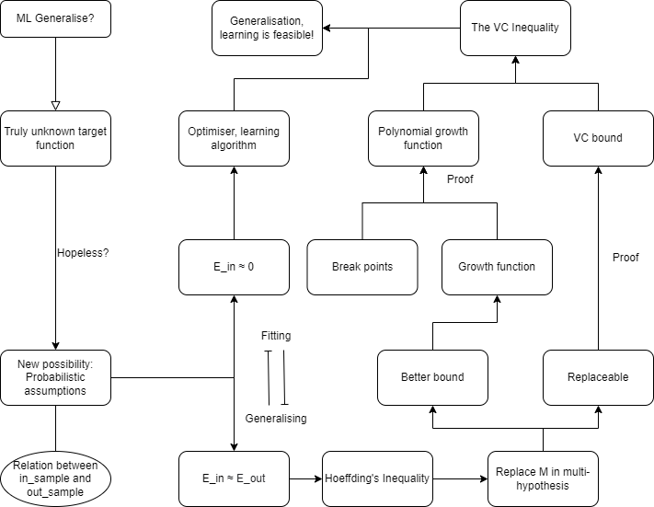
Full journey
Notes:
This is the full journey we just pathed through, and this is the end. Any questions?

