Slide 1
Ethereum-Fraud-Detection-System
University of Bologna
Muhammad zain: Master physics
BLOCKCHAIN AND CRYPTOCURRENCIES
A Decentralized Approach Using Machine Learning and Blockchain

Slide 2
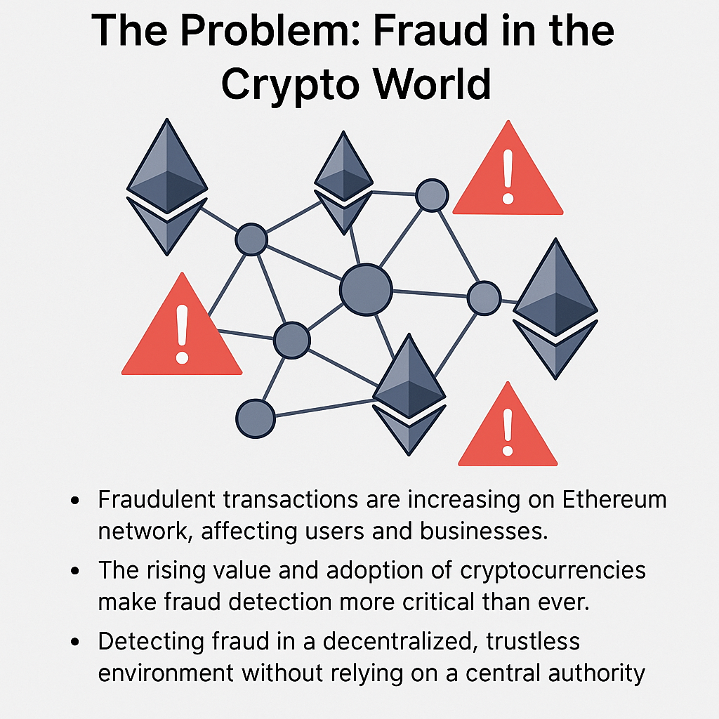


Slide 3
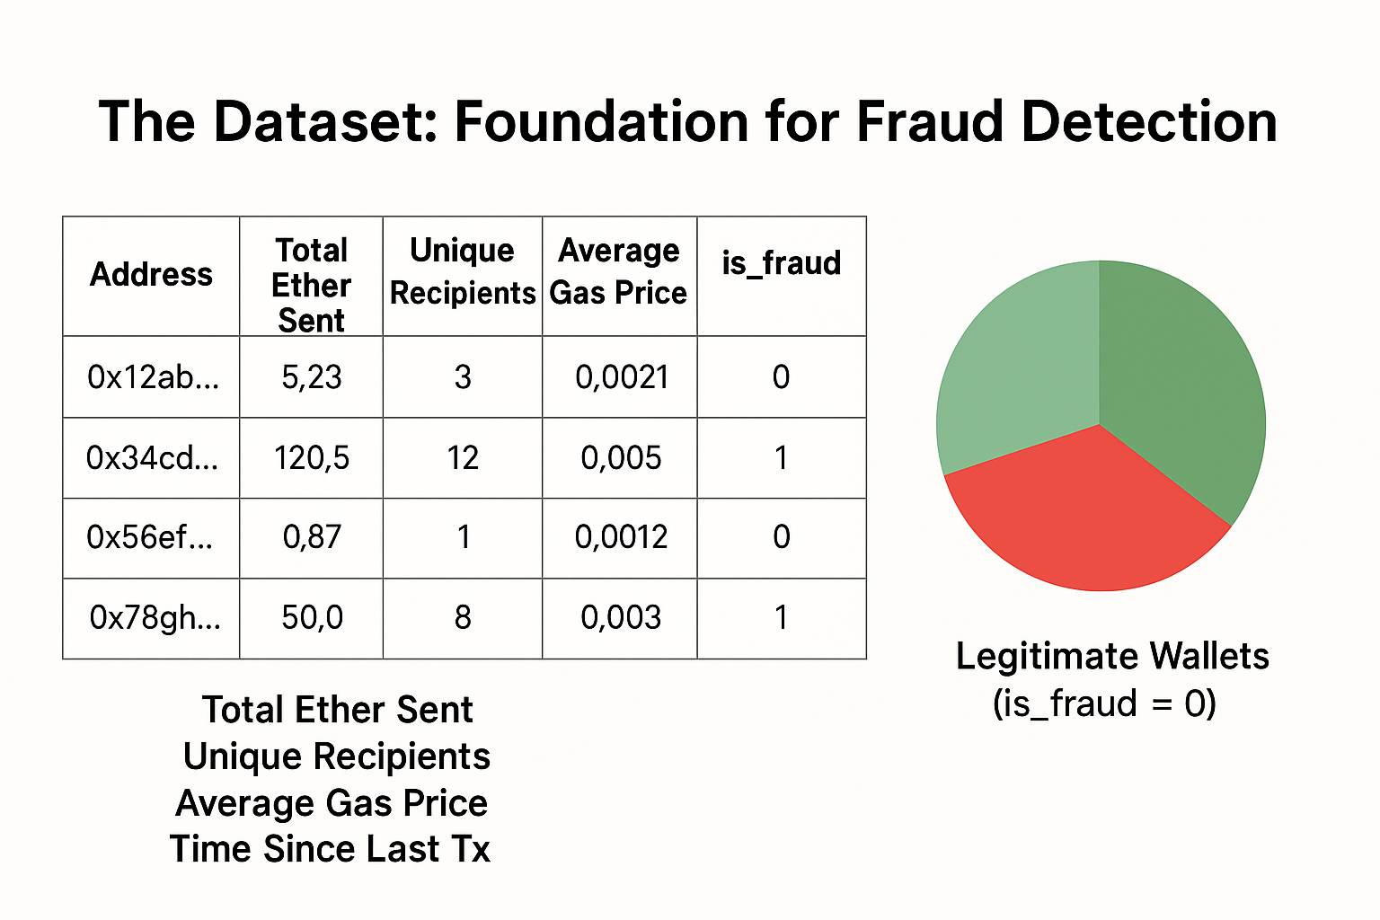
Dataset Overview
Size: 9,841 Ethereum wallet addresses
Features: 47 numerical features describing each wallet’s transaction activity
Dataset Imbalance: 2,179 wallets (22.1%) are fraudulent, indicating a moderate class imbalance suitable for effective ML training.
Handling Imbalance: Train/test split preserves class balance; evaluation uses precision, recall, and F1-scor
Target Variable: is_fraud column
0: Legitimate wallet
1: Fraudulent wallet

Slide 4
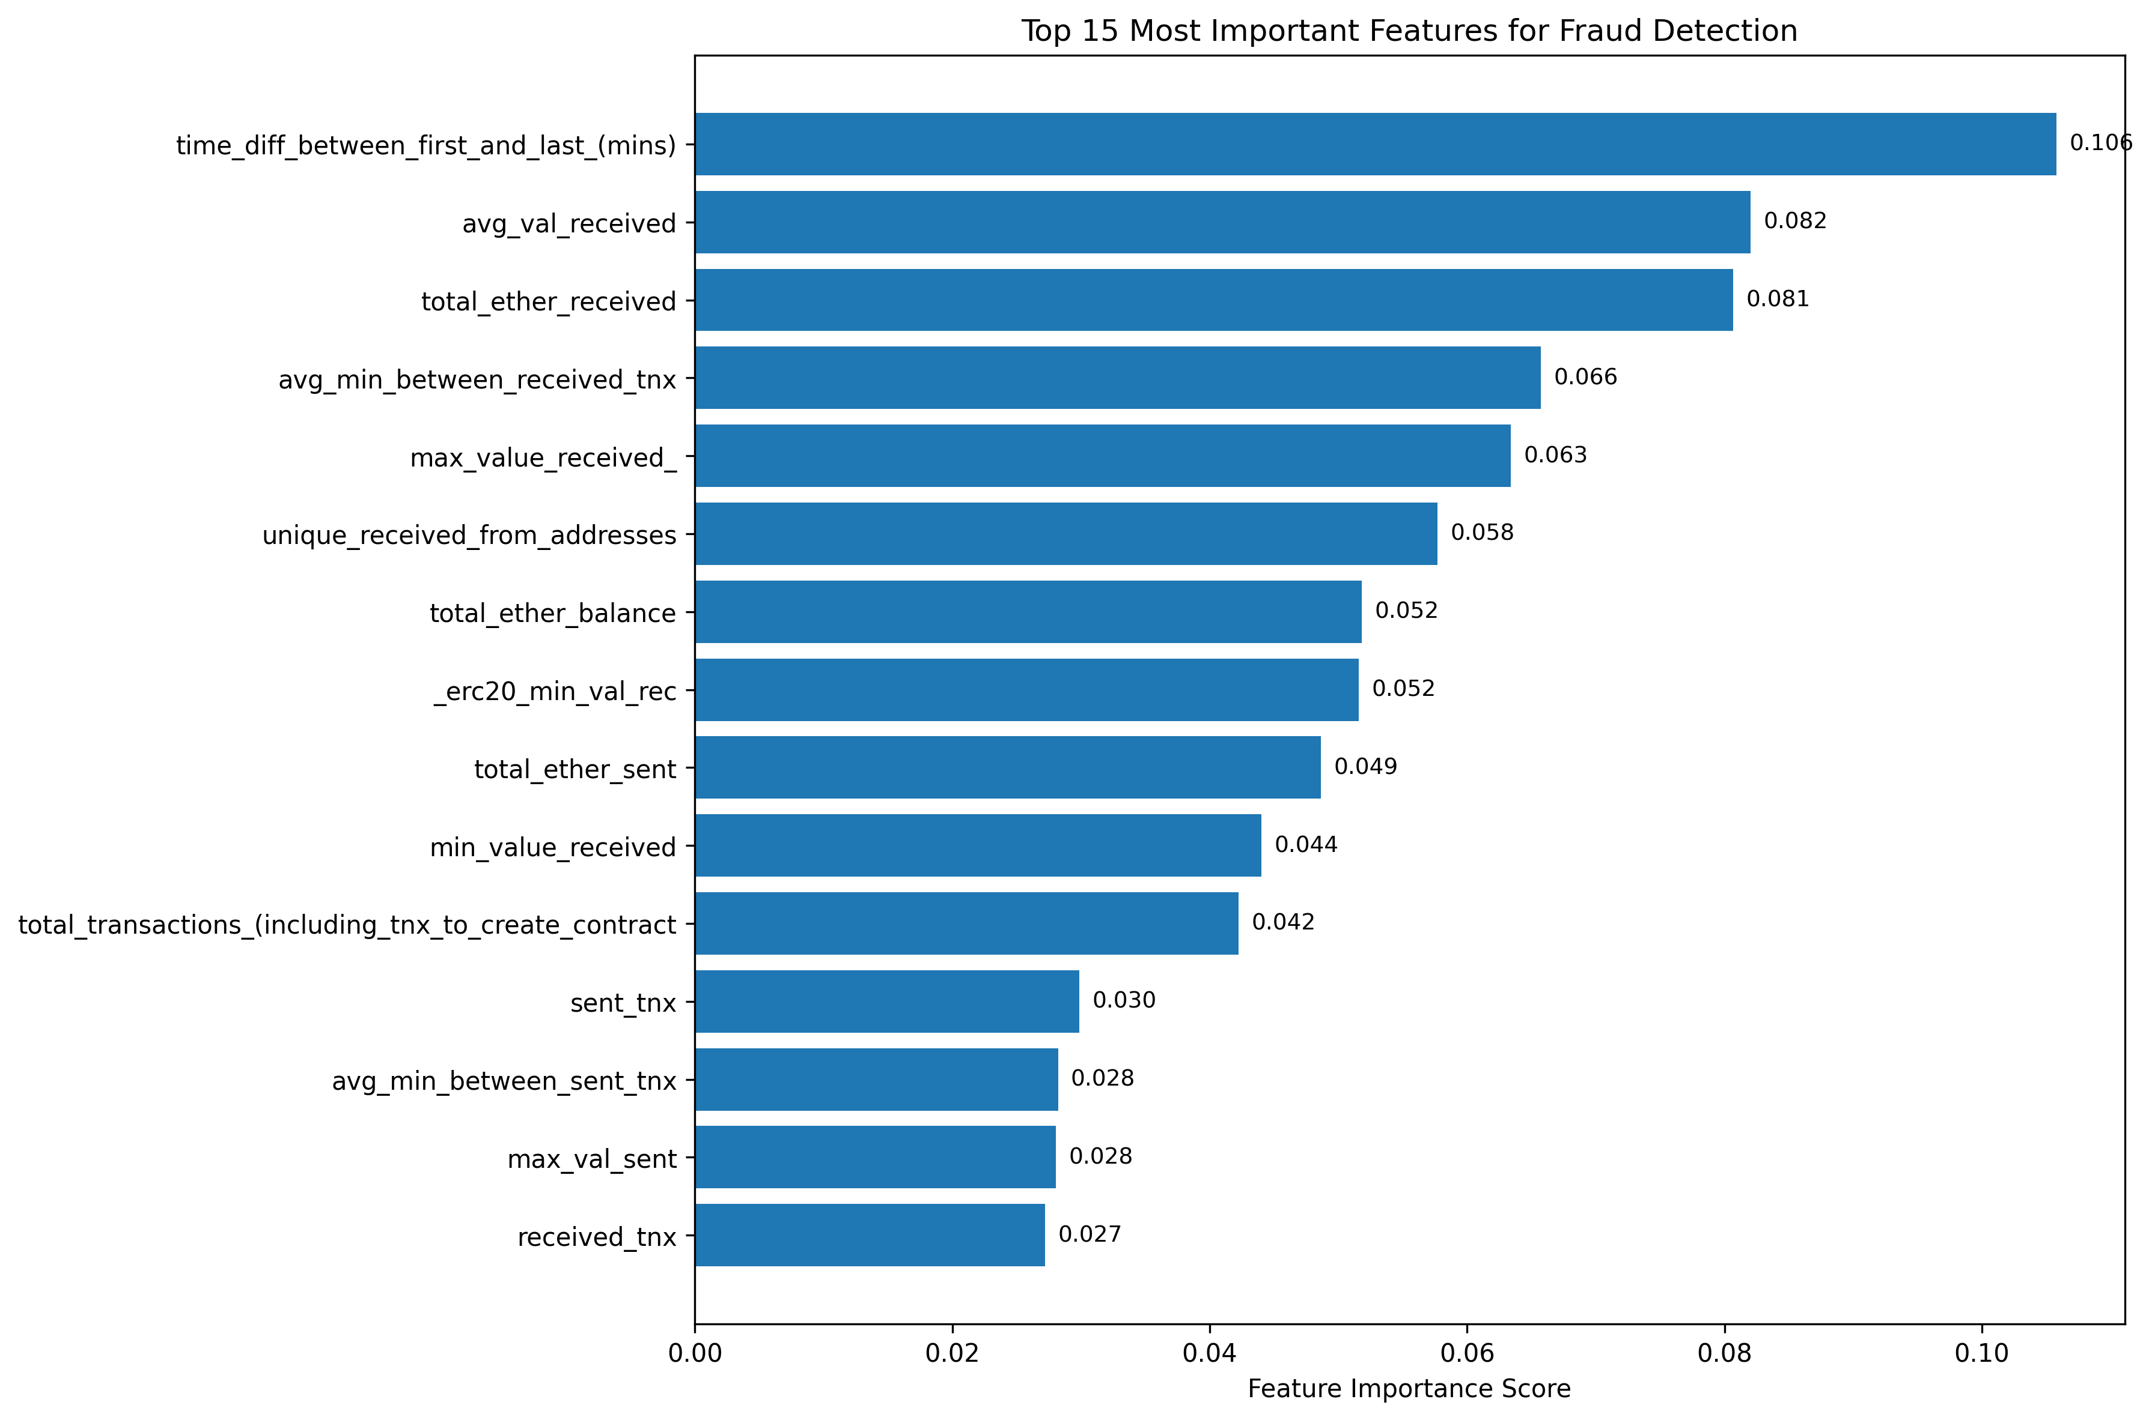
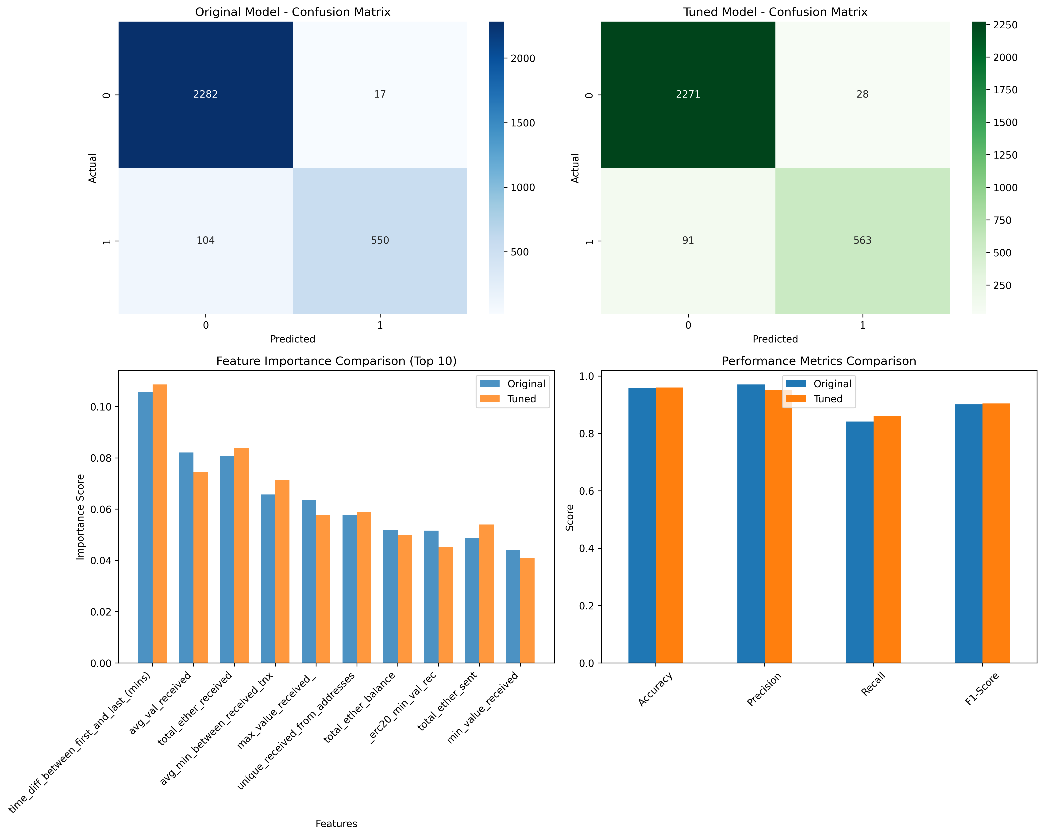
Machine Learning Model

Slide 5
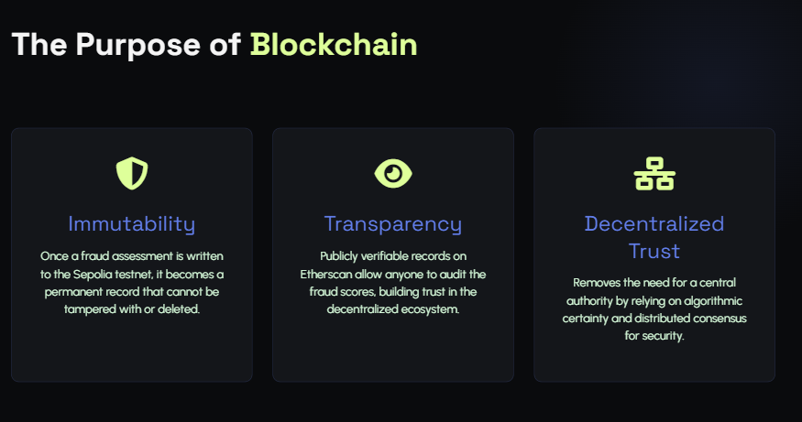

Slide 6
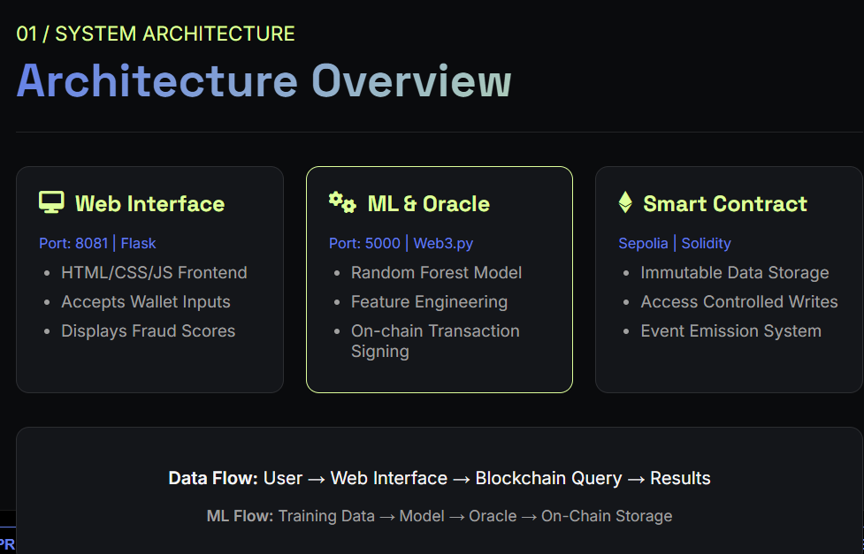

Slide 7
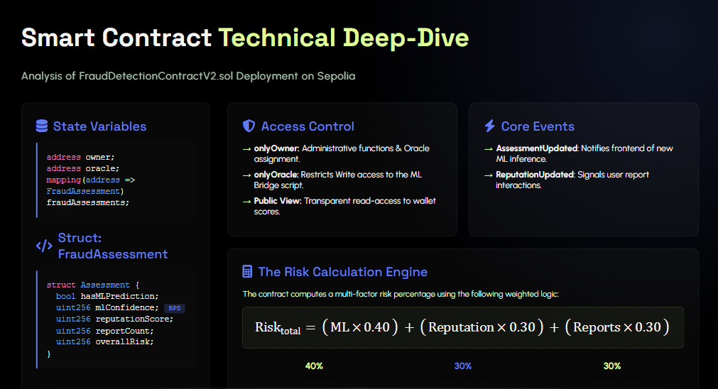

Slide 8
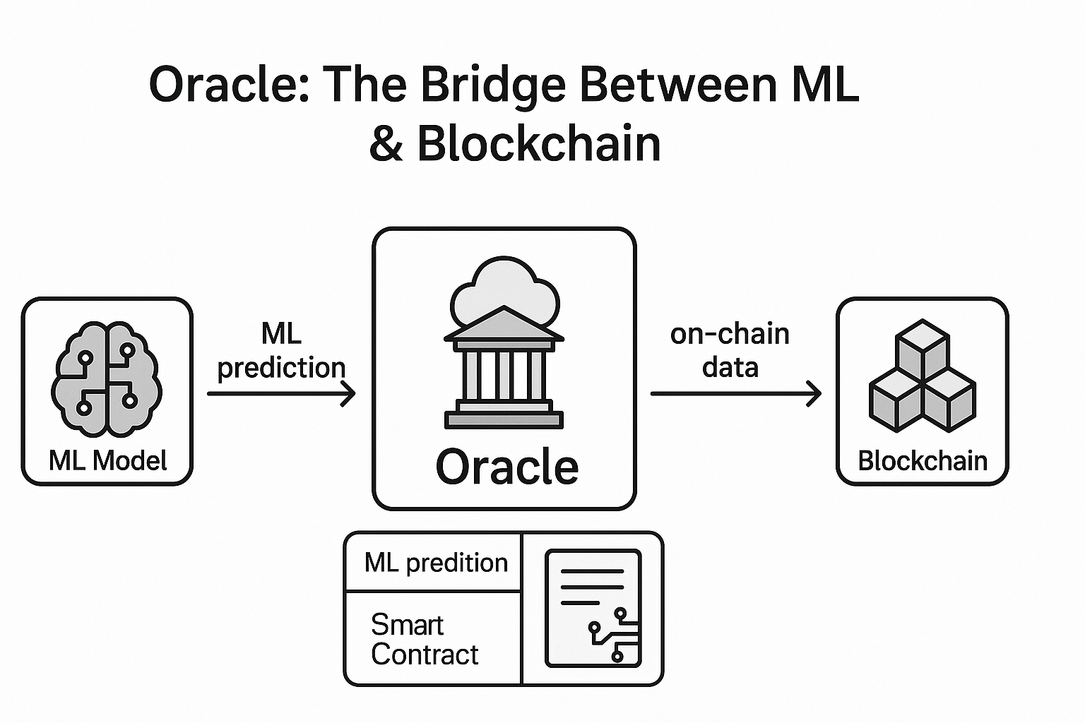
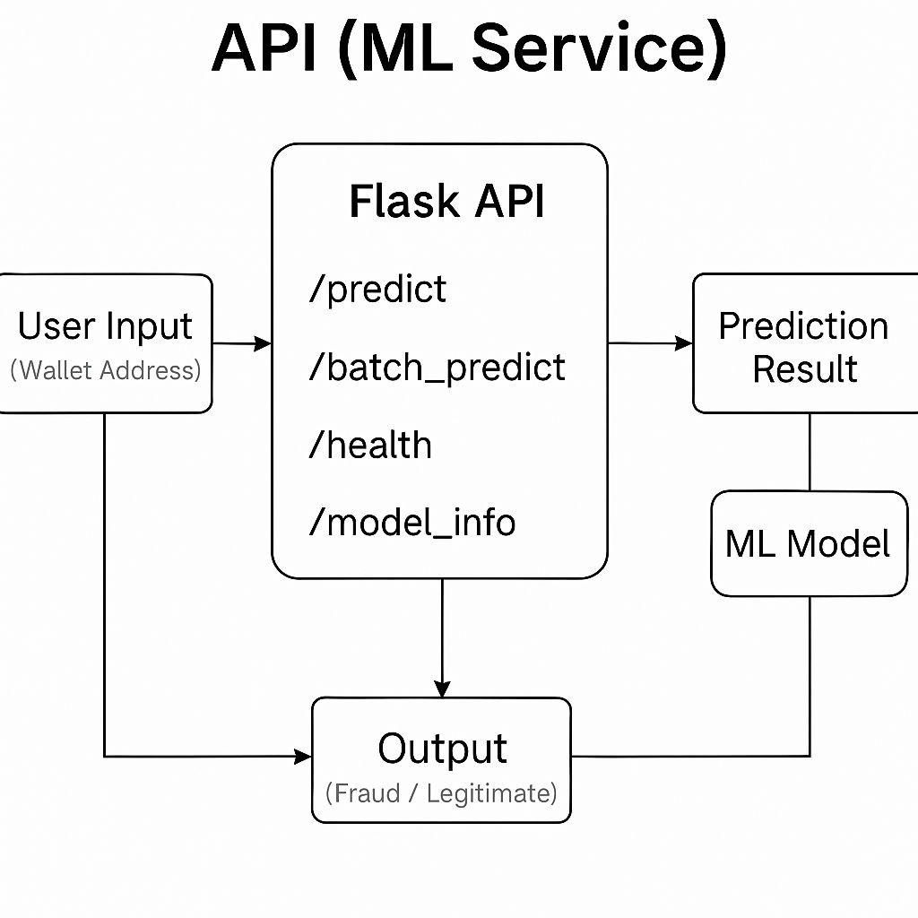
The Oracle Service: Secure Off-Chain to On-Chain Bridge
The Oracle bridges off-chain ML fraud predictions to the Ethereum blockchain by fetching wallet risk scores and writing them to the smart contract.
The Oracle calls the smart contract function:
updatedFraudAssessment(walletAddress,hasMLPrediction, mlIsFraudulent, mlConfidence, reputationScore, reportCount, overallRisk).
Smart contracts can’t access external APIs, so an oracle bridges off-chain AI data. A Python backend fetches ML predictions and updates the contract securely.

Slide 9

Deploying to Ethereum Sepolia Testnet
The Foundationhardhat.config.js
Defines the network connection. It loads the Infura RPC URL and Private Key from secure environment variables to authorize the transaction.
2. The Executionscripts/deploy_sepolia.js
The logic script that compiles the Solidity code, estimates gas (approx 0.01 Sepolia ETH), and broadcasts the contract to the network.
3. Public Verification
Used the Etherscan API to verify the source code, ensuring transparency and allowing public interaction with the contract.
4. Integration
Updated the Oracle Service with the new Contract Address to begin live fraud data submission.

Slide 10
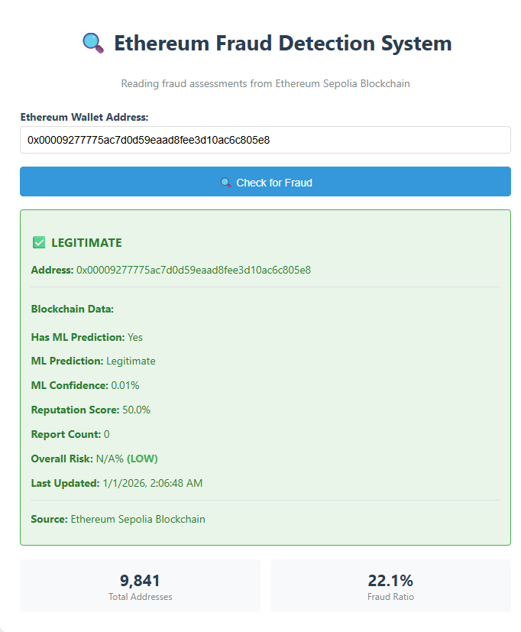

Slide 11
