Slide 1


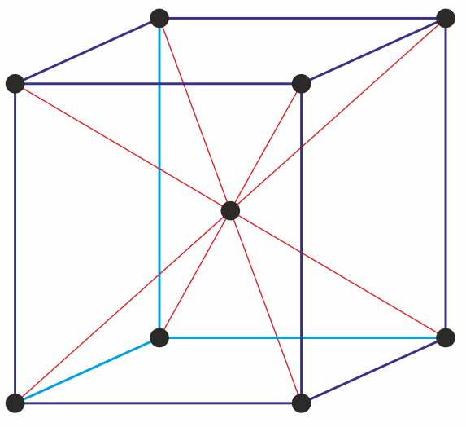
Crystallography of tungsten
Topic 1
Bochuan Sun
Material Science & Engineering
Clemson University
W
W
W
W
W
W
W
W
W

Slide 2
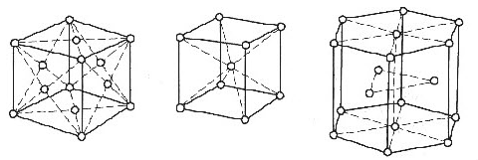
Common crystal structure of metals
Face-centered cubic (fcc)
Body-centered cubic (bcc)
Hexagonal Close Packed (hcp)
Aluminum (Al)
Copper (Cu)
Gold (Au)
Silver (Ag)
Nickel (Ni)
α-iron (Fe)
Tungsten (W)
Chromium (Cr)
Magnesium (Mg)
Titanium (Ti)
Zinc (Zn)
Cadmium (Cd)

Slide 3
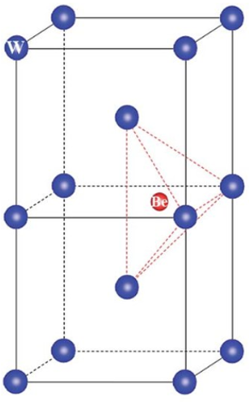
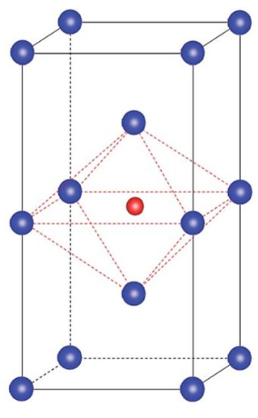


Crystal structure of W
Tetrahedral interstitial
Octahedral interstitial
In most cases, tungsten is body-centered cubic (BCC):
(0, $\frac{1}{2},\frac{1}{4}$)
($0$,$\frac{1}{2},\frac{1}{2}$), ($0$,$0,\frac{1}{2}$)
W
W
W
W
H
W
H
H
W
W
W
W
2 atoms per unit cell
Lattice parameter: 3.165 Å
The number of interstitial atoms per unit cell:
12
6

Slide 4
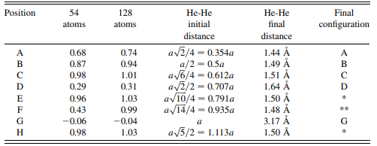
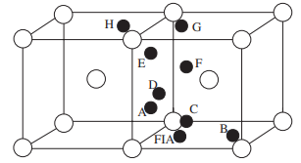


The formation energy of hydrogen (H) and helium (He) interstitial atoms in W (in eV)
He-He binding energy in W ^{[5]}
$E_{f}^{Int}$ = E_{(NW + Int)}-E_{(NW)}-E_{(Int)}
E(Int) = $\frac{1}{2} E_{H_{2}}$ or $E_{He} (fcc)$
 | H_{OIS} | H_{TIS} | He_{OIS} | He_{TIS}
[1] | 1.31 | 0.92 | 6.39 | 6.26
[2] | 1.28 | 0.90 | 6.34 | 6.07
[3] | 1.32 | 0.92 | 6.48 | 6.23
[4] |  |  | 6.41 | 6.19
He and H atoms prefer to sit in TIS
FIA is the first inserted He atom
(H-H binding energy is repulsive: 0 to -0.47 eV)
1. You, Yu-Wei, et al. "Effects of self-interstitial atom on behaviors of hydrogen and helium in tungsten." Physica Scripta 95.7 (2020): 075708.
2. Jiang, B., F. R. Wan, and W. T. Geng. "Strong hydrogen trapping at helium in tungsten: Density functional theory calculations." Physical Review B 81.13 (2010): 134112.
3. Lee, Seung-Cheol, Jung-Hae Choi, and June Gunn Lee. "Energetics of He and H atoms with vacancies in tungsten: First-principles approach." Journal of nuclear materials 383.3 (2009): 244-246.
4. Zu, Xiaotao T., et al. "Properties of helium defects in bcc and fcc metals investigated with density functional theory." Physical Review B 80.5 (2009): 054104.
5. Becquart, C. S., and C. Domain. "A density functional theory assessment of the clustering behaviour of He and H in tungsten." Journal of Nuclear Materials 386 (2009): 109-111.

Slide 5

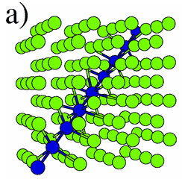
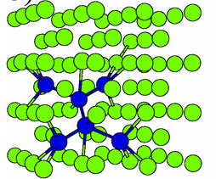
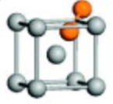
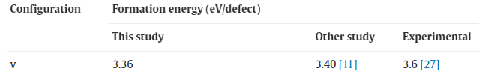

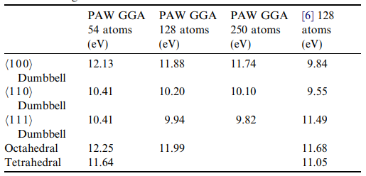

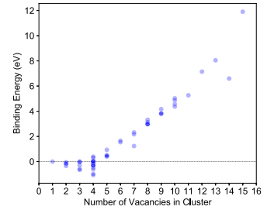





The formation energy of W-SIA in W ^{[1,2]}
The formation energy of vacancy in W ^{[3, 4, 5]}
$E_{f}^{SIA}$ = E_{(NW+SIA)}-E_{(N+1)W}
$E_{f}^{Vac}$= E_{(NW+Vac)}-E_{(N-1)W}
E_{(N+1)W} = $\frac{N+1}{N}$E_{NW}
E_{(N-1)W} = $\frac{N−1}{N}$E_{NW}
[3]
[4]
[5]
<1 1 1> Dumbbell
<1 1 0> Dumbbell
<1 1 1> Crowdion
The binding energy of vacancies in W ^{[6]}
^{[3]}
E_{b} = n $×$ $E_{W}^{N−1}$ - (${n\text{-}1)E}_{W}^{N}$- $E_{W}^{N−n}$
[1] Nguyen-Manh, D., A. P. Horsfield, and S. L. Dudarev. "Self-interstitial atom defects in bcc transition metals: Group-specific trends." Physical Review B 73.2 (2006): 020101.
[2] Becquart, C. S., and C. Domain. "Ab initio calculations about intrinsic point defects and He in W." Nuclear Instruments and Methods in Physics Research Section B: Beam Interactions with Materials and Atoms 255.1 (2007): 23-26.
[3] D. Nguyen-Manh, A.P. Horsfield, S.L. Dudarev, Phys. Rev. B 73 (2006) 020101
[4] K. Heinola, T. Ahlgren, A. Kuronen, K. Nordlund, Tungsten properties and defects studied by computational methods, Accelerator Laboratory, Department of Physical Sciences, University of Helsinki, The Second German-Finnish Workshop on Material Migration in Fusion Devices – Measurements and Modelling, Tervaniemi, Finland, 26–27 February 2007.
[5] Landolt-Börnstein, Numerical Data and Functional Relationships in Science and Technology, New Series, vol. III/25, Springer, Heidelberg (1991)
[6] Oda, Yasuhiro, et al. "First-principles study on migration of vacancy in tungsten." Plasma and Fusion Research 9 (2014): 3401117-3401117.

Slide 6
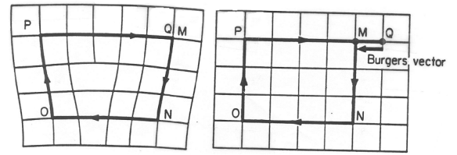
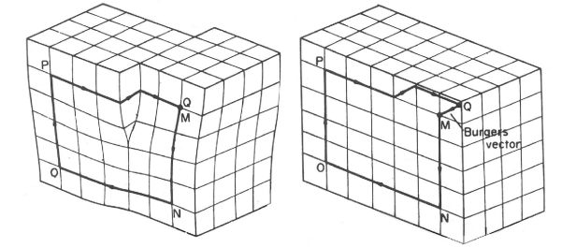



Edge dislocation
Screw dislocation
$$\overset{⃑}{b}⊥\overset{⃑}{l}$$
$$\overset{⃑}{b}∥\overset{⃑}{l}$$
In this dissertation
$\overset{⃑}{b}$: $\frac{a}{2}$ <1 1 1>
$\overset{⃑}{b}$: $\frac{a}{2}$ <1 1 1>
Glide plane: {1 1 0}
https://www.doitpoms.ac.uk/tlplib/dislocations/burgers.php

Slide 7
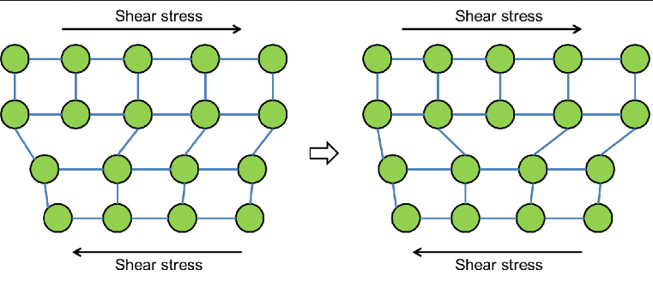



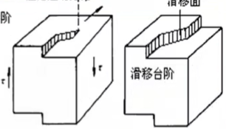



Dislocation glide
The glide plane contains the dislocation line and burgers vector.
$$\overset{⃑}{n}=\overset{⃑}{b}×\overset{⃑}{l}$$
$\overset{⃑}{b}⊥\overset{⃑}{l}$
Edge dislocation: unique glide plane
Sheer stress
Sheer stress
Screw dislocation: arbitrary glide plane
$$\overset{⃑}{b}∥\overset{⃑}{l}$$

Slide 8
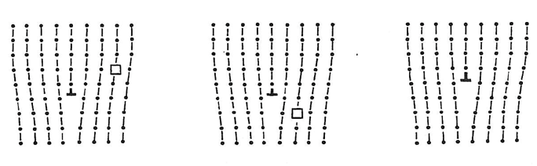
Edge dislocation climb
After absorbing point defects (addition or removal of atoms) edge dislocation can climb

Slide 9
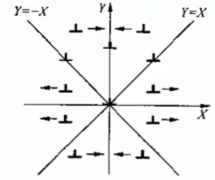
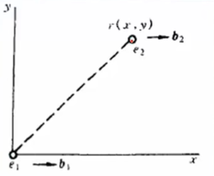
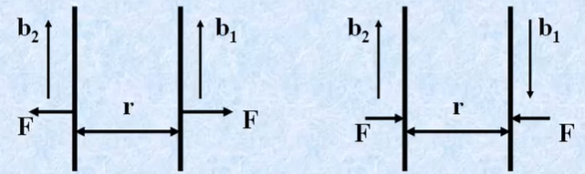


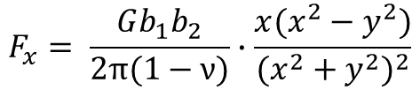
Interaction between dislocations
Edge dislocation
Screw dislocation
$$f= \frac{Gb_{1}b_{2}}{2πr}$$
$$F_{x}= \frac{Gb_{1}b_{2}}{2π(1−ν)}∙\frac{x(x^{2}−y^{2})}{{(x^{2}+y^{2})}^{2}}$$
G: shear modulus
ν: Poisson’s ratio
$$F_{y}= \frac{Gb_{1}b_{2}}{2π(1−ν)}∙\frac{y(3x^{2}+y^{2})}{{(x^{2}+y^{2})}^{2}}$$

Slide 10
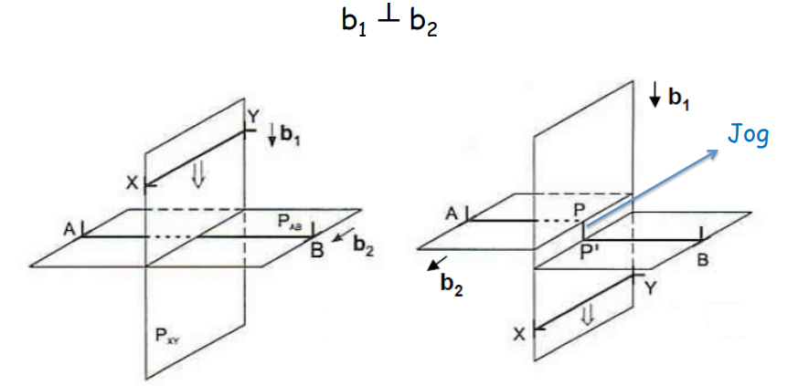
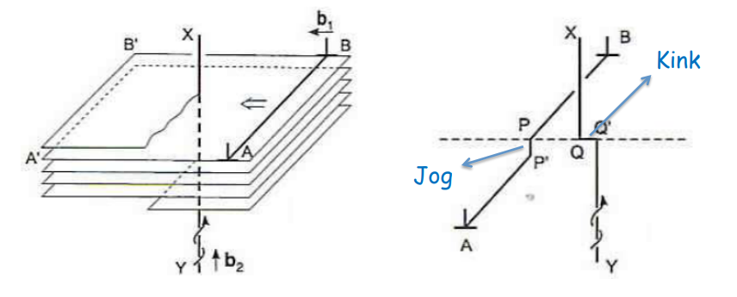
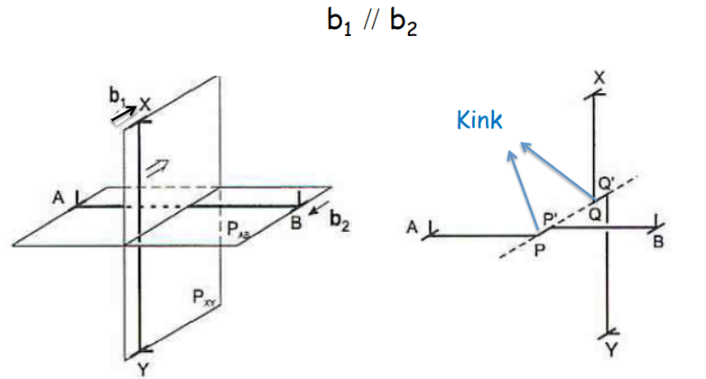
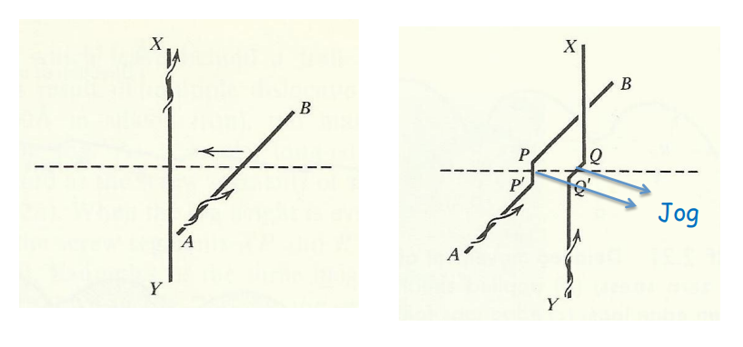
Intersection of dislocations
Two edge dislocations
An edge and a screw dislocation
Two screw dislocations

Slide 11
Any Questions

Slide 12



$$E_{edge}= \frac{Gb^{2}}{4π(1−ν)}ln\frac{R}{r}$$
$$E_{screw}= \frac{Gb^{2}}{4π}ln\frac{R}{r}$$
Peach-Koehler force: $F=τb$

