Slide 1


Computational methodologies applied in this dissertation
Topic 3
Bochuan Sun
Material Science & Engineering
Clemson University

Slide 2
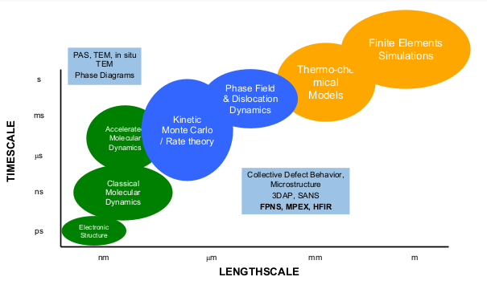
Multiscale modeling
Metropolis Monte Carlo

Slide 3
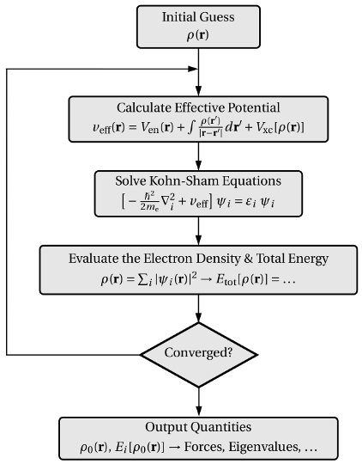

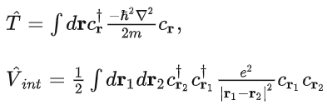



Density functional theory
Ground-state electron structure
Kinetic
Universal
Interaction potential (electron-electron)
External potential
Kohn-Sham theory
The ground-state electron density uniquely determines the electronic wavefunction.
The energy of an electron distribution can be described as a functional of the electron density, and this functional is a minimum ground-state density.
https://www.iue.tuwien.ac.at/phd/goes/dissse14.html

Slide 4
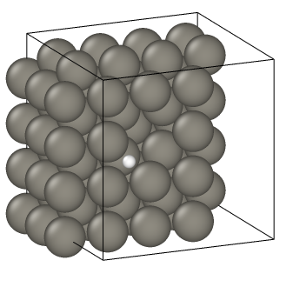

Application of density functional theory
Study the energy of the system
Solve the Kohn-sham equations and get the electron structure
Study elastic properties
VASP codes can apply a small strain to the system and calculate the resulting stress
The binding energy of an interstitial atom and a vacancy in W
The number of atoms is restricted (usually tens to hundreds) otherwise the cost will be super huge!

Slide 5

Molecular dynamics simulation
Trajectories of atoms
Initial atomic model
$$−∇E_{pot}=ma$$
Initial configuration file (data file): include the number of atoms, the size of the sample, atom types, and the position of each atom.
Interatomic potential: describe the atom-atom interactions.
Input file: contains various types of commands
System size and shape
Atom type definitions and positions
Force field or potential energy function parameters
Simulation settings and run time parameters
Thermodynamic or statistical measures to be computed
Output file specifications and data analysis commands.
Calculate molecular forces acting on each atom
Move each atom according to those forces
Advance simulation time

Slide 6
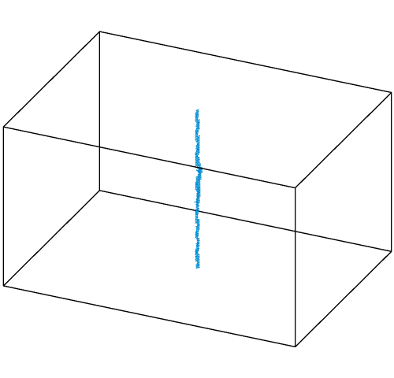
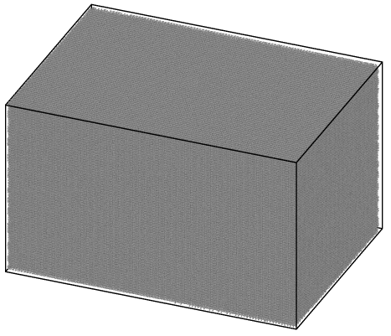
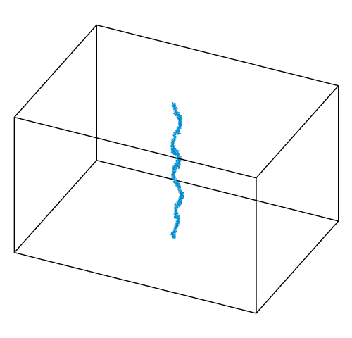
Application of molecular dynamics simulation
Allow to track the trajectory of each atom and the configuration change of the sample with a large number of atoms (can be over 100,000)
The accuracy and feasibility highly depend on the interatomic potential, for the high entropy alloys we studying, the interatomic potential is not established yet.

Slide 7
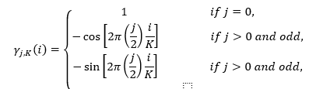
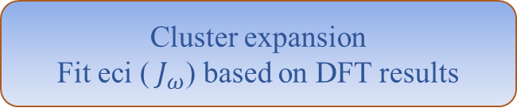


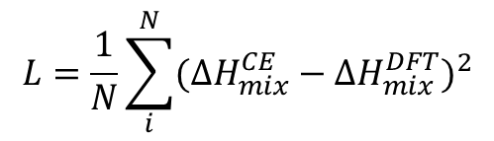

Cluster expansion
Enthalpy of mixing
$${∆H}_{mix}\left(\vec{i}\right)= \sum_{ω}{m_{ω}J_{ω}<{Γ_{ω}\left(\vec{i}\right)>}_{ω}}$$
First principal calculations (DFT)
m: multiplicity
J: the concentration-independent effective cluster interaction (eci)
$<{Γ_{ω}\left(\vec{i}\right)>}_{ω}:$the average correlation function
Cluster expansion
Fit eci (${ J}_{ω}$) based on DFT results
$$L=\frac{1}{N}\sum_{i}^{N}{{({∆H}_{mix}^{CE}−{∆H}_{mix}^{DFT})}^{2}}$$
Mean squared error loss function
Monte Carlo simulations
$$\begin{aligned}&Γ_{ω}^{\left(s\right)}\left(\vec{i}\right)= γ_{j_{1},K}\left(i_{1}\right)γ_{j_{2},K}\left(i_{2}\right)γ_{j_{3},K}\left(i_{3}\right){∙∙∙γ}_{j_{ω},K}\left(i_{ω}\right)\#\end{aligned}$$
Thermal properties
$γ_{j_{1},K}\left(i_{1}\right):$point functions tell the occupancy of each cluster

Slide 8

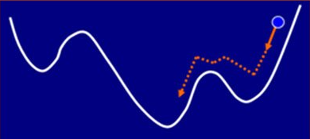


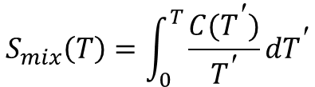
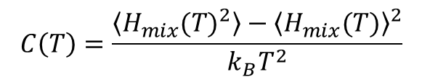

Metropolis Monte Carlo
In the HEA project, we combined Metropolis Monte Carlo and cluster expansion to obtain the equilibrium states with the minimum free energy for a given composition at a given temperature, and by using thermodynamic integration, we can calculate the free energy of mixing.
Over 10,000 atoms
$$C\left(T\right)=\frac{\left\langle H_{mix}{(T)}^{2}\right\rangle −{\left\langle H_{mix}(T)\right\rangle }^{2}}{k_{B}T^{2}}$$
$$S_{mix}\left(T\right)=\int_{0}^{T}{\frac{C(T^{\text{′}})}{T^{\text{′}}}dT^{\text{′}}}$$
$$F_{mix}= H_{mix}−{TS}_{mix}$$
$$π_{i}{Acc}_{i→f}=π_{f}{Acc}_{f→i}$$
https://hpc-lr.umontpellier.fr/wp-content/uploads/2018/03/6-Poster_L2C.pdf

Slide 9
Any Questions

Slide 10
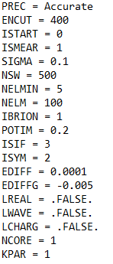
DFT calculations are usually implemented by VASP (Vienna Ab initio Simulation Package) codes, which include:
POSCAR: initial configuration (atom type, number of atoms, size of the sample, atom position)
POTCAR: pseudopotentials of each element
INCAR: VASP commands
KPOINT: Set up the number of k-points in the first Brillouin zone.
PREC: specifies the precision of the calculation
ENCUT: energy cutoff
ISTART: controls how the calculation is started
ISMEAR: specifies the type of smearing method used for electronic occupancies
SIGMA: sets the width of the smearing
NSW: specifies the maximum number of ionic steps to take in the relaxation of the atomic positions
NELMIN: sets the minimum number of electronic steps
NELM: sets the maximum number of electronic steps
IBRION: the type of ionic relaxation method
POTIM: sets the time step for ionic relaxation
ISIF: specifies the type of ionic relaxation and force calculations to perform
ISYM: controls the symmetry operations used to generate equivalent k-points and atomic positions
EDIFF and EDIFFG: sets the convergence criteria
LREAL: controls whether to use real-space or reciprocal-space projection
LWAVE: controls whether to write the WAVECAR file
LCHARG: controls whether to write the CHGCAR file
NCORE: sets the number of cores to use for the calculation
KPAR: sets the number of k-points to compute simultaneously in parallel

Slide 11
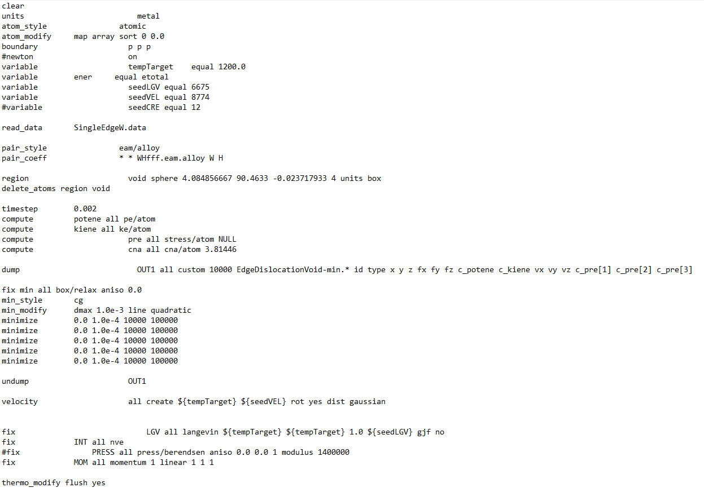
Set up sample
Set up variables
Read initial configuration
Read interatomic potentials
Create void
Simulation settings and run time parameters
Output command
Set initial velocity
Apply Langevin thermostat

Slide 12
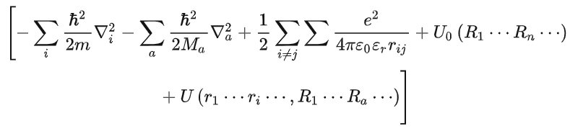
Born-Oppenheimer approximation
The Hamiltonian of a system:
The kinetic energy of electrons
The kinetic energy of nucleus
Interaction potential of elections
Interaction potential of nucleus
Interaction potential between electrons and nucleus
Since the electrons are much smaller and move much faster than the nucleus (10^{3~4}), when studying electron motion, the nucleus is assumed to be stationary at the lattice sites. Only the Coulomb force between the electron and the nucleus is considered.

Slide 13
NVE (micro-canonical ensemble): potential energy and kinetic energy can be converted into each other.
NVT (canonical ensemble): give or get energy from a big heat source, but the temperature keeps, can be used to learn a local area of a big system.
NPT: relax the system to keep the pressure
µVT(GCE): allow the particle change, but since the system needs to get equilibrium, the chemical potential needs to be kept.

Slide 14
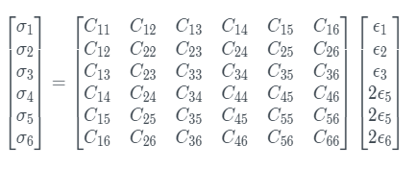
xx: 1, yy: 2, zz: 3, yz: 4, xz: 5, xy: 6
In bcc cells, because of the symmetry, only C11, C12 and C44 are independent
Bulk modulus Voigt average
9KV​=(C11​+C22​+C33​)+2(C12​+C23​+C31​)=3C11+6C12 (in bcc)
Shear modulus Voigt average
15GV​=(C11+C22+C33)−(C12​+C23​+C31​)+3(C44​+C55​+C66​) = 3C11 -3C12+9C44

Slide 15
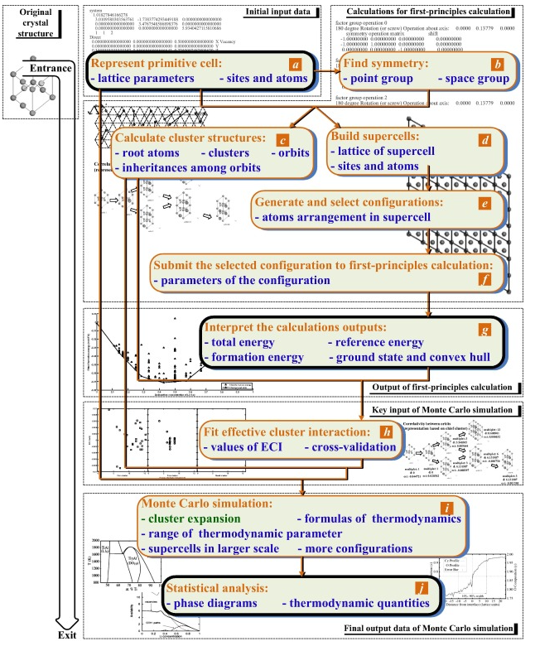
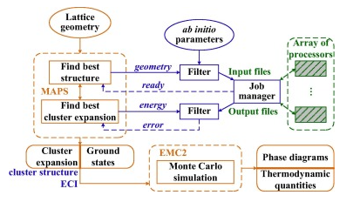


Backup slide: details of cluster expansion methodology
$${∆H}_{mix}\left(\vec{i}\right)= \sum_{ω}{m_{ω}J_{ω}<{Γ_{ω}\left(\vec{i}\right)>}_{ω}}$$
m can be found here
J can be found here
Controls the accuracy of cluster expansion
$Γ$ can be found here
To have the minimum configuration for the selected temperature and composition

