Slide 1

Process Manager
Upload_Recipe
Start_Process
Task Executor
Call_Service
Receive_Reply_Service
Update_Process
Analyze_Task
Collect_Answers
Sync. Service
Async. Service

Slide 2
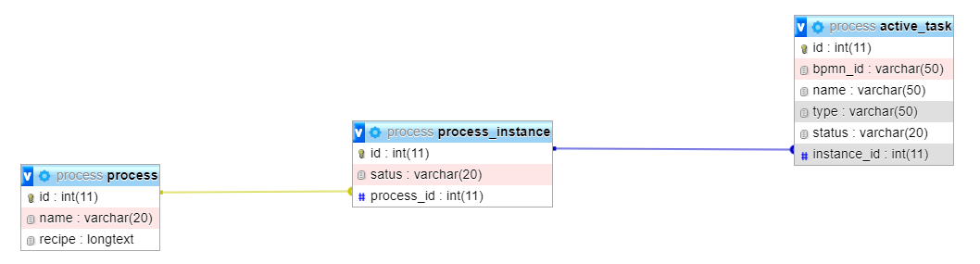
Bpmn_id: id as in BPMN document.
Name: as in BPMN document.
Type: startEvent, serviceTask, intermediateCatchEvent, parallelGateway …
Status: Ready_To_Start, In_Progress, Finished or Finished_Treated
Name: Name given during upload
Recipe: BPMN document
Status: In_Progress or Finished

Slide 3
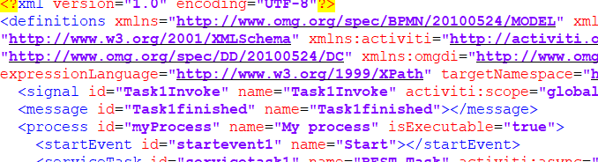
Upload_Recipe
Description: Endpoint where users can upload recipes in BPMN format.
Functionality: Perfoms the following actions:
Reads name of process from BPMN document (process id or name)
Inserts in DB a new process using name and whole BPMN document

Slide 4
Start_Process
Description: Endpoint where users can launch a process creating an instance of that process.
Functionality: Perfoms the following actions:
Reads the name of the process selected by the user.
Inserts a new process instance in DB (linked to the process)
Reads from BPMN name and id of startEvent
Inserts startEvent in active_task table (linked to instance, bpmn_id= startEvent id, name= startEvent name, type= startEvent and status= Ready_To_Start
Calls Update_Process

Slide 5
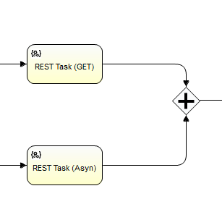
Update_Process
Description: Flow that updates the process instance by checking the status and adding/changing the active_task table.
Functionality: Perfoms the following actions:
Queries active_task table about tasks Ready_To_Start
For each of those tasks calls Analyse_Task (sub_Flow)
Queries active_task table about tasks Finished (to address merging with parallel Gateways)
For each of those tasks {
Collect TargetRef
If type_targetRef = parallelGateway check if all sequenceFlow/sourceRef are finisheds
If all_finished {
Update those tasks in active_task as Finished_Treated
Collect TargetRef (should be a parallelGateway)
Inserts parallelGateway in active_task table (linked to instance, bpmn_id= parallelGateway id, name= parallelGateway name, type= parallelGateway and status= Ready_To_Start}
}

Slide 6
Analyse_Task
Description: Flow that checks a task and updates the active_task table with new tasks or calls a service.
Functionality: Perfoms the following actions:
Collects the type of task
Proposes a switch where case type:
startEvent:
Finds startEvent in BPMN recipe (sequenceFlow)
Collects tasks from targetRefs (could be more than one)
Inserts those tasks in active_task table (linked to instance, bpmn_id= element id, name= element name, type= element type and status= Ready_To_Start
Finishes startEvent activity
serviceTask:
Change status of task to In_Progress
Call Task Executor Call_Service (pass process_instance_id, active_task_id, message_expected)
parallelGateway: (as for startEvent but with parallelGateway)
intermediateCatchEvent:
Change status of task to In_Progress
endEvent:
Set task status to Finished_Treated
Set process instance to Finished

Slide 7
Collect_Answers
Description: Endpoint where the Task Executor writes the replies to the tasks assigned.
Functionality: Perfoms the following actions:
Collects process instance id
Collects Task id
Collects results
If result is correct change task status to Finished
Call Update_Process

Slide 8
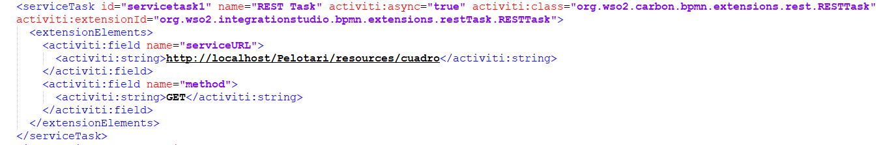
Call_Service
Description: Endpoint where the Process Manager request to make a call to an external service.
Functionality: Perfoms the following actions:
Collects extensionElements (need to decide how)
Get parameters: serviceURL, method, input, headers … (information about the service to be called)
If service asynchronous {
Get TargetRef type
Get message_expected (intermediateCatchEvent/messageEventDefinition/messageRef)
Call service with parameters (indicate process instance id, task_id, message_expected)}
Else{
result = Call service with parameters
Call Collect_Answers (process instance id, task_id, result) }

Slide 9
Receive_Reply_Service
Description: Endpoint /Subscription where the Service replies once finished (for asynchronous services).
Functionality: Perfoms the following actions:
Collects message_expected
Get process instance id, task_id, result
Call Collect_Answers (process instance id, task_id, result) }

