Slide 1
A Predictive Model for Early Detection of
Hypertension Among Adults in Uganda
By
Twinomujuni Wilson
Supervisor:
Dr. Jane Katusiime
Faculty of Computing and Informatics
Notes:
<number>

Slide 2

Introduction
Hypertension is a growing health issue in Uganda.[1]
27% of people in Uganda are suffering from hypertension [4].
33% of all mortality in Uganda is caused by Hypertension and other non-communicable diseases.
Only 8% of persons with hypertension are aware of their diagnosis [4]
Early detection is critical but challenging in low-resource settings [1].
Existing models from high-income countries don’t fit Uganda’s context.
Need for a predictive model tailored to Uganda’s healthcare system.
Notes:
The tea industry has the potential to play a major role in achieving the sustainable development goals(SDGs) through;
Zero Hunger (SDG 2)
Good Health and Well-being (SDG 3)
Decent Work and Economic Growth (SDG 8):
This represented 2.8 percent of Uganda's total exports, 1.26 percent of global tea exports and
0.36 percent of Uganda's Gross Domestic Product (GDP).
More than 67% of Uganda's tea is grown by small holder farmers under low-input systems [7]

Slide 3
Problem Statement
There are rising hypertension cases associated with poor early detection in Uganda [2].
Much as models for predicting hypertension are available globally, they rely on electronic health records which are rare locally.
Moreover, these models ignore local factors: diet, socio-economic conditions, healthcare access making them difficult to adapt to the Ugandan Context [3].
This has resulted into:
Late diagnoses
poor management
Increased deaths.
Urgent need for a simple, data-efficient, locally relevant model.

Slide 4
Main Objective
The main objective is to enhance early detection of hypertension Uganda by creating a predictive model tailored to identify high-risk adults, facilitating timely interventions.

Slide 5
Specific objectives
To identify and analyze factors associated with hypertension among adults in Uganda.
To develop a predictive model for early detection of hypertension based on the identified risk factors
To evaluate the accuracy of the developed model.

Slide 6
Significance of the study
Provides healthcare providers with clear, data-based insights to support early detection of hypertension.
Supports personalized care plans to help manage and reduce problems caused by high blood pressure.
Improves patient outcomes, enhances quality of life, and strengthens preventive healthcare systems.

Slide 7
Literature Review
STUDY | STRENGTH | GAP
Framingham Risk Score (FRS) [5] | simplicity and accessibility User friendly | Lacks accuracy for African populations. Relies on clinical data often unavailable in low-resource settings.
Hypertension Risk Prediction Score (HRPS) [6] | High accuracy and applicability. | Does not account for population-specific variables like dietary habits
WHO’s Global HEARTS Initiative [7] | Provides clear guidelines aimed at strengthening health systems. Focuses on areas such as training healthcare workers. | Does not specifically focus on predictive models or machine learning.

Slide 8
Methodology
Design Science Research Methodology &
User-Centered Design
DSRM focuses on solving practical problems through the creation of artifacts—in this case, a predictive model
UCD ensures the product meets real user needs
METHODS FOR OBJECTIVE 1(To identify and analyze factors associated with hypertension among adults in Uganda.).
Applied stratified sampling on 120 patients and purposive sampling on 30 healthcare providers involved in hypertension care
Used questionnaires to collect quantitative data from patients and conducted interviews with healthcare providers for qualitative insights

Slide 9
Methodology Cont’d
METHODS FOR OBJECTIVE 2(To develop a predictive model for early detection of hypertension based on the identified risk factors) .
Data Preparation
handled missing values and removed incomplete records.
Feature Selection
Selected features based on relevance to hypertension
Data Splitting
Divided the dataset into training, validation, and test sets using a 60-20-20 ratio
Model Training
Trained two classification models ie Random Forest and Logistic Regression.
Model Evaluation
Assessed model performance on the test set using metrics such as accuracy, precision, and recall.
Compared model outputs to select the best-performing one.

Slide 10
Methodology Cont’d
METHODS FOR OBJECTIVE 3 (To evaluate the accuracy of the developed model.).
Test Set Evaluation
Used the reserved test data (20%) to assess final model performance.
Performance Metrics
Accuracy
Precision
Recall

Slide 11
Results For Objective 1.
(To identify and analyze factors associated with hypertension among adults in Uganda.)
Significant Risk Factors Identified
Age
Family history (parent, sibling, others)
Smoking status
Alcohol consumption
Salt consumption
Education level
Fruit & vegetable intake
Household income

Slide 12
Results For Objective 2. (To develop a predictive model for early detection of hypertension based on the identified risk factors)
Model Comparison
Logistic Regression: lower performance.
Random Forest Classifier: Higher accuracy.
Final Model
Model Type: Random Forest Classifier
Features Used: Age, salt intake, smoking, alcohol, income, physical activity, family history, etc.
Output: Binary (0 = Low Risk, 1 = High Risk), with probability score
Implementation.
Flask to deploy the predictive model in a web environment.
HTML to structure the web application's interface.
CSS to style the interface.
Python libraries (Scikit-learn, Pandas) for data preprocessing, model training, and analysis
Google Colab for model development

Slide 13
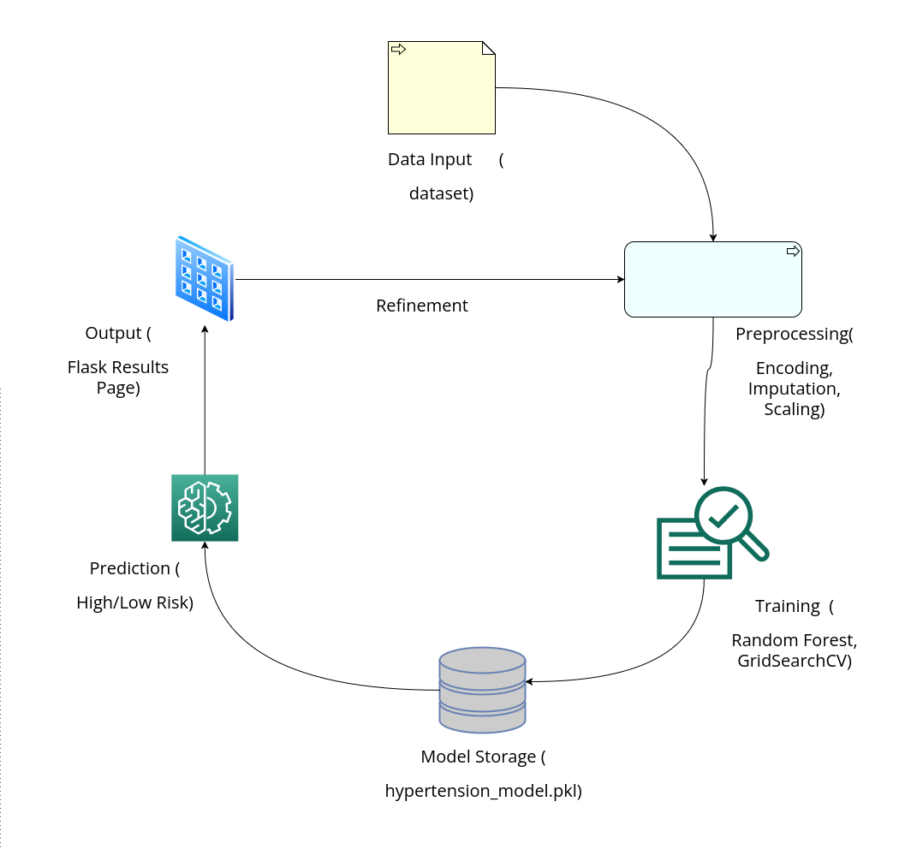
Model illustration

Slide 14
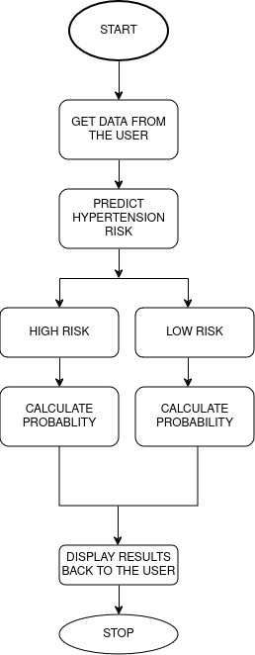
Integration of the model into a web application

Slide 15
Results For Objective 3.(To evaluate the accuracy of the developed model.)
Model | Accuracy | Precision | Recall | F1-Score
Random Forest Classifier | 0.97 | 0.98 | 0.88 | 0.92
Logistic Regression | 0.78 | 0.76 | 0.75 | 0.75

Slide 16
References
[1]. Guwatudde, D., Mutungi, G., Wesonga, R., Kajjura, R., Kasule, H., Muwonge, J., Ssenono, V. and Bahendeka, S.K., 2015. The epidemiology of hypertension in Uganda: findings from the national non-communicable diseases risk factor survey. PloS one, 10(9), p.e0138991.
[2].Mustapha, A., Ssekasanvu, J., Chen, I., Grabowski, M.K., Ssekubugu, R., Kigozi, G., Reynolds, S.J., Gray, R.H., Wawer, M.J., Kagaayi, J. and Chang, L.W., 2022. Hypertension and socioeconomic status in south central Uganda: a population-based cohort study. Global heart, 17(1), p.3.
[3]. Batte, A., Gyagenda, J.O., Otwombe, K., Muhindo, R., Bagasha, P., Kiggundu, D., Aujo, J.C., Atuhe, D.M., Kansiime, G., Hussein, R. and Namuyimbwa, L., 2023. Prevalence and predictors of hypertension among adults in Mbarara City, Western Uganda. Chronic Illness, 19(1), pp.132-145.
[4]. Majumdar, U., Nanyonga Clarke, R., Moran, A.E., Doupe, P., Gadikota-Klumpers, D.D., Gidio, A., Ssentamu, D. and Heller, D.J., 2022. Hypertension screening, prevalence, treatment, and control at a large private hospital in Kampala, Uganda: A retrospective analysis. PLOS global public health, 2(5), p.e0000386.

Slide 17
References Cont’d
[5]. Ralph B D’Agostino Sr, Ramachandran S Vasan, Michael J Pencina, Philip A Wolf,
Mark Cobain, Joseph M Massaro, and William B Kannel. General cardiovascular
risk profile for use in primary care: the framingham heart study. Circulation,
117(6):743–753, 2008.
[6] Kawasoe, M., Kawasoe, S., Kubozono, T., Ojima, S., Kawabata, T., Ikeda, Y., Oketani, N., Miyahara, H., Tokushige, K., Miyata, M. and Ohishi, M., 2022. Development of a risk prediction score for hypertension incidence using Japanese health checkup data. Hypertension Research, 45(4), pp.730-740.
[7]. World Health Organization. HEARTS: technical package for cardiovascular dis-
ease management in primary health care: risk-based CVD management. Technical
report, World Health Organization, 2020

Slide 18


