Slide 1
Credit Risk Prediction & Default Analysis
Finding risky loans before they are approved, without turning good customers away
Business presentation for bank management | Machine Learning Analyst
Notes:
Purpose of the deck: show management how a predictive model can reduce bad debt, what it costs in rejected customers, and how we recommend deploying it.

Slide 2
The model cuts bad debt by more than half
85%
39% → 17%
63.5%
of defaulting loans caught before approval
bad-debt ratio of approved loans (by value)
of applications can be decided instantly
What we recommend
Deploy the Logistic Regression model as a risk score with three lanes: auto-approve, manual review, auto-reject.
Expect a trade-off: higher recall means more good applicants are reviewed or declined. The cut-off is a policy lever the bank controls.
Leave gender and marital status out of the model; it is just as accurate without them.
Notes:
On 200 held-out applicants the Logistic Regression model, at the balanced cut-off of 0.44, catches 85% of defaults. Bad-debt ratio by value falls from 38.9% to 16.6%. The price is that 49% of good customers would be declined if the model were used as an automatic gate, which is why we recommend routing the middle band to credit officers.

Slide 3
30% of loans default, so accuracy misleads
Recall
A missed default (false negative) costs the whole loan principal, so catching defaults is the priority.
F1-score
Balances losing a good customer (false positive) against approving a bad loan.
AUC-ROC
Shows how well the model separates good from bad applicants at every cut-off.
Notes:
A model that approves everybody is 70% accurate but catches no defaults. That is why recall, F1 and AUC-ROC are the success measures. Data: 1,000 historic applicants, 23 columns, target 'default'.

Slide 4
Who defaults? Clear patterns emerge
Missing data is informative
No checking account on file: 12% default vs 42% with one. We keep it as a flag instead of filling it in.
Loan terms and history matter
Longer loans and a weaker asset base default more often.
No single rule is enough
Every numeric feature has |correlation| below 0.21 with default, so we combine many signals.
Notes:
Default rates by group (training data = all 1,000 rows). Applicants with no checking account on file default at 12% versus 42%; missing is a signal, not noise. Longer loans (over 24 months, n=230) default at 44% versus 21% for loans up to 12 months (n=359). No single numeric feature has a correlation with default above 0.21, so a multivariate model is needed.

Slide 5
Data was cleaned without losing signal
1
2
3
4
Parse & flag
Text durations ('13 years') became months. Missing balances and phone became has-account flags.
Tame outliers
Log transform for loan amount and savings; cap one extreme checking balance at the 99th percentile.
Encode & scale
Missing numbers filled with the median, categories one-hot encoded, numbers standardised.
Split fairly
Stratified 80/20 train/test split; imbalance handled with balanced class weights.
Also dropped: the observation ID and the raw phone number (identifiers), and, deliberately, gender and marital status (see fair-lending slide).
Notes:
All steps are fitted on the training set only, inside a pipeline, to avoid data leakage. Stratified 80/20 split keeps the 30% default rate in both sets.

Slide 6
Four models, one clear trade-off
Decision Tree
Highest recall but weakest AUC and most good customers rejected.
SVM
Best AUC but misses almost half of defaults at 0.5.
Logistic Regression and Random Forest
Most balanced: good recall, F1 and AUC together.
Notes:
Held-out test set, 200 applicants, threshold 0.5. Test differences between models are small relative to the sampling noise (the AUC 95% interval is roughly +/-0.07), so we selected the model using cross-validation on the training data, not the test set.

Slide 7
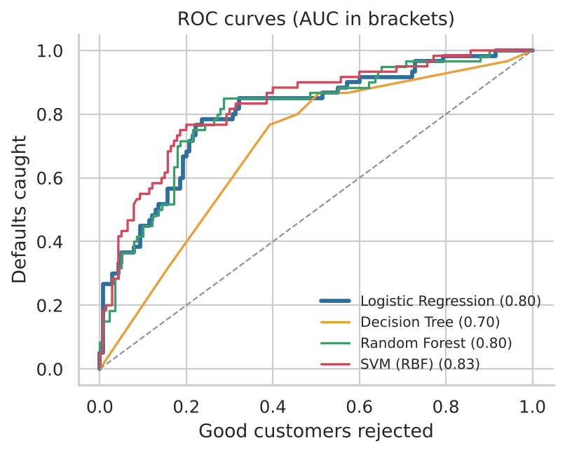
Logistic Regression is our pick
Selection score = average of Recall, F1 and AUC-ROC (5-fold CV, training data).
Why it wins
Best balance of recall, F1 and AUC in cross-validation
Transparent: each factor has a direction and size
Fast to score and simple to monitor
Notes:
Selection rule decided before looking at the test set: highest average of Recall, F1 and AUC in 5-fold cross-validation on the training data. Logistic Regression wins, and it is also the easiest model to explain to credit officers and regulators.

Slide 8
The approval cut-off is a business choice
Lowering the cut-off catches more defaults but also rejects more good customers.
Balanced: cut-off 0.44
Best F1 while keeping recall at 80% or more.
Strict: cut-off 0.28
Cheapest under assumed costs, but very restrictive.
No model
Balanced (cut-off 0.44), recommended
Strict (cut-off 0.28)
Approve everyone
Recall 85%
Recall 98%
Recall 0% | Approved 100%
Approved 40% | Good rejected 49%
Approved 14% | Good rejected 81%
Notes:
Both cut-offs were set on training cross-validation predictions, never on the test set. Balanced = maximise F1 subject to recall of at least 80% (cut-off 0.44). Strict = minimise monetary loss assuming a lost default costs 100% of principal and a rejected good loan costs a 10% margin (cut-off 0.28); the margin is an assumption, not in the data.

Slide 9
Business impact on held-out applicants
87%
of defaulted principal avoided (balanced policy)
85%
of defaults caught (95% interval 75% to 94%)
49%
of good customers flagged: the cost, softened by manual review
Notes:
Test set of 200 applicants with their actual loan amounts. Defaulted principal in the approved book: 280,001 with no model versus 36,817 under the balanced policy (units as in the dataset). Net benefit versus no model is 217,751 assuming 100% loss on default and a 10% margin; it is sensitive to those assumptions.

Slide 10
Checking-account status drives risk most
What credit officers should watch
Checking account: 12% default without one vs 42% with one
Long loans carry more risk
Purpose, installment burden and credit history add smaller but real signal
Confirm with the data owner what a missing balance means
Notes:
Permutation importance on the test set: drop in AUC when a feature is shuffled. 'Checking account on file' reflects the missing-value pattern: applicants with no checking balance recorded default far less often. The meaning of the missing value should be confirmed with the data owner.

Slide 11
Most applications can be decided instantly
11%
Auto-approve
actual default rate
32%
Manual review
actual default rate
62%
Auto-reject
actual default rate
63.5% decided instantly; only 36.5% need a credit officer
Notes:
Cut-offs set on training cross-validation scores: auto-approve at or below 0.44 (observed default rate at most 12%), auto-reject at or above 0.62 (observed default rate at least 60%). Results shown are on the 200 test applicants.

Slide 12
Fair lending: sensitive data is excluded
0.803 vs 0.798
test AUC without vs with gender and marital status
Our approach
Remove gender and marital status from inputs: no loss of accuracy, lower regulatory risk
Audit false rejections by gender and age on every model refresh
Notes:
Gender and marital status are not model inputs. Adding them changed test AUC from 0.803 (without) to 0.798 (with), so they add no accuracy. Audit on 200 test applicants: group sizes are small (29 to 139), so gaps of a few points are not conclusive. Younger applicants are rejected more, partly because their actual default rate is higher (45% for age 25 and under versus 17% for 50+); compliance should review whether age may be used in the applicable jurisdiction.

Slide 13
Recommendations and next steps
1
Pilot a three-lane process
Auto-approve the lowest-risk 41%, send the middle band to credit officers, auto-reject only the top-risk band.
2
Set the cut-off from your own numbers
Replace our assumed loss and margin with actual recovery rates and margins, then re-run the cut-off analysis.
3
Act on the main risk drivers
Review policy on long loans, installment burden, loan purpose and credit history; confirm what a missing checking balance means.
4
Keep sensitive attributes out
Exclude gender and marital status; audit approvals by group on live decisions.
5
Monitor and retrain
Track recall, approval rate and bad-debt ratio monthly; retrain at least yearly.
Notes:
Close by asking management to approve a pilot of the three-lane process and to supply real margin and recovery figures so the cut-off can be re-set from the bank's own economics.

Slide 14
Assumptions and limitations
Assumptions we made
Limitations to keep in mind
Loss on a default = 100% of principal (per the project brief)
Net margin on a good loan = 10% (not in the data; tested from 5% to 20%)
Recall target of 80% for the balanced policy
A missing checking or savings balance means no such account
Only 1,000 loans; the test set has 200, so results carry wide intervals
Outcomes exist only for approved loans (selection bias)
Column units and meanings should be confirmed with the data owner
Next: gradient boosting, calibration, a champion/challenger pilot
Notes:
Be explicit that the monetary results rest on assumed loss-given-default and margin, and that the test set is small.

