Slide 1
Chapter 10.2
Traits: Defining Shared Behavior

Slide 2

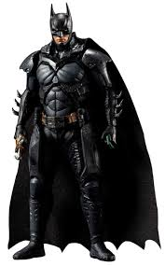
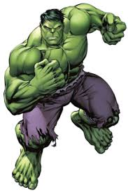
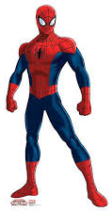
Different Characters
SUPERMAN
BATMAN
HULK
SPIDERMAN

Slide 3
Making Structs
struct Superman {
name: String,
}
struct Hulk {
name: String,
}
struct Batman {
name: String,
}
struct Spiderman {
name: String,
}

Slide 4
Making a Character
let my_superman = Superman {
name:String::from("Superman");
};

Slide 5
Characteristics
Power
Intelligence
Wisdom

Slide 6
Defining a Trait
pub trait Power {
fn power_score (&self) -> u8;
}

Slide 7
Implementing a trait on Superman
impl Power for Superman {
fn power_score (&self) -> u8{
100
}
}

Slide 8
Implementing a trait on Batman
impl Power for Batman {
fn power_score (&self) -> u8{
80
}
}

Slide 9
Implementing a trait on Hulk and Spiderman
impl Power for Hulk {
fn power_score (&self) -> u8{
50
}
}
impl Power for Spiderman {
fn power_score (&self) -> u8{
50
}
}

Slide 10
Implementing a trait on Hulk and Spiderman
impl Power for Hulk {
fn power_score (&self) -> u8{
50
}
}
impl Power for Spiderman {
fn power_score (&self) -> u8{
50
}
}
Duplication

Slide 11
Let add Default in trait definition
pub trait Power {
fn power_score (&self) -> u8{
50
}
}

Slide 12
Implementing a trait on Hulk and Spiderman
impl Power for Hulk {}
impl Power for Spiderman {}
Muhammad Areeb Siddiqui

