Slide 1
Object Oriented Programming
Lecture ia- Starting OOP

Slide 2
Procedural vs. Object-Oriented
Procedural
Withdraw, deposit, transfer
Object Oriented
Customer, money, account

Slide 3
Object-Orientation (OO)

Slide 4
What is Object-Orientation?
A technique for system modeling
OO model consists of several interacting objects

Slide 5
What is a Model?
A model is an abstraction of something
Purpose is to understand the product before developing it

Slide 6
Examples – Model
Highway maps
Architectural models
Mechanical models

Slide 7
Example – OO Model

Slide 8
…Example – OO Model
Objects
Ali
House
Car
Tree
Interactions
Ali lives in the house
Ali drives the car
lives-in
Ali
House
drives
Car
Tree

Slide 9
Object-Orientation – Basic Advantages
People think in terms of objects
OO models map to reality
Therefore, OO models are
easy to develop
easy to understand

Slide 10
More Advantages-OO
Code recycle and reuse.
Wrapping up of data into a single unit.
Easy to partition the work in a project based on objects.
Message passing technique between objects for communication makes interface description with external systems much more straightforward.
Software Complexity can be easily handled and managed.
Possible to map objects in a problem domain within a program.
Data hiding is possible.
Use of inheritance can eliminate redundant codes in a program.

Slide 11
What is an Object?
An object is
Something tangible (Ali, Car)
Something that can be apprehended intellectually (Time, Date)

Slide 12
… What is an Object?
An object has
State (attributes)
Well-defined behaviour (operations)
Unique identity

Slide 13
Example – Ali is a Tangible Object
State (attributes)
Name
Age
behaviour (operations)
Walks
Eats
Identity
His name

Slide 14
Example – Car is a Tangible Object
State (attributes)
- Color
- Model
behaviour (operations)
- Start Car
Accelerate
- Change Gear
Identity
- Its registration number

Slide 15
Example – Time is an Object Apprehended Intellectually
State (attributes)
- Hours - Seconds
- Minutes
behaviour (operations)
- Set Hours - Set Seconds
- Set Minutes
Identity
- Would have a unique ID in the model

Slide 16
Example – Date is an Object Apprehended Intellectually
State (attributes)
Year - Day
Month
behaviour (operations)
- Set Year - Set Day
- Set Month
Identity
- Would have a unique ID in the model

Slide 17
Definition
What Is an Object?
An object is a software bundle of related variables and methods. Software objects are often used to model real-world objects you find in everyday life.
Objects are key to understanding object-oriented technology. You can look around you now and see many examples of real-world objects: dog, desk, television set, bicycle.

Slide 18
Real-world objects share two characteristics
They all have state and behavior
dogs have state (name, color, breed) and behavior (barking, fetching, and wagging tail).
Bicycles have state (current gear, current pedal cadence, two wheels, number of gears) and behavior (braking, accelerating, slowing down, changing gears).

Slide 19
Software objects are modeled after real-world objects
A software object maintains its state in one or more variables .
A software object implements its behavior with methods . A method is a function (subroutine) associated with an object.

Slide 20
Can represent real-world objects by using software objects.
You might want to represent real-world dogs as software objects in an animation program or a real-world bicycle as a software object in the program that controls an electronic exercise bike.
You can also use software objects to model abstract concepts. For example, an event is a common object used in GUI window systems to represent the action of a user pressing a mouse button or a key on the keyboard.

Slide 21
Moving to new thinking …
C programming cannot do the following well:
Functions have unrestricted access to global data.
Data and Functions are unrelated; they do not form a logical group or show any form of binding.
Cannot model ‘real world’.
In real world, we deal with objects like cars, people etc.
Are such objects like ‘data’? Which data type describes a car, for example?
Are such objects like ‘functions’? What will a function car() do?

Slide 22
Moving to new thinking …
A real world object, e.g. car:
Is its description purely the ability to have a ‘data type’ to represent its specifications or ‘attributes’ only? For example what attributes describe a car?
So by having all these attributes ‘only’ do you know all about a car? Would you buy a car by merely looking at these attributes and their values?
No! What else do you wish to have?

Slide 23
Moving to new thinking …
A real world object, e.g. car:
Test drive! Right?
What would you know through a test drive: how it ‘behaves’ in response to various stimulus!
How can it negotiate a speed braker, a speedy turn, full braking etc.
Effectively, you wish to know how it ‘functions’.
Behaviour is like a function.
So neither data nor functions, by themselves, model real-world objects effectively.

Slide 24
Object Oriented Approach …
Neither data nor functions, by themselves, model real-world objects effectively.
OO languages (like Java) combine both ‘data’ and ‘functions that operate on that data’ into a single unit, called ‘object’. Hence ‘encapsulating’ an entity.
The objects functions are called member functions.
Typically, data can be accessed through functions only. So data gets ‘hidden’.
Data hiding ensures the data is not accidentally altered.
Reference analogy of a growing company; 2 people vs 100 employee company.
Objects communicate with each other by calling each other’s member functions.

Slide 25
Creating Objects Example-1

Slide 26
class Box {
int height, int depth, int width;
class BoxDemo{
public static void main(String[] args) {
Box myBox = new Box();
myBox.height = 10;
myBox.width = 20;
myBox.depth = 20;
int volume;
volume = myBox.height * myBox.width * myBox.depth;
System.out.println("Volume of myBox Object is: "+volume);
} } }

Slide 27
Creating Objects Example-2

Slide 28
class student {
int age, int classname, double CGPA;
class studentDemo{
public static void main(String[] args) {
student std = new student();
std.age = 10;
std.classname = 5;
std.CGPA = 3.5;
System.out.println(“Student age=”+ std.age + “Student is in class”+ std.classname + “got the CGPA” +std.CGPA);
} } }

Slide 29
Creating multiple objects by single instance of a class

Slide 30
class Box {
int height, int depth, int width;
class BoxDemo{
public static void main(String[] args) {
Box myBox = new Box();
Box myBox2 = new Box();
myBox.height = 10;
myBox.width = 20;
myBox.depth = 20;
int volume;
volume = myBox.height * myBox.width * myBox.depth;
System.out.println("Volume of myBox Object is: "+volume);
myBox2.height = 50;
myBox2.width = 30;
myBox2.depth = 60;
int volume2;
volume2 = myBox2.height * myBox2.width * myBox2.depth;
System.out.println("Volume of myBox2 Object is: "+volume2); } } }

Slide 31
Abstraction
Abstraction is a way to cope with complexity.
Principle of abstraction:
“Capture only those details about an object that are relevant to current perspective”

Slide 32
Example – Abstraction
Ali is a PhD student and teaches BS students
Attributes
- Name - Employee ID
- Student Roll No - Designation
- Year of Study - Salary
- CGPA - Age

Slide 33
Example – Abstraction
Ali is a PhD student and teaches BS students
behaviour
- Study - DevelopExam
- GiveExam - TakeExam
- PlaySports - Eat
- DeliverLecture - Walk

Slide 34
Example – Abstraction
Student’s Perspective
Attributes
- Name - Employee ID
- Student Roll No - Designation
- Year of Study - Salary
- CGPA - Age

Slide 35
Example – Abstraction
Student’s Perspective
behaviour
- Study - DevelopExam
- GiveExam - TakeExam
- PlaySports - Eat
- DeliverLecture - Walk

Slide 36
Example – Abstraction
Teacher’s Perspective
Attributes
- Name - Employee ID
- Student Roll No - Designation
- Year of Study - Salary
- CGPA - Age

Slide 37
Example – Abstraction
Teacher’s Perspective
behaviour
- Study - DevelopExam
- GiveExam -TakeExam
- PlaySports - Eat
- DeliverLecture - Walk

Slide 38
Example – Abstraction
A cat can be viewed with different perspectives
Ordinary Perspective
A pet animal with
Four Legs
A Tail
Two Ears
Sharp Teeth
Surgeon’s Perspective
A being with
A Skeleton
Heart
Kidney
Stomach

Slide 39
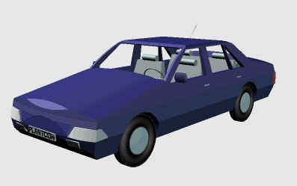
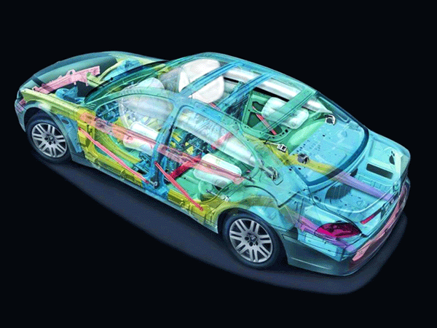
Example – Abstraction
Engineer’s View
Driver’s View

Slide 40
Abstraction – Advantages
Simplifies the model by hiding irrelevant details
Abstraction provides the freedom to defer implementation decisions by avoiding commitment to details

Slide 41
Classes
In an OO model, some of the objects exhibit identical characteristics (information structure and behaviour)
We say that they belong to the same class

Slide 42
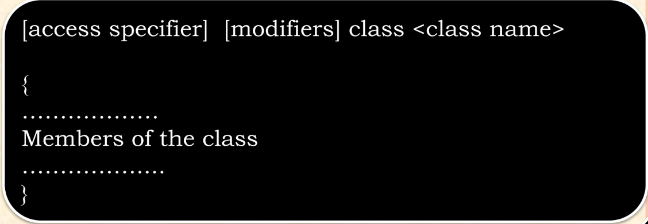
What is Class?
It is defined as a blueprint or a template from which an object is declared

Slide 43
Example – Class
Ali studies mathematics
Anam studies physics
Sohail studies chemistry
Each one is a Student
We say these objects are instances of the Student class

Slide 44
Example – Class
Ahsan teaches mathematics
Aamir teaches computer science
Atif teaches physics
Each one is a teacher
We say these objects are instances of the Teacher class

Slide 45
Graphical Representation of Classes
(Class Name)
(Class Name)
(attributes)
(operations)
Suppressed Form
Normal Form

Slide 46
Example – Graphical Representation of Classes
Circle
center
radius
Circle
draw
computeArea
Suppressed Form
Normal Form

Slide 47
Example – Graphical Representation of Classes
Person
name
age
gender
Person
Suppressed Form
eat
walk
Normal Form

Slide 48
Method (Behavior)

Slide 49
Declaration of Method
<return-type> <method-name>
(<arguments/parameters>...) { <statements>...
}
For example
Void calculate(){
System.out.print(“This is the method and will calculate nothing, just print out the statement”);
}

Slide 50
class BoxWithMethod{
int height, depth, width;
void volume(){
int volume;
volume = height*depth*width;
System.out.println("Volume of myBox Object is: "+volume);
} }
class Box2{
public static void main(String[] args) {
BoxWithMethod myBox = new BoxWithMethod();
myBox.height = 10;
myBox.width = 20;
myBox.depth = 20;
myBox.volume();
}}

Slide 51
class BoxWithMethod{
int height, int depth, int width;
void volume(){
int volume;
volume = height*depth*width;
System.out.println("Volume of myBox Object is: "+volume);
} }
class Box2{
public static void main(String[] args) {
BoxWithMethod myBox = new BoxWithMethod();
BoxWithMethod myBox2 = new BoxWithMethod();
myBox.height = 10;
myBox.width = 20;
myBox.depth = 20;
myBox2.height = 10;
myBox2.width = 20;
myBox2.depth = 20;
myBox.volume();
myBox2.volume(); }}

Slide 52
Returning a value
If you want to calculate something the better way to implement volume() is to have it compute the volume of the box and return the result to caller.

Slide 53
Example 1 Method (Behavior)-returning values

Slide 54
class BoxWithMethod{
int height, int depth, int width;
double volume(){
return height*depth*width;
} }
class Box2{
public static void main(String[] args) {
BoxWithMethod myBox = new BoxWithMethod();
Double vol;
myBox.height = 10;
myBox.width = 20;
myBox.depth = 20;
vol= myBox.volume();
System.out.println("Volume of myBox Object is: "+vol);
}}

Slide 55
class BoxWithMethod{
int height, int depth, int width;
double volume(){
return height*depth*width;
} }
class Box2{
public static void main(String[] args) {
BoxWithMethod myBox = new BoxWithMethod();
BoxWithMethod myBox2 = new BoxWithMethod();
Double vol1,vol2
myBox.height = 10; myBox.width = 20; myBox.depth = 20;
vol= myBox.volume();
System.out.println("Volume of myBox Object is: "+vol);
myBox2.height = 50; myBox2.width = 30; myBox2.depth = 10;
vol2= myBox2.volume();
System.out.println("Volume of myBox Object is: "+vol2);
}}

Slide 56
Example 2 Method (Behavior)-returning values

Slide 57
class human{
int age;
double basicsalary;
int ID;
double salary(){
return basicsalary*20000;
}}
public class humanDemo{
public static void main(String[] args){
human doctor=new human();
doctor.age=50;
doctor.basicsalary=25000;
doctor.ID=5;
double totalsal;
totalsal=doctor.salary();
System.out.print(totalsal); } }

