Slide 1

NestFix
PRESENTATION
SUBMITTED BY:
01: Abdu Nafih VP
26: Faizan Thekke Pulukkool
27: Fatih Abdul Fattah
33: Jyothish P S

Slide 2
Table of content
Motive
Problem Definition
Project Overview
Stakeholders
Project Requirements
System Features
Design and Style Guidelines
Use Case and Class Diagrams

Slide 3
Motive
Provide a convenient platform for homeowners to connect with local service professionals for various home-related tasks and repairs.
Offer a wide range of home services, including plumbing, electrical, cleaning, handyman, landscaping, and more, to ensure that all the needs of homeowners are met.
Maintain high-quality standards for all the services provided through NestFix, ensuring that only reliable and experienced service professionals are listed on the platform.
Develop trust and transparency between homeowners and service professionals by providing clear pricing, detailed job descriptions, and ratings and reviews from previous customers.
Continuously improve and innovate the platform to enhance the user experience and meet the changing needs of homeowners and service professionals.
Building a trusted brand that customers can rely on for all their home repair and maintenance needs by promoting fairness and equity

Slide 4
Problem Definition
Inefficient home service booking process: The current process of finding and booking home service providers is often time-consuming, cumbersome, and inconvenient for customers. This leads to a poor customer experience and dissatisfaction with the service.
Lack of trust: Due to the high number of scams and unreliable service providers in the market, customers often find it hard to trust home service providers. This lack of trust leads to customers being apprehensive about using such services.
Difficulty in finding experienced and verified service providers: It can be challenging for customers to find experienced and verified service providers that meet their specific requirements. This can lead to frustration and a lack of confidence in the services provided.
Lack of transparency: There is often a lack of transparency in the pricing and services provided by home service providers. This can lead to customers being overcharged and feeling misled.
Limited options: Customers often have limited options when it comes to finding reliable home service providers. This can be especially problematic for those who require specialized services.

Slide 5
Project overview
NestFix is designed to provide a platform for users to search for and book various services provided by service providers. The website acts as an intermediary between service providers and customers, allowing customers to select the services they need and make bookings with service providers. The website will support offline payment methods, including cash and bank transfers. It will create a numerous job opportunities.

Slide 6
Stakeholders
The main stakeholders of this project are:
Users : Those who use the website to find and book service providers
Service Providers : Those who offer their services through the website
Admin : Those who manage and maintain the website

Slide 7
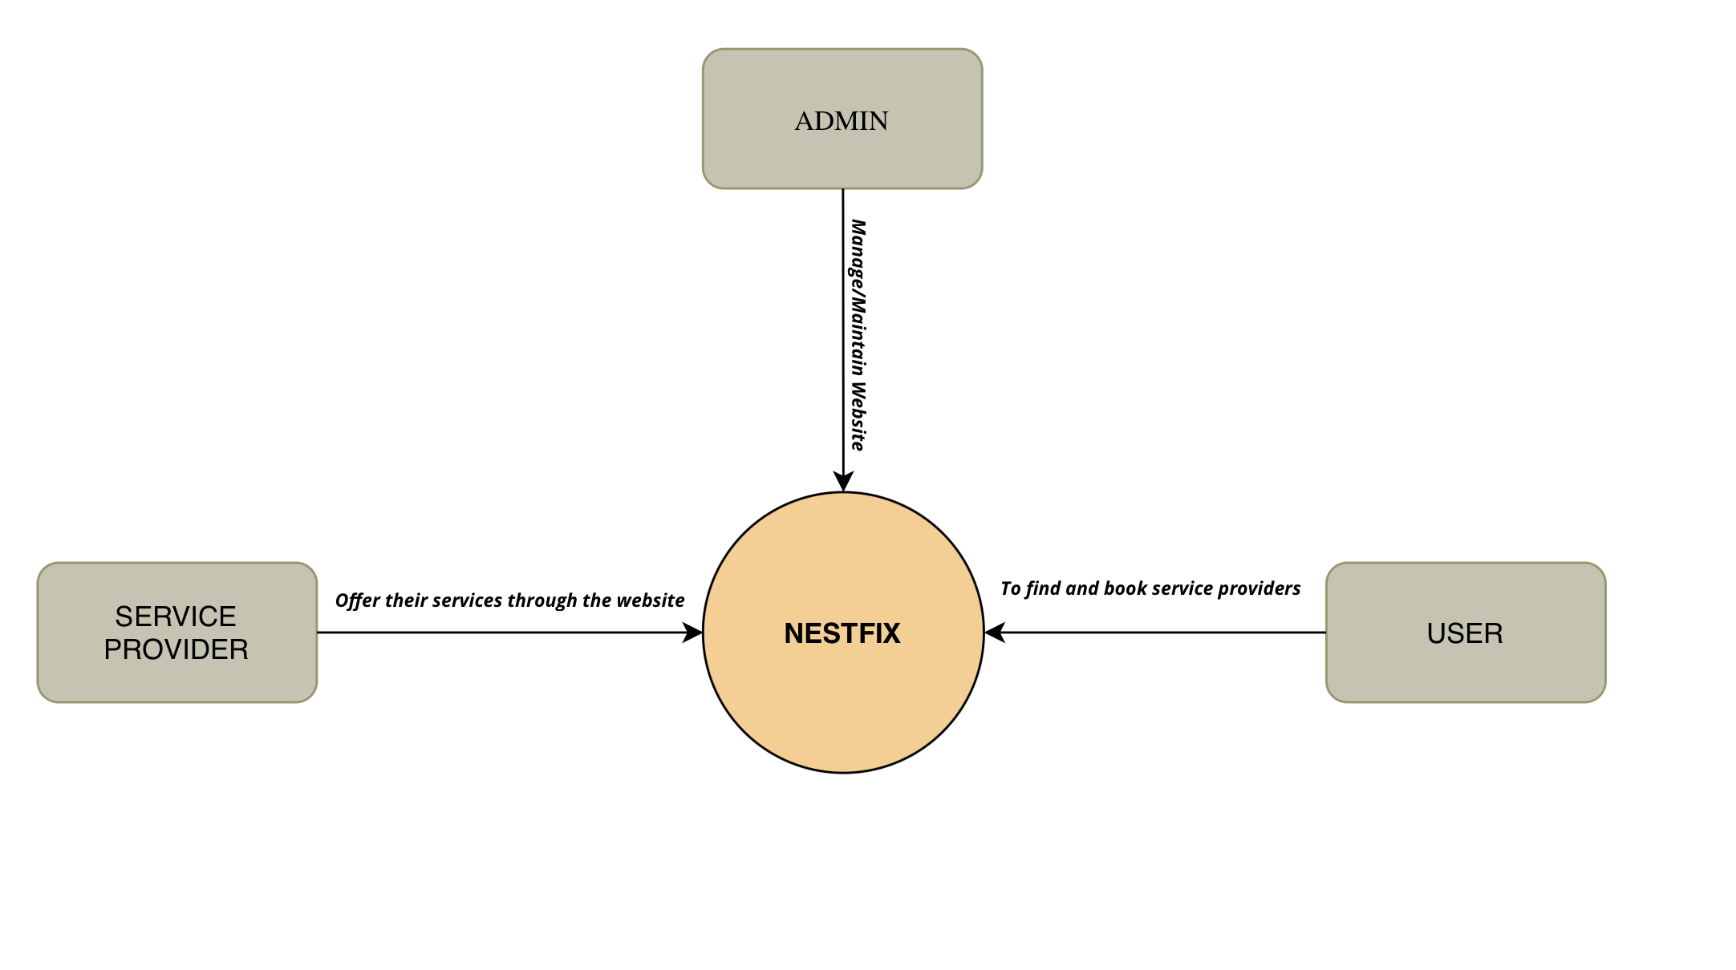
How Different Users use NestFix

Slide 8
Requirements
Functional Requirements
User Registration : NestFix shall allow users to create an account , validate user registration details , store user registration details securely.
Service Providers Registration : NestFix shall allow service providers to create an account , validate user registration details , store user registration details securely.
Service Booking : NestFix shall allow users to browse and book services based on location, service type, and provide users with real-time availability and pricing information.

Slide 9
Service Provider Verification : Define the qualification requirements , Request documentation , Conduct interviews or assessments , Perform background checks , Set up a rating system.
2. External Interface Requirements
Hardware Interfaces : The hardware interface for NestFix is minimal, as users only need a device with internet access to use the website.
User Interfaces : NestFix have an easy-to-use interface that is accessible on multiple devices.
Communications Interfaces : NestFix have the ability to use location-based services to provide users with relevant service providers in their area.

Slide 10
3. Nonfunctional Requirements
Performance Requirements : The website should load quickly and be responsive to user input, with minimal downtime.
Maintainability : The website should be easy to maintain and update, with clear and well
documented code and minimal technical debt.
Compatibility : The website should be compatible with a range of devices and web browsers,
with a mobile-responsive design.
Software Quality Attributes : NestFix provides the users with a simple, intuitive interface. Due to its well
designed and easy to use interface it can be used by anyone with a basic knowledge
of website usage.

Slide 11
System Features
Encryption for data privacy and security : All data that is sent from user app is stored in a database in an encrypted form.
Customer Reviews and Ratings : A system that allows customers to rate and review service providers based on their experience.
Admin Dashboard : Allow admins to manage the website, including managing service providers, approving service requests, and monitoring customer feedback.
Location Based Services : Provide location-based services to help users find service providers near them for easy access to services.

Slide 12
Design and Style Guidelines
The following design constraints will be considered during the development of the Home Service Website:
NestFix must be accessible via web browsers on desktop and mobile devices. • The website must be designed to be responsive to ensure optimal user experience on all devices.
The website must be developed using industry-standard web development frameworks and technologies.
The website must be scalable to accommodate a growing number of users and service providers

Slide 13
Design and Style Guidelines
Accessibility: NestFix is designed with accessibility in mind, with consideration given to users with disabilities such as visual impairments. This includes the use of alt text for images and the implementation of keyboard navigation.
User Feedback: User feedback should be taken into consideration when designing and updating the website. This can help to identify areas for improvement and can ensure that the website is meeting the needs of its users

Slide 14
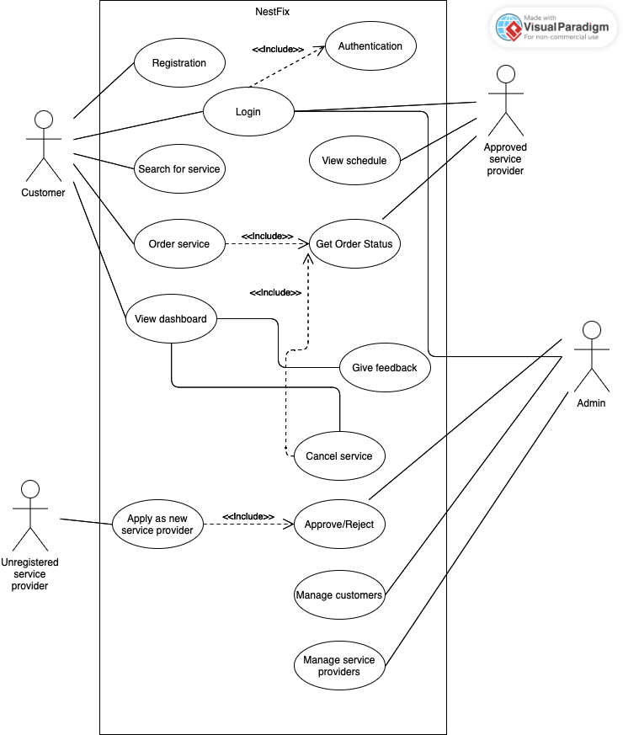
USE CASE DIAGRAM

Slide 15
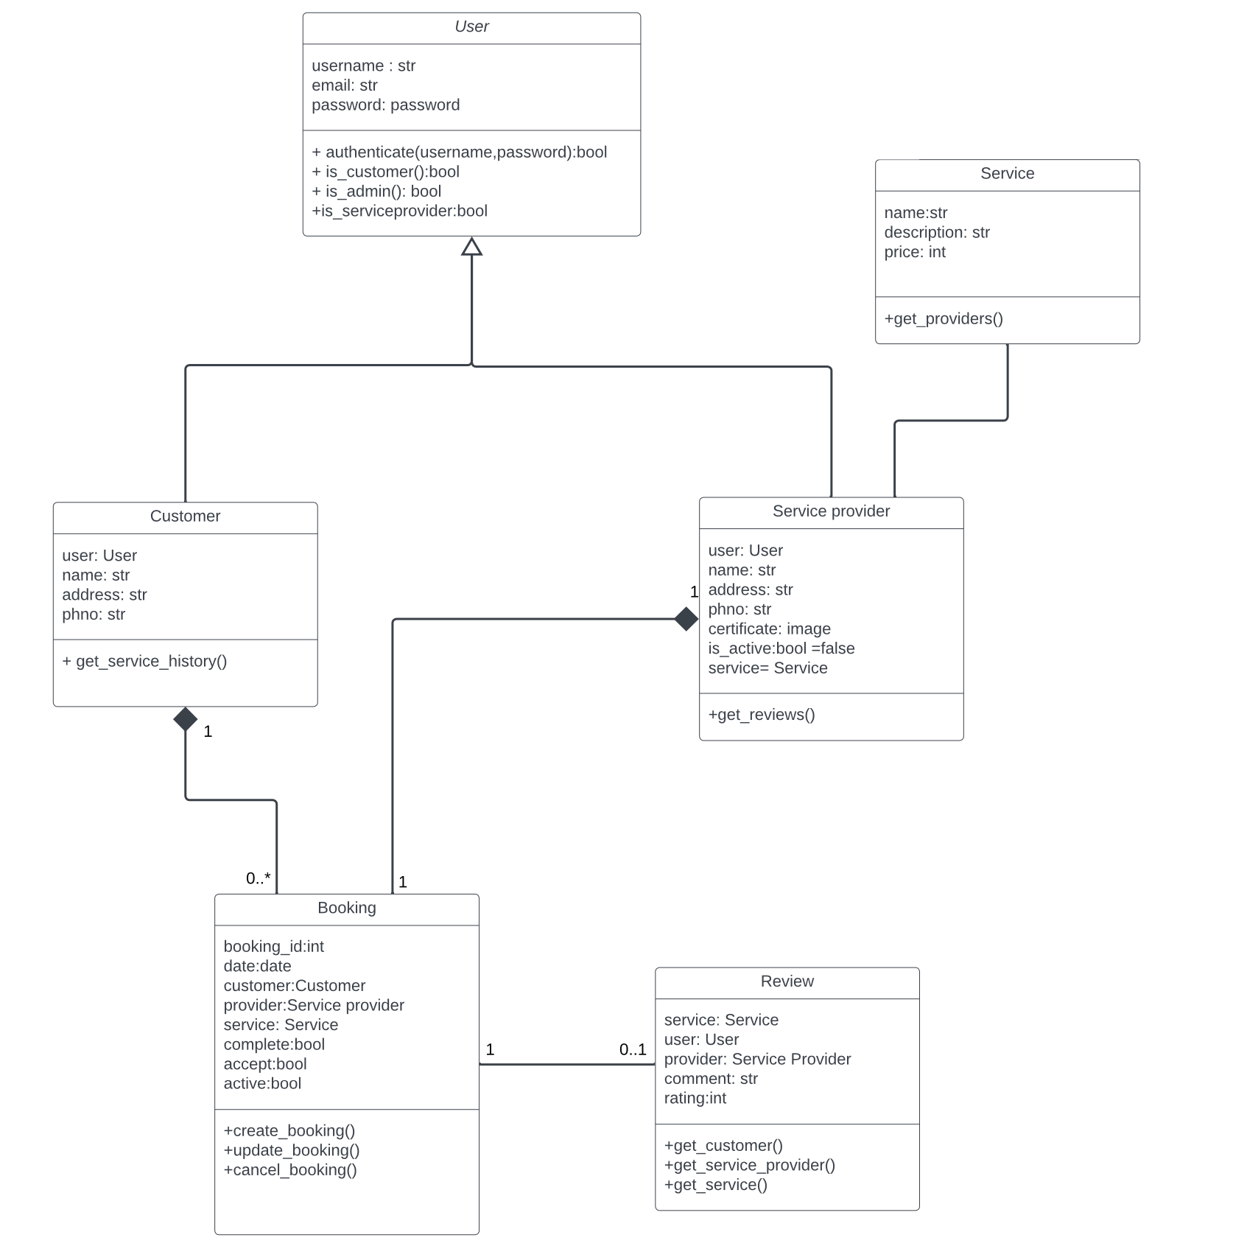
CLASS DIAGRAM

Slide 16
THANK YOU

