Slide 1
MVVM

Slide 2
Step 1 Model
Model is nothing but simple class that define what type of data is like getting data from API in from of JSON model class tell us data format and we parse using it and then access easily.
For example image data class contain properties of
Id , author width , height, URL, download URL.
Model class convert data from JSON to object and object to JSON.

Slide 3
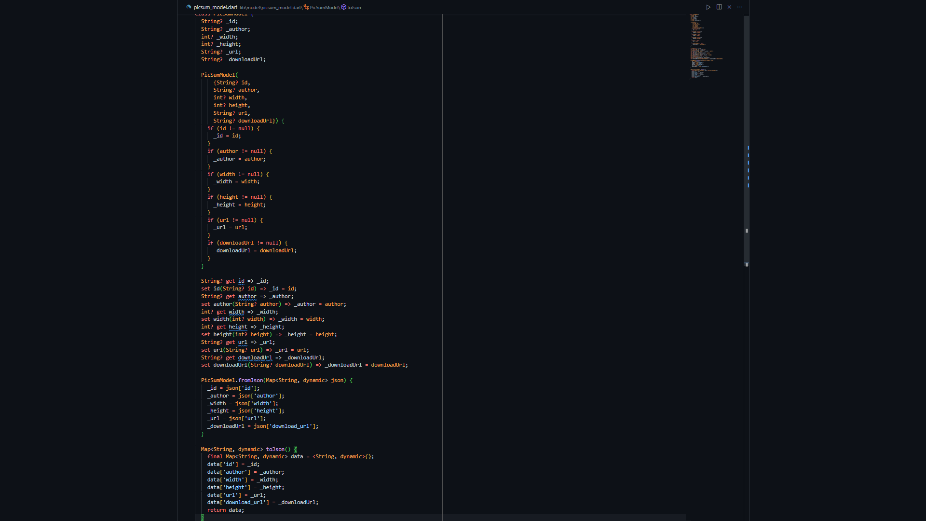
Step 1 Model

