Slide 1
Google Cloud request a Google Cloud Platform coupon
Prof. Luis A. Hernández Gómez
luisalfoso.hernandez@upm.es

Slide 2
Dear Students,
Here is the URL you will need to access in order to request a Google Cloud Platform coupon.
You will be asked to provide your school email address and name. An email will be sent to you to confirm these details before a coupon is sent to you.
Dear Students,
Here is the URL you will need to access in order to request a Google Cloud Platform coupon. You will be asked to provide your school email address and name. An email will be sent to you to confirm these details before a coupon is sent to you.
Student Coupon Retrieval Link
You will be asked for a name and email address, which needs to match the domain. A confirmation email will be sent to you with a coupon code.
You can request a coupon from the URL and redeem it until: 6/11/2019
Coupon valid through: 2/11/2020
You can only request ONE code per unique email address.
Please contact me if you have any questions or issues.
Thanks,
Prof. Luis Hernandez-Gomez

Slide 3
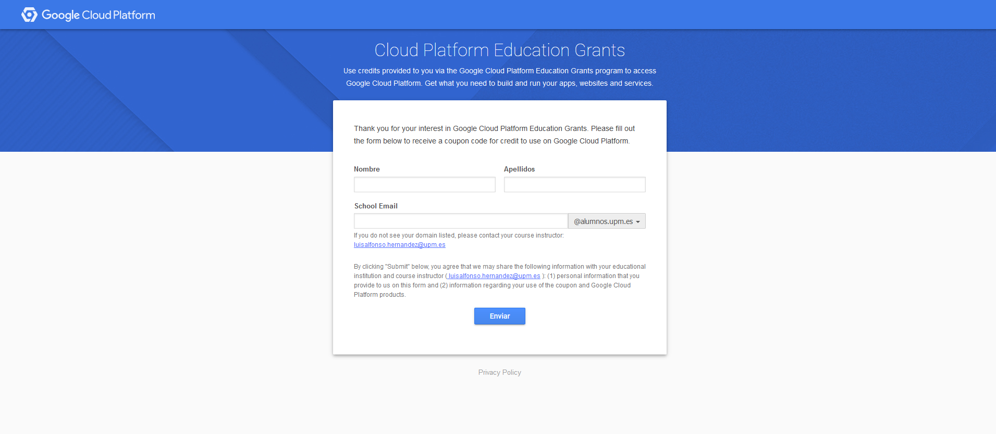
…by following the link you should be redirected to this page where you must give your name and alumnos.upm email address

Slide 4
… then you should receive an email:
Dear your NAME,
Thank you for your interest in downloading a Google Cloud Platform Coupon Code. Please click on this link to verify your email address and a code will be sent to your email account.
Instructor Name: Luis Hernandez-Gomez
Email Address: luisalfonso.hernandez@upm.es School: ETSI Telecommunications Universidad Politecnica de Madrid
Course/project: Machine Learning Lab
If you have any questions, please contact your course instructor as listed above.
Thanks,
Google Cloud Platform Education Grants Team

Slide 5
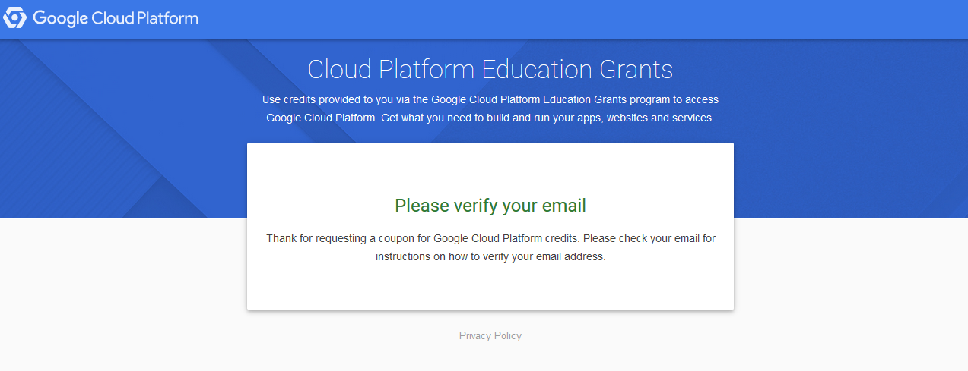

Slide 6
Dear your NAME,
Here is your Google Cloud Platform Coupon Code: 2VQ4-GFL8-L818-TDYQ
Click [here] to redeem.
Course/Project Information Instructor Name: Luis Heranandez-Gomez
Email Address: luisalfonso.hernandez@upm.es School: ETSI Telecommunications Universidad Politecnica de Madrid
Course/project: Machine Learning Lab
Activation Date: 5/09/2018
Redeem By: 5/01/2019
Coupon Valid Through: 5/09/2019
If you have any questions, please contact your course instructor as listed above.
Thanks,
Google Cloud Platform Education Grants Team

Slide 7
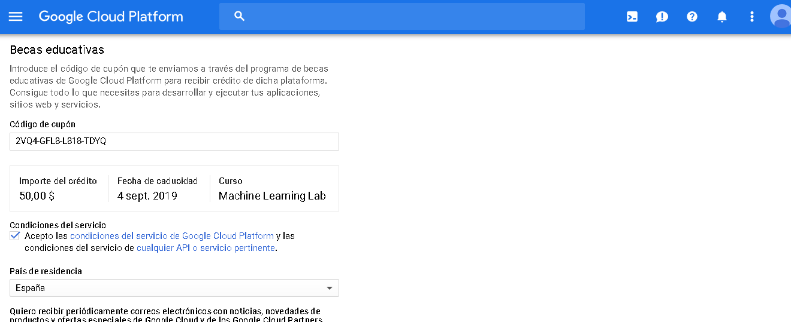
After clicking in : Click [here] to redeem. You can redeem your coupon…

