Slide 1
Google Cloud
Prof. Eduardo López Gonzalo
eduardo.lopez@upm.es
Prof. Luis A. Hernández Gómez
luisalfoso.hernandez@upm.es

Slide 2

Setup project
In this session we will open and learn Google Cloud CONSOLE
You should also try: download and install Google Cloud SDK.
Once installed, the gcloud command should be usable from any command prompt with an up-to-date PATH variable.

Slide 3
Create a “working” Compute Engine
Create a Project (you have already one “My First Project”)
Create a Compute Engine
Access the VM through SSH
Install ANACONDA
Install ngrog
Use ngrog to access Jupyter notebooks from your laptop

Slide 4

Access with your Gmail account

Slide 5
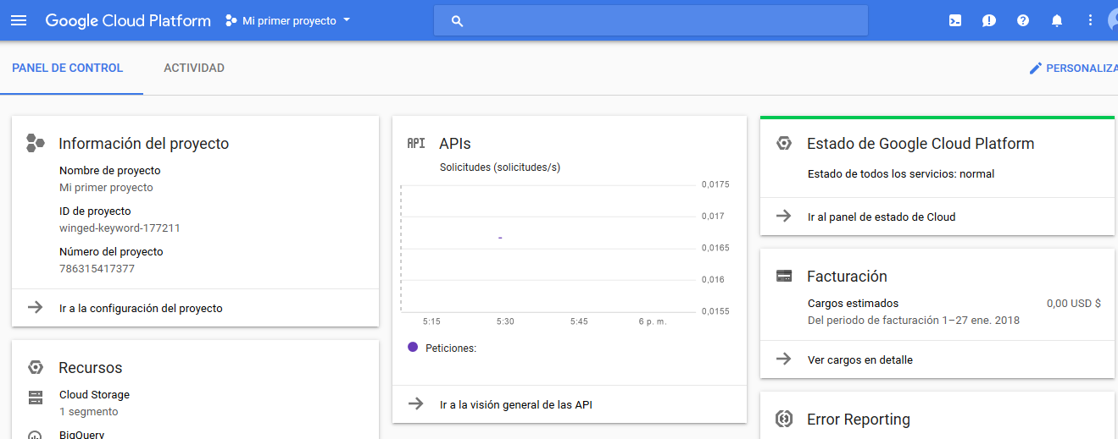
You will Access to “My First Project”

Slide 6
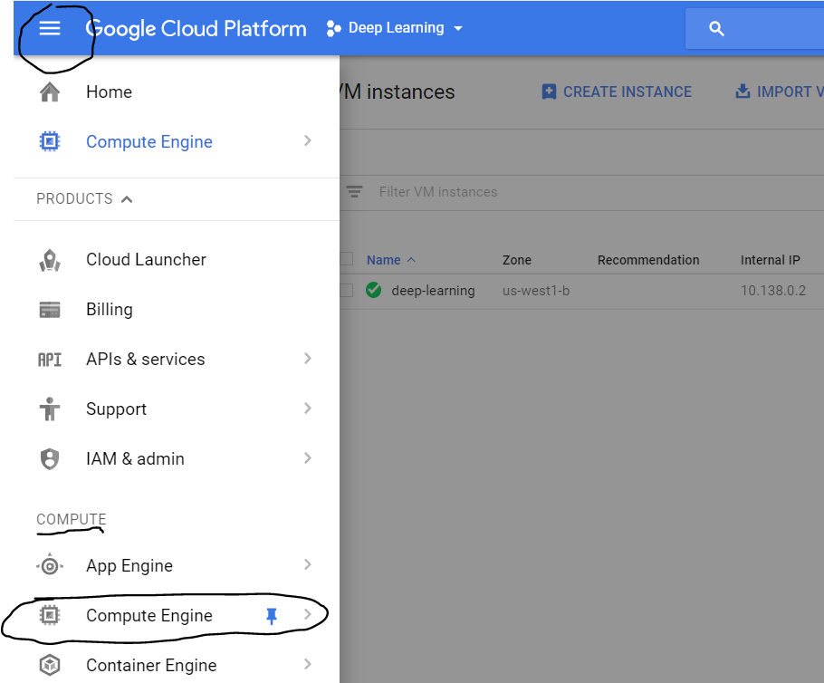
Create a Compute Engine’ VM instance
Click on the three lines on the upper left corner, then scroll down till the compute option, click on ‘Compute Engine’

Slide 7
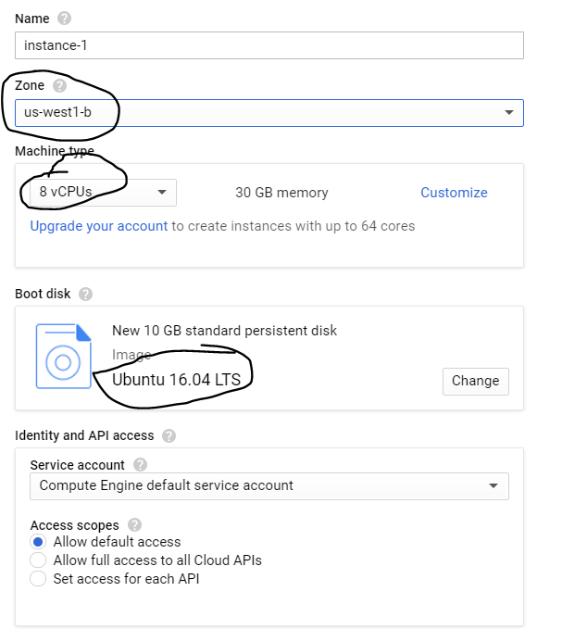
This region is important if you need GPUs

Slide 8
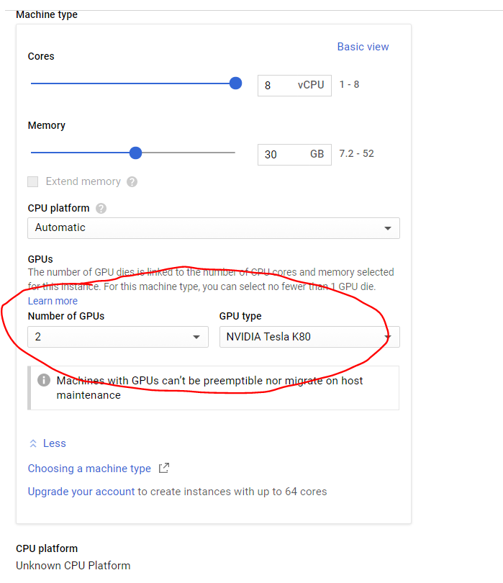
If you click on ‘customize’, you will be able to find options for using GPUs. You can choose between 2 NVIDIA GPUs
Don’t do it!!
We will discuss why…

Slide 9
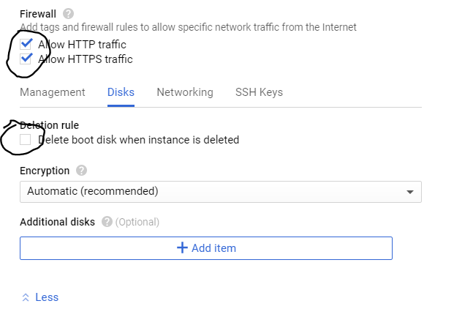
Check these two HTTP options to be able to access your VM from outside world…

Slide 10
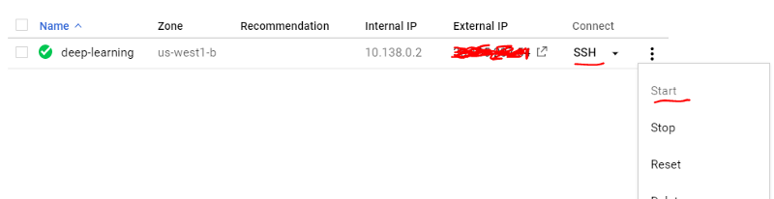
Start your VM instance

Slide 11
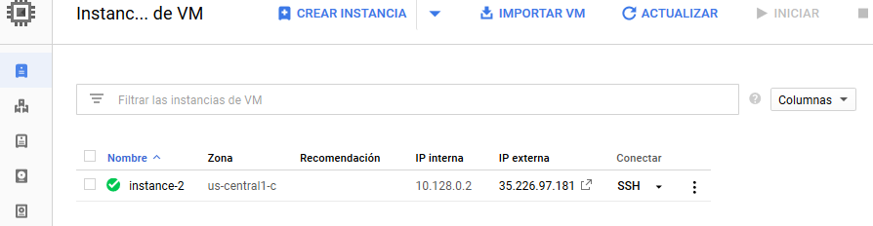
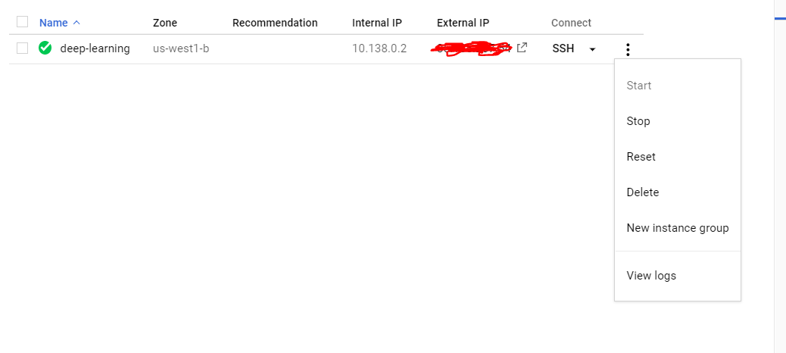
IMPORTANT : When finished DON’T FORGET TO STOP YOUR VM INSTANCE AFTER YOU ARE DONE BY CLICKING ON THE THREE DOTS ON THE IMAGE ABOVE AND SELECTING STOP. OTHERWISE Google Cloud WILL KEEP CHARGING YOU ON AN HOURLY BASIS.

Slide 12
Connect to your VM using SSH through CONSOLE
This solves the problem of exchanging credentials with your laptop .. but you should learn how to do it!

Slide 13
Install ANACONDA that includes Python packages and Jupyter notebook
In your SSH terminal, enter
sudo wget https://repo.continuum.io/archive/Anaconda3-5.0.0.1-Linux-x86_64.sh
sudo apt-get install bzip2
bash Anaconda3-5.0.0.1-Linux-x86_64.sh
check if conda registered to path by running the conda command
> conda
If not recognized, add to path manually:
> source ~/.bashrc

Slide 14
Access Jupyter using tunnels with ngrok (I)
(see https://stackoverflow.com/questions/18300263/how-to-use-ipython-notebook-with-ngrok )
Open a SSH and install ngrok
wget https://bin.equinox.io/c/4VmDzA7iaHb/ngrok-stable-linux-amd64.zip
sudo apt-get install unzip
unzip -o ngrok-stable-linux-amd64.zip

Slide 15
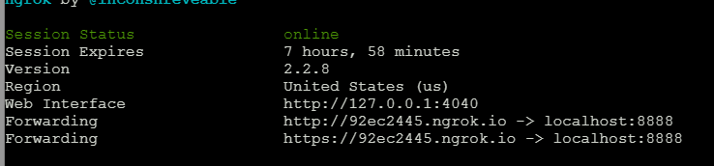
Access Jupyter using tunnels with ngrok (II)
(see https://stackoverflow.com/questions/18300263/how-to-use-ipython-notebook-with-ngrok )
In one SSH console launch
jupyter notebook
(“normal “ on port 8888)
In another SSH run:
./ngrok http 8888
… and use the link! To connect jupyter in your laptop

Slide 16
ATTENTION — FOR THE LOVE OF GOD! DO NOT FORGET TO STOP THE VM INSTANCE WHEN YOU FINISH!!

